Slide 1
DBCP National Report
DBCP – 37, VIRTUAL, 8-11 November 2021
Dr.R.Venkatesan
National Institute of Ocean Technology
Ministry of Earth Sciences,India
dr.r.venkatesan@gmail.com

Slide 2
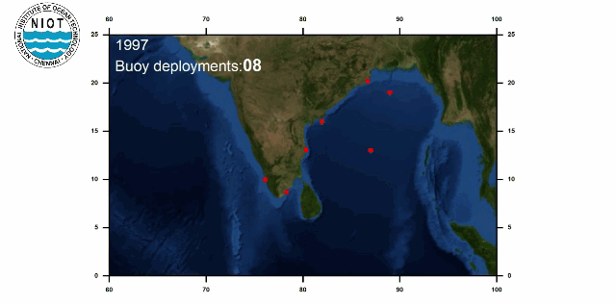
Current Programme
Ministry of Earth Sciences
National Institute of Ocean Technology NIOT
Indian National Centre for Océan Information Services INCOIS
NIOT
25 years of Moored Buoy Programm
20 and Met-Ocean Buoys, Tsunami Buoy and IndARC
a) Forecast; b)met/ocean research; c)developmental
Constraints COVID Pandemic Servicing of Buoys were undertaken

Slide 3
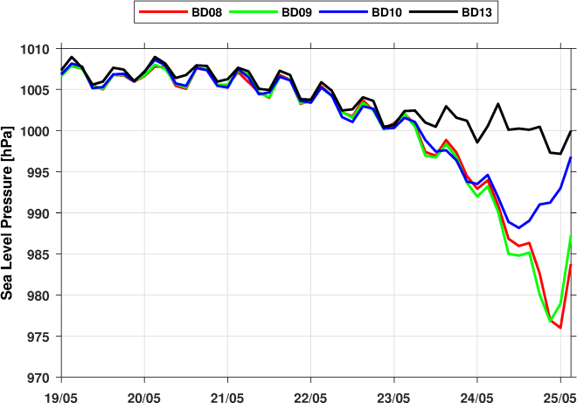
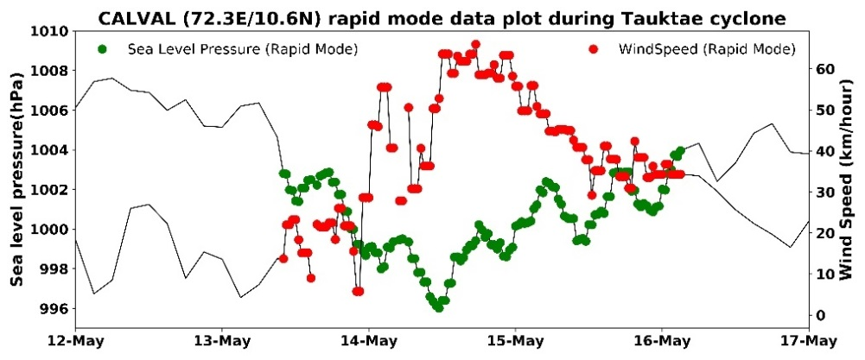
Buoy Network Observations during Cyclones
Significant Observations during Cyclones
Sea Level Pressure drop during Yaas Cyclone
Track of Cyclone Yaas ,Tauktae and moored buoys
Rapid mode Transmission data at 30 minute interval during Cyclone Tauktae
Data buoy ‘CALVAL’ triggered cyclone mode Extremely Severe Cyclone Tauktae in May 2021.
Real-time met-ocean data sets at every 30 minute interval was disseminated

Slide 4
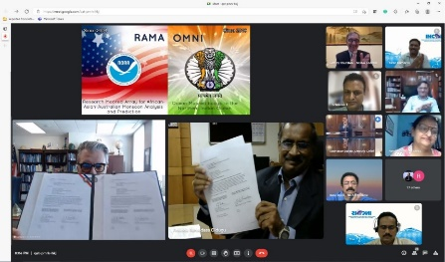
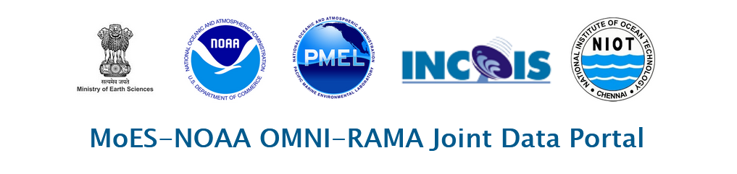
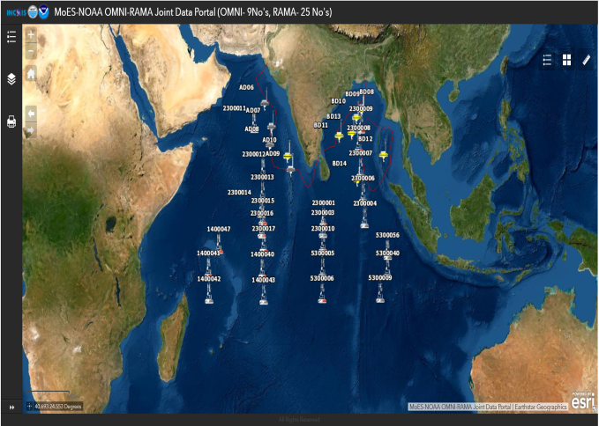
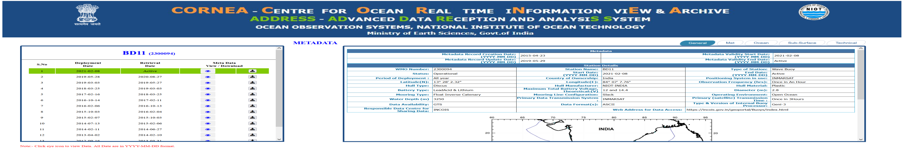
Implementing Arrangement between NOAA/PMEL and MoES-NIOT on 9th August 2021.
Data from RAMA buoy and OMNI buoys outside EEZ will be shared in the portal.
https://incois.gov.in/portal/datainfo/buoys.jsp

Slide 5
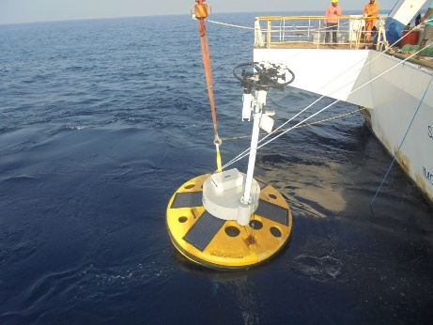
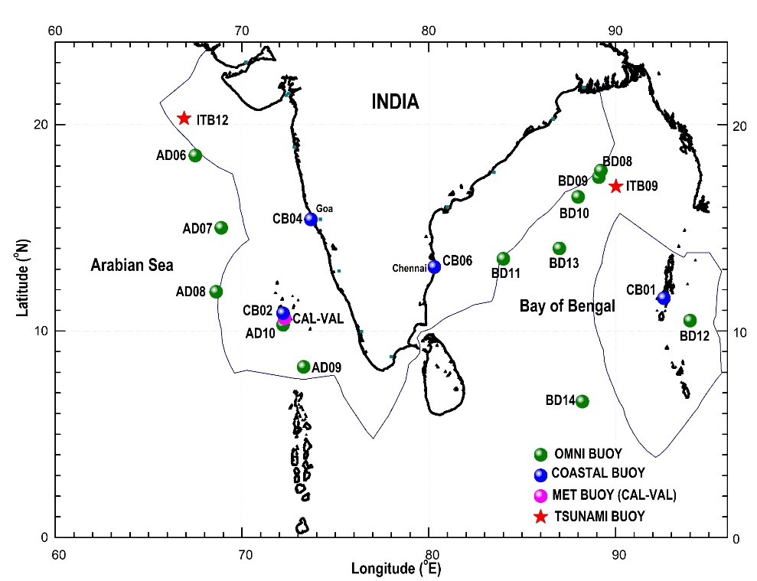
Planned
Sustain the moored buoy network in Bay of Bengal and Arabian Sea (Northern Indian Ocean Region).

Slide 6
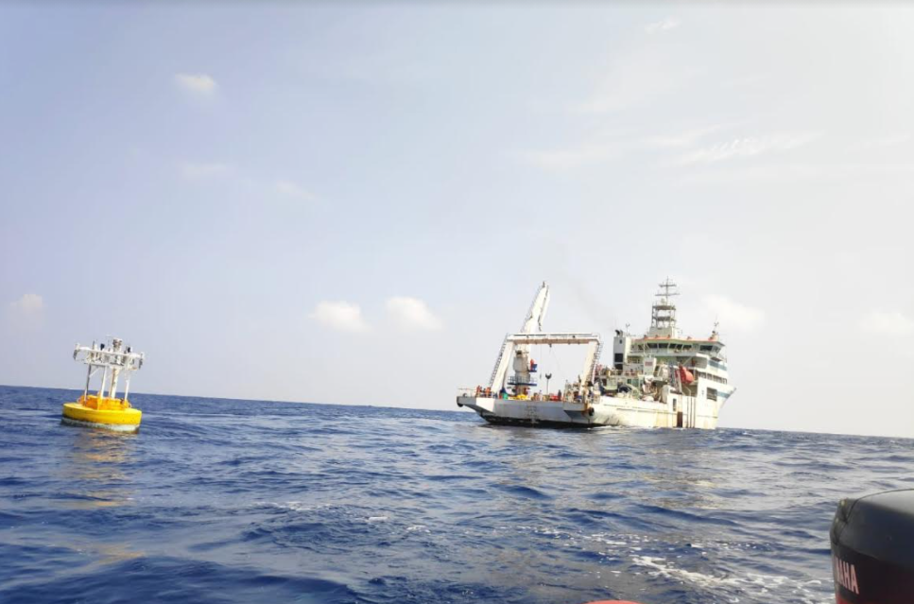
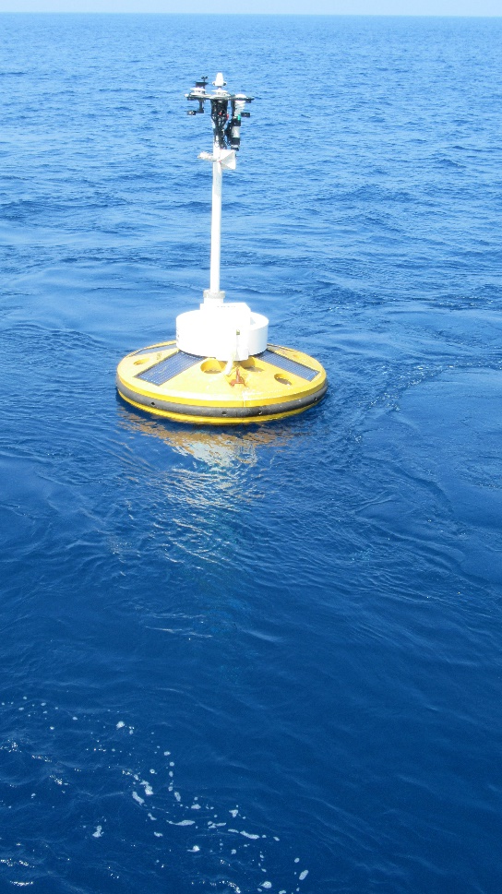
Global Atmospheric Watch – Ocean
GAW of WMO importance of in-situ measurements of air quality parameters in the ocean.
GESAMP study Shipping responsible for 18-30% of NOx; 9% of SOx and 70% of ship emissions are within 400km of land much of the oceans are nitrogen limited
the atmosphere is the dominant external source of nitrogen to Oceans enhancing productivity by about 0.4%.
IMO has adopted new emissions standards, MARPOL Annex VI, ive Modelling Of NOx/Sox
NIOT has started working on installing AW sensors

Slide 7
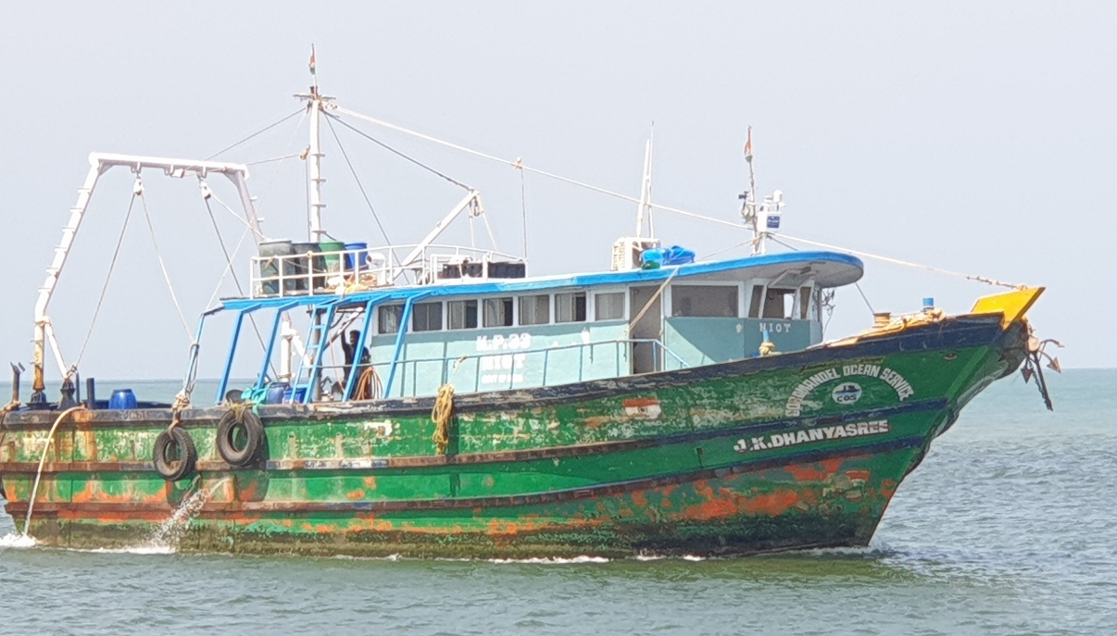
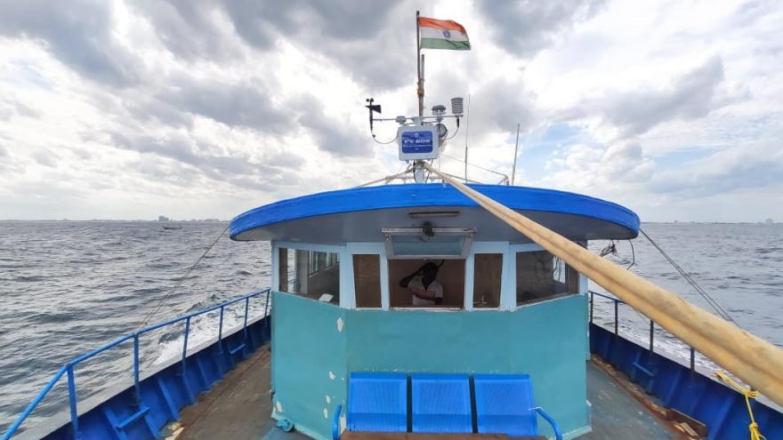
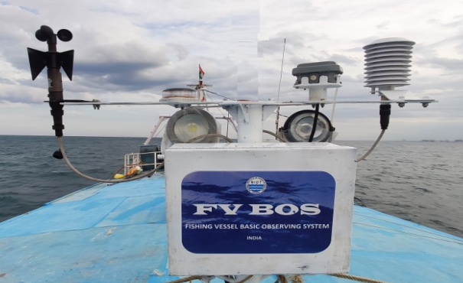
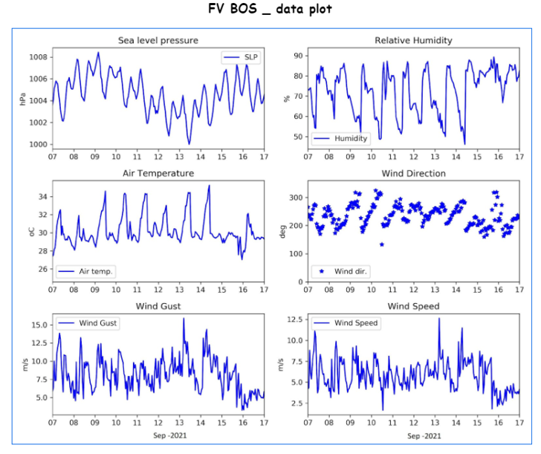
Fishing Vessel – Basic Observing System (FV- BOS)
FV-BOS collects Wind speed, Wind direction, Air temperature, Air Pressure, Humidity and sea surface temperature
Transmission System
Intelligent Data Logger
Wind Speed & Direction Air Pressure
SST
Battery and Solar Panel

Slide 8
DATA
QC
  Quality control being carried out as per WMO standard
  Two OceanSITES stations established and deployed sensors at 2000m,3000m and 4000m depth.
  Metadata shared to JCOMMOPS/OceanSITES
  OMNI buoys sharing real timed data through BUFR format from October 2021
Communications
  INMARSAT Satellite telemetry used for Deep met ocean buoy
  Indian Satellites used for data telemetry
  GPRS/GSM Communication used for Coastal buoys
  Work initiated to obtain Iridium satellite telemetry approval for moored buoys
  Buoy and Iridium communication interfacing is underway
Buoy Lifetime: Two years (exclusive of Sensor performance)
Data Accessibility: https://incois.gov.in/portal/datainfo/mb.jsp

Slide 9
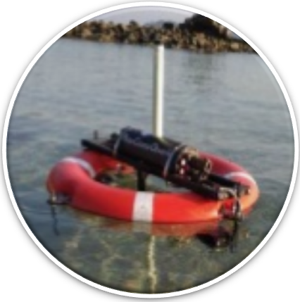
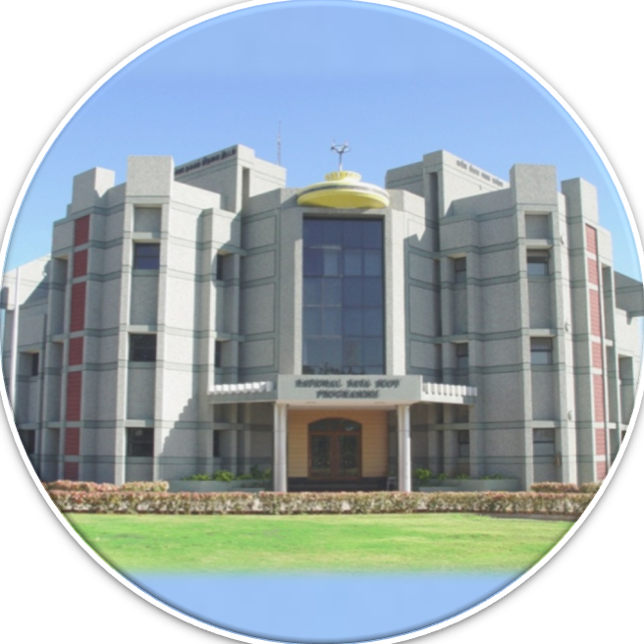
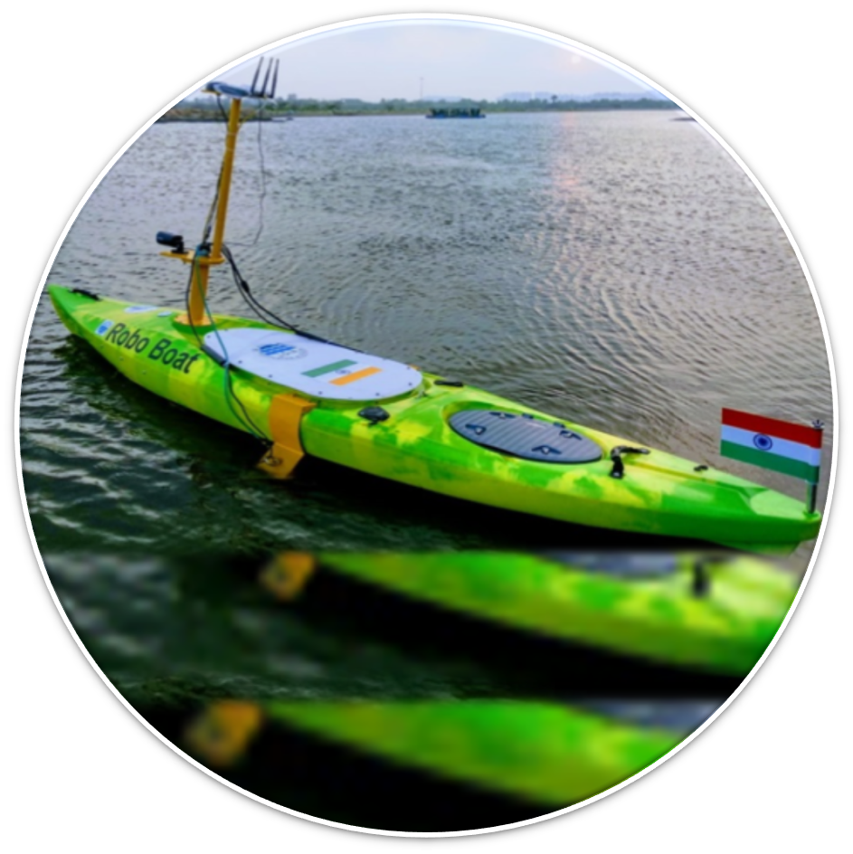
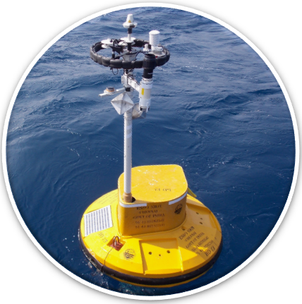
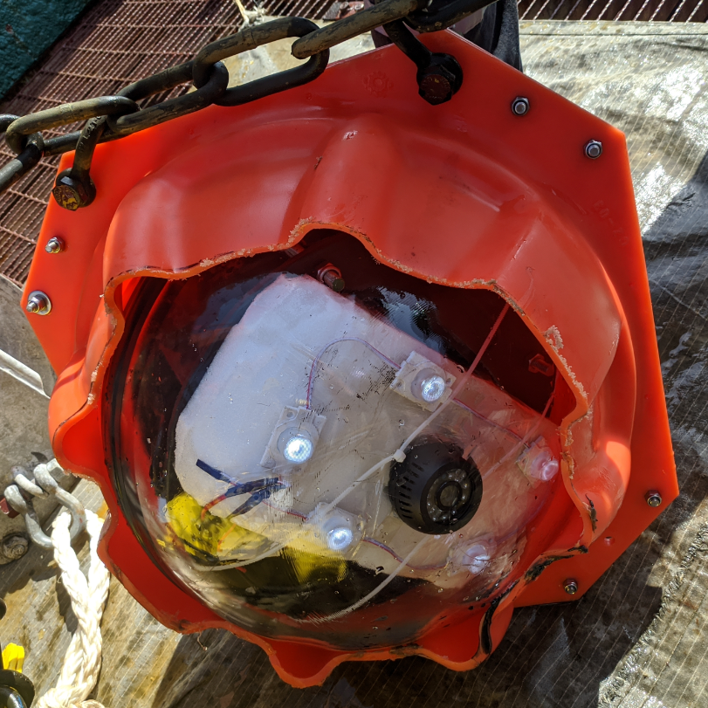
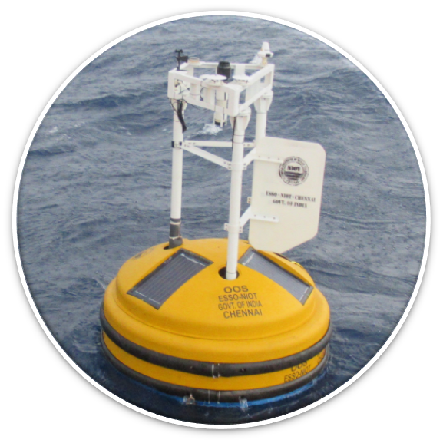
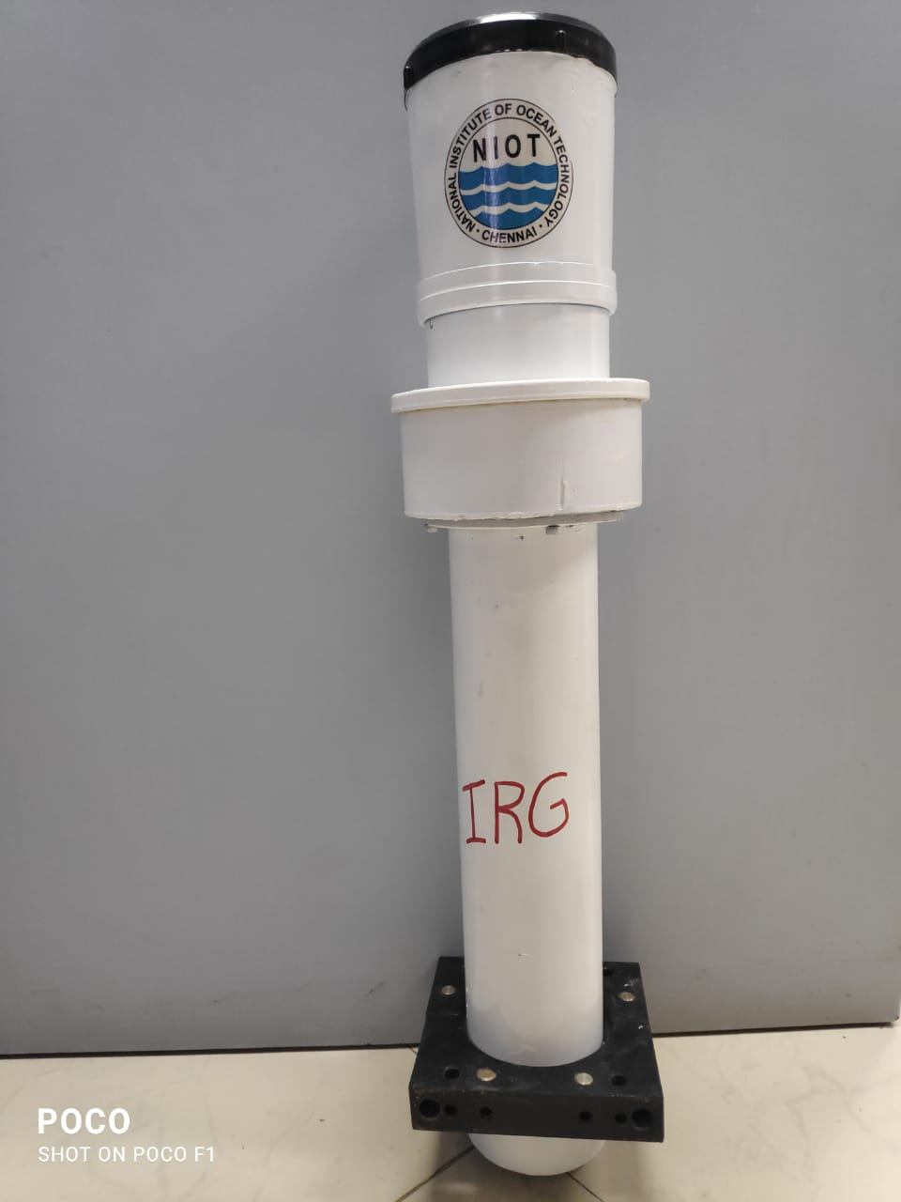
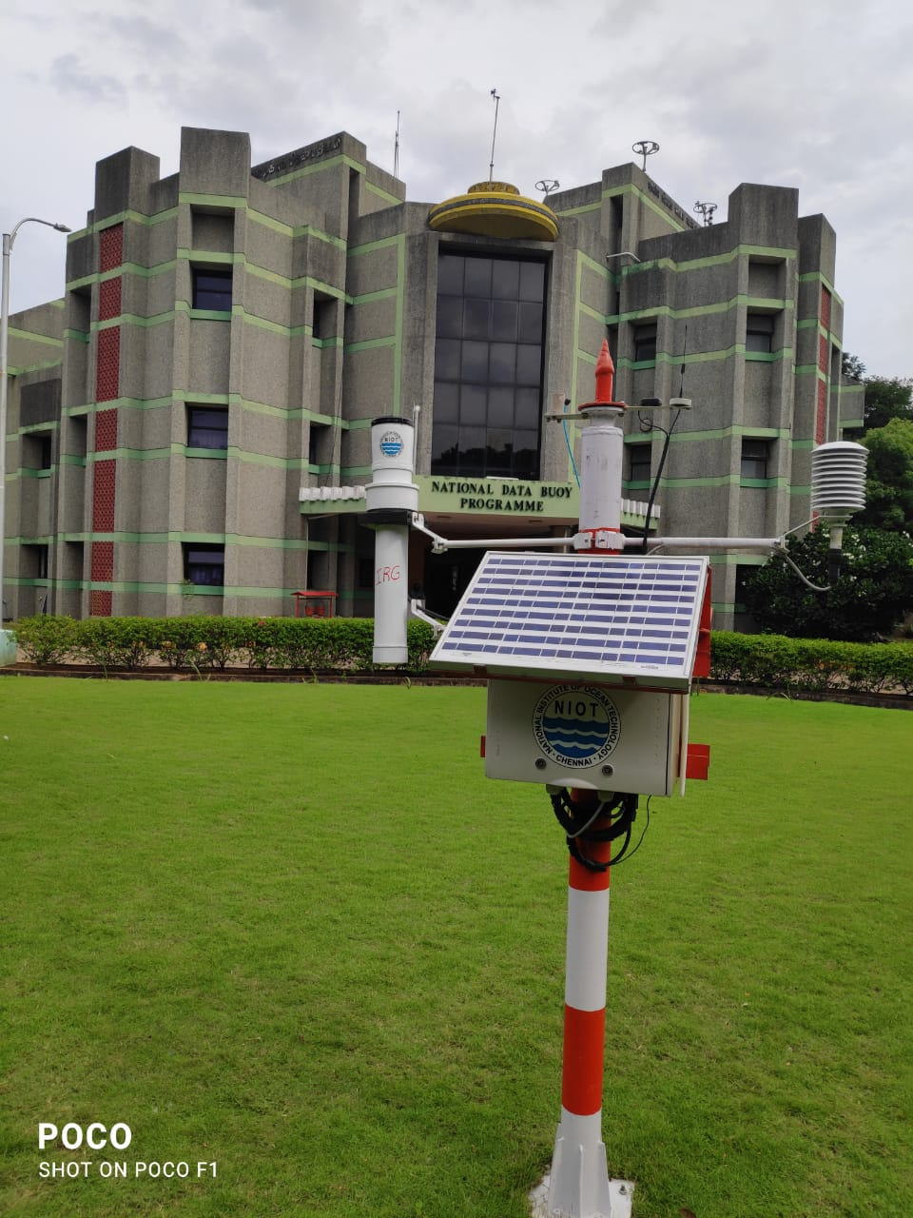
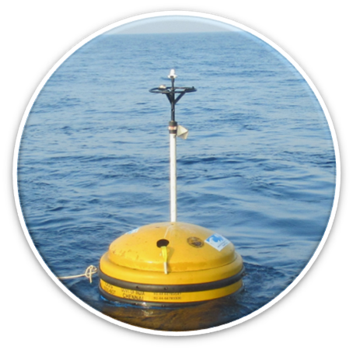
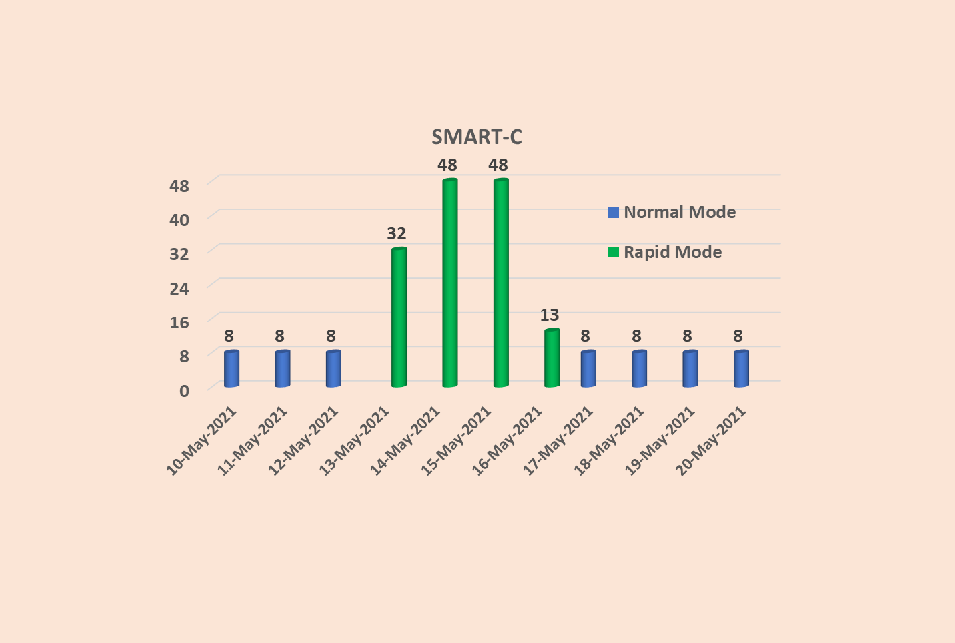
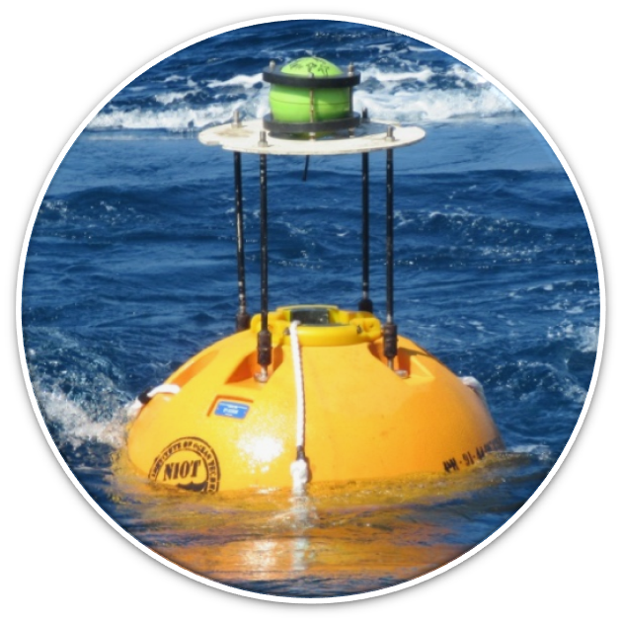
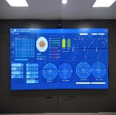
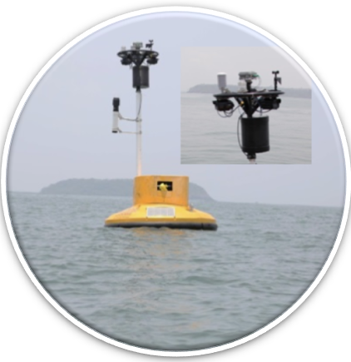
NIOT/OOS - ToT
01. Robo Coastal Observer (RCO)
13. Universal Data Acquisition System
UDAS
02. Robo Boat Technologies
12. Marine Basic Observation System
MBOS
03. MET Ocean Buoy System Type – 1
11. Deep Ocean Autonomous Video Recording System
04. MET Ocean Buoy System Type – 2
10. Indigenous Rain Gauge(IRG)
05. Indian Tsunami Buoy System Type - 1
09. Rapid mode transmission - SMART-C
National Data Buoy Programme
06. Indian Tsunami Buoy System Type - 2
08. ADvanced Data REception and analysiS System - ADDRESS
07. Integrated Marine Surveillance System (IMSS)

Slide 10
NIOT/OOS - PATENT
An apparatus and the functioning of integrated marine surveillance systems.
1
2
Real Time Tsunami Monitoring System
3
A System And Method For Rapid Mode Transmission During Cyclone
An Underwater System for Tsunami Early Warning
4
A buoyant apparatus for performing Rescue Operation and Remote Data Collection
5
6
Composition coating for biofouling protection

Slide 11

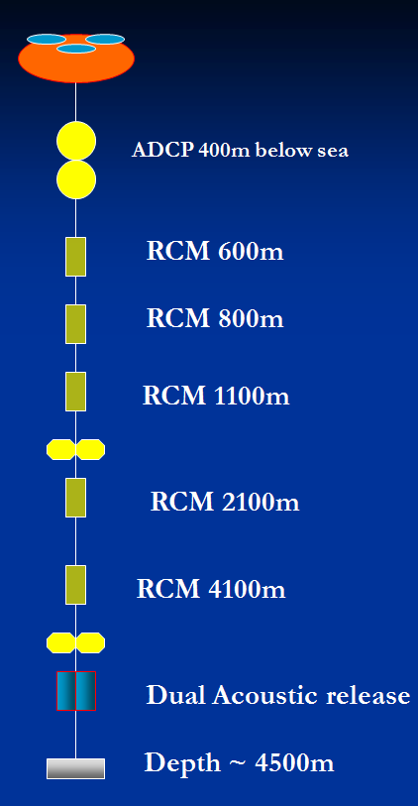
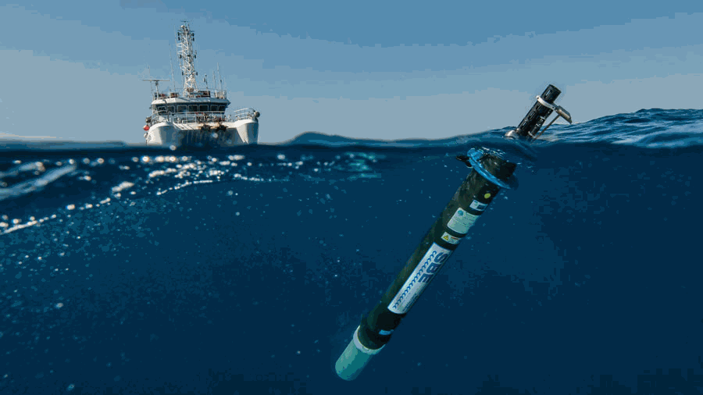
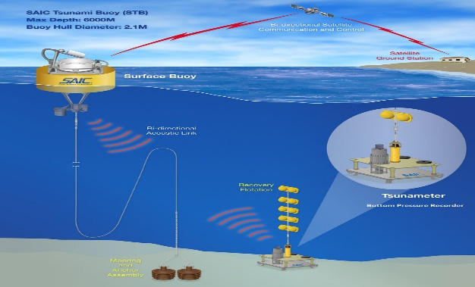
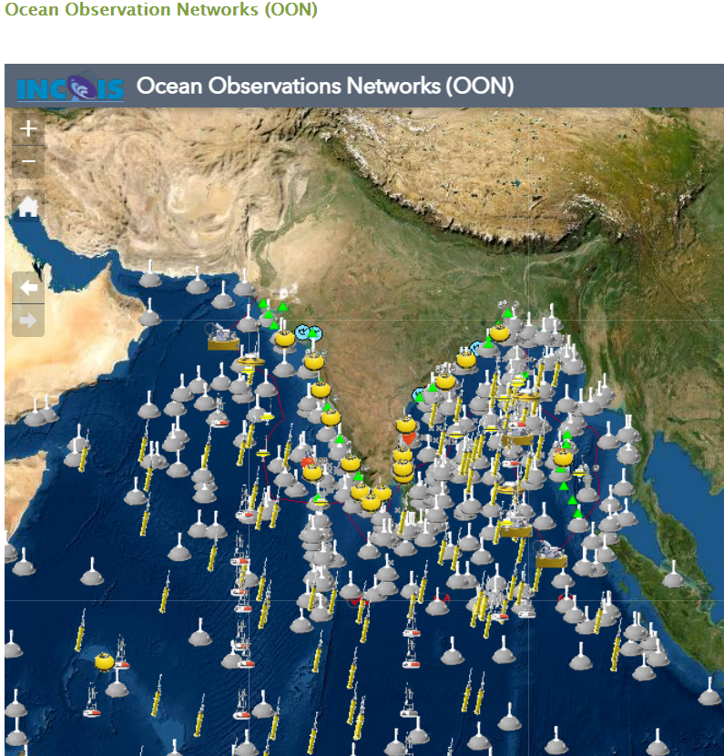
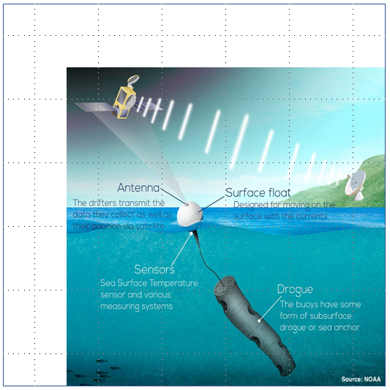
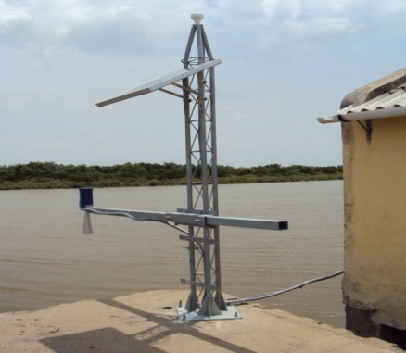
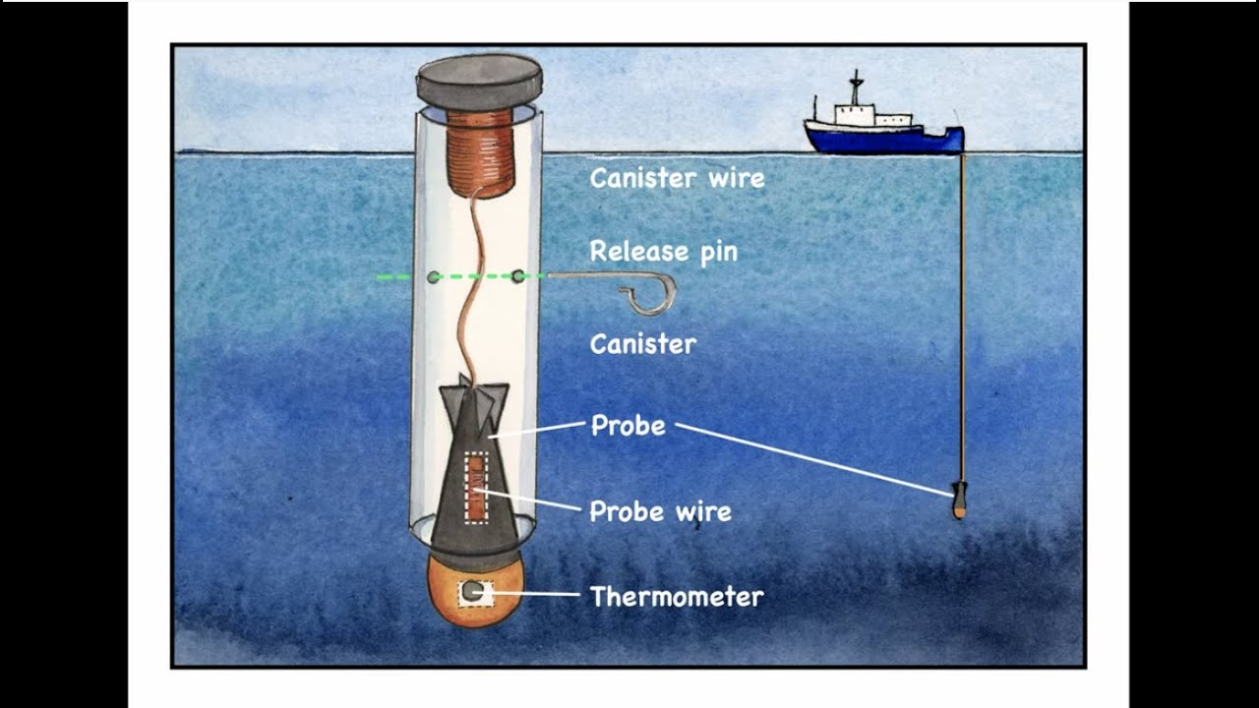
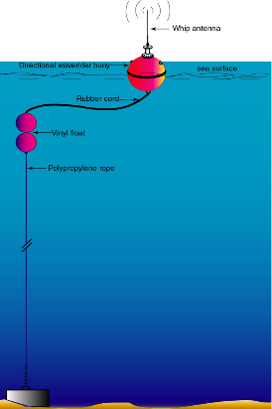
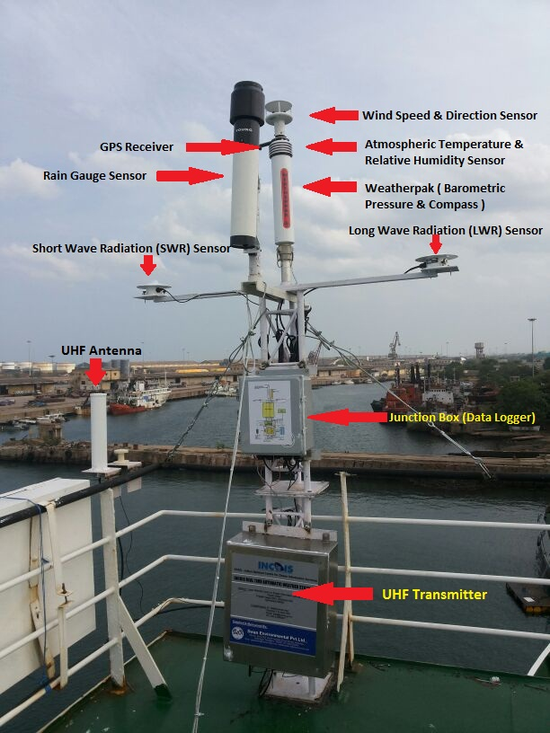
ADCP
Argo
BPR
Drifter
Tide Gauge
XBT
AWS
WRB

Slide 12
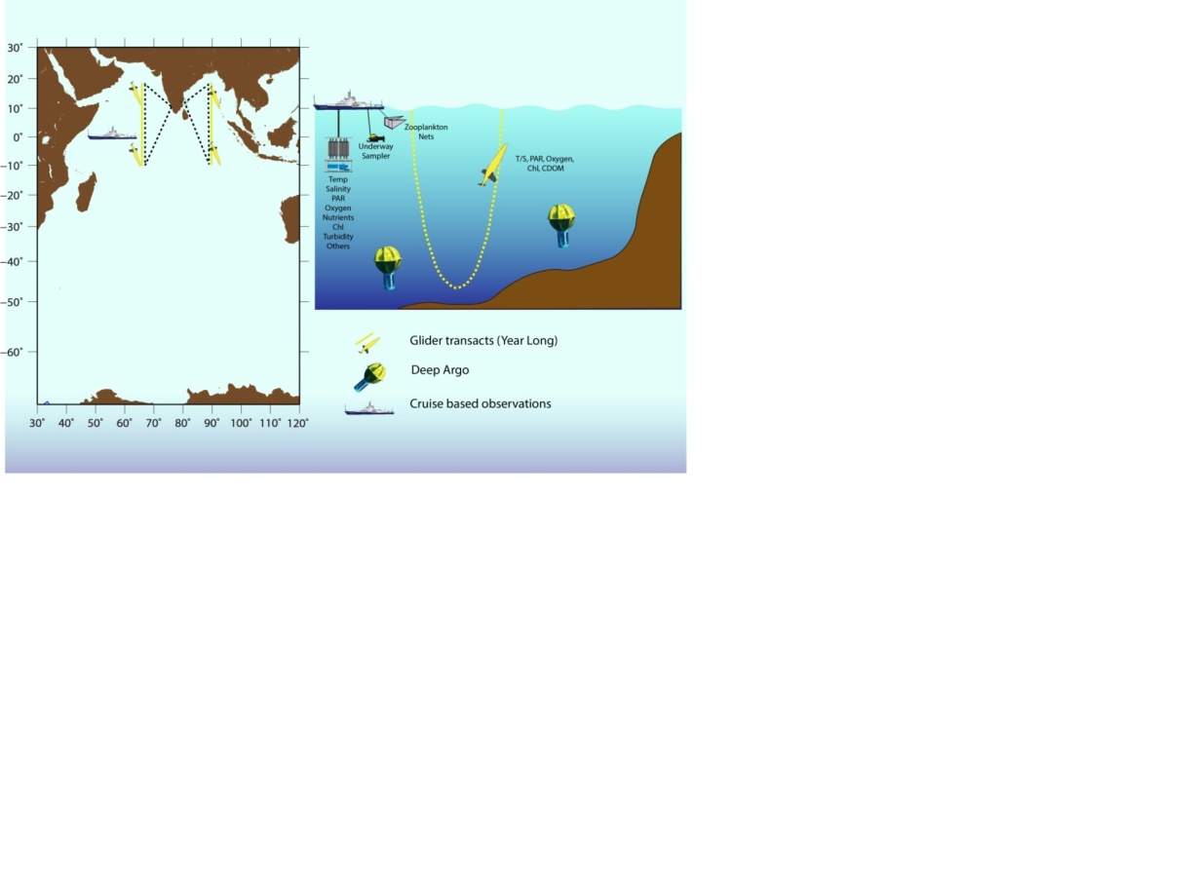
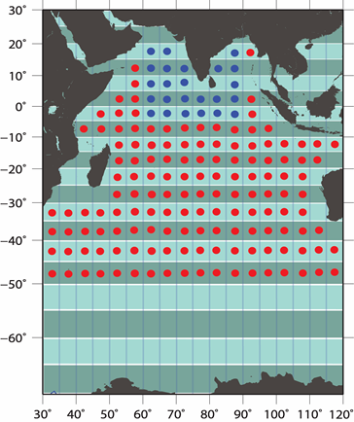
Deep Ocean Mission
Instruments
Deep Sea Gliders, Deep Argo and Wave Drifters
Parameters
Vertical profile of temperature, salinity, chl-a, CDOM fluoroscence, backscattering, DO & PAR
Applications
Long term monitoring of deep ocean physical and biogeochemical parameters in northern Indian Ocean.
Understanding the temporal and spatial variability of OMZ.
Track and monitor water mass properties and ventilation processes of the North Indian Ocean.
Assess and tune model simulations for the physical and biogeochemical parameters.
Data availability
Real-time & Delayed-mode
Plan (2021-22)
Procurement of Gliders (2 Nos), Deep Argo (10 Nos) and Wave Drifters (30)

Slide 13
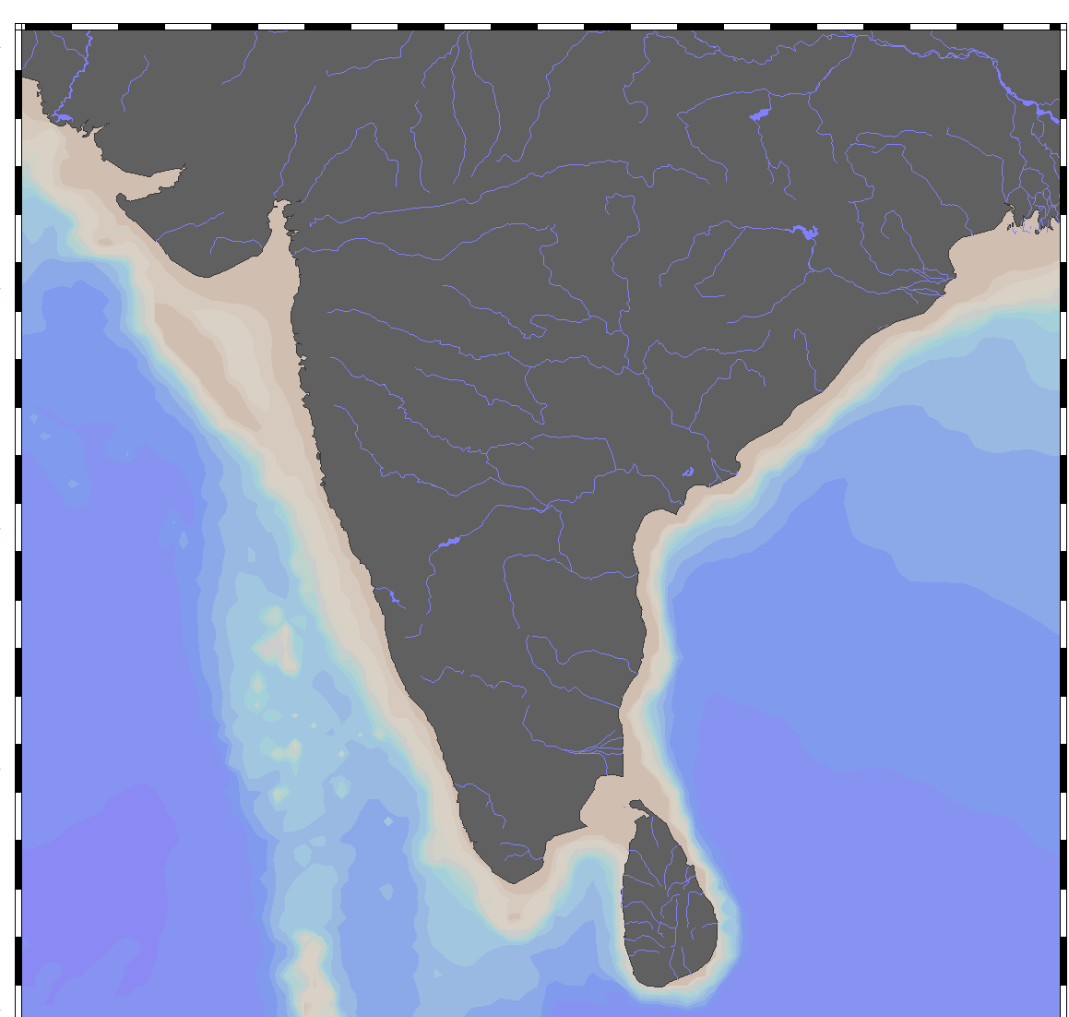
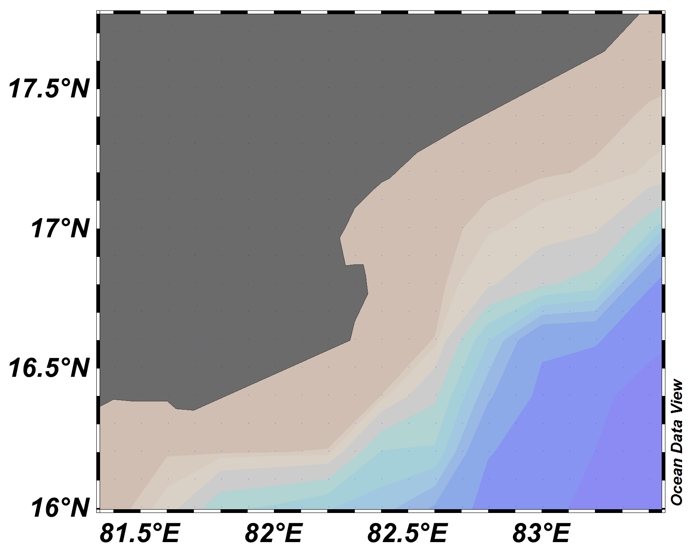
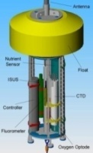
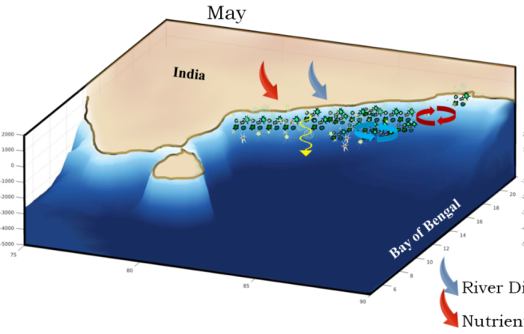

Coastal Water Quality Buoy Network
A network of 6 buoys in Indian coastal waters
Instruments
Buoy based Autonomous coastal observatories
Parameters
Temp, sal, current, Chl-a, DO, scattering, turbidity, pCO2, pH, inorganic nutrients, CDOM, phycocyanin & phycoerythrin
Applications
Long-term changes in coastal water quality
Understand coastal hypoxia, eutrophication, Ocean acidification and species shift.
Calibrate/validate satellite data and develop/improve semi-analytical algorithms.
Validation / tuning of high-resolution coastal biogeochemical model
Provide water quality services such as Algal bloom information, jelly fish aggregation and Trophic state index
Data availability
Real-time
Work Plan (2021-22)
Deployment of observatories off Visakhapanam and Kochi

Slide 14
Plans for 2021-22
Sl. | Activity
Operational and research observatories | Operational and research observatories
1 | Procurement of Argo floats
2 | Testing and deployment of Drifters (30 Nos)
3 | Sustain three XBT/XCTD transects
4 | Sustain network of 17 ADCP in shelf and slope of Indian coastal waters
5 | Sustain three Current Meter moorings at the equator
Deep Ocean Mission
6 | Procurement of two gliders and continue transect in Bay of Bengal
7 | Procurement of deep Argo (10 Nos)
8 | Procurement of wave drifters (30 Nos)
Observation for Services (Tsunami)
9 | Refurbishment and deployment of two STB with BPR
10 | Sustain Network of 35 GNSS & SMA stations in A&N Is.
11 | Sustain Network of 36 tide gauge stations and upgradation of 15 stations with RADAR sensors
Observation for Services (Ocean State)
12 | Sustain Network of 16 Wave Rider Buoy
13 | Sustain network of 36 AWS
Observation for Services (Water Quality)
14 | Deployment of observatories off Visakhapatnam and Kochi and

Slide 15
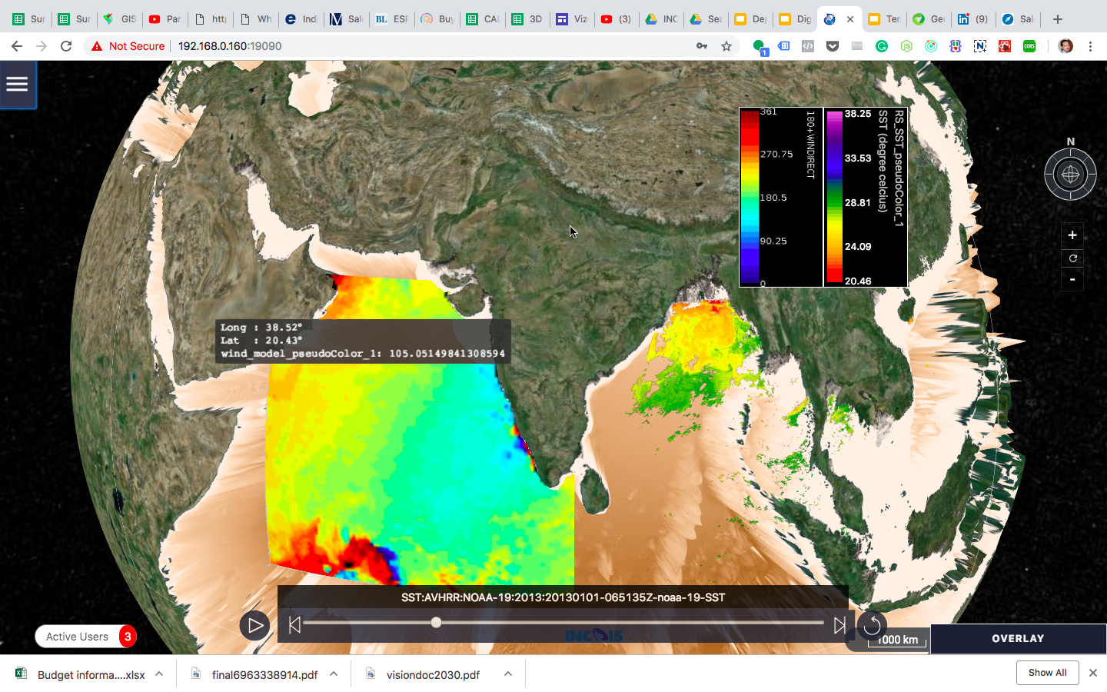
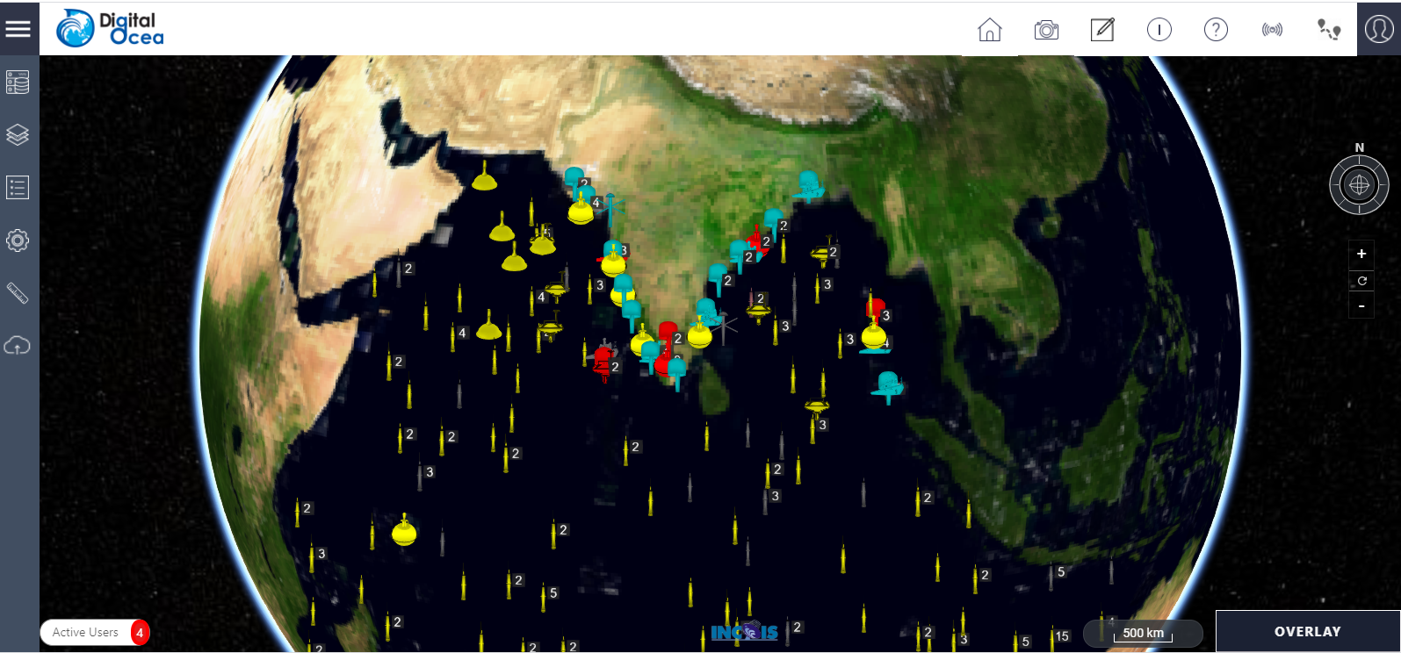
Digital Ocean
One-stop solution for all kinds of the data: In situ, Remote Sensing & Model
Interactive Visualization (multi-dimensional data in 2D, 3D & 4D)
  Comprehensive plot options for all kinds of meteorological and oceanographic data
  Analysis options: Subsetting, Countouring, multi sensor Scatter, along track, anamoly plots
  Time animations along with multi-dimensional plots,
  Bathymetry & satellite Imagery overlays on the 3-D world map with option to use Bhuvan
Fusion of Insitu & Remote Sensing Data
Seperate user workspaces - Create, Save & Share and come-back for more
OGC Standards based backend - WCS, WMS, SensorThings
Dedicated admin panel for Data Adminstrators
  User management, permission control (EEZ Restrictions, etc)
  Sensor availability
  View Usage & system statistics
Data downloads (inc netCDF format), and many other innovative features

Slide 16
Thank you!

