Slide 1


DBCP a vital role in the GOOS
The Global Ocean Observing System
www.goosocean.org
David Legler, Chair OCG, NOAA
Emma Heslop, Programme Specialist GOOS and OCG, IOC/UNESCO
DBCP-37 November 2021

Slide 2
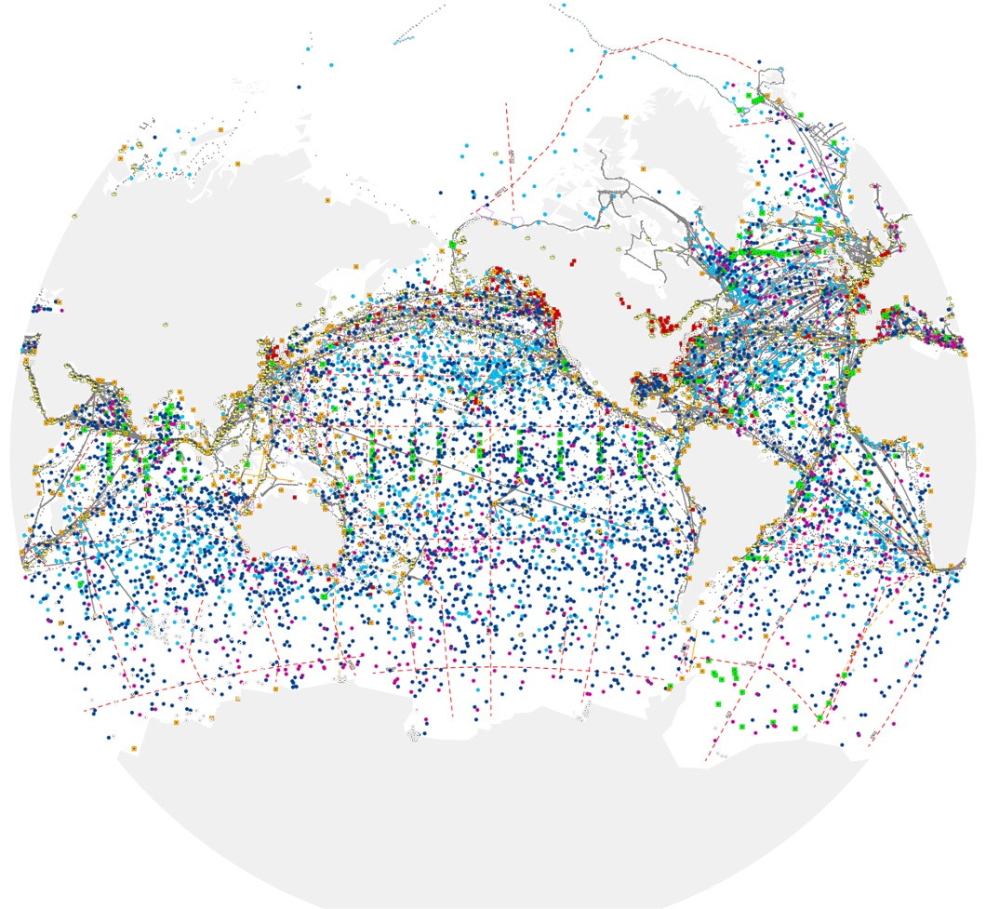
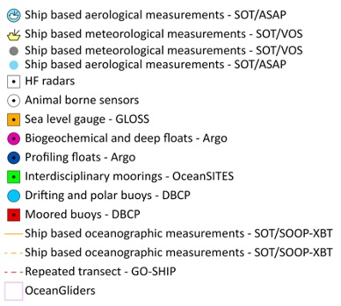
The Global Ocean Observing System
a key infrastructure for climate, weather,
disaster risk reduction, and ocean health
86 countries, 8,000+ observing platforms, 12 global networks under OCG
Ocean and marine metrological EOVs and EVCs
DBCP – drifting, moored, ice buoys – are vital components of the global integrated system
“The weather forecasting systems will run off the rails if they don’t have the surface pressure information over the ocean to constrain them,” Lars Peter Riishojgaard, Director of the Earth System Branch WMO.
www.ocean-ops.org/reportcard2020
Notes:
Importance of data buoys - sentinels of the ocean, provide key ocean and atmospheric data vital to climate, weather, tsunami, and marine services; as well as support a wide range of research that will catalyze future products and services.
For operational drifters that share data to GTS, it averaged 1585 units, with data volume averaged >80,000
Congratulations on completion of the DBCP 2022-2027 Strategy. The 6 Pillars of Success address some critical needs of the ocean observing system and assessing the impact/value of DBCP activities to those who will benefit from ocean knowledge
Data buoys are one of many ocean observing systems and complements other global systems such as SOT, Argo, OceanSites, GO-SHIP, AniBOS, Underwater gliders, etc
The Observation Coordination Group (OCG) coordinates across a number of these ocean observation networks
.

Slide 3

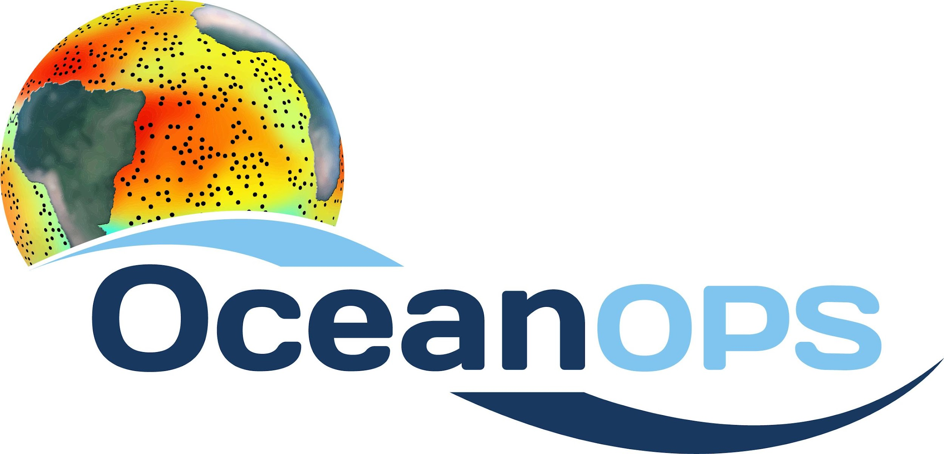
Covid-19 impacts ongoing
a key infrastructure for climate, weather,
disaster risk reduction, and ocean health
8000+
observing platforms
-10%
reduction in data flow from Covid-19 restrictions
  Tropical Moored Array:
  TAO 75%, PIRATA 60%, RAMA 24%
  Combination Covid, resources and vandalism
  Impacts of fewer buoys/reduced data?
  Should we highlight the issue through GOOS?
  Decreasing drifter deployments since pandemic started (83%):
  Atlantic Ocean 159%
  Indian Ocean 50%
  Pacific Ocean 72%
  Some priority on the Indian Ocean?
www.ocean-ops.org/reportcard

Slide 4

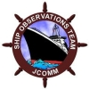
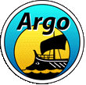

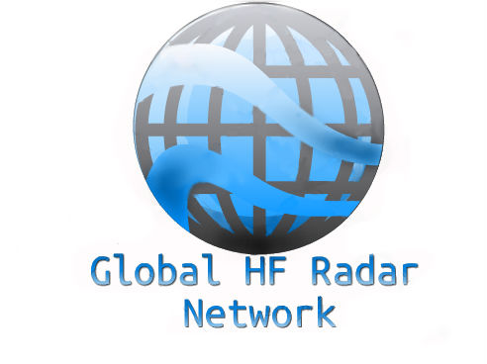





The Observation Coordination Group (OCG) works to efficiently operate, innovate, coordinate, evaluate and integrate a comprehensive in-situ global ocean observing system
Recent/Current actions:
Input to the new WMO Data Policy
Evolution Ocean Observing System Report Card
Analysis of data and metadata flows across OCG
Engaging with users of ocean observations - modeling community
Developing a series of dialogues with the private sector
Environmental stewardship – DBCP leading
Summarizing new OCG TORs:
  ensures an effective and integrated global ocean observing system
  supports processes for reviewing/evaluating an integrated GOOS
  provide annual reports on the status, effectiveness, and operation of the GOOS OCG networks
  Encourages technical development and new technologies
  Encourages network plans, metrics, and strategic targets for implementation
  Oversees OceanOPS plans and budget
  Supports capacity development; best practices and standards; effective and integrative data systems; environmental stewardship
  Promotes diversity and inclusion
  Works with other parts of the ocean observing and forecasting enterprise
Notes:
The OCG coordinates a number of these ocean observation networks (FIGURE/SLIDE);
It works to (summarizing TOR):
ensures an effective and integrated global ocean observing system
supports processes for reviewing/evaluating an integrated GOOS
provide annual reports on the status, effectiveness, and operation of the GOOS OCG networks
Encourages technical development and new technologies
Encourages network plans, metrics, and strategic targets for implementation
Oversees OceanOPS plans and budget
Supports capacity development; best practices and standards; effective and integrative data systems; environmental stewardship
Promotes diversity and inclusion
Works with other parts of the ocean observing and forecasting enterprise

Slide 5
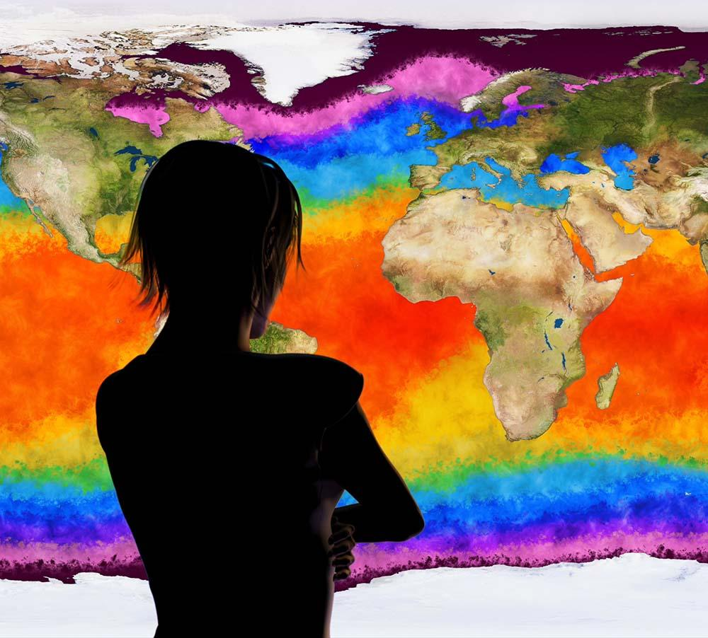

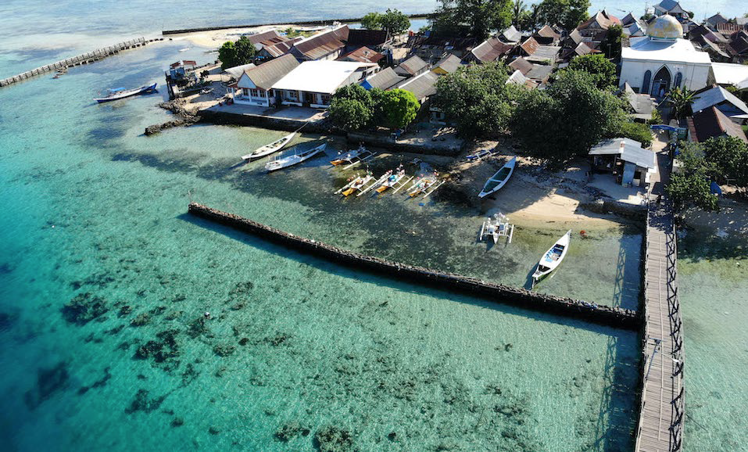

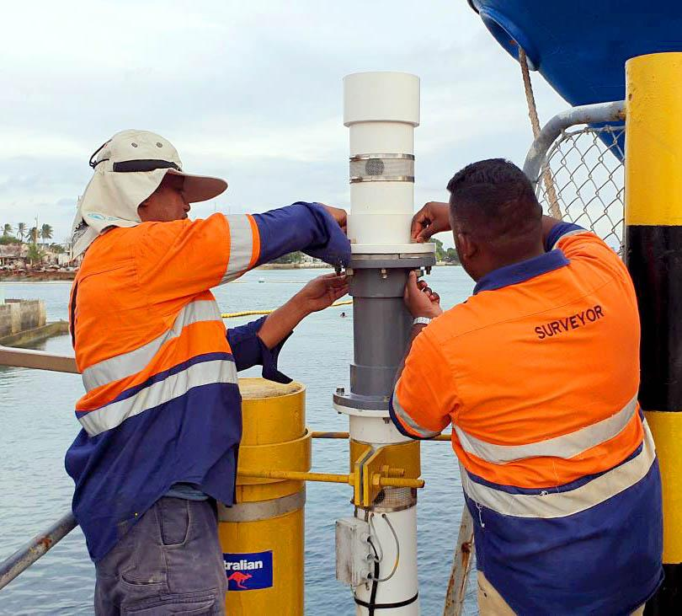
Ocean Observing Co-Design
Transforming our ocean observing
system assessment and design process
CoastPredict
Revolutionising Global Coastal Ocean observing and forecasting
Observing Together
Meeting stakeholder needs and making every observation count
Notes:
Observing Co-Design Objectives:
Offer national government funders the information needed to target investment globally, regionally and locally and establish what implementation will have the greatest impact. Governments will be able to track implementation, show the benefits that justify costs and increase ROI.
Provide investors with the opportunity to help create a hub or center of excellence that analyses observing systems and results in sustainable management.
Make ocean observing and information appreciably more accessible and impactful through transformative co-design, working with the modelling community and key user stakeholders to achieve tangible integration and interoperability.
Develop system diagnostics, tools and reporting capability to better assess fitness-for-purpose across evolving requirements and use-inspired needs, including digital scenario tools that work backwards from intended impact to give us a priority plan for observing.
Establish the international capacity and modular infrastructure to co-design and regularly evaluate the observing system at different scales. For example, using a toolkit of software and user engagement/co-design methods that we can apply to global problems or local challenges.

Slide 6

Looking forward
  OCG values your engagement and stewardship
  Engage in Ocean Decade Programmes; Ocean Observing Co-Design, Coast Predict, ForeSea, and Observing Together
  New observing platforms and technologies are emerging regularly; big appetite for data from these platforms. Which, if any, of these technologies will DBCP engage and support?
  Continue support and leadership in OCG cross-network activities, Capacity Development, Environmental Stewardship, commercial sector dialogues, and more…
  Achieving metrics, how can OCG/GOOS help?
Notes:
For example, we will soon be looking for exemplars and demonstrations of observing networks co-designed by users and observers that deliver improved and more integrated observing systems and the process by which that system is designed and assessed

Slide 7
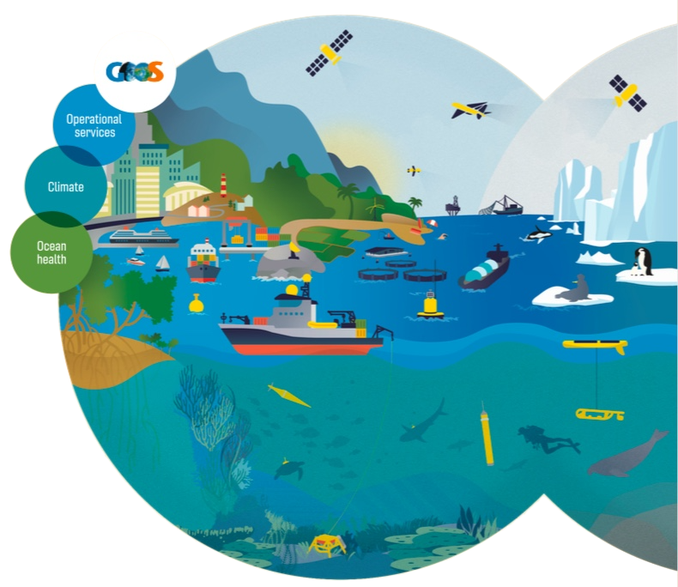
Thank you
goosocean.org

Slide 9
The Observation Coordination Group (OCG) works to efficiently operate, innovate, coordinate, evaluate and integrate a comprehensive in-situ global ocean observing system
OCG has 8 current foci:
  Requirements
  Observing Advances
  Standards and Best Practices
  Data Management
  OceanOPS
  Metrics
  Environmental Stewardship
  Capacity Development
Summarizing new OCG TORs:
  ensures an effective and integrated global ocean observing system
  supports processes for reviewing/evaluating an integrated GOOS
  provide annual reports on the status, effectiveness, and operation of the GOOS OCG networks
  Encourages technical development and new technologies
  Encourages network plans, metrics, and strategic targets for implementation
  Oversees OceanOPS plans and budget
  Supports capacity development; best practices and standards; effective and integrative data systems; environmental stewardship
  Promotes diversity and inclusion
  Works with other parts of the ocean observing and forecasting enterprise
Notes:
The OCG coordinates a number of these ocean observation networks (FIGURE/SLIDE);
It works to (summarizing TOR):
ensures an effective and integrated global ocean observing system
supports processes for reviewing/evaluating an integrated GOOS
provide annual reports on the status, effectiveness, and operation of the GOOS OCG networks
Encourages technical development and new technologies
Encourages network plans, metrics, and strategic targets for implementation
Oversees OceanOPS plans and budget
Supports capacity development; best practices and standards; effective and integrative data systems; environmental stewardship
Promotes diversity and inclusion
Works with other parts of the ocean observing and forecasting enterprise

Slide 10
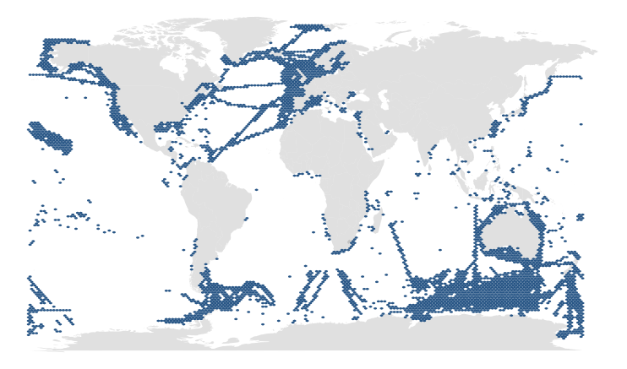
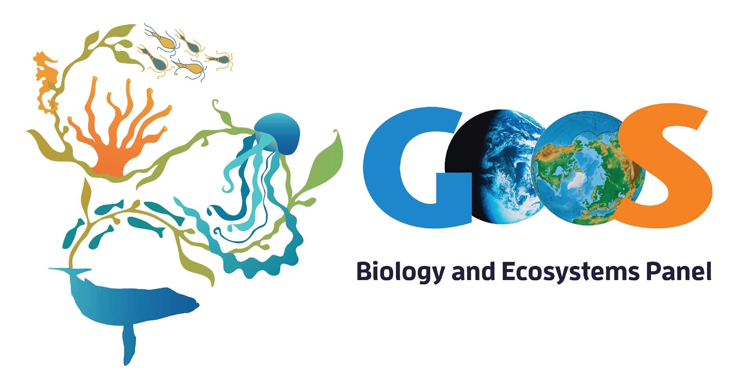
GOOS today
BioEco observations
203 active long-term biological observing programs*
12 Essential Ocean Variable based networks
Coverage 6 -7% of the global ocean, 93% without known sustained observations
* Survey 643 observing entities identified, 371 responded, 203 programs were active, long-term (5 years or more) and sampled at least EOVs systematically but spatial data were only available for 192 observing programs (Satterthwaite et al. 2020 in prep)
ocean-ops.org
Notes:
In addition to ocean observations through established and emerging global networks
BioEco Panel under GOOS focuses on biological observations
Coverage 6 -7% of the global ocean, 93% without known sustained observations

