Slide 1
International Programme for Antarctic Buoys
Chair/s: Petra Heil
Rapporteur: Ignatius Rigor and Christian Haas, Coordinators
DBCP 37

Slide 2
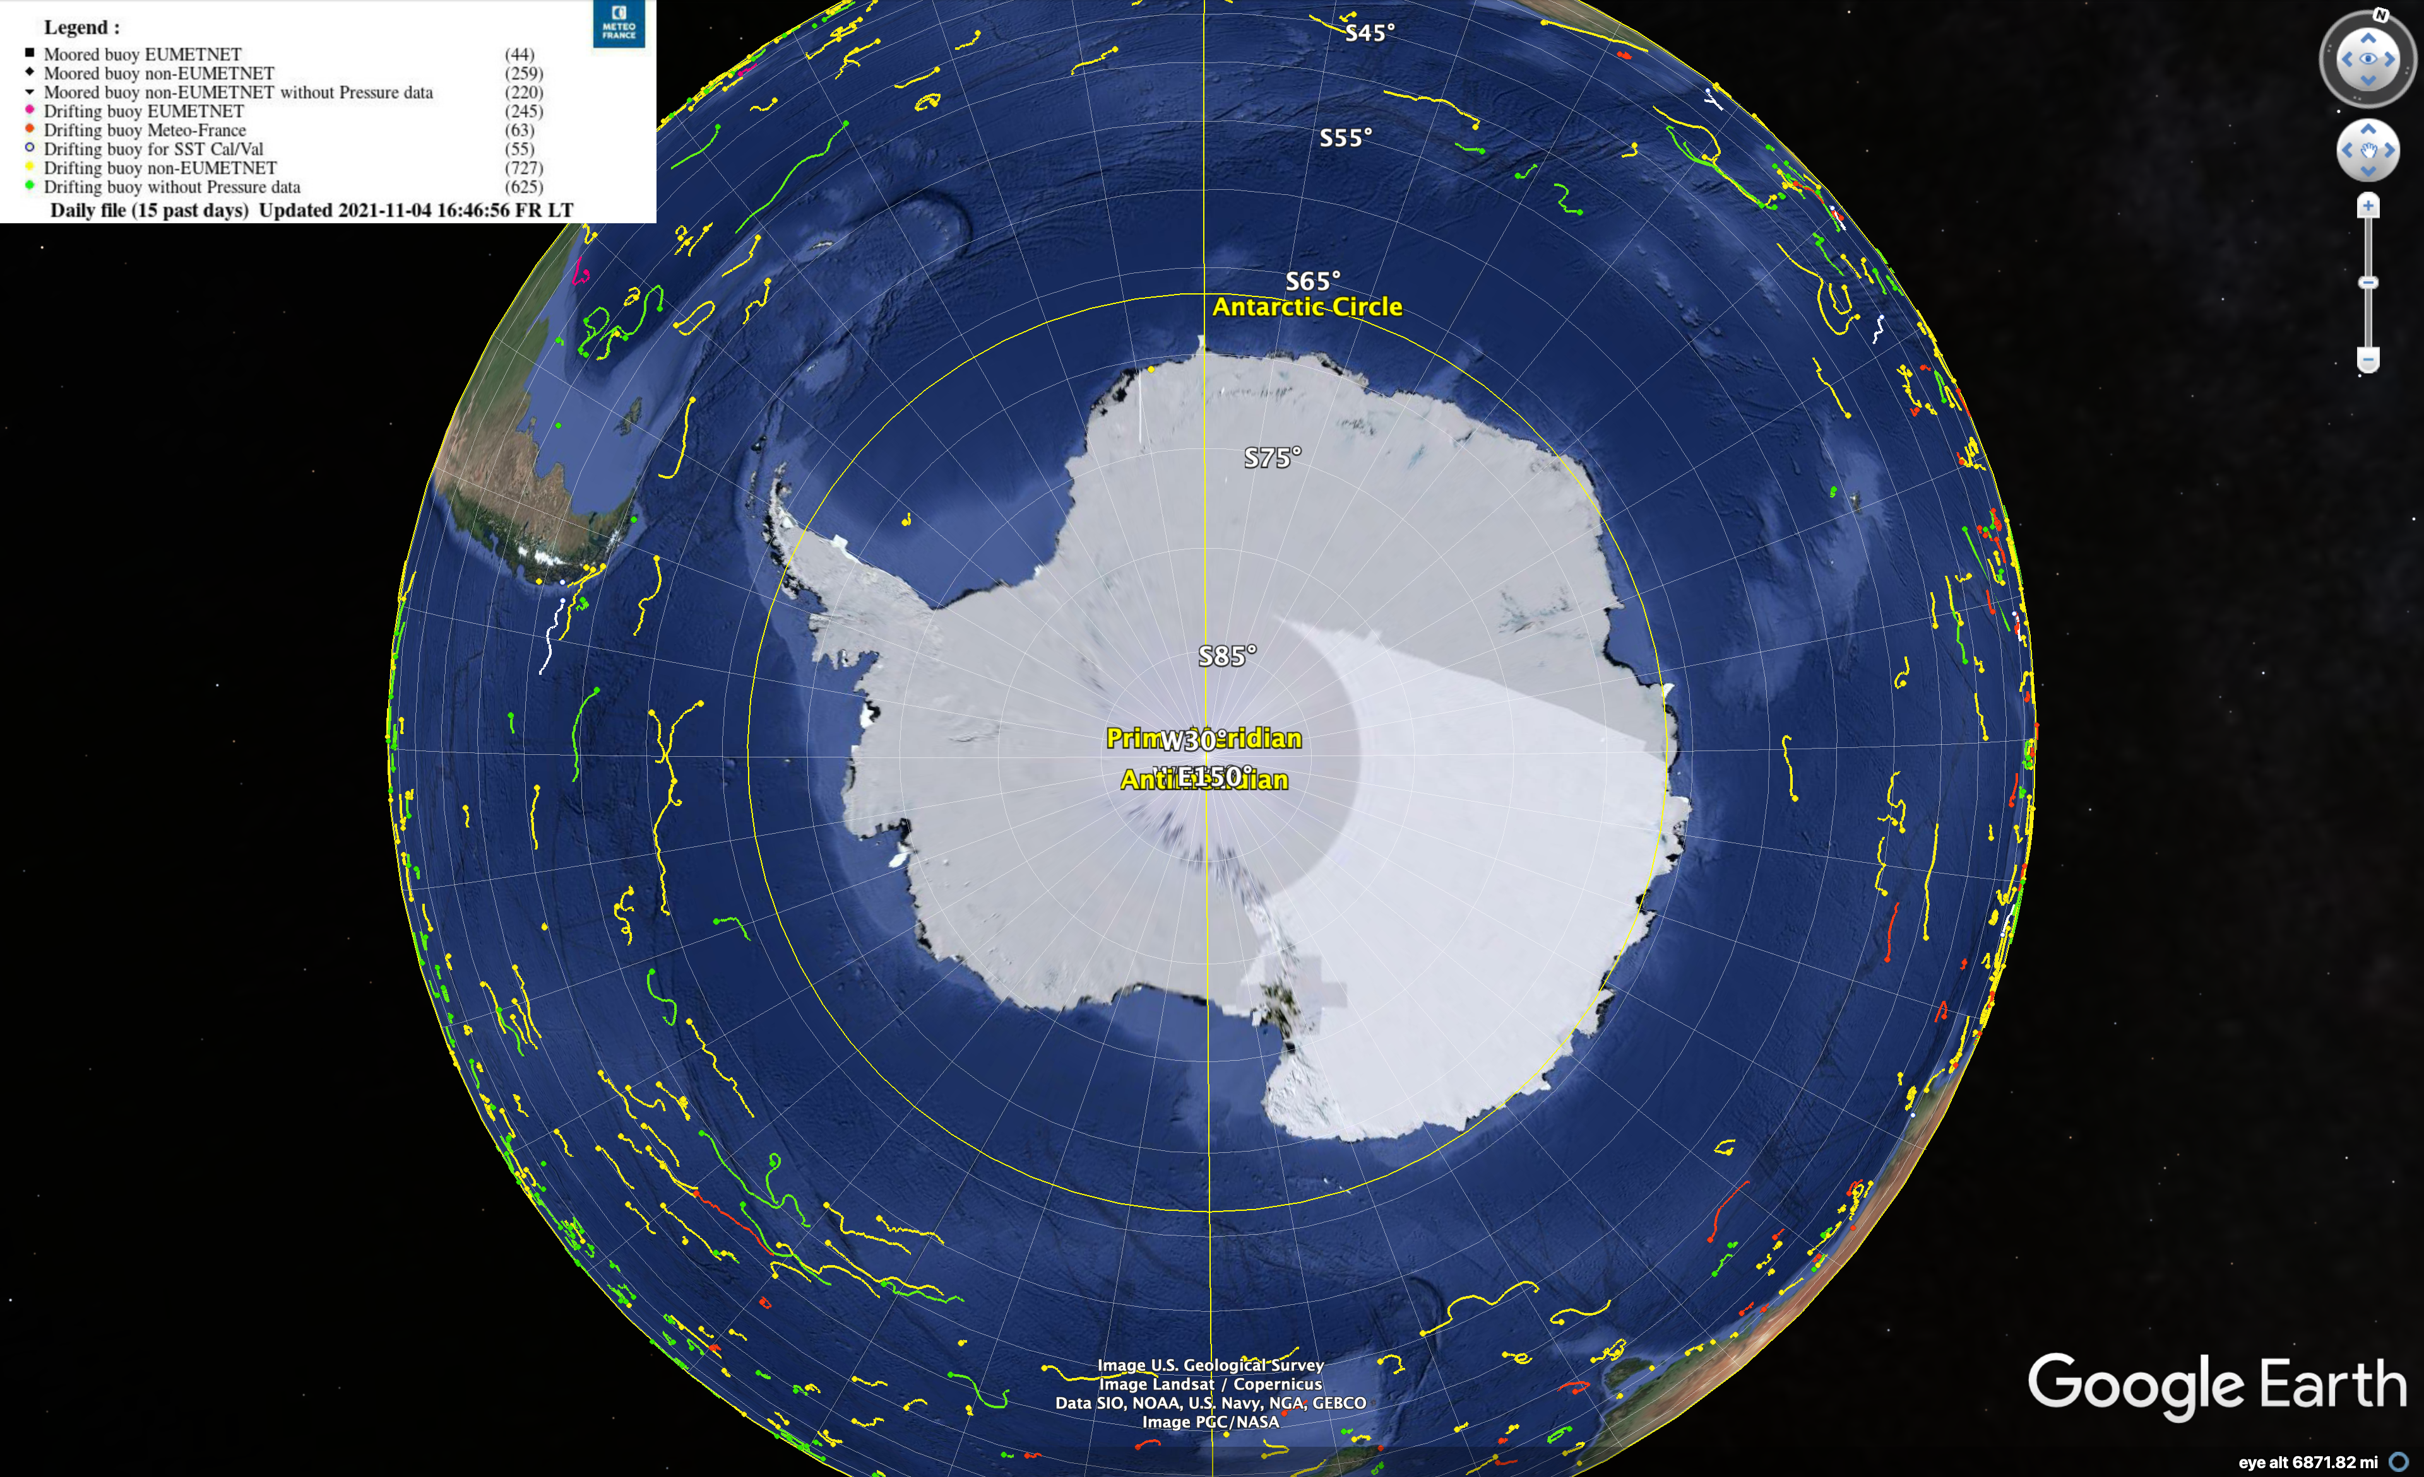
3. Key highlights this year
There are 80 buoys reporting in the IPAB domain (Southern Ocean, South of 55S).
These buoys were deployed by ships from Australia, Brazil, Germany, Korea, New Zealand, South Africa, USA, and others.

Slide 3
4. Key focus areas for next year
Due to the strong divergence of sea ice and ocean currents away from the continent, IPAB needs to find ways to increase deployments closer continent in areas of sea ice.

