Slide 1
International Arctic Buoy Programme
Chair/s: Christian Haas, Chair; and Takashi Kikuchi,Vice Chair
Rapporteur: Ignatius Rigor, Coordinator
DBCP 37

Slide 2
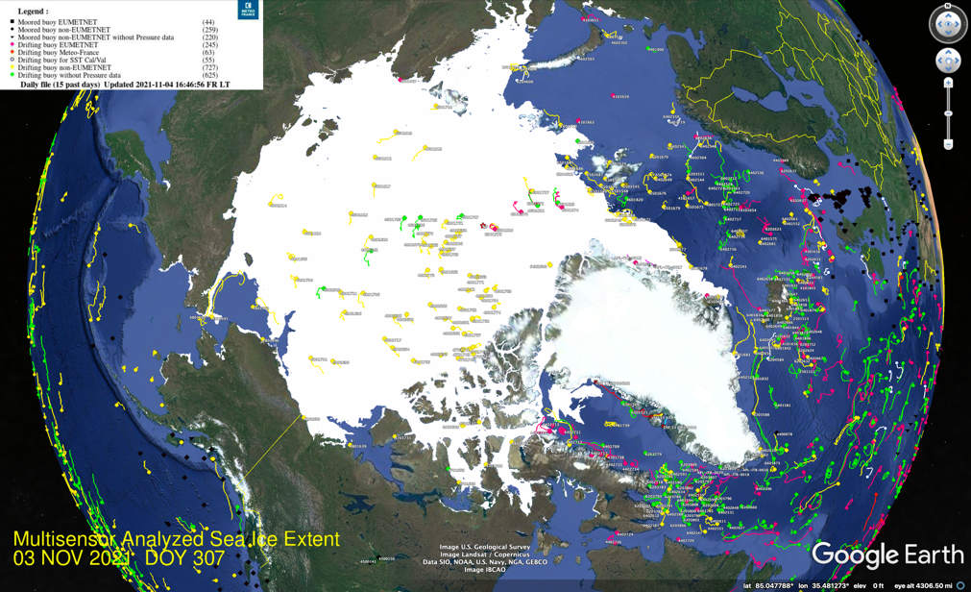
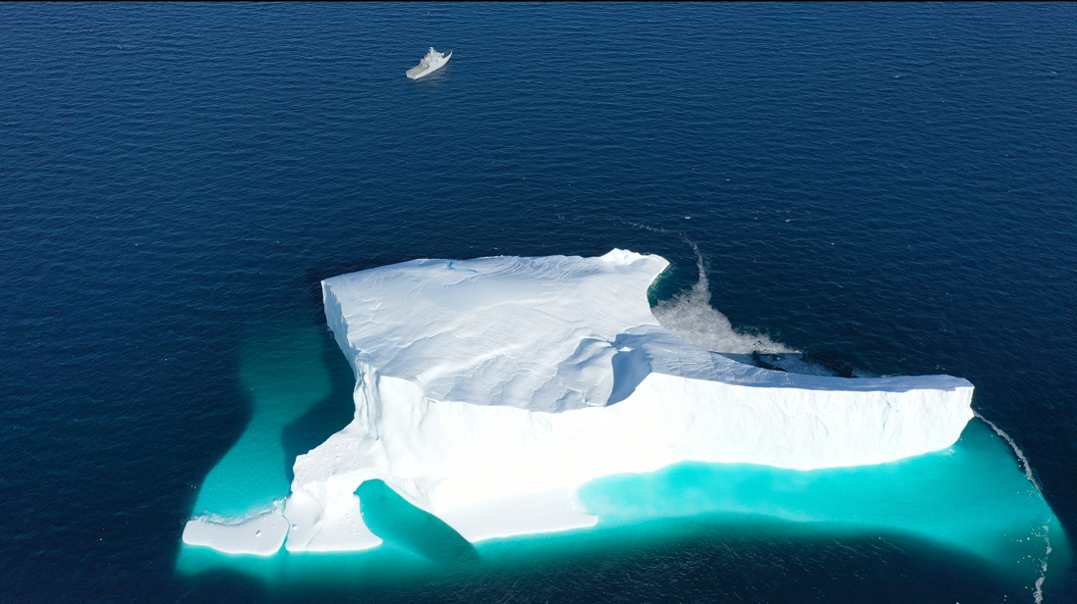
3. Key highlights this year
We have been able to sustain the IABP Network despite many cancelled deployment opportunities due to COVID-19. Current status map is shown on the left below.
We have increased our efforts to place GPS tags on ice islands and icebergs in the Arctic.
13 DSE EJMI.png

Slide 3
4. Key focus areas for next year
Increase deployments in the Eurasian Sector of the Arctic Ocean (red oval on map below).

Slide 4
5. Key take-home messages
The IABP has been able to sustain the Arctic Observing Network despite hurdles due to COVID-19, but plan to meet in person as soon as possible so we don’t lose our momentum.
The IABP has even expanded its efforts to tag more ice islands and icebergs.
Maintaining the network in the recurring gap in the Eurasian Arctic continues to be one of our top priorities.

