Slide 1
DBCP UK National Report
DBCP – 37, VIRTUAL, 8-11 November 2021
Fraser Cunningham
Met Office

Slide 2
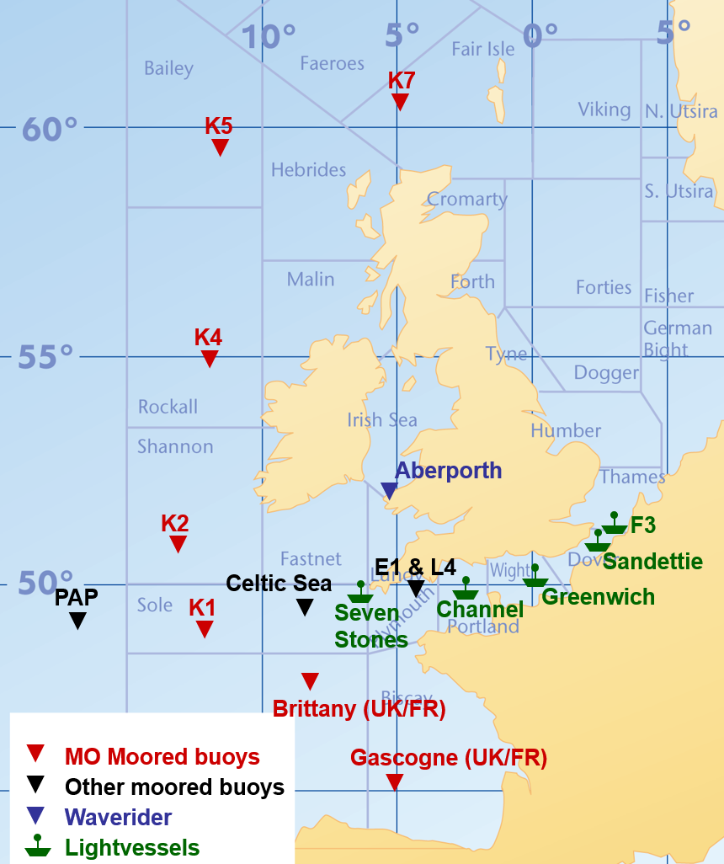
Moored Buoys
K1 to K7 and Cardigan Bay waverider operated by Met Office
Brittany & Gascogne operated jointly with Meteo-France
PAP (OceanSITES) operated jointly with National Oceanography Centre
E1, L4 operated jointly with Plymouth Marine Laboratory (not deployed at present)
Light vessels operated by Trinity House with Met Office systems installed
Primary use of moored buoy data by Met Office is for forecasting and early warning of severe weather conditions and validation of wave model forecasts
Data also used in marine climate datasets and studies
Notes:
List parameters

Slide 3
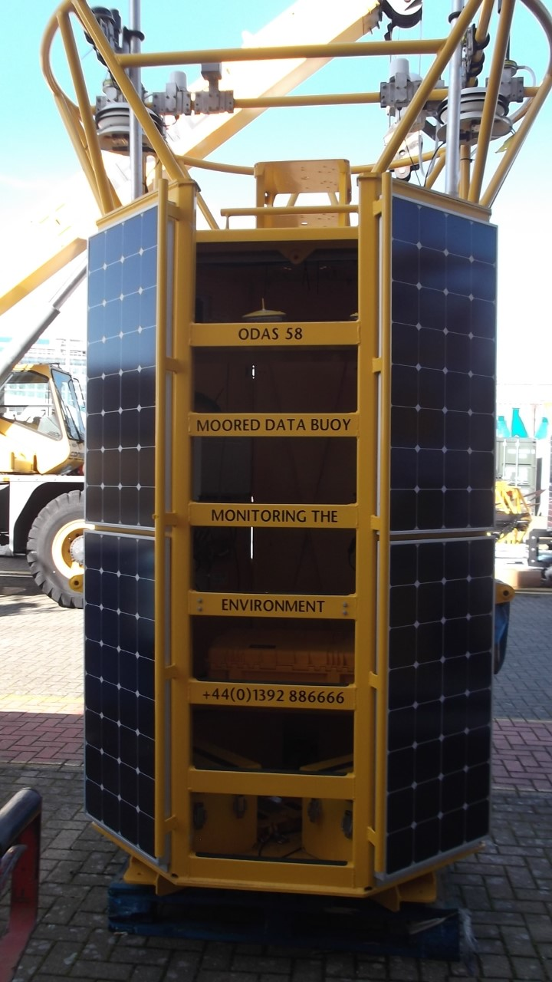
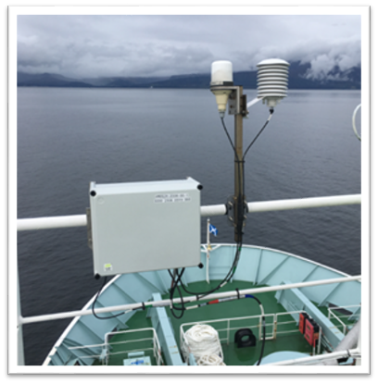

Technology/Developments
New generation of buoys rolling out: AMOS2X (CR1000X loggers/Iridium comms) on Mobilis/Hyrdosphere hulls. One type of system deployed across automated networks.
2 buoys (Brittany, Gascogne) have Axys Watchman systems on Mobilis/Hyrdosphere hulls and dual Iridium comms ​(will be replaced soon)
Legacy Mk2b CR10x/PC42 based systems on Balmoral hulls have been retired
Data processing/monitoring migrated to common SurfaceNet architecture - flexible/easy to maintain - Delayed
Moored buoy BUFR template generation delayed to 2022

Slide 4
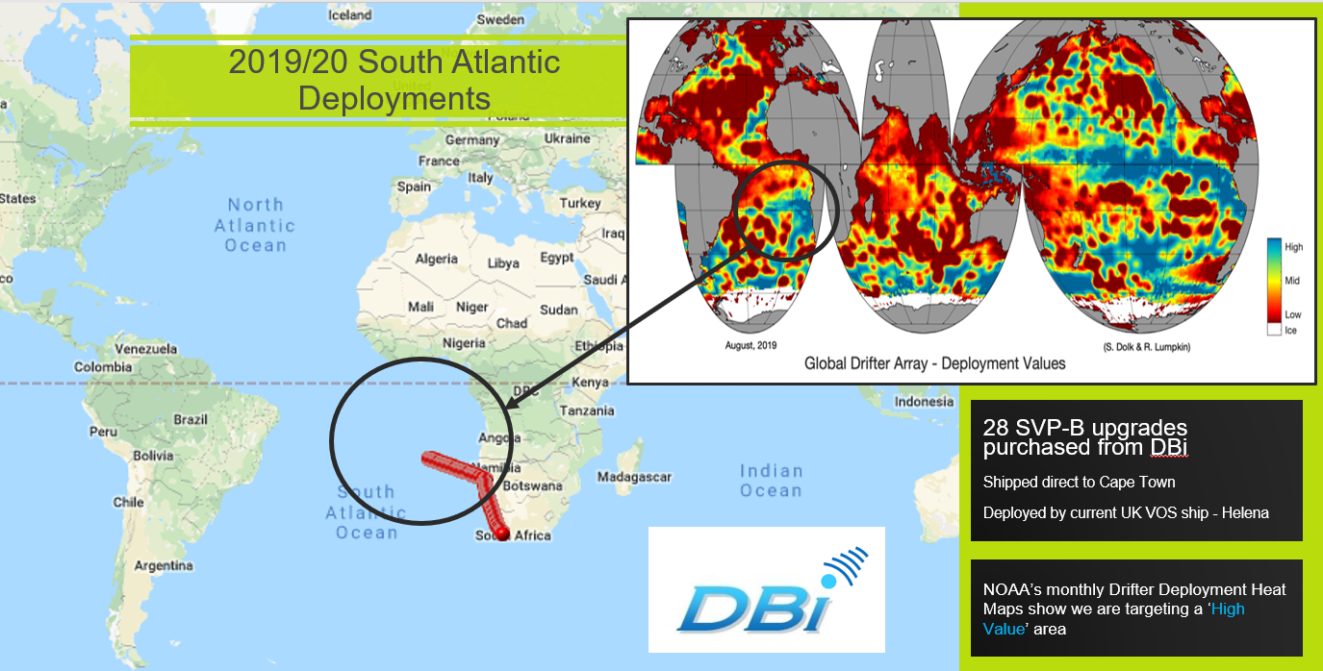
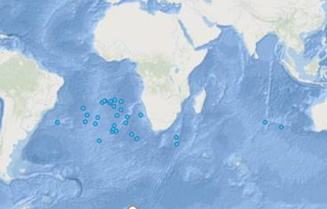
Drifting Buoys
2021 Deployments
33 SVP-B:
5 MetOcean on behalf of ESURFMAR North Atlantic
28 DBi buoys as UK contribution to GDP in South Atlantic
34 deployments scheduled for 2021/22 targeting either side of South Atlantic. DBi, Pacific Gyre, Scripps
2020/21 South Atlantic Deployments
Assimilation into NWP models
Use in Hadley Centre climate datasets

Slide 5
Covid-19
X
Had a significant impact over the last couple of years but we’ve made a good recovery thanks to a strong engineering effort
Two buoys still need to be returned to operations
X
X

Slide 6
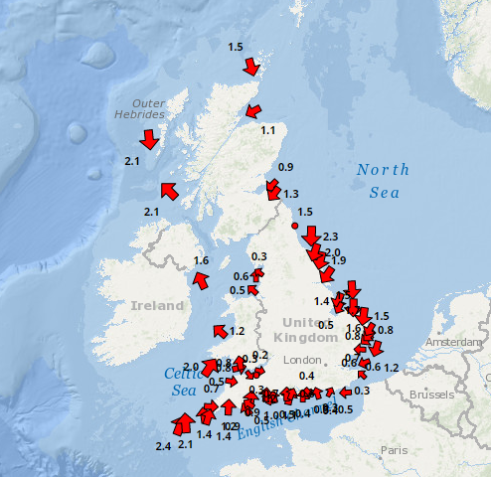
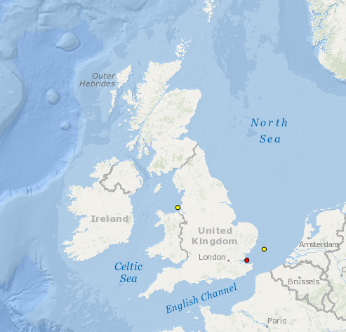
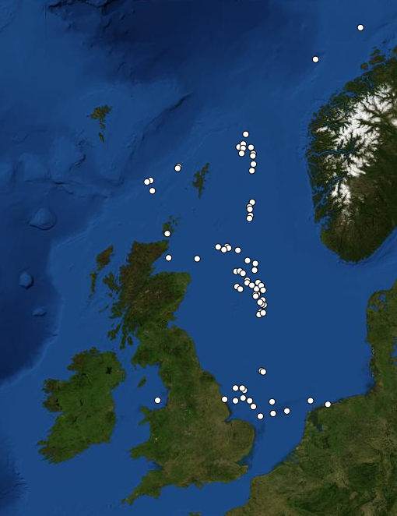
Other UK networks
Cefas WaveNet - real-time wave data from a network of wave buoys located in areas at risk from flooding
Cefas SmartBuoys - multi-parameter platforms to collect marine environmental data for eutrophication, environmental variability and change, ecosystem function monitoring
RigNet MetReach – real-time metocean data from around 50 offshore oil and gas platforms (data exchanged on the GTS)

Slide 7
Thank you!
fraser.Cunningham@metoffice.gov.uk

