Slide 1

Session Link
37th Session (Virtual)
Data Buoy Cooperation Panel
08-11 November, 2021

Slide 2
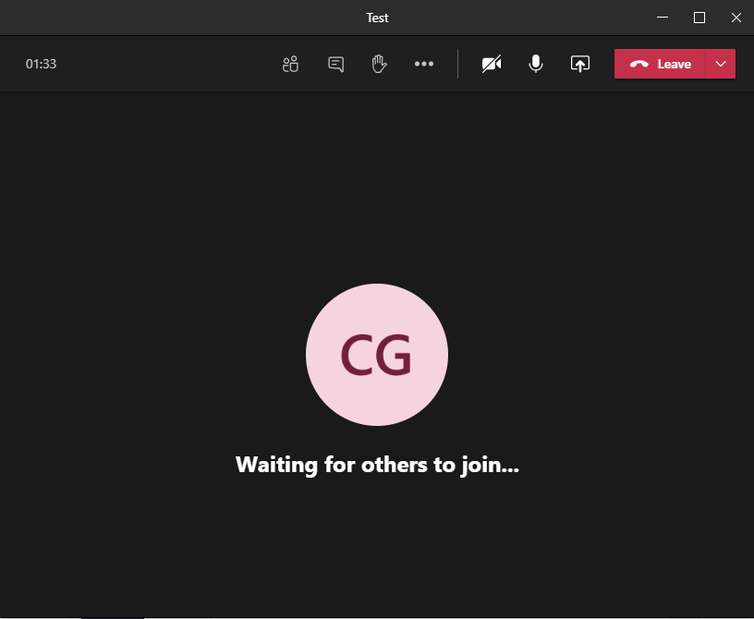

Online meeting Tools
Chat box
(Type your comments questions here)
Share your screen
Raise Hand
Turn on/off your
Microphone
Turn on/off your camera

Slide 3

Online meeting Etiquette
By default, keep your microphone muted unless you are speaking. We will try to use video, unless it presents a problem for bandwidth, so join with your camera on.
If you have a question or comment, please either use the “chat box” in Teams Meeting to type your question/comment or indicate by “raise hand” in order to be called upon by the moderator.
Please be succinct in both your questions and answers.
The sessions will be recorded for the purpose of writing the report, and the recordings deleted afterwards

Slide 4
Reminders
Meeting documents are available through
    https://www.goosocean.org/DBCP-37
Send your presentations to dbcp-tc@jcommops.org at your earliest
Session Link everyday: Dial in here

Slide 5
Reminders
Nomination of DBCP Executive Board Members will be conducted by 0800UTC 11th November. A vote link will be sent to eligible delegates attending the session (DBCP NFPs and their delegates, WMO/IOC focal points, etc. )
Send your email to dbcp-tc@jcommops.org to confirm your credential to vote by 10th Nov

Slide 6

Thank you
Merci

