Slide 1




Persistence of cold wedges in the somali current system
VERENA HORMANN & Luca R. centurioni
vhormann@UCSD.EDU
Dbcp-37 scientific & technical workshop
08 nov. 2021

Slide 2
Monsoon circulation
Seasonally reversing strong boundary currents along with localized intense upwelling cells – particularly in the Somali Current system, as well as interbasin exchanges between the Arabian Sea and Bay of Bengal
Schott et al., 2002

Slide 3
Indian monsoon rainfall
Horizontal advection, coastal upwelling, wind-driven mixing, and Ekman pumping all affect sea surface temperature (SST) in the Arabian Sea, which ultimately feeds back to rainfall over India
Izumo et al., 2008

Slide 4
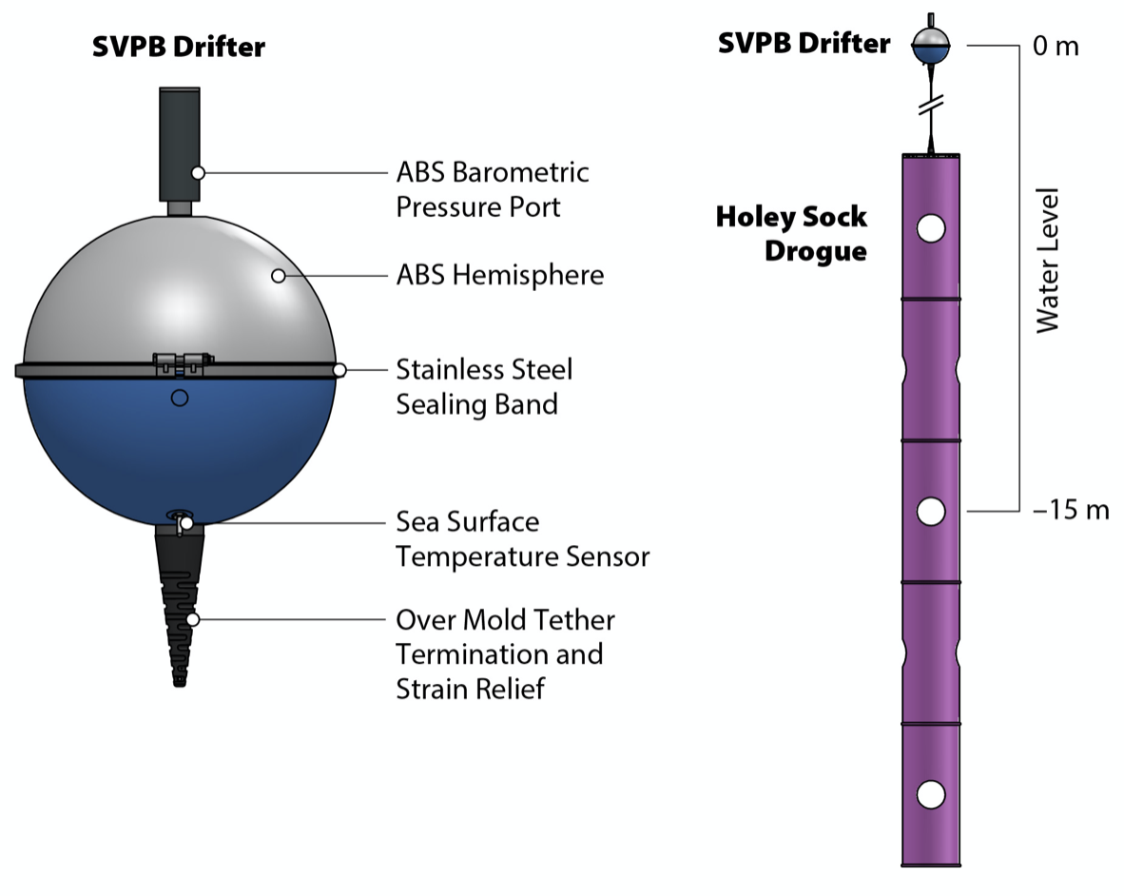
Lagrangian drifters
Over 200 SIO-LDL drifters deployed in the western Indian Ocean since 2013
MOU established between SIO and the Kenya Meteorological Office to facilitate VOS deployments in the Arabian Sea

Slide 5
Cold wedges
Drifters sampled pronounced Somali cold wedge near 4ºN in July 2014, which persisted in the surface circulation until November 2014
Northward Somali Current may extend well beyond the summer southwest monsoon

Slide 6
Coastal upwelling
Southwest monsoon winds were generally upwelling favorable during boreal summer 2014 and coastal SSTs were low, which also confirm the drifter-observed cold wedge in July 2014
Winds started blowing from the northeast in early November 2014, with SSTs indicating again a wedge-like signature near 4ºN that decayed within one week

Slide 7
surface circulation
Somali Current turned offshore at about 3ºN in boreal summer 2014, flowed around the observed cold wedge, and then continued northward along the coast
Turn-off latitude associated with enhanced eddy kinetic energy (EKE)
Northward phase of the Somali Current broke down in early November 2014 with the arrival of a mesoscale eddy and the onset of the winter northeast monsoon

Slide 8
Eddy Propagation
Cyclonic eddy appears to be generated near 54ºE at the beginning of October 2014
Westward propagation toward the Somali coast with a phase speed of about 0.2 m/s

Slide 9
Chlorophyll distribution
Mesoscale eddy is clearly recognizable in chlorophyll map for early November 2014
Chlorophyll distributions can affect SSTs through the absorption of solar radiation in the upper ocean

Slide 10
Conclusions
Drifter trajectories in the western Arabian Sea during boreal summer and fall 2014 revealed that the northward Somali Current and associated cold wedges can persist into the intermonsoon period
Fast breakdown of the Somali Current system within one week when winds started blowing from the northeast and the arrival of a cyclonic eddy in early November 2014
Observations may not only have implications for regional ocean-atmosphere interactions but also biogeochemical processes and the marine ecosystem in the northern Indian Ocean

