Slide 1
Evaluation of HRSST drifters using Copernicus SLSTR
Gary Corlett, Luca Centurioni, Anne O’Carroll, Igor Tomazic

Slide 2
Introduction
Reference data, such as drifting buoys, are essential for satellite SST validation
Estimated uncertainty of drifters was 0.1 K
  However many studies suggested drifter uncertainty was closer to 0.2 K
GHRSST/DBCP HRSST Pilot Project
A number of drifters to be upgraded to a higher specification
  Position accuracy and reporting to 0.01 degrees (HRSST-1)
  SST accuracy < 0.05 K; reporting to 0.01 K (HRSST-2)
    Total standard uncertainty in measured SST to be < 0.05 K
Requirements
  Hourly measurements
  Report design depth in calm water to ±5 cm
  Report of geographical location to ±0.5 km or better
  Report of time of SST measurements to ±5 minutes
Most drifters deployed are now HRSST-2

Slide 3
Aims of this work
The aims of this work are to:
  To assess the overall accuracy of HRSST drifters
  Use TRUSTED data to develop a ‘self-QC’ methodology
    Apply TRUSTED methods to all HRSST drifters
Analyse Copernicus SLSTR versus drifter match-ups and identify issues that impact validation results
  SLSTR-A MDB (01/08/2016 to 30/09/2021)
  N3 retrieval only; nighttime only; no adjustment for depth and time difference
Step 1: Investigate large satellite/drifter SST differences and variability of drifter SSTs
  Large (> 5 K) differences are mixture of drifter (usually ‘step’ change in SST) and satellite (failure of cloud mask)
Step 2: Identification of HRSST-2 drifters and basic assessment
  Presented here

Slide 4
Drifter metadata
Metadata currently extracted from AOML website
Fields extracted
  Deployment date (in order to discriminate multiple WMO IDs plus age of buoy)
  Manufacturer (9 in SLSTR-A MDB)
  Type
  Drogue-off date
Preliminary list of HRSST drifters defined in collaboration with GDP
  Iridium and not Dbi
  This is simply because Dbi calibration < 0.05 K has not yet been confirmed

Slide 5
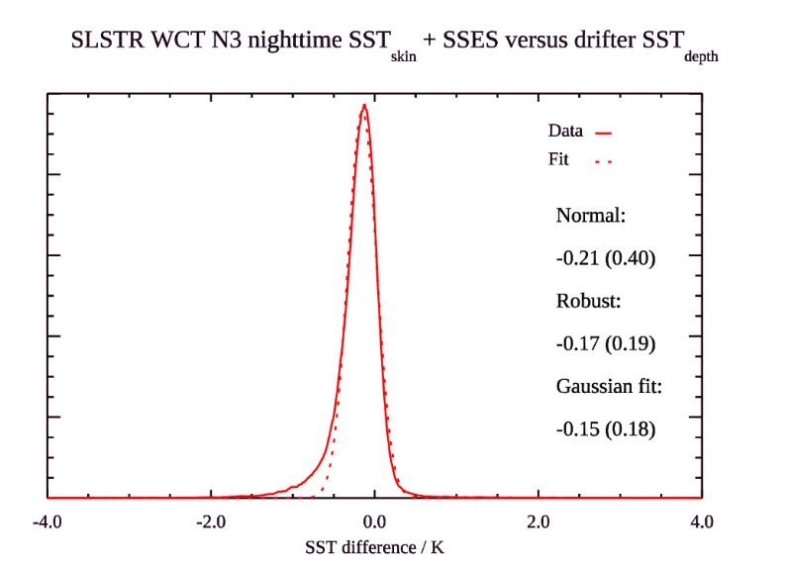

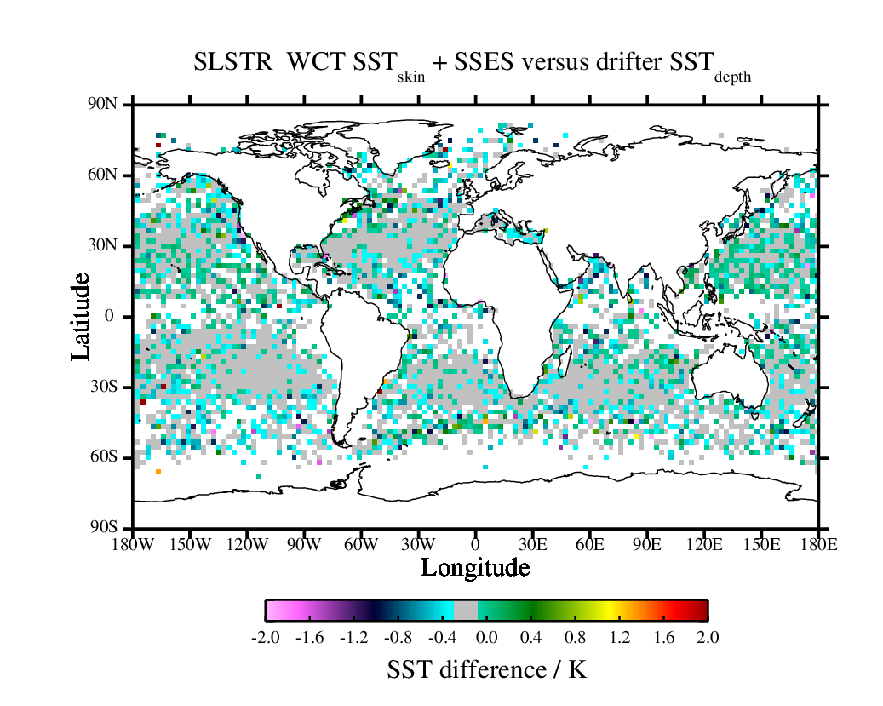
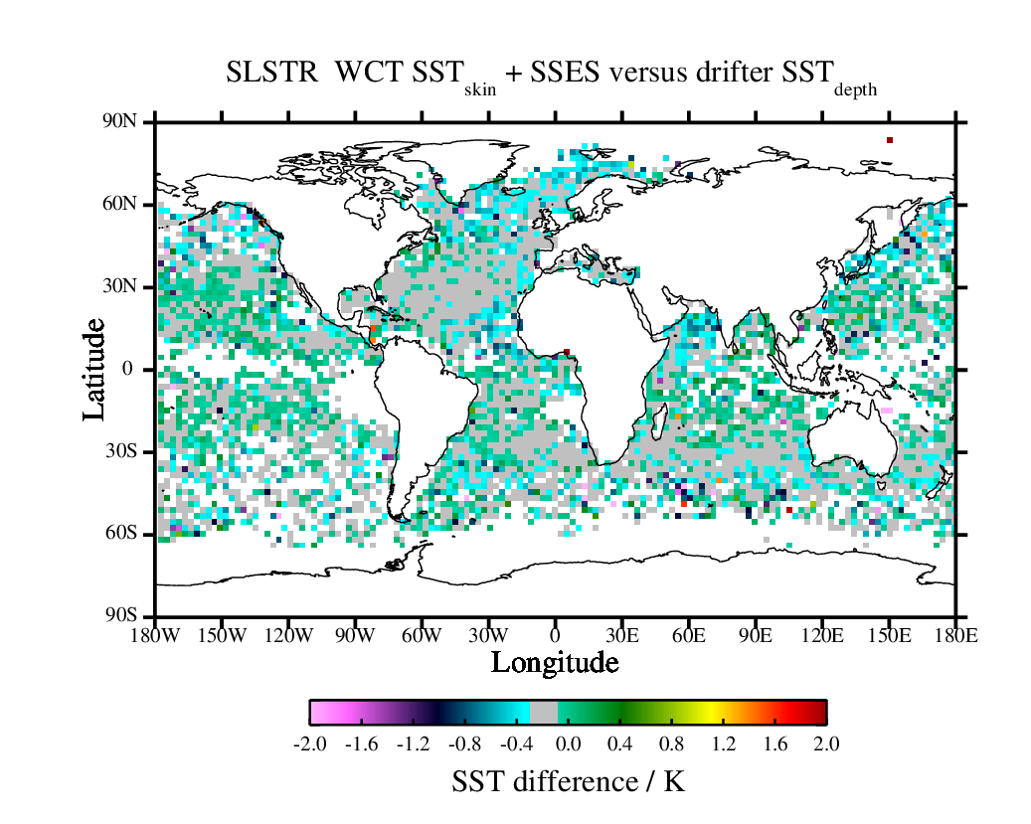
Non-HRSST versus HRSST
Non-HRSST
HRSST
100,203 matches
131,964 matches
Results shown for comparison between drifters and SLSTR-A N3 retrieval only; no adjustments for depth and time differences have been made

Slide 6
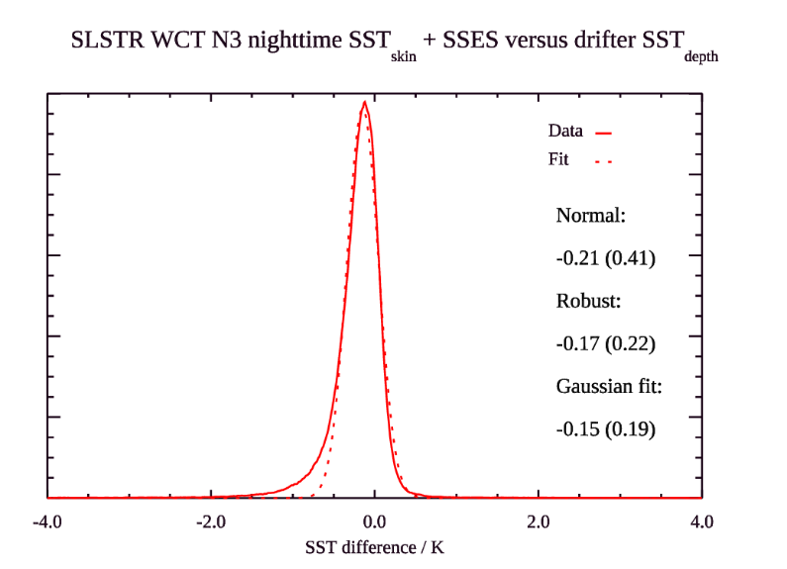

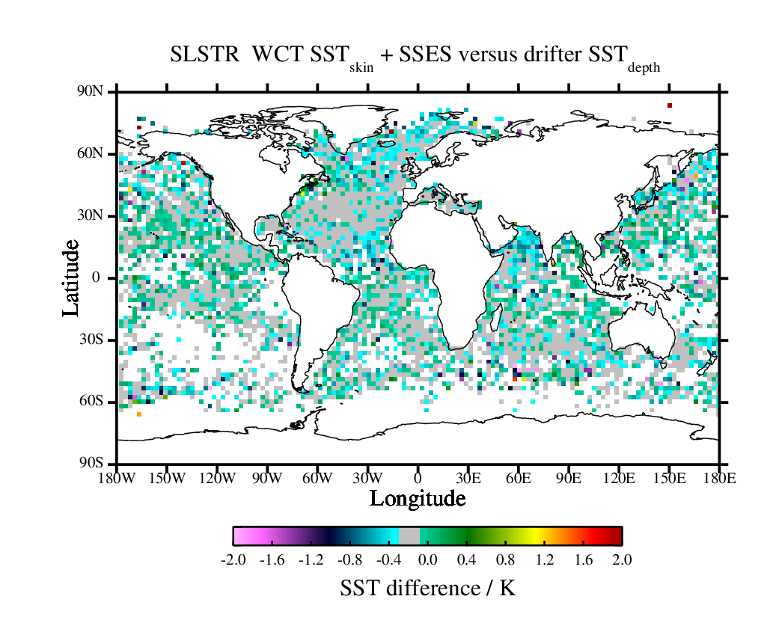
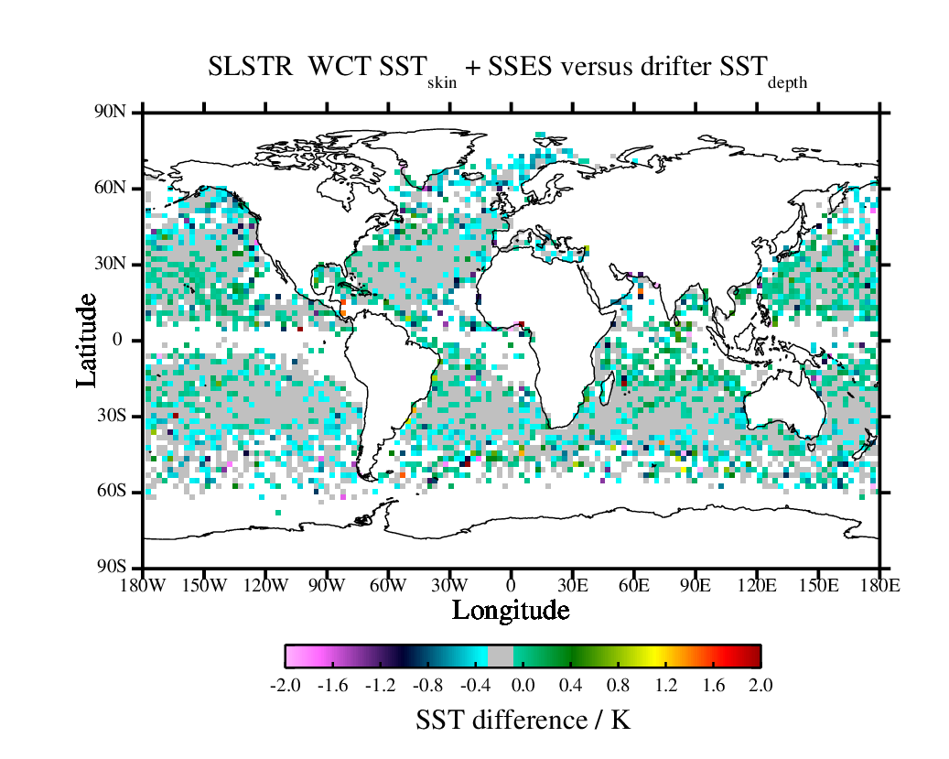
Drogue-on versus drogue-off
Drogue-on
Drogue-off
Drogue-on
Drogue-off
131,964 matches
105,292 matches
87,148 matches
115,490 matches
Results shown for comparison between drifters and SLSTR-A N3 retrieval only; no adjustments for depth and time differences have been made

Slide 7
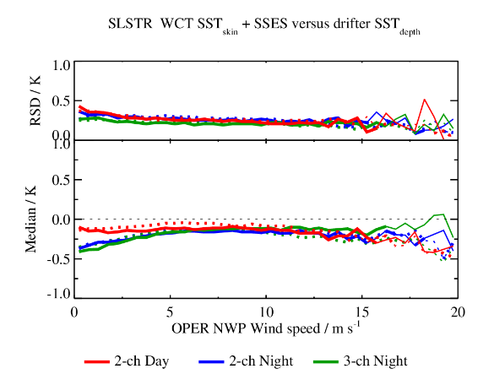
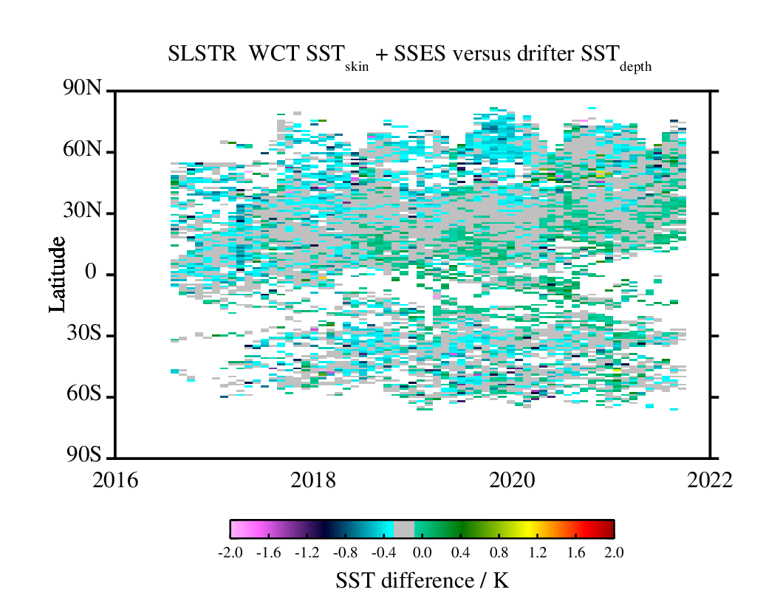
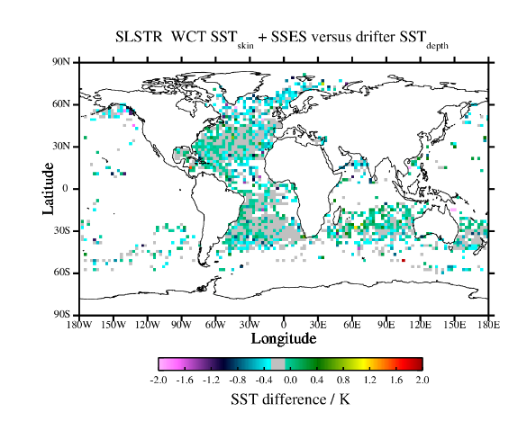
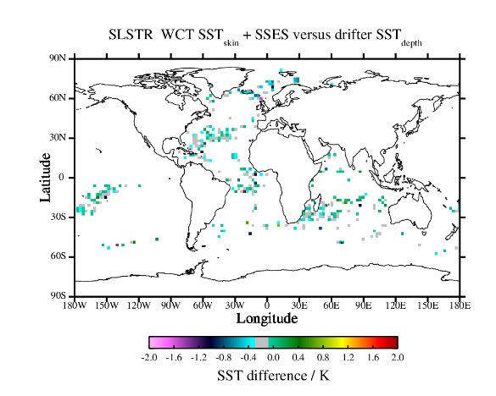
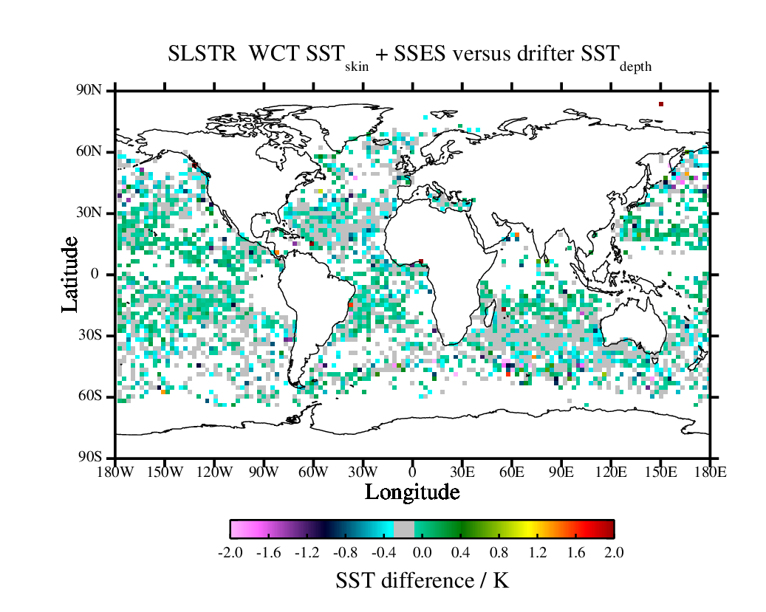
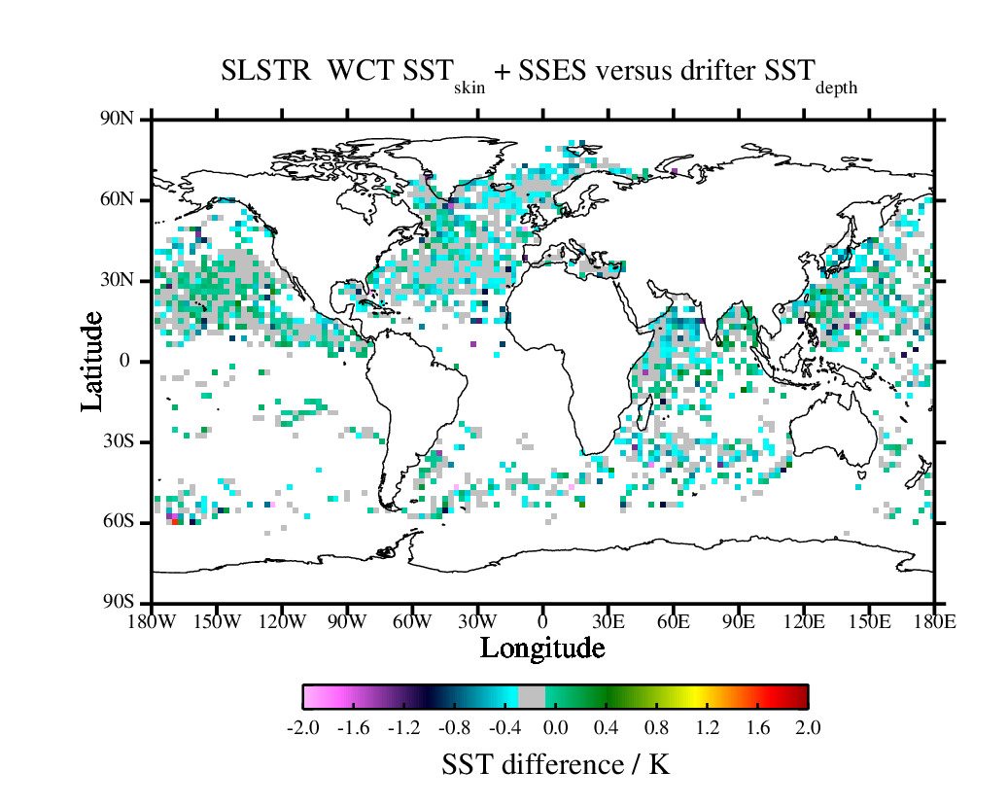
By manufacturer: HRSST
SIO
Manufacturer | Num matches | Median / K | RSD / K
Metocean | 37,466 | -0.14 | 0.22
NKE | 3,653 | -0.14 | 0.21
Pacific Gyre | 48,865 | -0.12 | 0.19
SIO | 41,921 | -0.18 | 0.24
Metocean
NKE
Pacific Gyre
Results shown for comparison between drifters and SLSTR-A N3 retrieval only; no adjustments for depth and time differences have been made

Slide 8
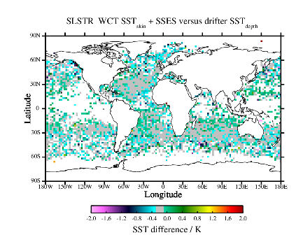
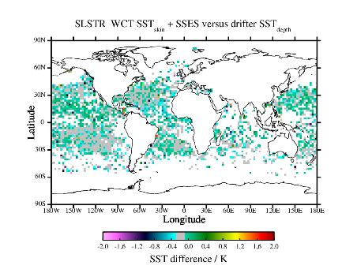
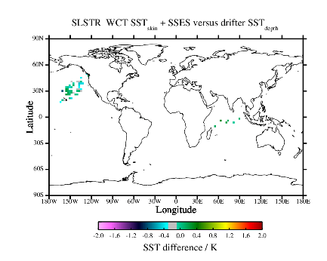
By type
BD2GI
Type | Num matches | Median / K | RSD / K
BD2GHI | 19736 | -0.21 | 0.24
BD2GI | 86765 | -0.16 | 0.21
SVGSHI | 1442 | -0.08 | 0.15
SVP3GI | 52932 | -0.12 | 0.19
SVPGHI | 19964 | -0.17 | 0.22
SVPVHI | 1089 | -0.16 | 0.24
SVP3GI
BD2VHI
Results shown for comparison between drifters and SLSTR-A N3 retrieval only; no adjustments for depth and time differences have been made

Slide 9
Summary
SLSTR-A MDB stratified for HRSST drifters
  Most drifters now HRSST-2 (thanks to GDP and other providers)
  Is current identification scheme optimal?
  Current analysis presented here has some limitations that need to be addressed
Early results also show no difference with and without drogue
SLSTR-A MDB stratified by drifter manufacturer and types
  Preliminary results show good consistency between manufacturers and drifter types
Next steps
  Refine identification of HRSST drifters
  Continuation of ‘self-QC’ work (part of TRUSTED evaluation)
  Add skin/depth and time adjustments
Provision of robust online searchable metadata is important
  Ongoing work to define a minimum set of fields

