Slide 1
REPUBLIC OF KOREA National Report
DBCP – NO.37, 8-11 Nov.2021
Korea Meteorological Administration

Slide 2
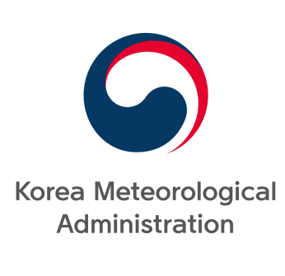

Buoy Operational Institutions
KMA
(Korea Meteorological Administration)
To observe and analyze meteorological phenomena and provides
weather forecasts, warnings, weather data statistics
KHOA
(Korea Hydrographic and Oceanographic Agency)
To conduct hydrographic survey and ocean observation to ensure the safety of navigation, efficient use of sea, etc.

Slide 3
CONTENTS
Ⅰ. Current and Planned BUOY Programmes
Ⅱ. Sensor Duplication Plan

Slide 4
Ⅰ. Current and Planned
BUOY Programmes

Slide 5
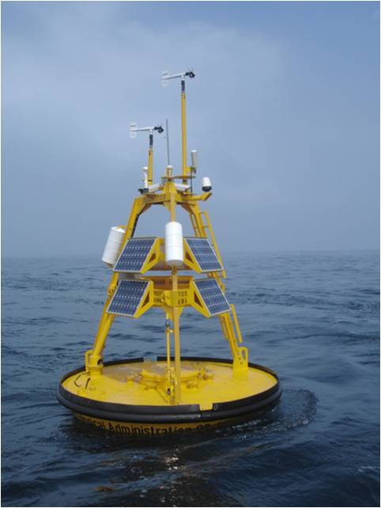
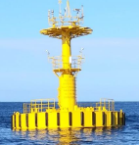
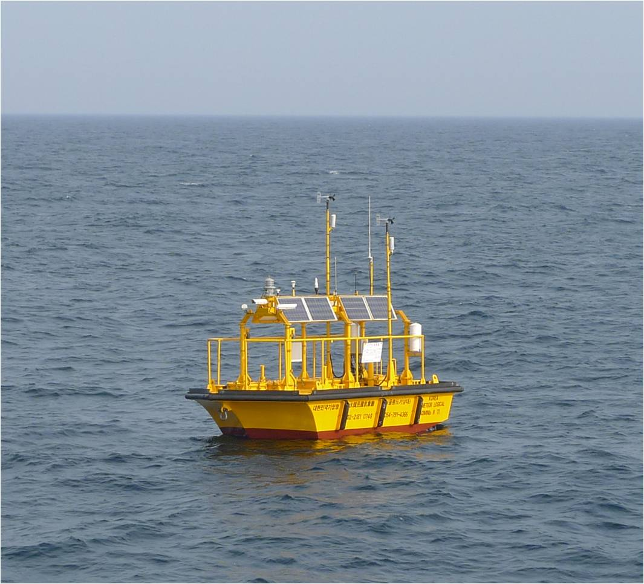
KMA Moored Buoys I
Moored buoys observation network
- Discus & Nomad-
To observe offshore sea and atmosphere conditions
operational as of 31 August 2021
⇒ 24 buoys(17 Discus, 7 Nomad)
reporting on GTS as of 31 August 2021
⇒ 24 buoys
planned for deployment in the next 12 months
⇒ 2 buoys
Discus
Nomad

Slide 6
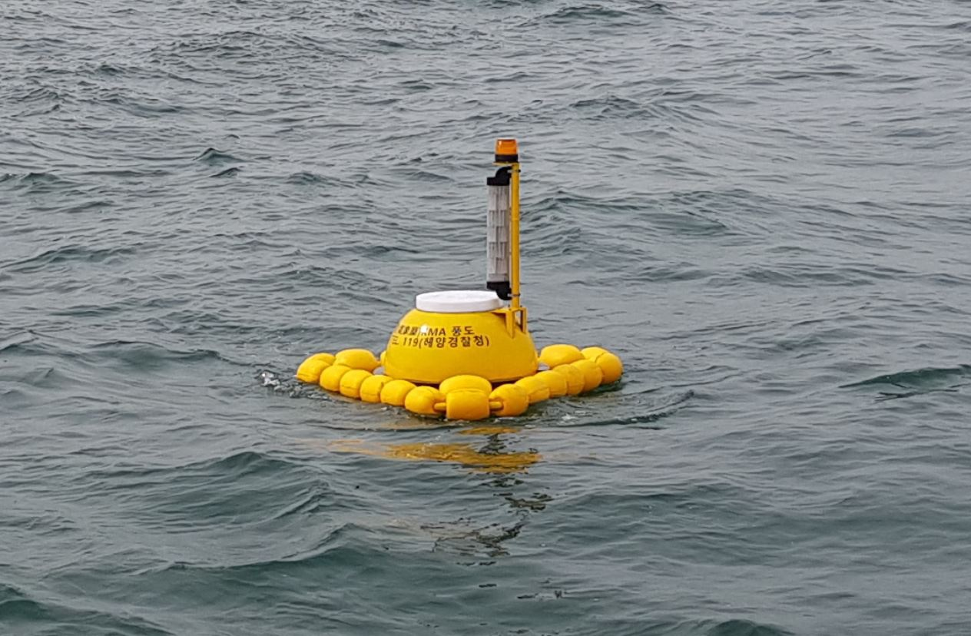
KMA Moored Buoys II
Moored buoys observation network
- 0.7m Coastal Wave Buoys -
0.7m Coastal Wave Buoy
To observe coastal wave conditions
operational as of 31 August 2021
⇒71 buoys

Slide 7
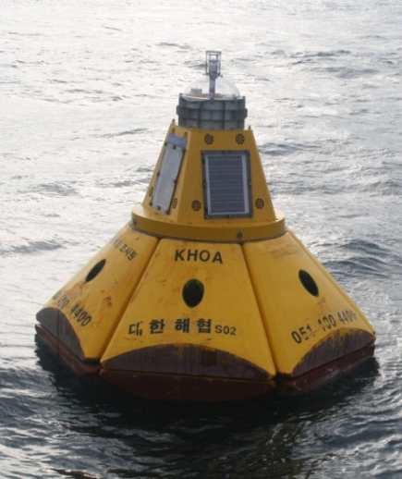
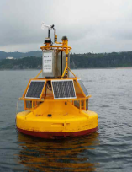
KHOA Moored Buoys I
Moored buoys observation network
Observations of tide, currents, etc.
In operation as of August 31. 2021
⇒ 35 moored buoys
planned for replacement in the next 12 months
⇒ 3 moored buoy
KHOA Ocean Buoy

Slide 8
Ⅱ. Sensor Duplication Plan

Slide 9
1. Necessity
discus buoy |  | Existing buoy(west sea)
Location | Distance from land | Location | Distance from land
westsea1 | 232km | buoy1 | 52km
 |  | buoy2 | 113km
 |  | buoy3 | 70km
westsea2 | 310km | buoy4 | 60km
 |  | buoy5 | 58km
 |  | buoy6 | 23km
average | 271km | average | 62km
Ensured Continuity of Observation Data and protected safety of buoy =>in case of Inmarsat network error, unable collecting data and equipment status monitoring
According to the physical distance of the BUOY, increased repair time and cost =>Located farther than the existing buoy

Slide 10
2. Improvement
Network System Duplication establishment =>(Main Network) Inmarsat satellite network (Sub network) Iridium satellite network
Sensor Duplication establishment => Equipped with the same spare sensor as the original buoy

Slide 11
3. Benefit
Stable data collection and efficient management
Reacting Rapid equipment failure repair

Slide 12
THANK YOU FOR LISTENING!
IF YOU WANT QUESTIONS,
PLZ SEND MY E-MAIL:
kyjin0169@korea.kr

