Slide 1
Task Team on Stewardship
Chair: Karen Grissom
Rapporteur: Long Jiang
DBCP 37
14:00-14:15 UTC Wednesday 10th November 2021

Slide 2
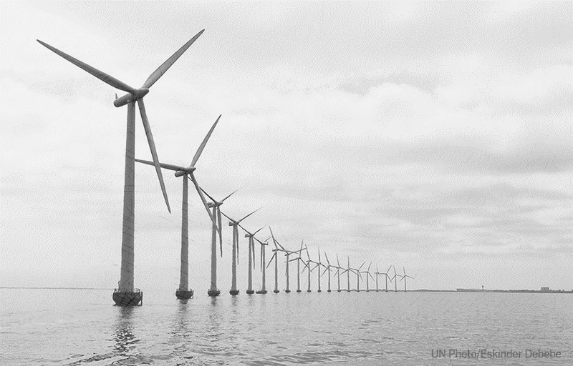
What is Environmental STEWARD?
The responsible use and protection of the natural environment through conservation and sustainable practices to enhance ecosystem resilience and human well-being. It is an action-oriented framework intended to foster sustainability of a rapidly changing planet.
Three strategies of environmental stewardship include:
Reduce the magnitude, exposure and sensitivity to known stresses;
Promote proactive policies of change;
Evade and escape unsustainable social-ecological traps

Slide 3
Five Stewardship Actions
Restore & Protect: recovery/preservation of damaged ecosystem to allow that ecosystem to evolve with minimal human influence (clean up liter, invasive species, establish marine reserve) *
Science stewardship: monitoring data to inform management of the natural resource.*
Community awareness: inform others in an effort to convince them to take action (presentations, social media)*
Civic action: Actions that inform public/organizational policy decisions that improve environmental outcomes for many (voting, engaging with officials)
Everyday lifestyle choices: Personal actions to reduce impact (reduce, reuse, recycle, research)
* Relevant to DBCP members

Slide 4
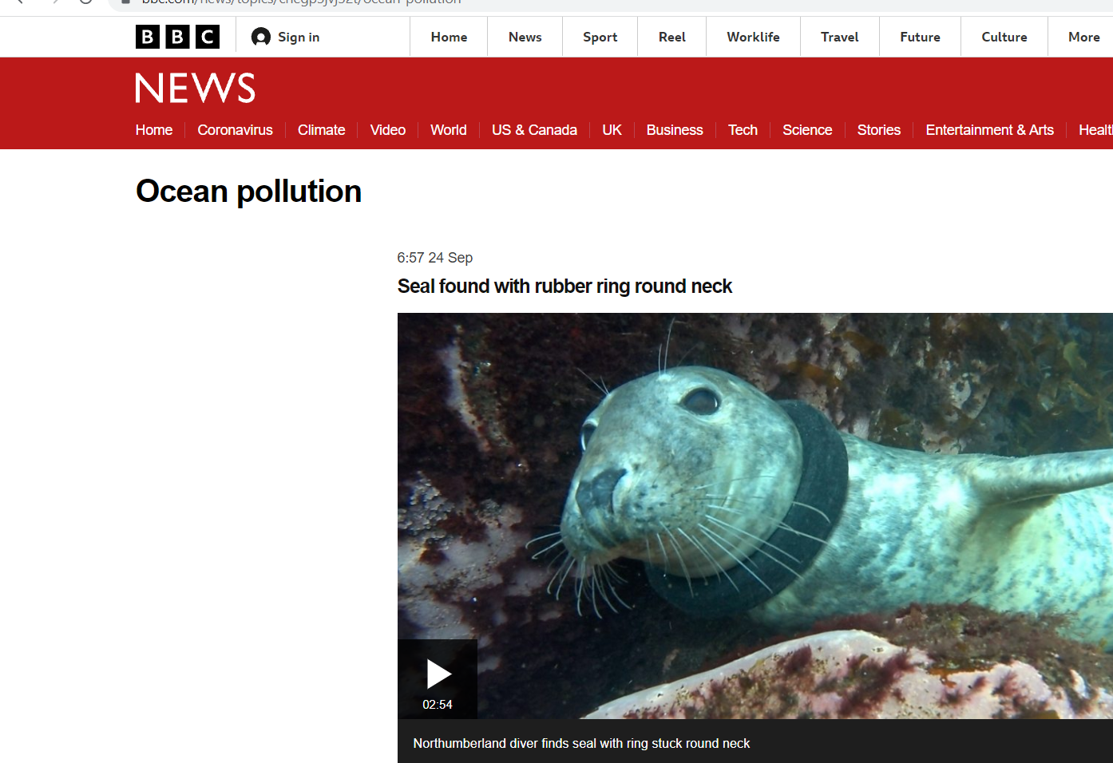
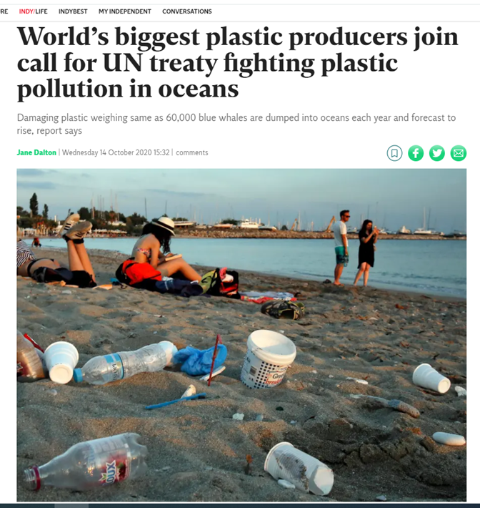
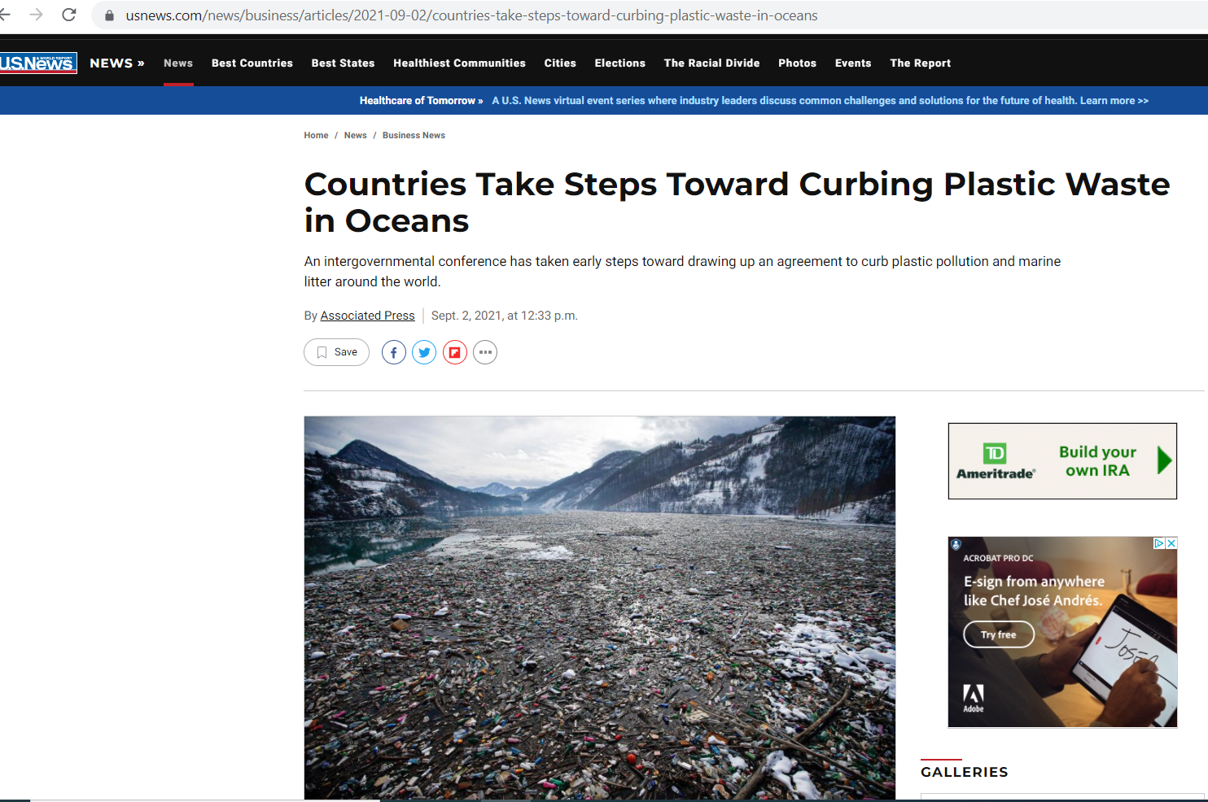
Public Demands: A Call to Action

Slide 5
Environmental Stewardship is here to stay
WMO/INFCOM, GBON: Update of Regulatory Material Related to Establishment of the GBON: mentions ES 6 times
NSF Post Award Requirement and Consideration: “Prior to making an award, NSF considers the anticipated environmental impacts associated with the activities described in the proposal”.
NOAA Administrative Order 216-6A: Compliance with NEPA
UKRI/NERC Responsible Business Statement: One of four priority areas, Environmental Sustainability
NERC: Marine Environment Interaction Policy
European Research Council/ERC: Ethics Self-Assessment includes possible adverse impact to Environment, Health and Safety

Slide 6
DBCP ES Strategy
Promote technologies and practices that reduce the environmental impact of our operations. The specific actions of the DBPC strategy include:
The establishment of a DBCP Task Team focusing on our environmental impacts.
Work with ocean observing network partners to baseline and continually review and minimize our environmental footprint.
Collect feedback from member and report on plans, actions and progress to reduce environmental impact.

Slide 7
Past Year Key Highlights
New TT-ES officially formed
Terms of Reference complete
Current membership: 9
Led OCG Workshop on ES
Webpage created
Held 4 meeting this year (if OCG ES related, we had more)

Slide 8
Task Team Terms of Reference
1.Best Practices: Review, report on and recommend standards, technologies, and best practices of environmental stewardship (ES) in the use of ocean buoys with the goal of reducing the magnitude and exposure of stressors to the environment. Work with DBCP members to develop and maintain sustainable best practices that minimize - impact on the environment through community engagement, as applicable, with buoy and instrument users, manufacturers, WMO, IOC, and GOOS. Support members in establishing best practices to assist clearance process for responsible buoy operations.
2.Baseline: Work with members of the DBCP and ocean observing community to complete a self-assessment of environmental footprint and potential environmental risk to establish a baseline of environmental impacts and develop possible solutions for improvements based on best knowledge and capacity of the DBCP. Encourage and support members in undertaking regular reviews against baseline assessments, and as needed.
3.Foci: Act as the focal point for DBCP environmental stewardship matters and keep a repository of available national and international resources (e.g., UNCLOS Law of the Sea, UNEP, MARPOL, MSR, etc.).
4.Liaise: Coordinate with TT-CB and WG-Vandalism, mainstreaming ES issues for education and capacity development activities. Liaise with WMO, IOC and GOOS (including the Observations Coordination Group) for guidance and regulatory materials on environmental impact assessment, marine scientific research, and best practices.
5.Feedback: Seek input from DBCP members regarding existing national policy or programs that promote environmental stewardship and would facilitate a self-assessment of environmental impact (baseline). Work with members to identify and address obstacles prohibiting adoption of best practices, and knowledge gaps.
6.Report: Inform DBCP Executive Board of recommendations to address items above and report on progress of actions to Executive Board and at annual sessions of the DBCP. Propose to the DBCP and its Executive Board any evaluation activities and pilot projects that it deems beneficial to drifting buoy operators.
7. TT-ES chair is a member of the DBCP-EXB. TT-ES chair is elected by the TT-ES and in principle serve 2 years with the possibility to extend to 4 years in that capacity.

Slide 9
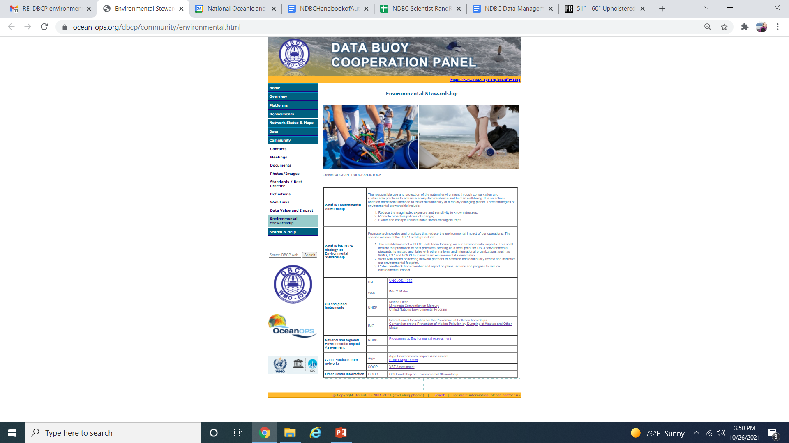
https://www.ocean-ops.org/dbcp/community/environmental.html
What is ES
ES Role in DBCP
Regulatory & Policy Information
Examples
Best Practices

Slide 10
Common concerns/challenges
Concern/Challenge
Solution/Approach
Resources
Information
Public perception of lack of transparency
Compliance to support operations: deployments and infrastructure
How to reduce impact?
???
Best Practices
Communicate Findings
Self-assessment of impact
Mitigate invasive species transport, recoverable technology, work with manufacturer to influence development

Slide 11
Some Questions to Ask Yourself
Does your nation or program have an established policy that promotes the enhancement or protection of the environment?
Has your program or observing system undertaken an environmental assessment to determine if a proposed action will have an impact on the environment?
What are some best practices that DBCP members can adopt to help minimize our impact on the environment?

Slide 12
Looking Forward
Build membership within DBCP (+)
Develop task(s) and deliverables for next year
Begin to baseline environmental impact of DBCP operations
Connection with GOOS, WMO, and IOC on ES
Improvements to environmental footprint recognized beyond DBCP​
Thank you,
Questions?

