Slide 1
DBCP National Report
DBCP – 37, VIRTUAL, 8-11 November 2021
Joel Cabrie
Manager Marine Networks
Bureau of Meteorology

Slide 2
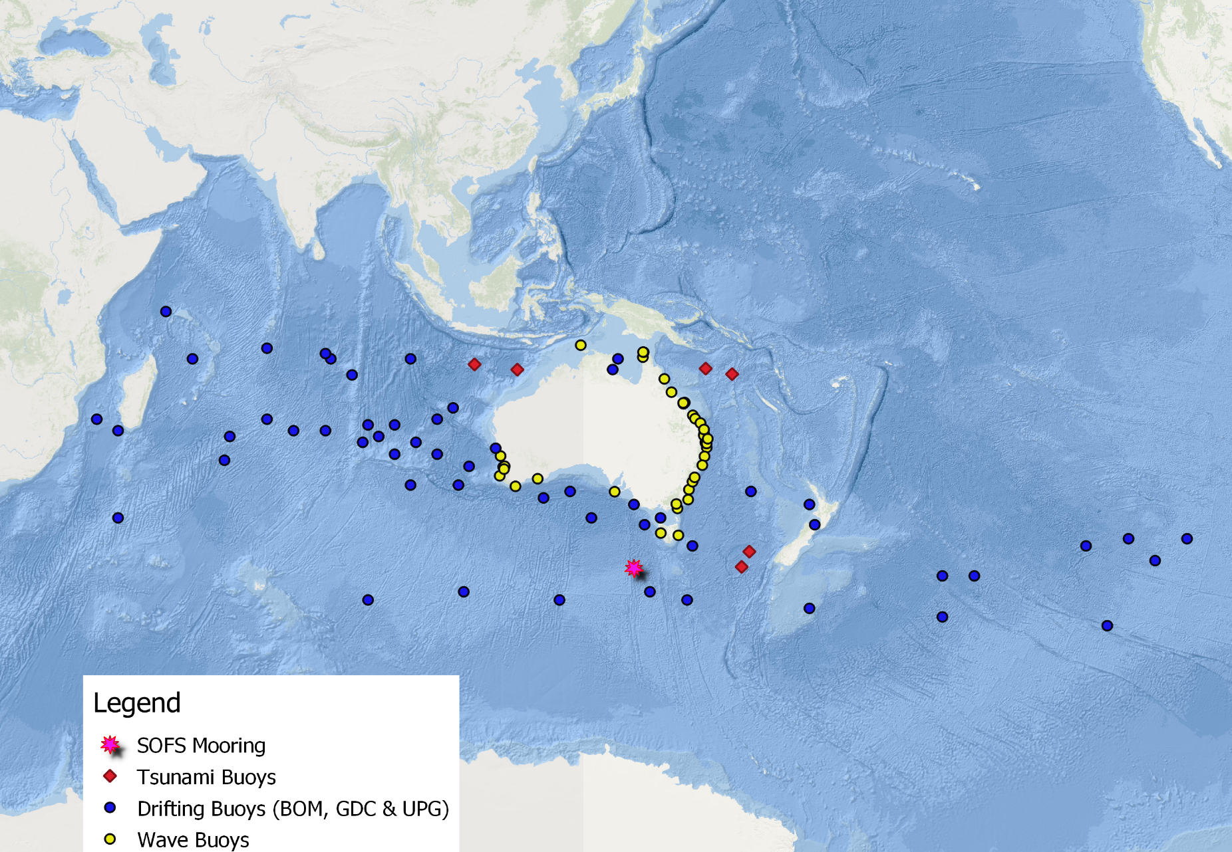
Australian Buoy Network
Indian Ocean 1 DART buoy to be relocated due to repeated vandalism incidents.
6 Tsunami buoys
41 Wave buoys
60 Drifting buoys
1 SOFS Mooring
Note: Some buoys owned and operated by external parties
Notes:
Drifting buoys (operational): 30 x BOM, 27 x GDC, 3 x Upgrades. Main areas of responsibility are Indian and Southern Oceans.
Wave Buoys (operational): 2 x BOM, 2 x co-invest with IMOS, 37 x 3rd party providers. 2 additional buoys deployed by 3rd party providers in 2021.
DART buoys (operational): 6 x buoys, deployed in pairs for redundancy
SOFS mooring (research): 1 x buoy as co-investment with IMOS
Vandalism: Indian Ocean 1 DART buoy to be relocated SE of Christmas Island (within EEZ) due to repeated vandalism incidents.

Slide 3
Planned Programme(s)
Drifting Buoys:
  40 x SVP-B deployments (BOM/GDC/Upgrades)
  8 x SVP-B deployments by Lisa Blair during circumnavigation of Antarctica (2 in each ocean basin)
Wave Buoys:
  Annual maintenance of 4 x BOM operated buoys
Tsunami Buoys:
  3 maintenance trips planned for next 12 months, pending COVID travel restrictions.
Moored Buoy:
  Minimet buoy to be moored in the Gulf of Carpentaria

Slide 4
Technical Developments
Limited success with mooring of SVP-B buoys in the Gulf of Carpentaria.
Mooring failures after 6-8 months
Improved mooring design to be applied with the deployment of a Scripps Minimet buoy at the beginning of next trawling season (May/June 2022)

Slide 5
Publications & User Impact
Data from the national wave buoy network (41 buoys) now being used for forecast verification.
All wave and SOFS mooring data made available on the Australian Ocean Data Network (AODN) database for research purposes.

Slide 6
Additional Comments
QC
  Research-funded project underway to standardize national wave buoy practices, including QC, metadata collection and data formats
Buoy Lifetimes (Mean / Max.)
  Metocean = 0.96 years / 5.21 years
  PacificGyre = 0.85 years / 2.56 years
  DBi = 0.62 years / 2.75 years

Slide 7
Thank you!
Joel Cabrie
Joel.cabrie@bom.gov.au

