Slide 1
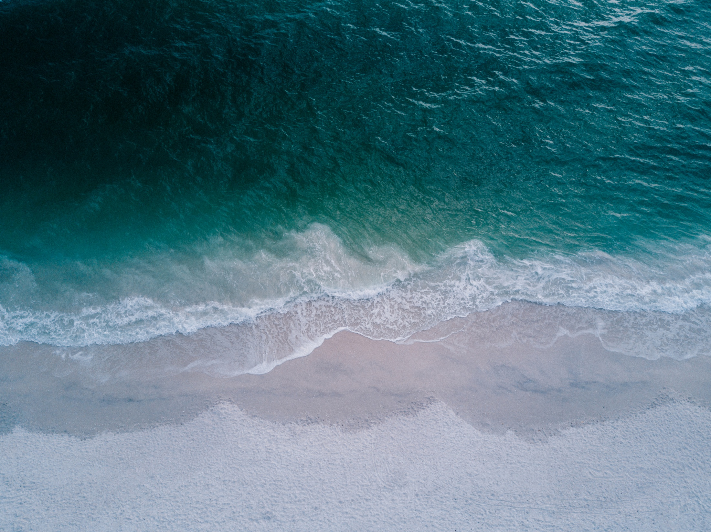
Deep FuXing
—— Deep Argo Designed by TJU & QNLM
Dr. Jiayi Xu
Tianjin University
Email: xjy0125@tju.edu.cn
Notes:
1
1

Slide 2

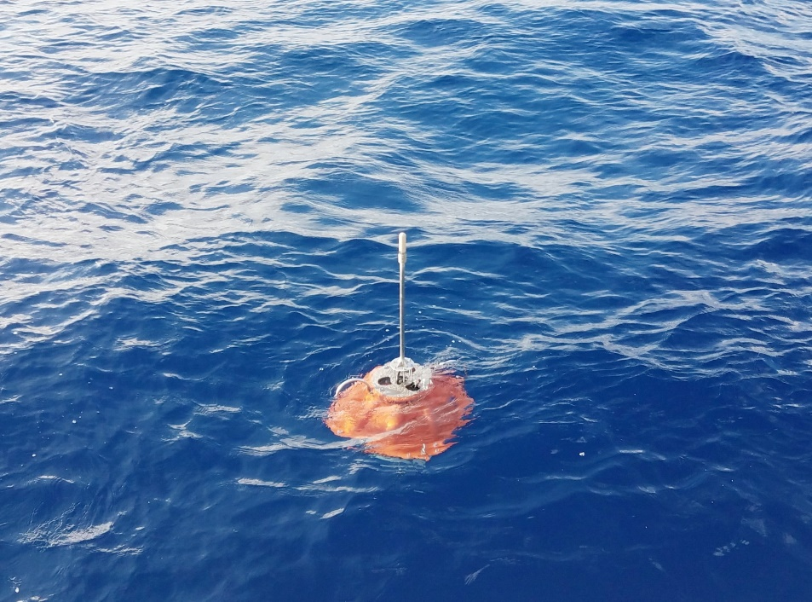
Introduction
Deep FuXing
Deep FuXing, which is a deep Argo over 4000 meters depth, is designed by Tianjin University and Pilot National Laboratory for Marine Science and Technology (Qingdao). The first prototype of Deep FuXing was deployed in 2018 with the pressure measurement.
Deployment of Deep FuXing in August 2018 at South China Sea

Slide 3
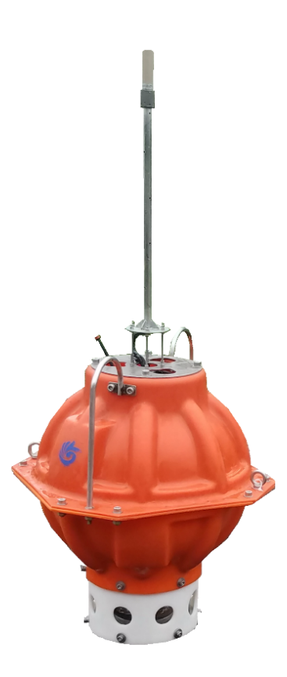
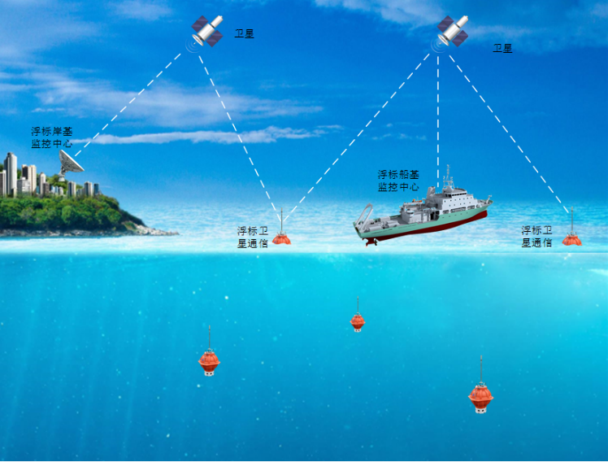
Introduction
Deep FuXing
Deep FuXing float Characteristics
Deep FuXing float Development
Deep FuXing float Measurement
Summary and Outlook

Slide 4
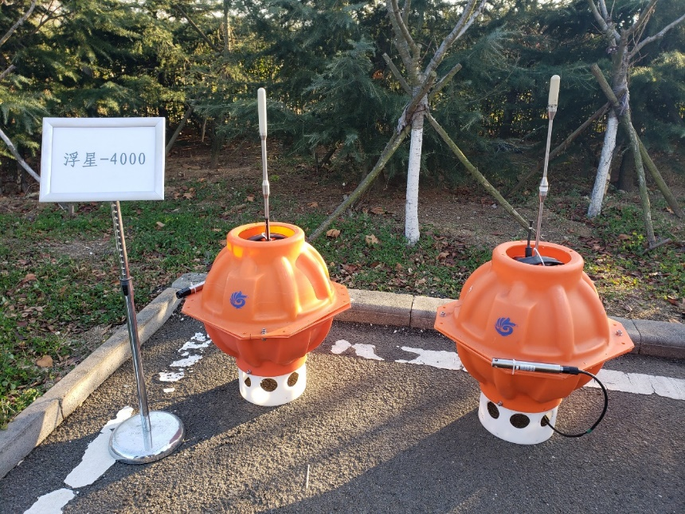
Characteristics
Deep FuXing
Target depth: 4000 meters
Dive cycles: 100 (ten-day cycle)
Mass: smaller than 58 kg
Carrying capacity: over 8 kg
Telemetry: Beidou or Iridium
Using an air bag to raise the antenna for the better communication.
The power consumption is reduced to 1mW in the sleep state.

Slide 5
Development
Deep FuXing
Offshore test in South China Sea
3500 meters test in South China Sea
4000 meters test in Western Pacific
2018.01
2018.07
2019.08
2018.02
2019.03
1500 meters test in South China Sea
Extreme environmental test in Western Pacific

Slide 6
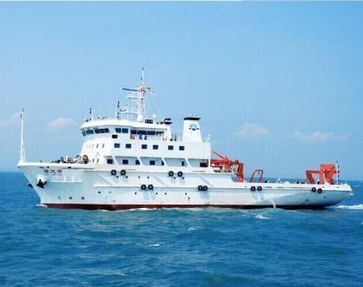
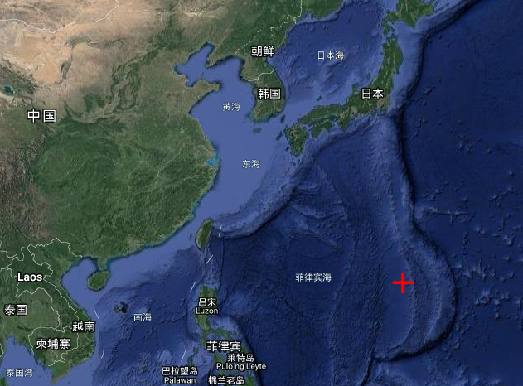
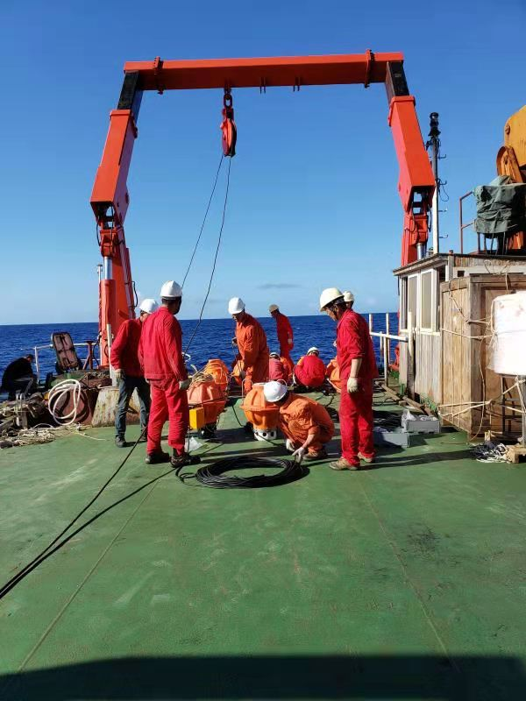
Development
Extreme environmental test in Western Pacific
ID: Deep FuXing – 5
Sensor: Pressure sensor
Depths: 4080m to 4180m
Position:Western Pacific (N19.005897, E142.002541)

Slide 7
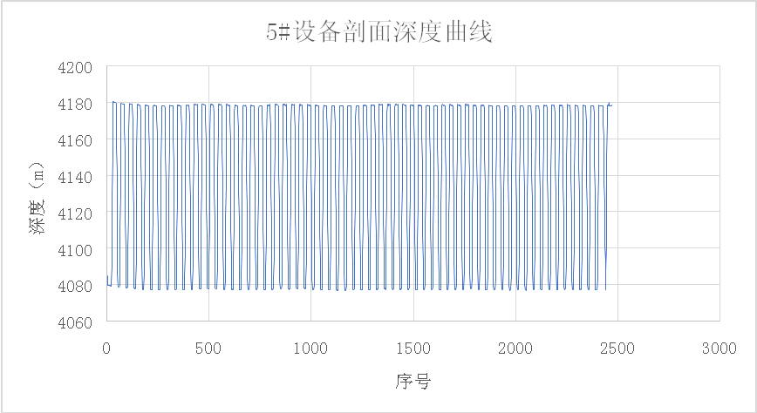
Development
Extreme environmental test in Western Pacific
110 cycles has been operated
Verified characteristics under the extreme condition

Slide 8
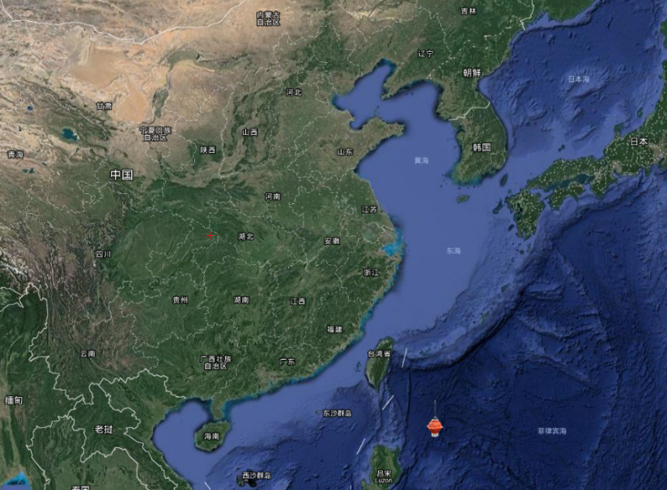
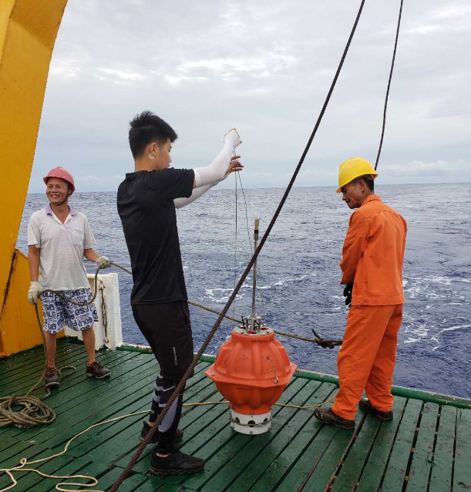
Development
4000 meters test in Western Pacific
ID: Deep FuXing – 6
Sensor: CTD sensor from NOTC
Depths: 4082.9m
Position:Western Pacific (N19.003888, E124.648790)

Slide 9
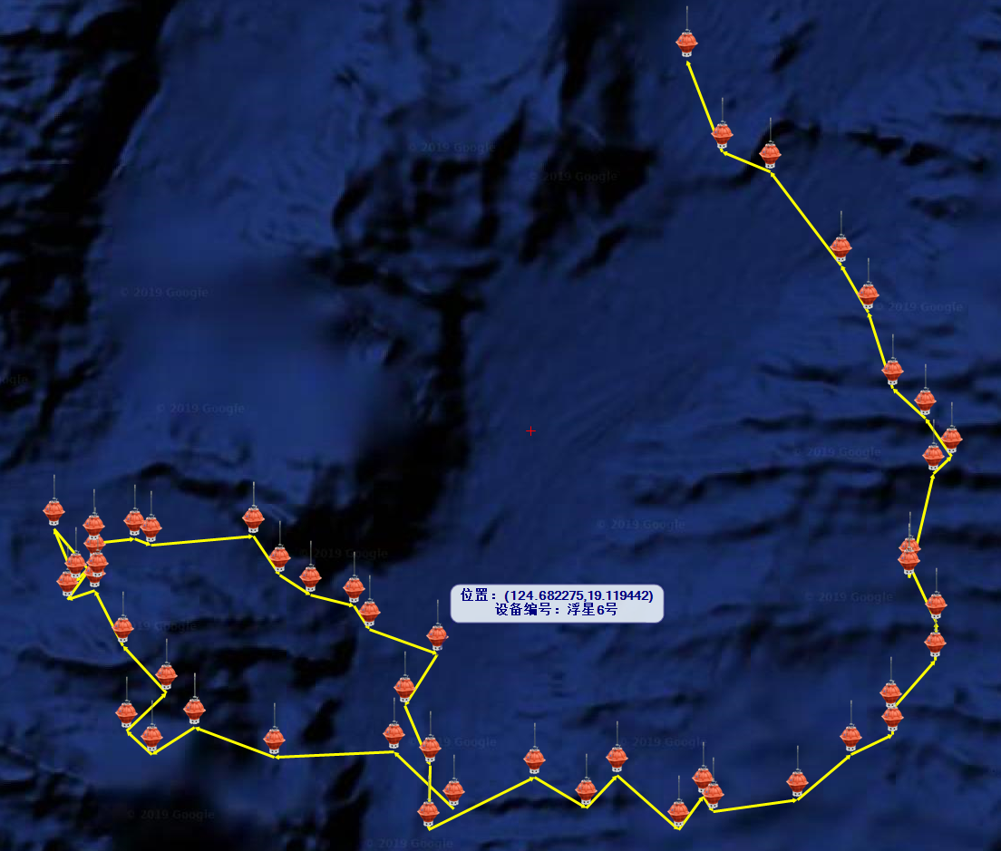
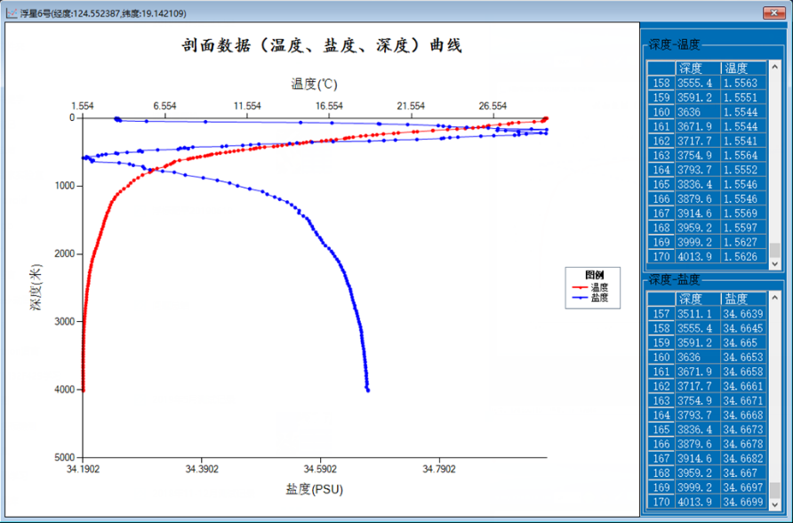
Measurement
4000 meters test in Western Pacific
48 cycles over 4000 meters has been operated
Temperature and salinity are measured
Satellite transmission success rate reaches 98%

Slide 10
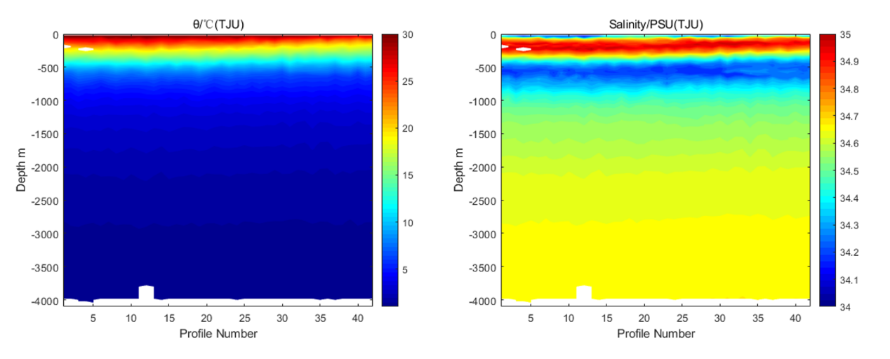
Measurement
4000 meters test in Western Pacific
Plotted the temperature and salinity heat map
The data of 48 profiles aren’t drifting obviously
The data vary greatly in the mixed layer
The data have a good consistency in the deep sea isothermal layer

Slide 11
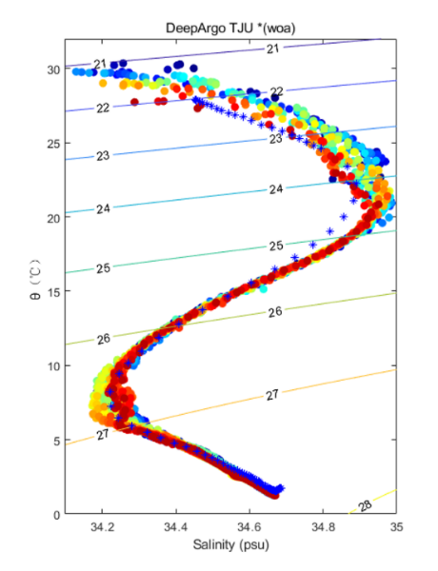
Measurement
4000 meters test in Western Pacific
The temperature is basically consistent with WOA2018, and the salinity is within 0.01PSU compared with WOA2018. The data quality is good and meets the observation requirements of the international Argo plan, which verifies the performance of the buoy in real sea conditions.

Slide 12
Summary and Outlook
Deep FuXing
Deep FuXing, which carried the CTD sensor from NOTC, has been deployed in the Western Pacific. 48 cycles over 4000 meters has been operated and the data of temperature and salinity are good.
Deep Argo is one of the important part for deep sea survey, We will continue to optimize Deep FuXing and look forward to entry into the Argo program.
A 6000 meters Deep FuXing has been assembled last quarter, and it will be deployed at the end of this year.

Slide 13
Thanks for listening!
Deep FuXing —— Deep Argo Designed by TJU & QNLM
Dr. Jiayi Xu
Tianjin University
Email: xjy0125@tju.edu.cn
Notes:
13
13

