Slide 1
9th September report
From PAKISTAN
By
AMEER HYDER

Slide 2
Welcome speech
I have introduced basic seismicity of Makran coast and give brief historical earthquake events.
Then give short brief introduction of time line and warning chain.
3 brief them regarding SOP
How we issue Buellton

Slide 3
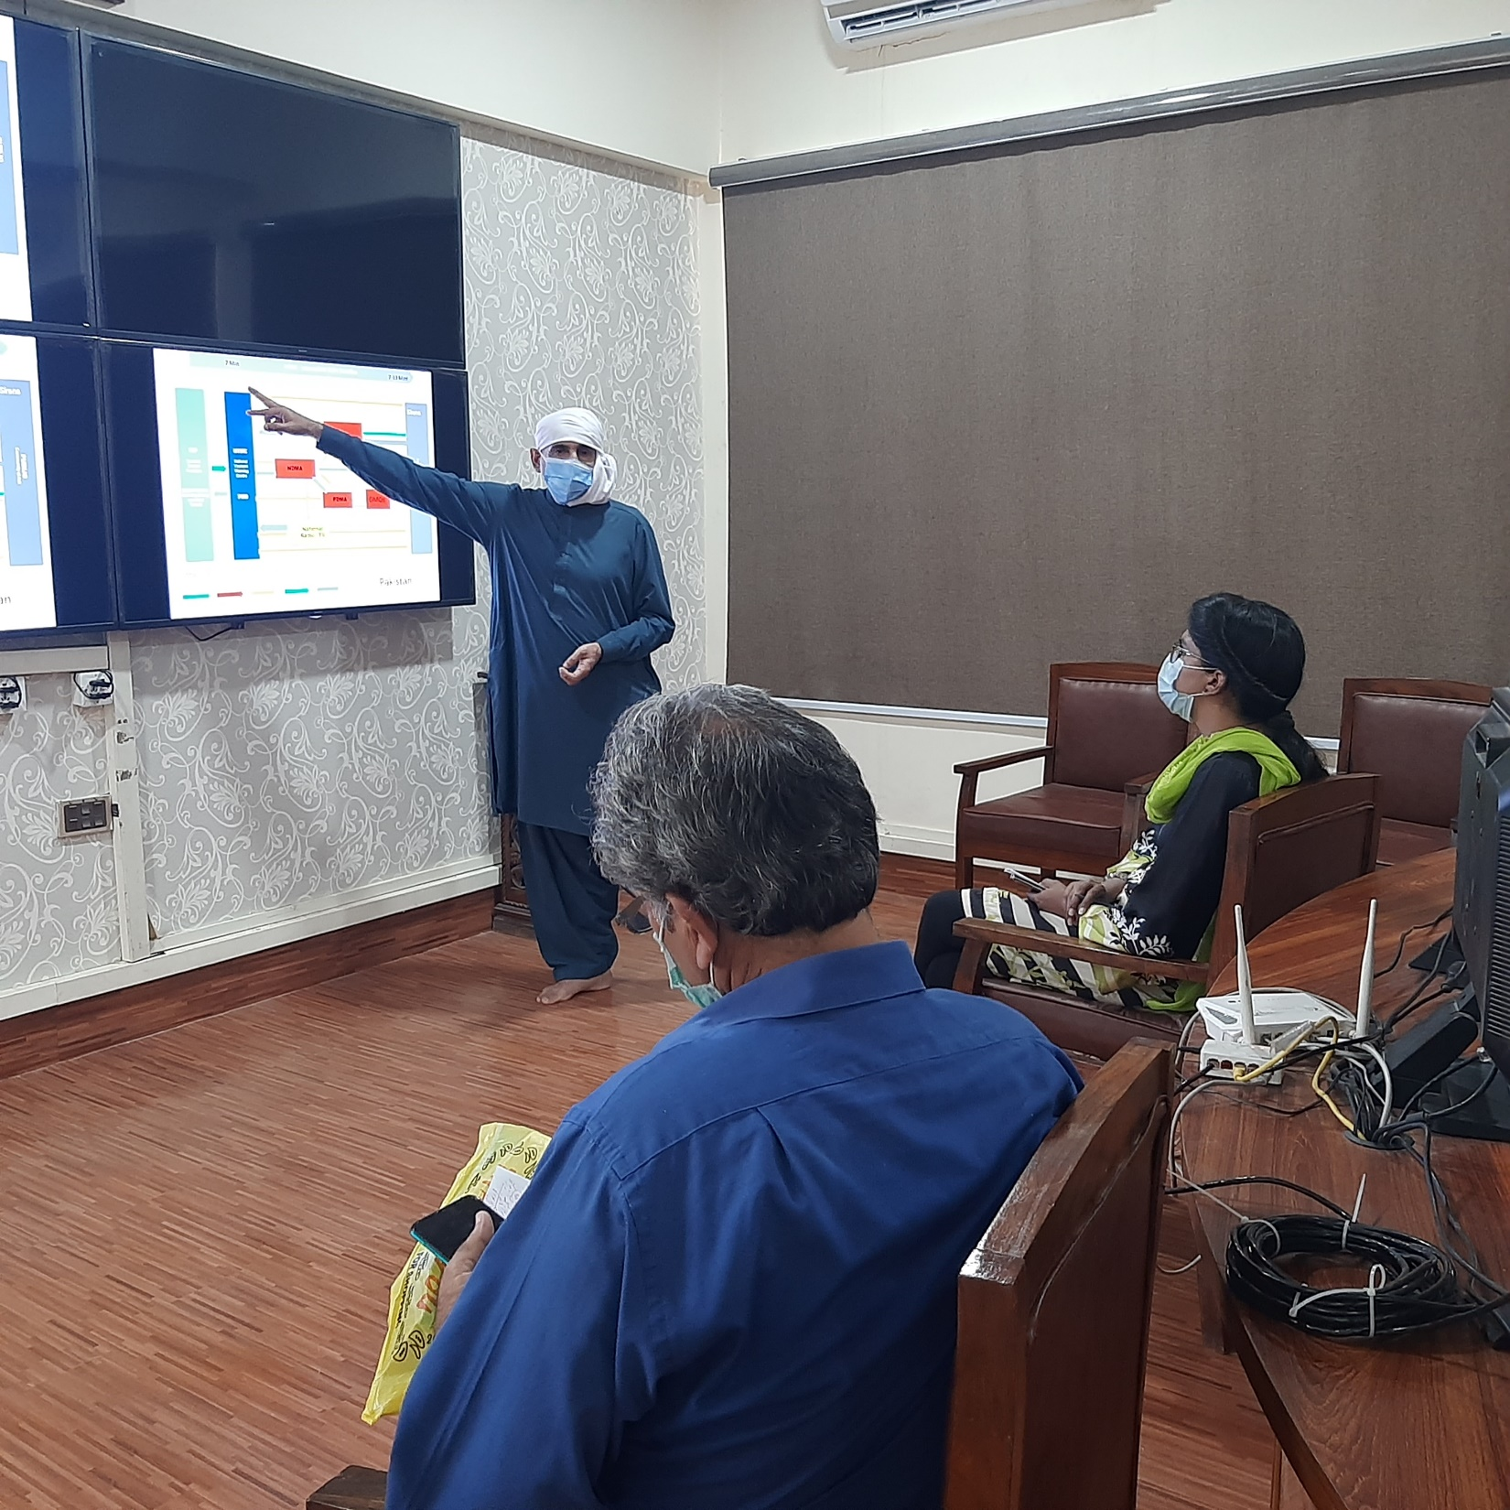

Slide 4
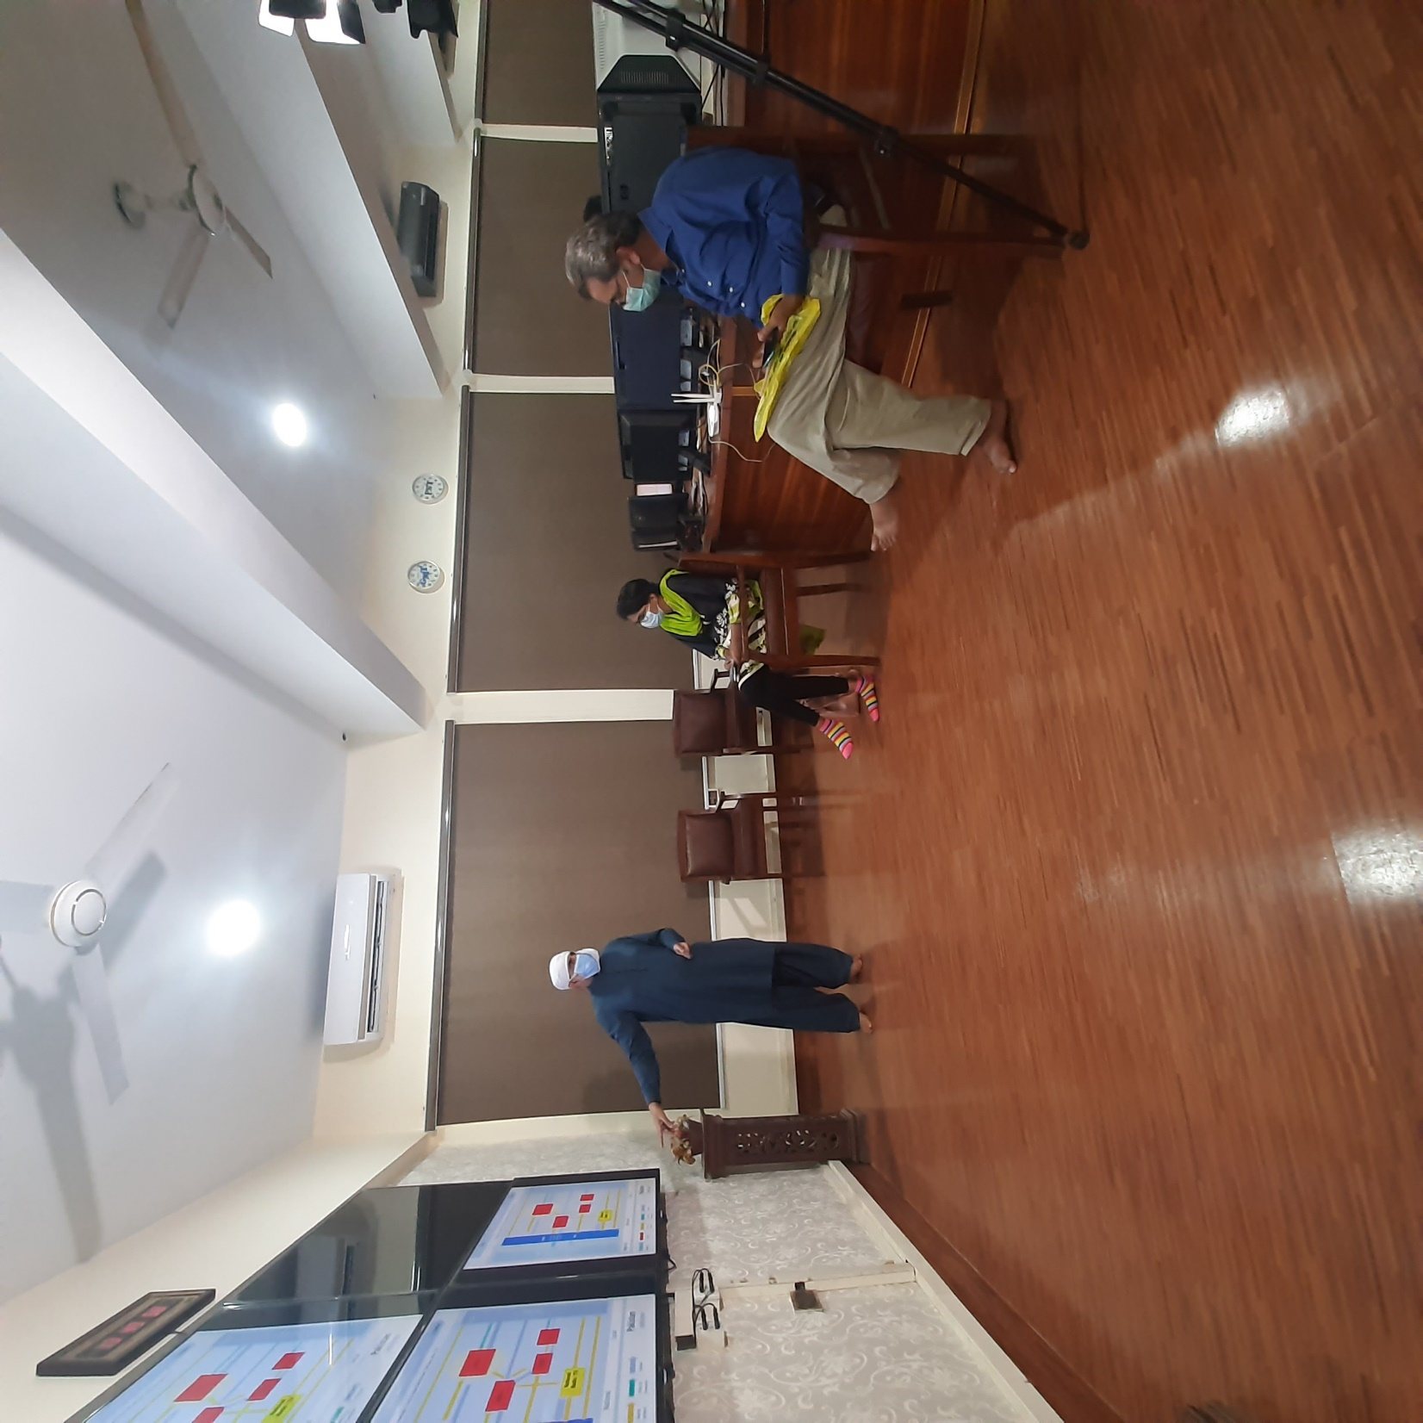
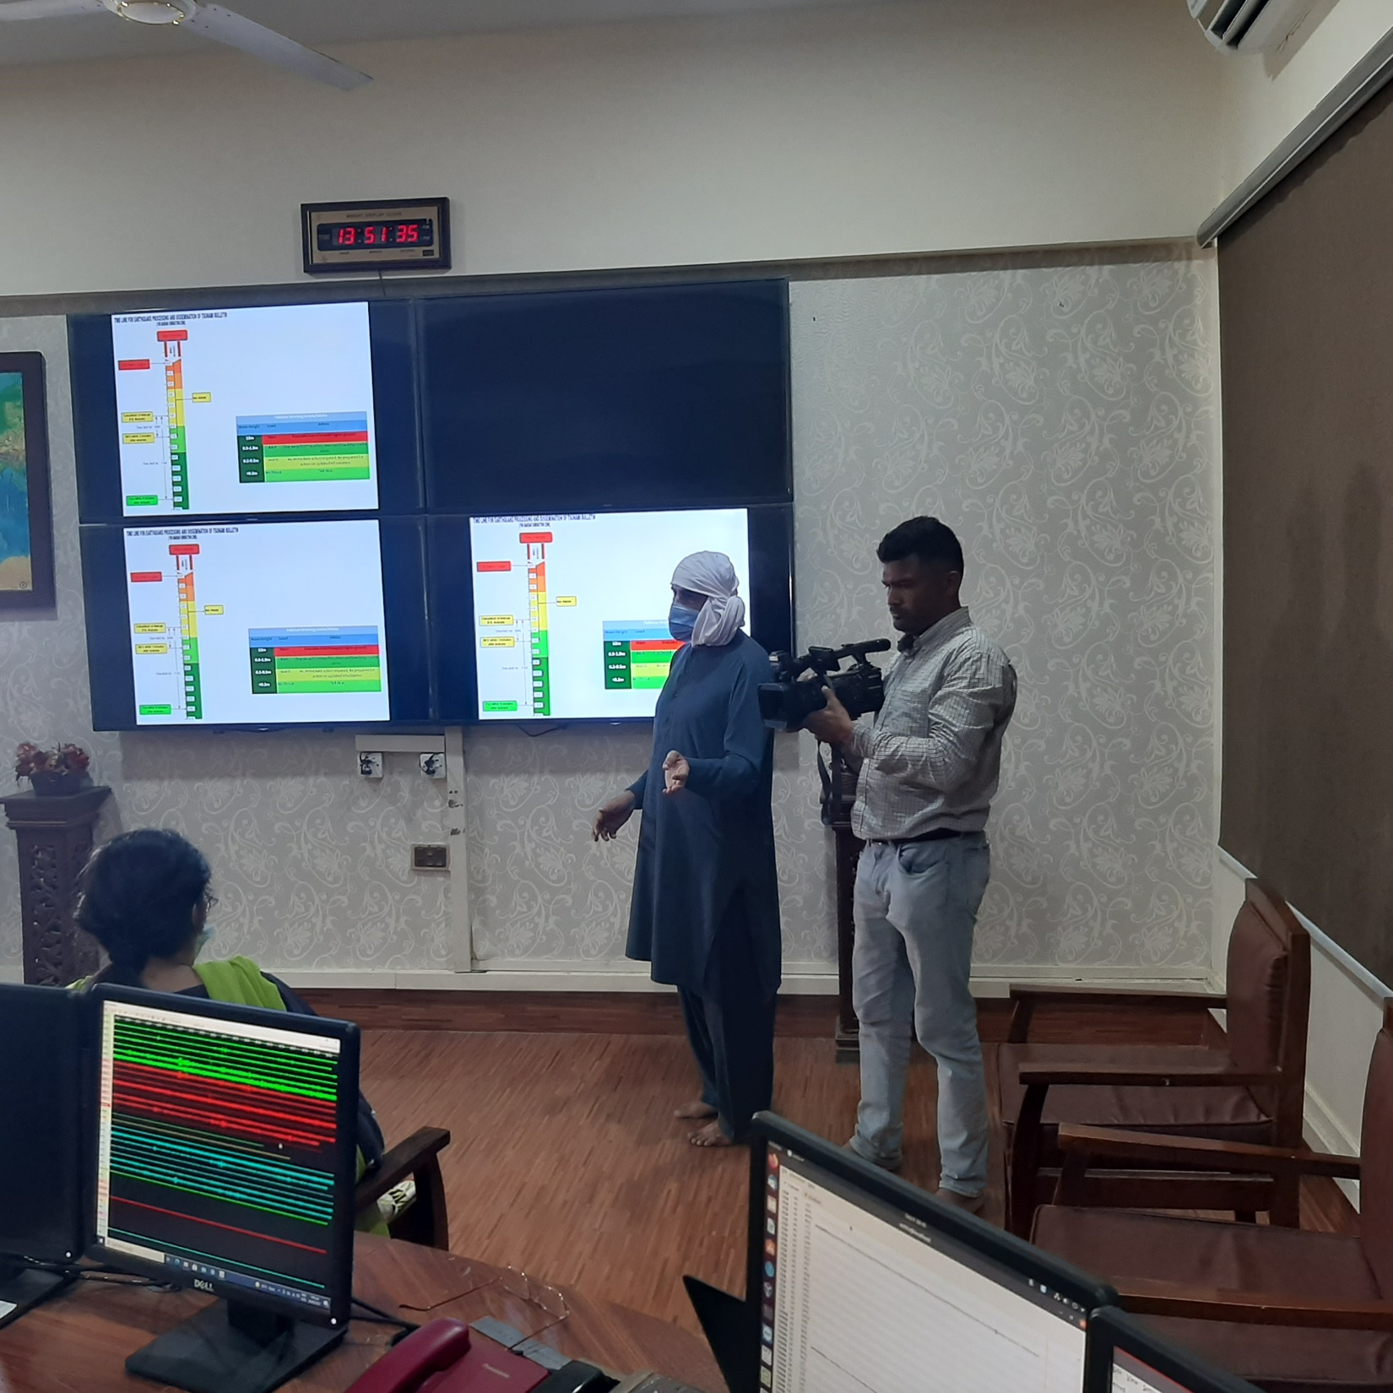

Slide 5
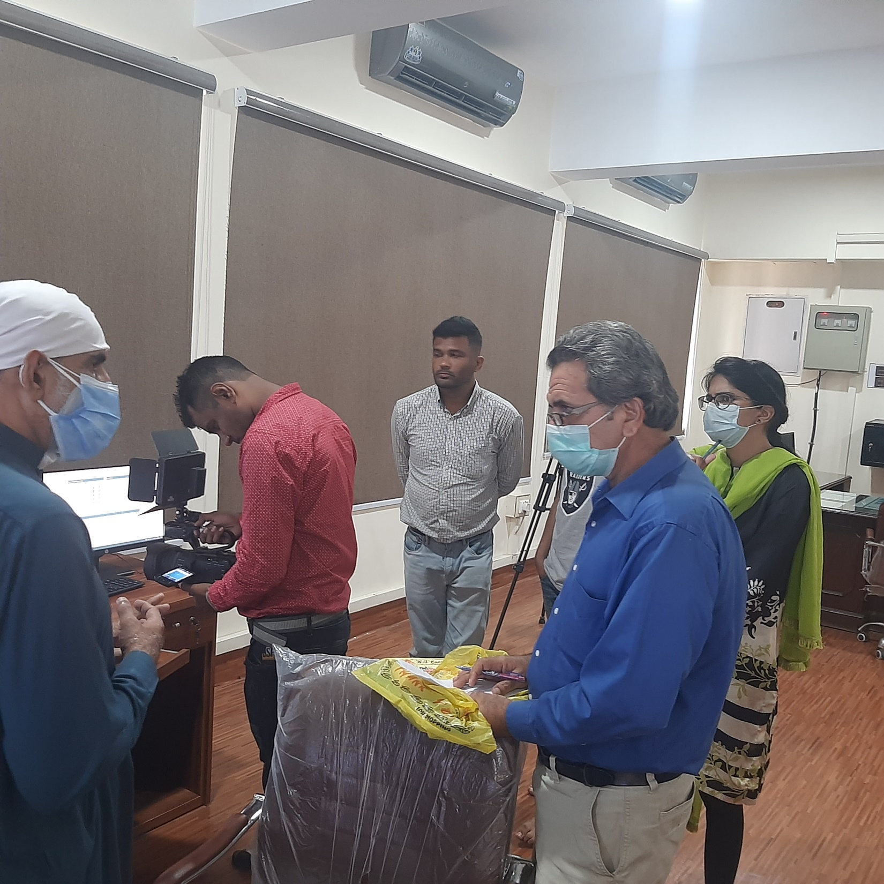

Slide 6
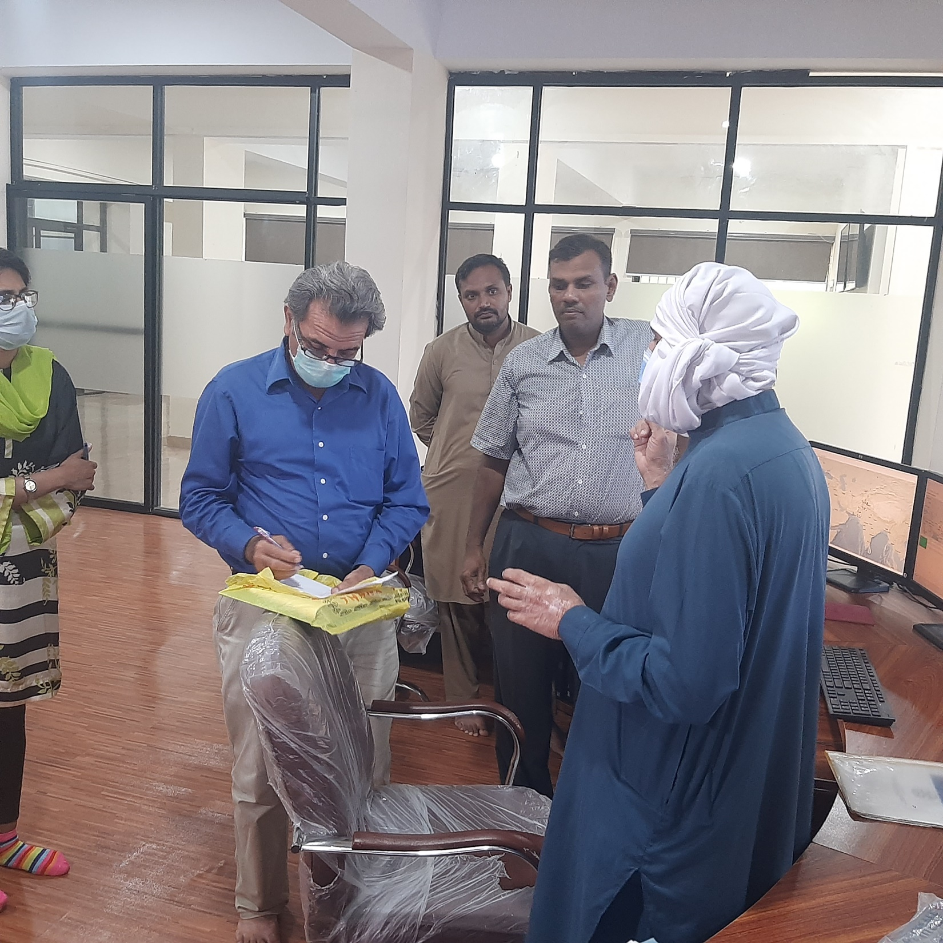

Slide 7
