Slide 1
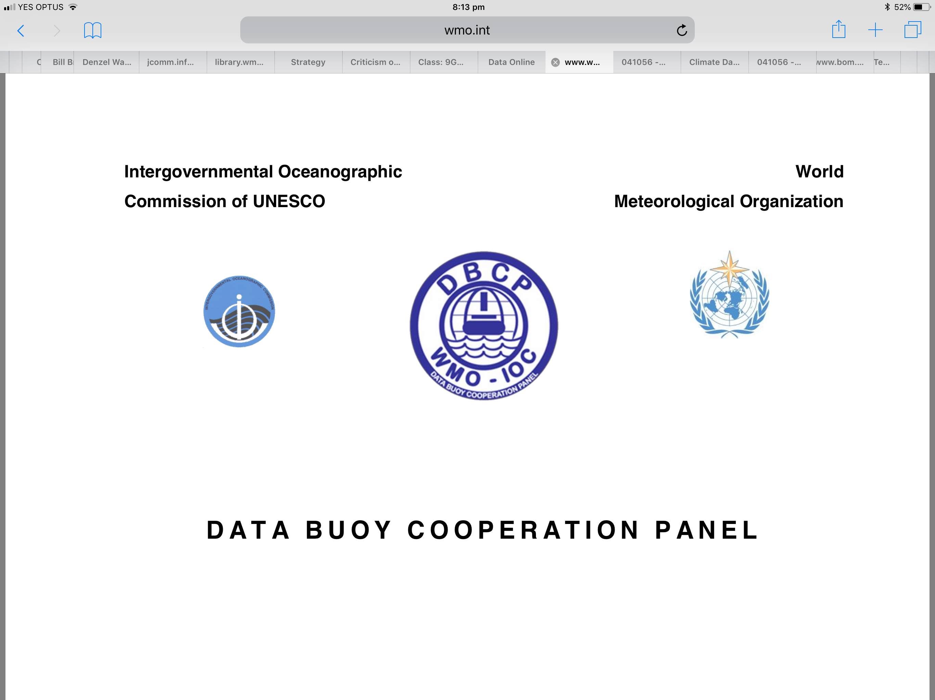
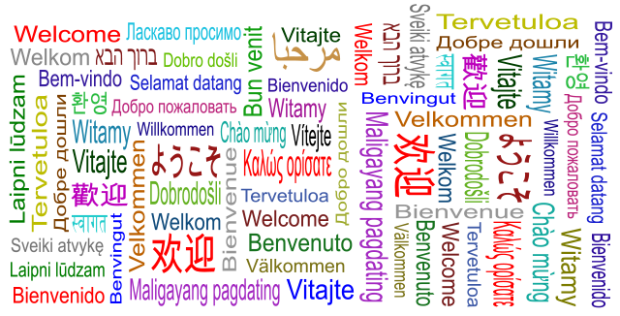
Welcome to DBCP 36
Boris Kelly-Gerreyn
Chair, DBCP
Live From Across the World
5-9 October 2020

Slide 2

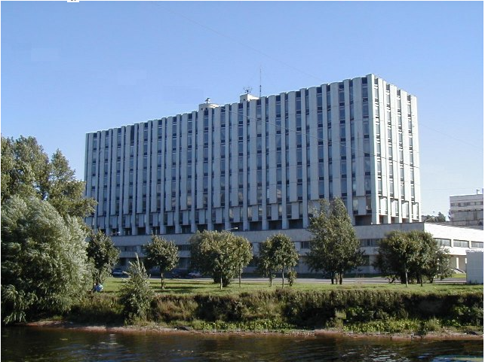
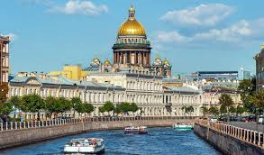
DBCP-36 – Our original destination!
State Scientific Centre of the Russian Federation
The Arctic and Antarctic Research Institute
Thank you for offering to host DBCP-36
Igor A. Shumakov (PR of the Russian Federation)
Vasily Smolyanitsky
Ashik Igor
In beautiful St Petersburg…

Slide 3
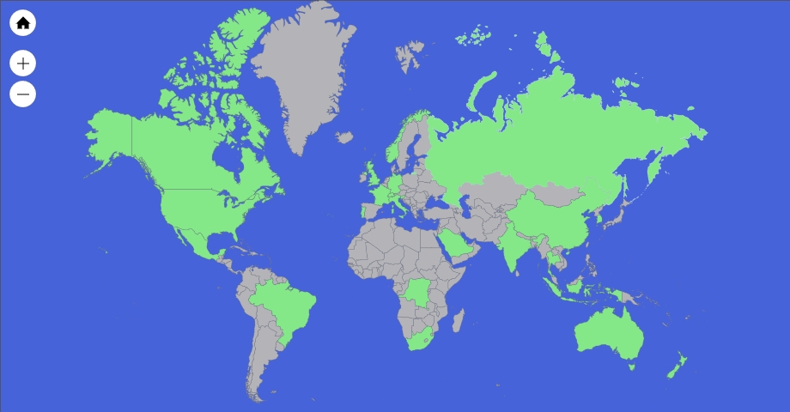

Participation at DBCP 36 is amazing!
22 countries
39 countries
DBCP 35
DBCP 36
143
Across all continents
62
39
22

Slide 4
Participation by WMO Member at DBCP 36

Slide 5
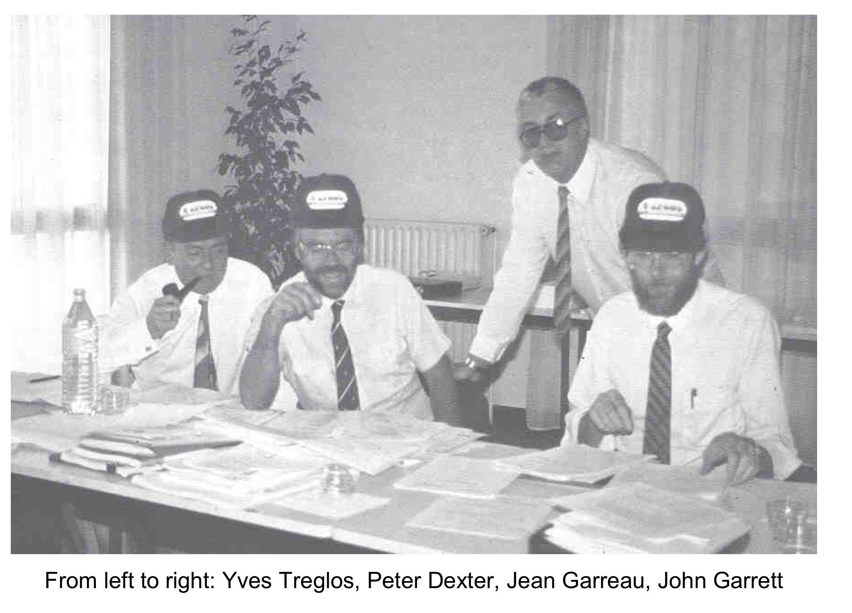
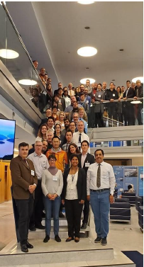
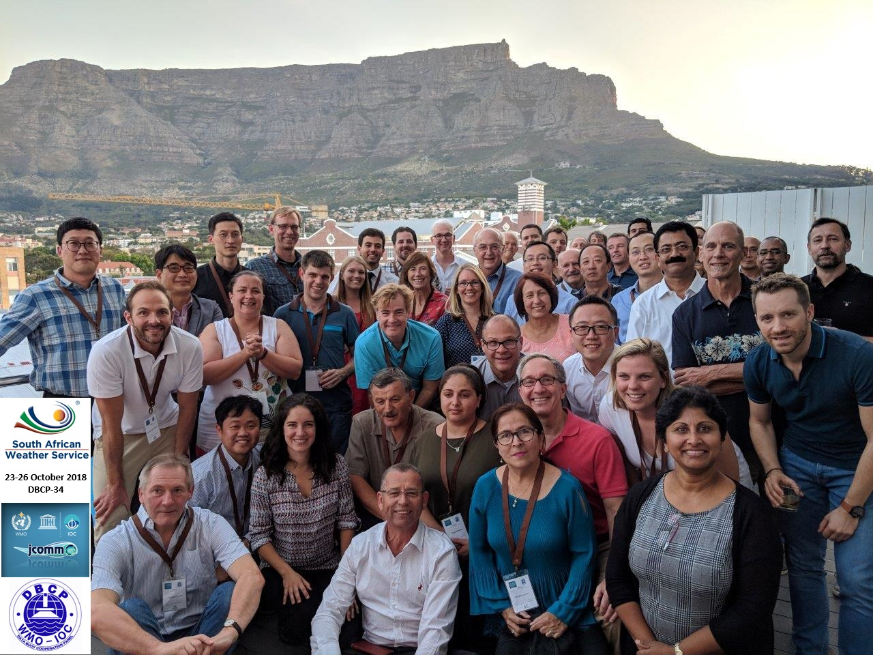
Our Evolution
DBCP-35
DBCP-1
DBCP-34
1985
2018
2019

Slide 6
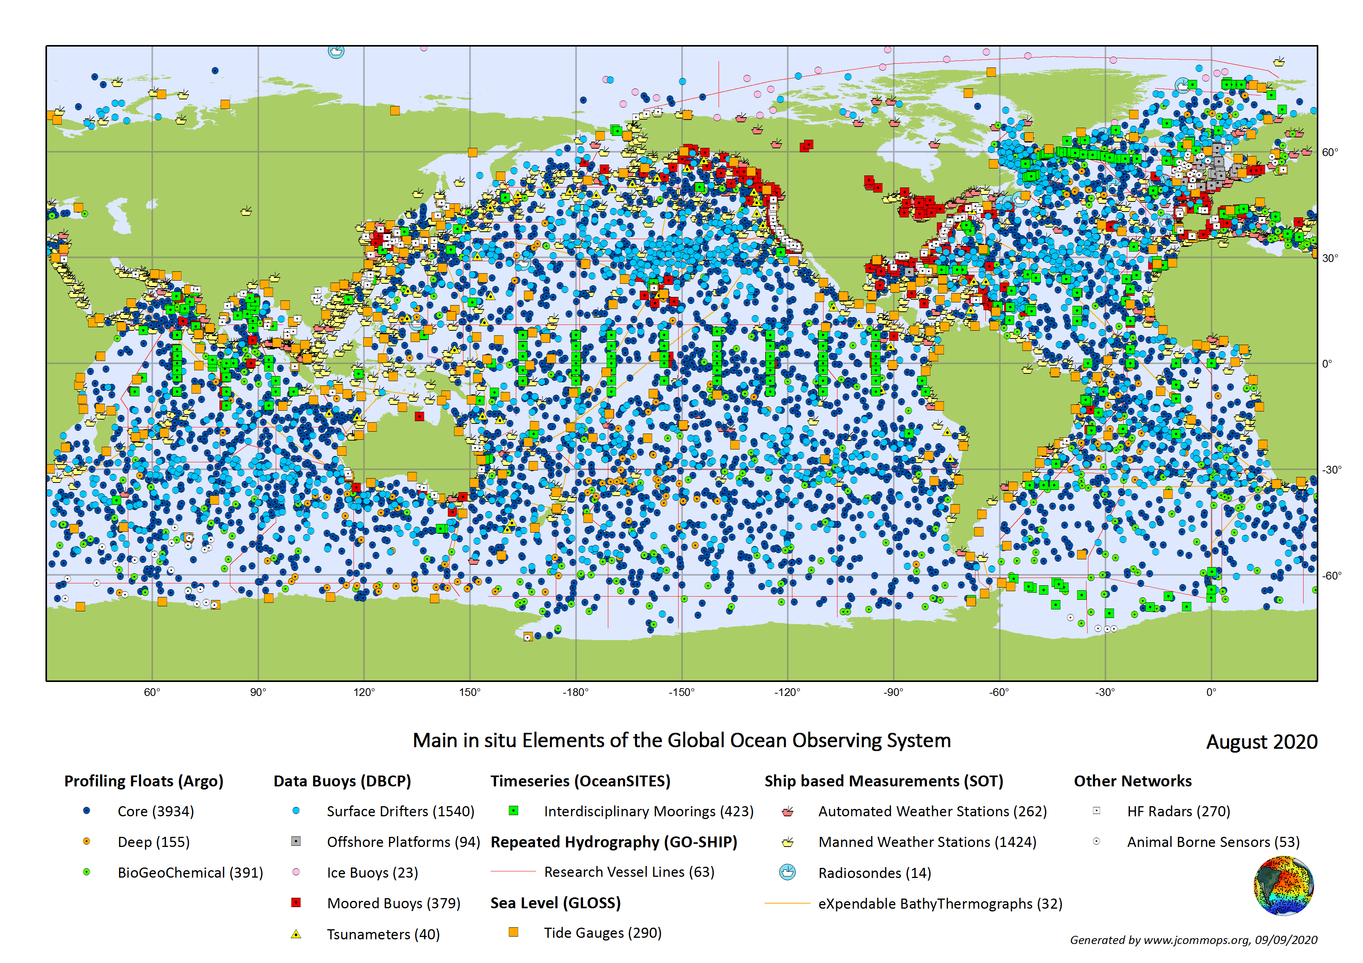

Our Evolution
The in situ global ocean observing community

Slide 7
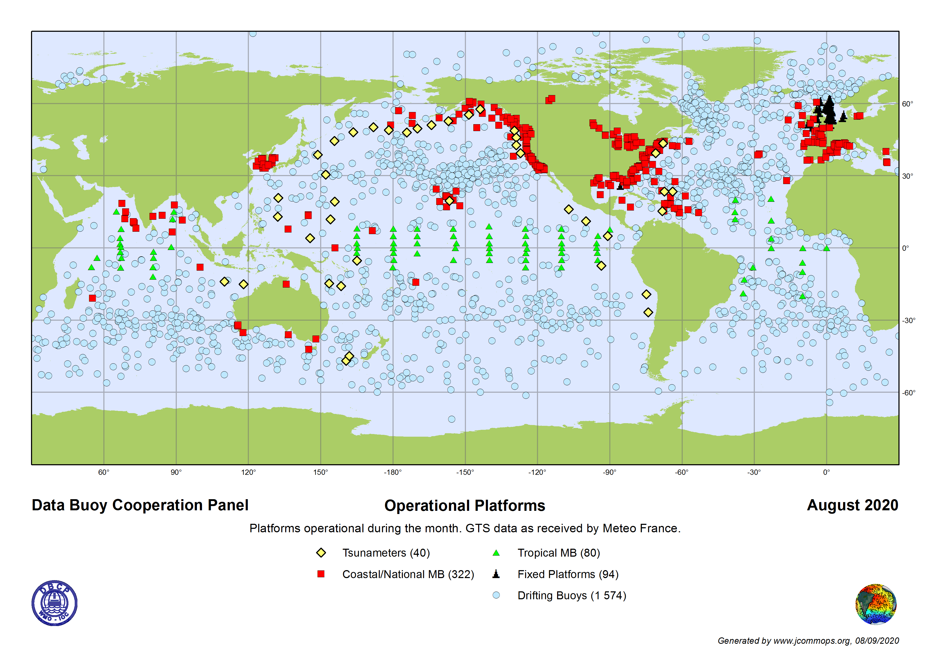
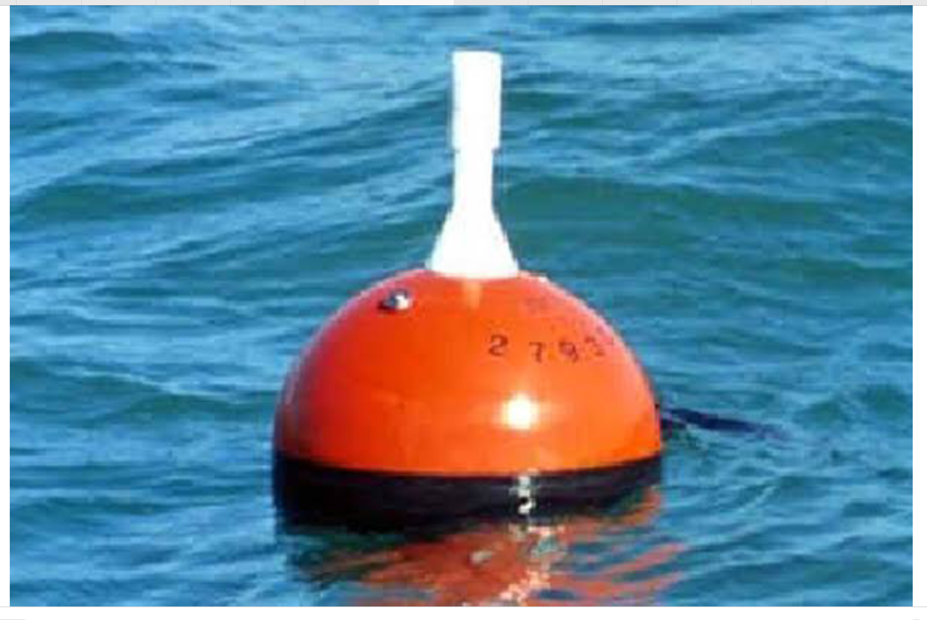
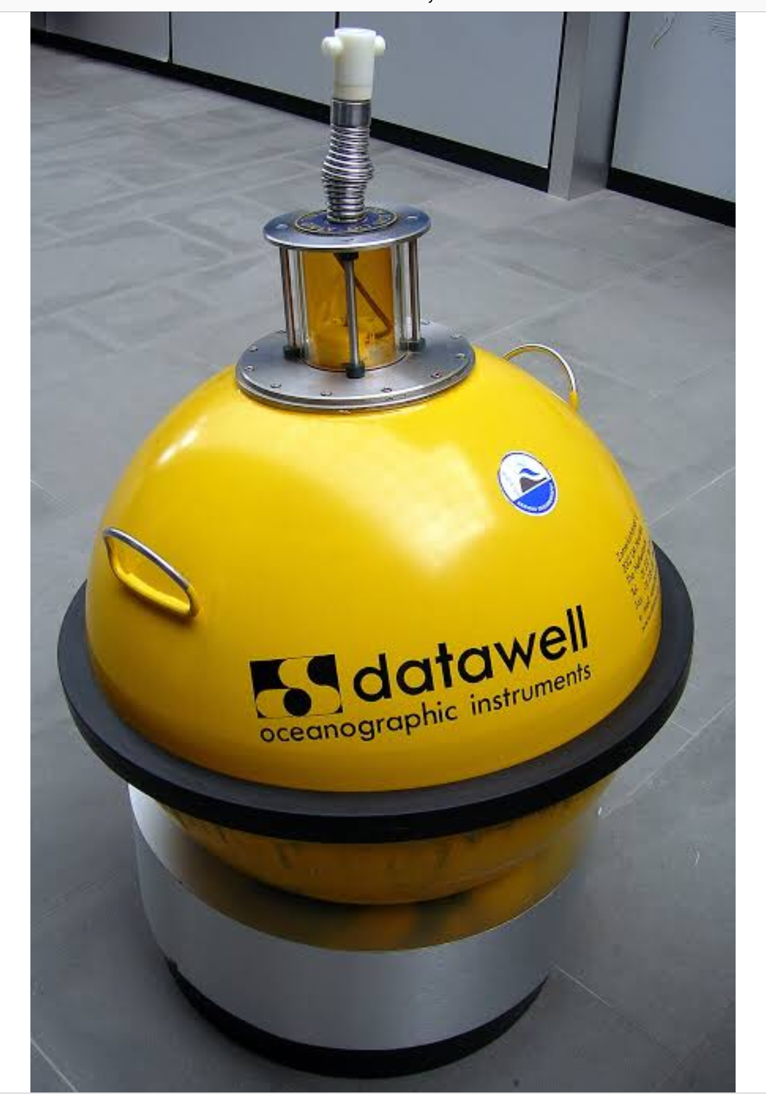
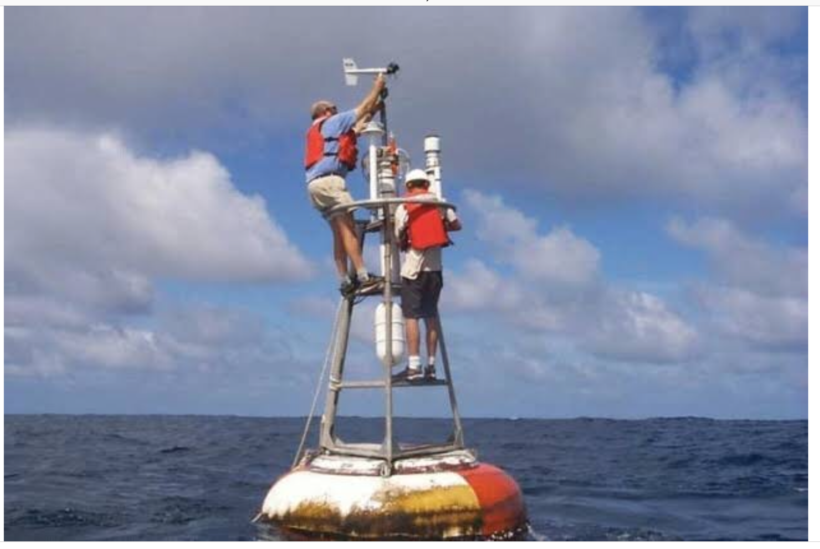
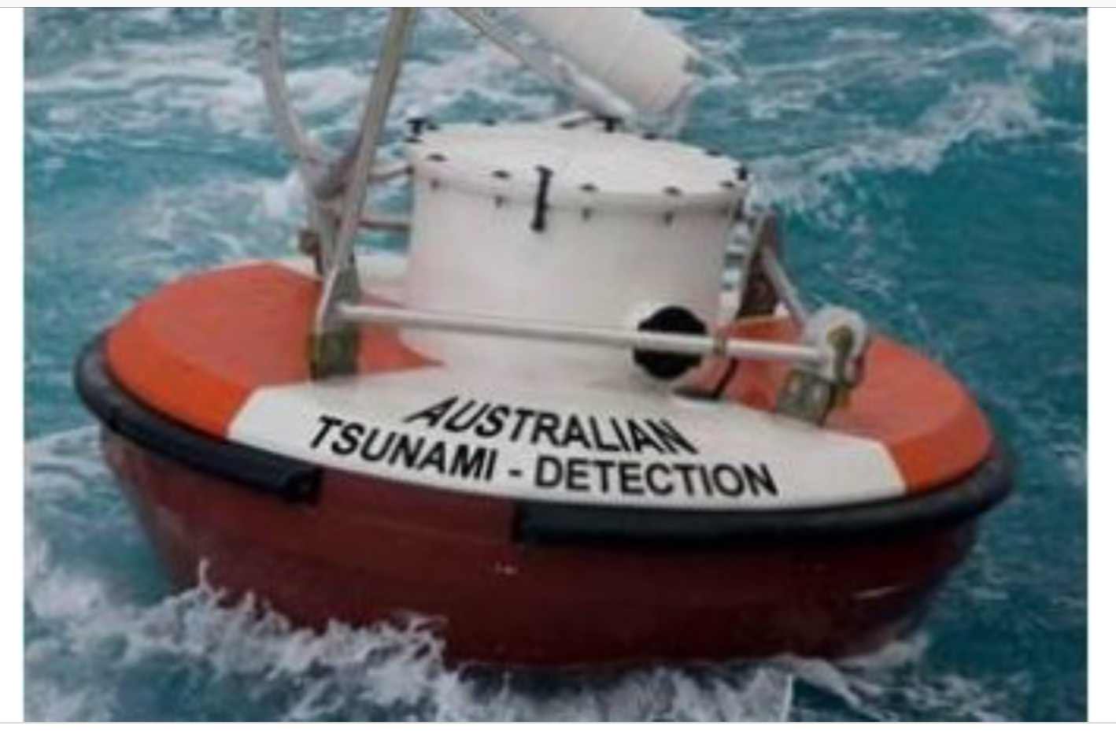
Our Evolution
The DBCP part…
Above, at and just below the ocean surface
Met-Ocean buoys
Drifting buoys
Wave buoys
Temp, Pressure, Salinity, currents, wind, waves are primary observations
Tsunami buoys

Slide 8
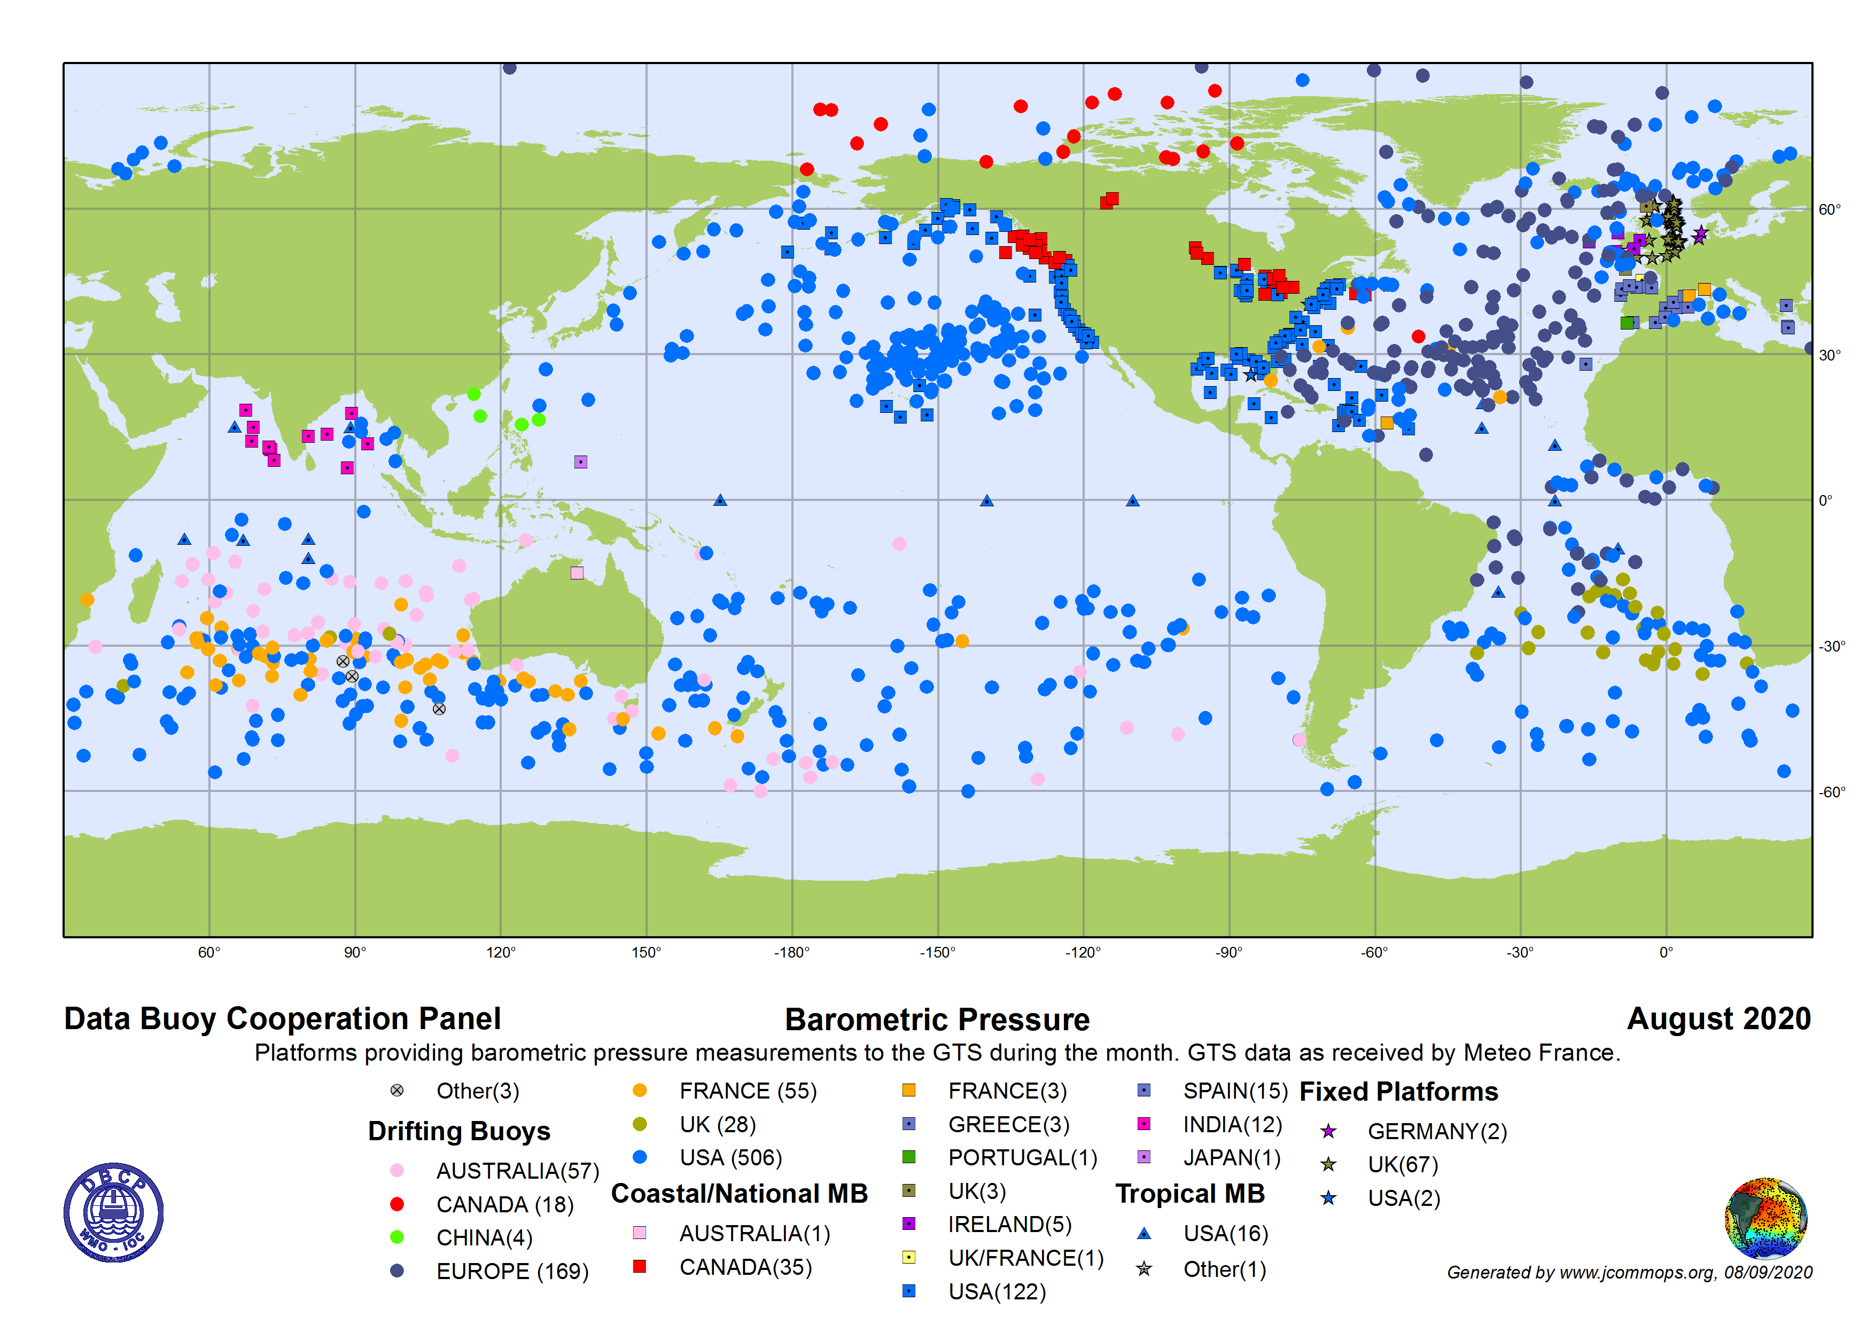
Coverage gaps – e.g. sea level pressure…

Slide 9
The landscape is changing!
WMO reforms
UN Decade of Ocean Science for Sustainable Development
UN Sustainable Development Goal – SDG 13 & 14
GOOS 2030
OceanObs19
Paris Agreement plus plus plus…

Slide 10
The need for the DBCP has never been greater
Growing awareness and concern of public of ocean and climate change
Climate change and its impacts
Extreme weather events
Food and Energy needs
Ocean health
Fundamental science
Forecasting capability
Marine debris (plastics)
Growing involvement of the commercial sector in observations
Demand for us is urgent and growing
Our future is intimately linked to all of this
Rapid technology innovation
Big Data

Slide 11
The week ahead (packed & exciting!)
Making the most of our virtual time together
Encouraging engagement and discussion (hearing from you)
Strong user focus
Strategic Planning for greater impact where it matters
Key sessions:
Session 2 (Monday) - Science and Technology Workshop
Session 4 (Tuesday) - User Impact (Guest speakers and Q&A)
Session 5 (Wednesday) - The DBCP strategy
Session 8 (Thursday) - Breakout sessions

Slide 12


