Slide 1
Italian National Report
DBCP – NO.36
Maurizio Ferla
ISPRA – Italian Institute for Environmental Protection and Research
maurizio.ferla@isprambiente.it

Slide 2
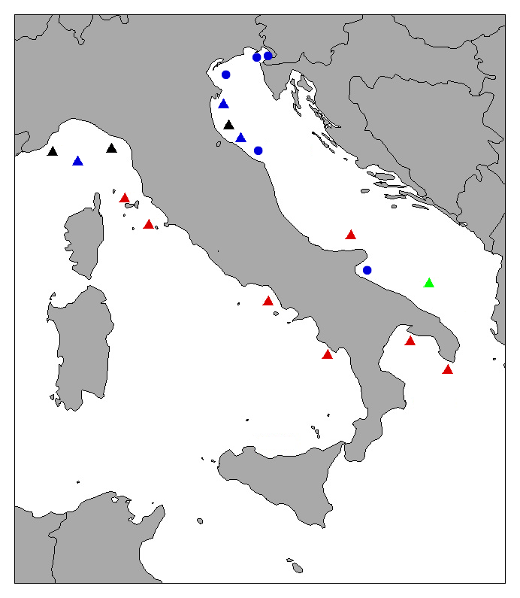
Current Programme
SNPA (black), CNR (blue),OGS (green), Regional administration (red)
14 moored buoys (triangles) and 7 marine platforms (circles)
Purpose of programme: operational and research
Main deployment areas: Italian Seas, in particular Adriatic Sea

Slide 3
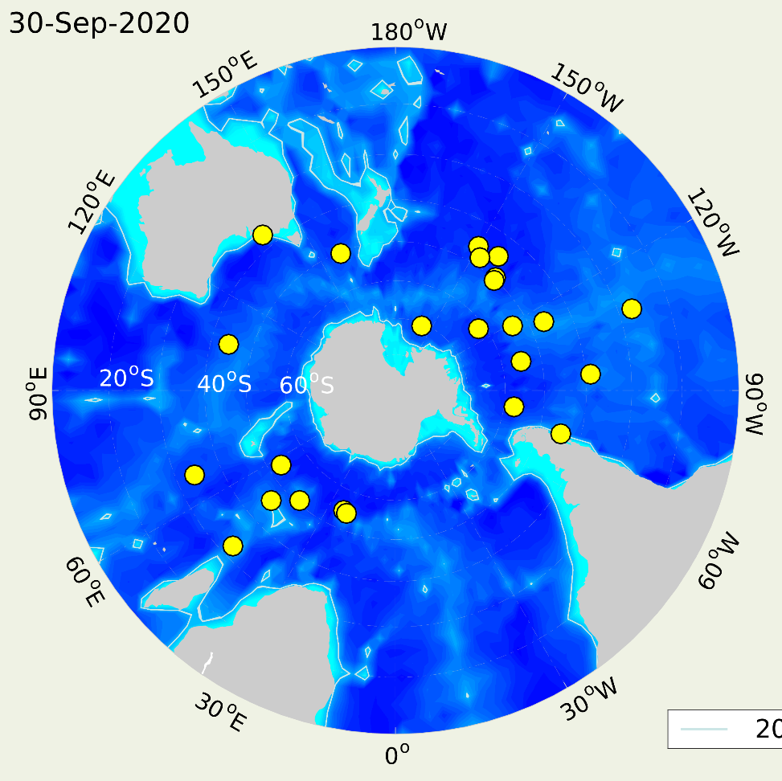
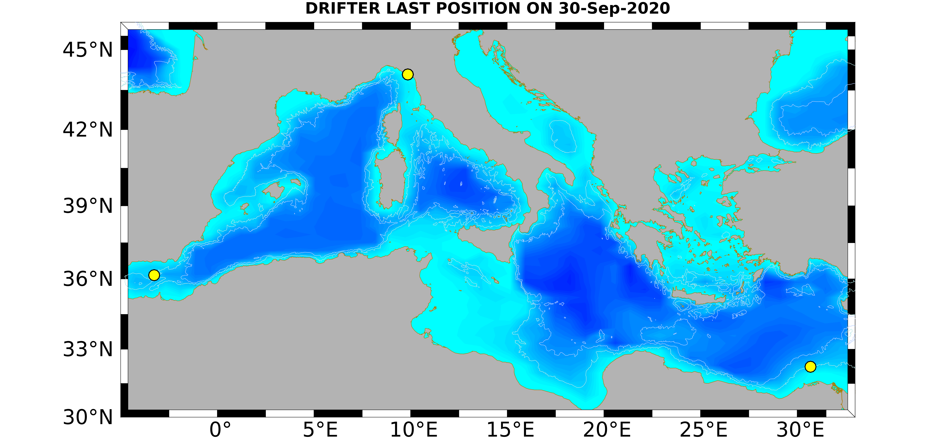
Current Programme
OGS drifters
Purpose of programme: research
Main deployment areas: South Atlantic and Pacific Ocean, Mediterranean Sea

Slide 4
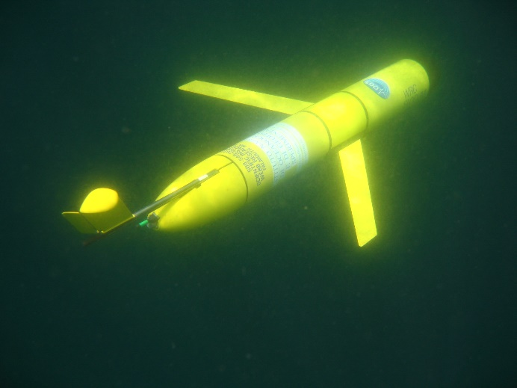
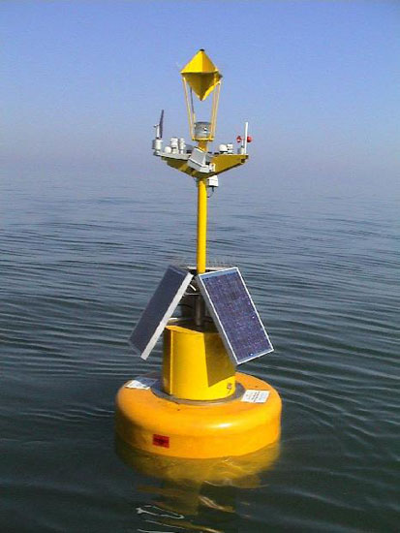
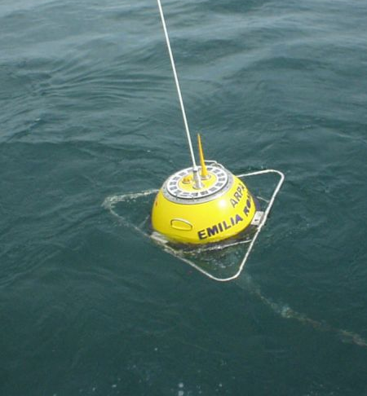
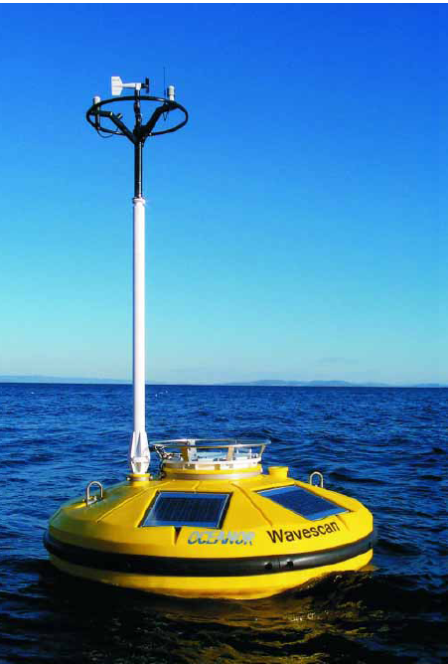
Current Programme
Glider OGS
Cesenatico Buoy - ARPAE
Capri Buoy
Campania Regional administration
S1 station - Northern Adriatic, Po Delta

Slide 5
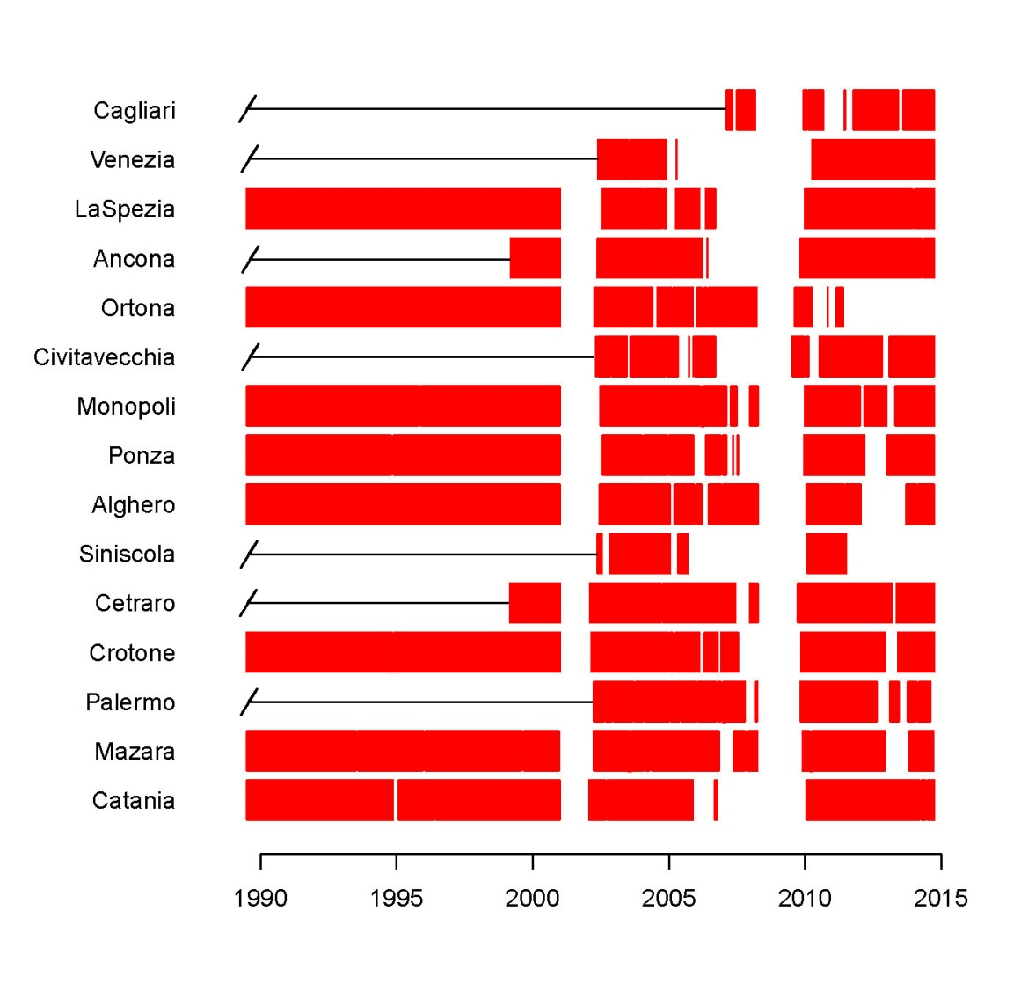
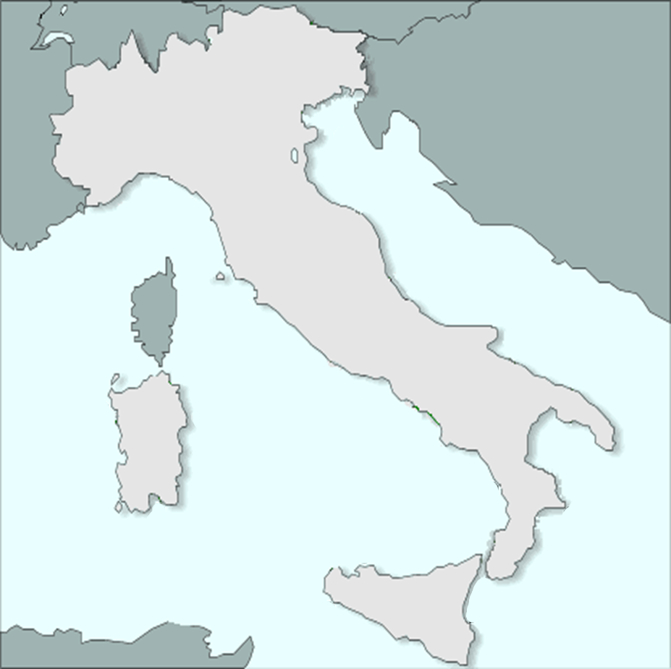
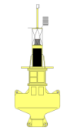
Planned Programme
The Italian Data Buoy Network RON

Slide 6
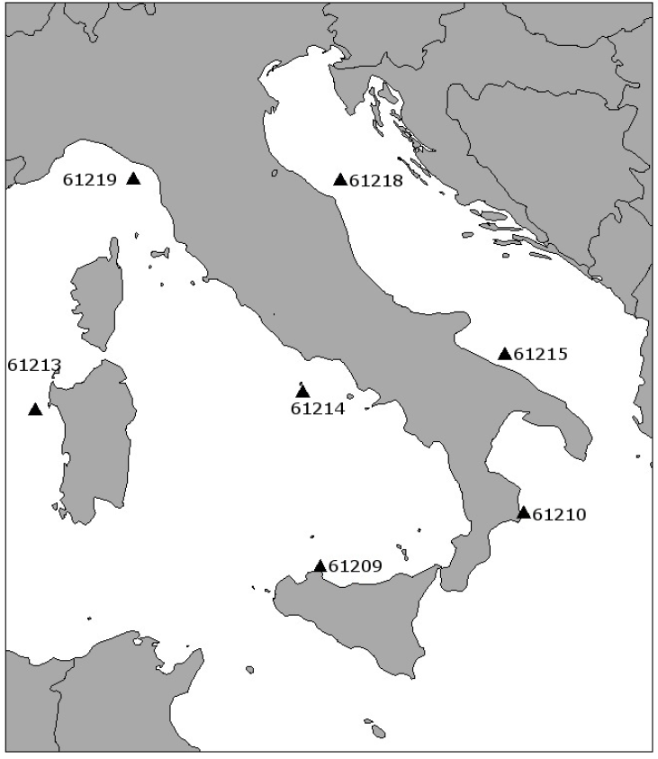
Planned Programme
The Italian Data Buoy Network RON
ISPRA will restore 7 of the 15 meteo-marine moored buoys of the network (Alghero, La Spezia, Ponza, Palermo, Ancona, Monopoli, Crotone)
Purpose of programme: operational and research
Main deployment areas: Italian Seas (covering areas not yet monitored by other programme)

Slide 7
Planned Programme
The Italian Data Buoy Network RON
Meteorological | wind speed wind direction wind gust air temperature barometric pressure relative humidity
Water | sea surface temperature significant and maximum wave height wave period and direction water temperature
Image | Video Monitoring
Position (GPS) | Latitude, longitude
Data trasmission | Satellite (Iridium) AIS GTS

Slide 8

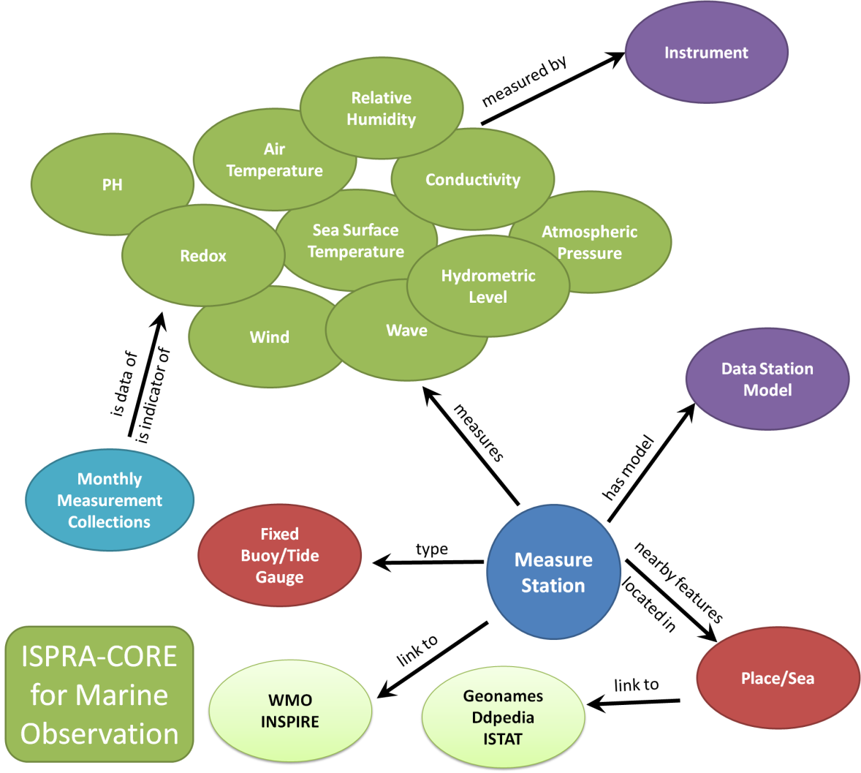
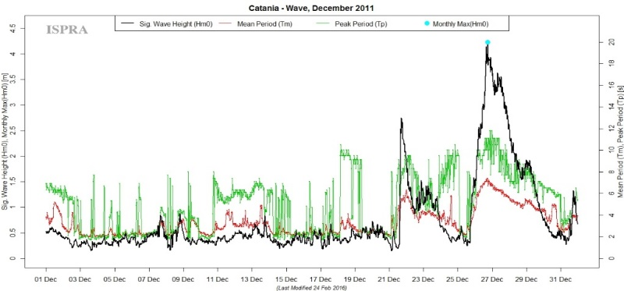
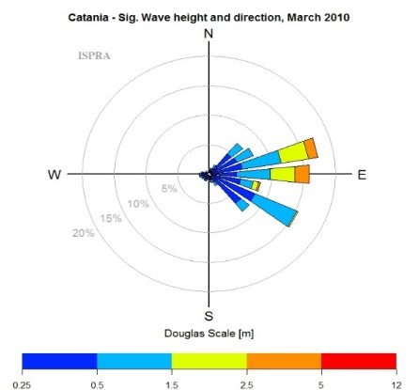
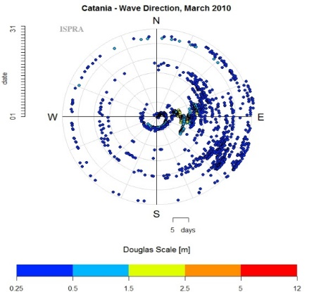
Planned Programme
The Italian Data Buoy Network RON
A F.A.I.R. way to share and reuse data from marine monitoring networks
http://dati.isprambiente.it

Slide 9
Thank you!

