Slide 1



The Ocean Data and Information System
Creating an inclusive digital commons for
ocean science & sustainable development
Pier Luigi Buttigieg on behalf of the ODIS working group
Notes:
ODIP

Slide 2
The Mission
Creating a robust and extensible foundation of our planet’s
digital ocean ecosystem

Slide 3
Current thinking
Each custom exchange incurs more set-up and maintenance cost
Node
Node
Node
HUB
Single hub systems can be brittle, and very hard/slow to change and respond to new needs
Node
Node
Node

Slide 4


A more
sustainable model
A more
sustainable model
The ODIS concept can be summarized as follows:
“The IOC Ocean Data and Information System (ODIS) will be an e-environment where users can discover and access data, information and associated products or services, provided by Member States, projects and other partners associated with IOC”.
Node
Node
Node
Node
Node
Node
The Web is our collective Hub
Each node is in charge of their own contribution
Linked Open Data and Semantic Web technologies will bridge nodes
A set of interoperability and exchange standards will allow any node to continuously cross-talk to any other (ODIS-Arch)
Anyone can “spin up” solutions like portals & hub(lets) using the interoperability architecture → greater inclusivity
HUB
WWW
Node
Node
Node
Node
Node
Node

Slide 5
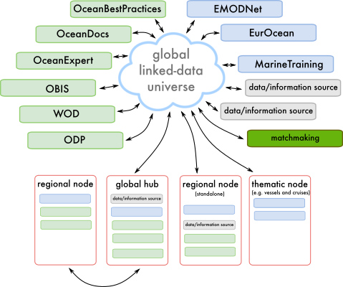
An example of leveraging ODIS
IOC Ocean Infohub
+ ODIS technology development: reference architecture to enhance interoperability and functionality
matchmaking
matchmaking
matchmaking
Decision support system

Slide 6
The Concept
A digital ecosystem with high cyberdiversity, but the same underlying ecological rules

Slide 7
Digital ecology facilitated through ODIS
Everyone has one or more “niches”, which can change over time
  Producers of digital products
  [1°, 2°, 3°, …] consumers of digital products
  The data “mixotrophs” – a producer & consumer
  Recyclers and de/recomposers (no data should be wasted!)
1°
2°
3°
P
2°
4°
1°
2°
∞

Slide 8
Key principles
ODIS
A cyberdiverse, distributed, and inclusive digital
ocean ecosystem
ODIS-Arch
the laws of ecology holding it all together
Node
Node
Node
WWW
Node
Node
Node

Slide 9
Key principles
No one “owns” the ecosystem, but we’re all charged with tending to it and keeping it healthy
Nodes in our digital ecosystem
  should have all the independence they need
  should have clear “niches” (roles) to prevent redundancy and increase partnership
  can pull and push resources to other nodes under automatically recognised usage conditions / licenses
Reuse over re-invent, adapt as a community
Easy to spin up solutions, minimal loss when spinning down
Success is not measured by individual use of a node, but by how many nodes are used in a single user session
Multiple entry points and levels of commitment to the ODIS network
Digital products and streams should align to the FAIR principles, and link to metadata and related data to allow automatic discovery, quality diagnostics, and much more

Slide 10
The strategy
Co-design and –development with all stakeholders

Slide 11
ODIS “Step”
Stepwise and responsive co-development based on stakeholders capacities, needs, and shared interests
ODISCat will be the nucleus – a common index that all nodes can reliably reference for trusted ocean data and information
Based on the needs and visons of the collaborating nodes, the details of ODIS’ implementation will take shape, around the core principles of linked open data and continuous interoperability

Slide 12
The main challenge: “data diplomacy”
The main obstacles we face are not technical ones, but those that prevent us creating a community of practice
Interests of each node must be heard and accommodated for a digital commons to be sustained
The community looks to the UN partners to show how agreements can be forged to create a mutualistic digital ecology, turning competition into collaboration

Slide 13
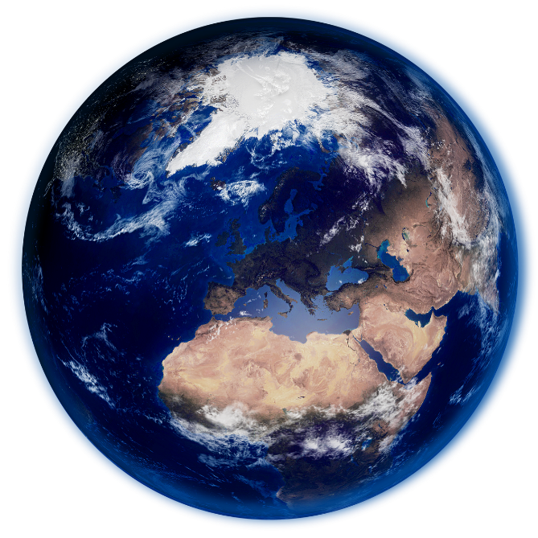
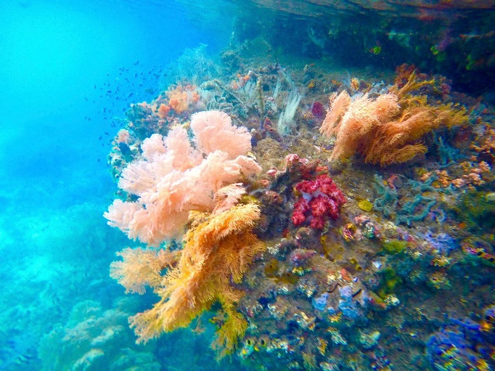
From a digital ecosystem to the digital biosphere
The digital ocean ecosystem is just one of many in a “digital biosphere”
needed to address the SDGs and their successors

Slide 14
From digital ecosystems to the digital biosphere
The digital ocean ecosystem is just one of many in a “digital biosphere”
needed to address the SDGs and their successors
Oceans (ODIS)
Resilient food
system
Atmosphere
Planetary
Access to
education
Mariculture
Ocean literacy
Cities
Terrestrial
Healthy oceans

Slide 15
Questions to the participants
How can we connect our digital ecosystems in the same biosphere?
How can ODIS provide your systems with sustainable digital products and services for the oceans?
What should ODIS reuse for your system(s)? What interoperability solutions have worked for you?
How do we align incentives and credit one another?

