Slide 1

Data Management Programme Area report
Sergey Belov
Chair DMPA
15th Session of the JCOMM Management Committee
31 October - 3 November 2018, Paris France

Slide 2
DMPA Structure
Data Management Coordination Group (DMCG)
Expert Teams (ET):
ET on Data Management Practices (ETDMP) (joint with IODE)
ET on Marine Climatology (ETMC)
Inter-Program ET for Integrated Marine Meteorological and Oceanographic Services within WMO and IOC Information Systems (IPET-MOIS)
Task Teams:
Table Driven Codes (TDC)
Satellite Data Communication Systems (Satcom)

Slide 3
DMCG Terms of References
The Data Management Coordination Group, in close collaboration with the International Oceanographic Data and Information Exchange (IODE) and Commission for Basic Systems subsidiary bodies and related experts, shall:
(a) Maintain a data management plan for JCOMM that identifies, assesses and specifies priorities and actions for the Data Management Programme Area addressing issues relevant to both real time and delayed mode marine meteorological data management
(b) In concurrence with the co-presidents of JCOMM and the co-chairs of the International Oceanographic Data and Information Exchange (IODE), establish and create expert teams, task teams, and pilot projects, as appropriate, to undertake the work of the Data Management Programme Area;
(c) Ensure collaboration, appropriate coordination and liaison with IODE as well as with the Commission for Basic Systems (CBS) and other relevant bodies and activities external to WMO and IOC;
3

Slide 4
DMCG Terms of References
(d) Keep under review, assess and coordinate the adoption of appropriate new information technology;
(e) Establish and maintain cooperation with science programmes and assist with their data management activities, as appropriate;
(f) Provide advice and feedback to users of the Data Management Programme Area functions, through the appropriate JCOMM Programme Area, through IODE directly;
(g) Identify capacity development requirements related to the Programme Area and, as appropriate, coordinate activities to address these requirements;
(h) Identify satellite data and information related to the Programme Area.
4

Slide 5

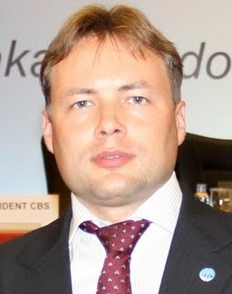
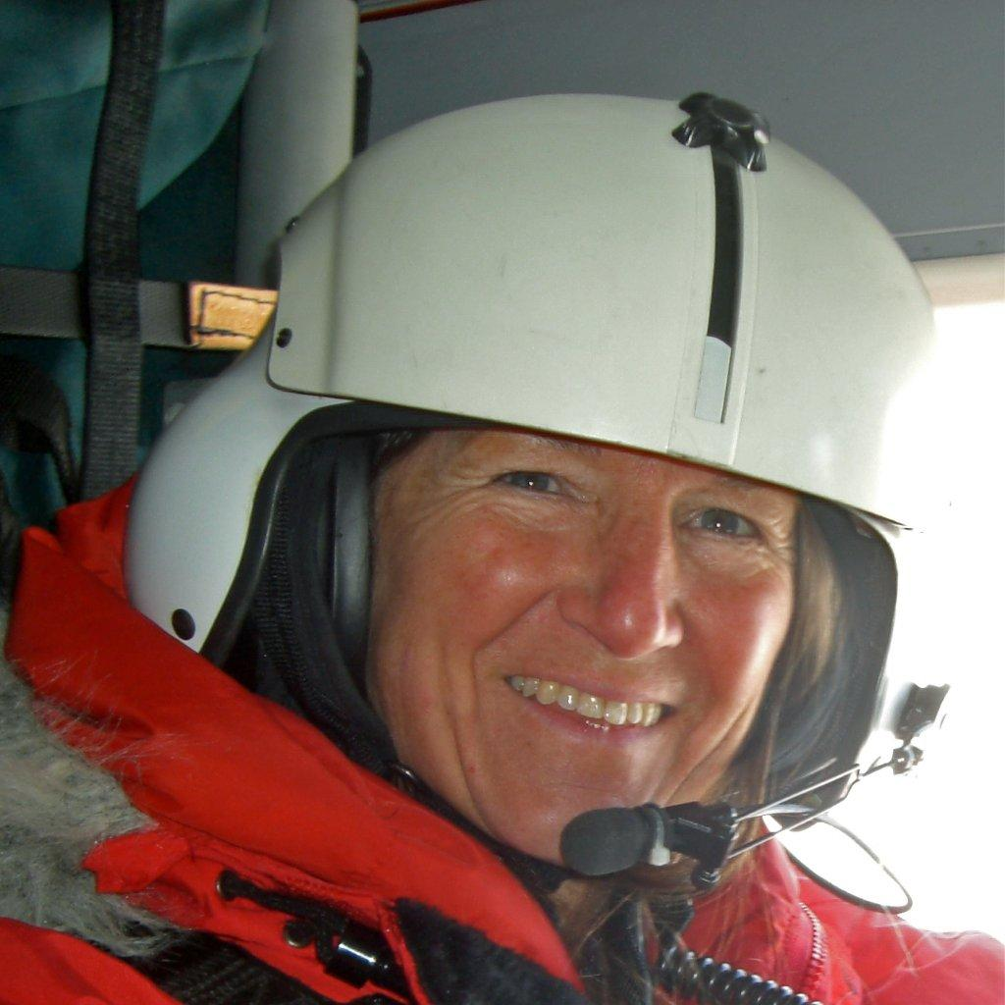

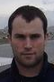
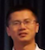

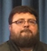

2. DMCG Membership
Champika GALLAGE Secretariat (WMO)
Sergey BELOV Chairperson, DMCG (Russia)
Cynthia CHANDLER IODE, Co-chairperson (USA)
Yutaka MICHIDA IODE, Co-chairperson (Japan)
David BERRY Coordinator, Table Driven Codes (UK)
Yulong LIU Chairperson, Inter-Program ET for Integrated Marine Meteorological and Oceanographic Services within WMO and IOC Information Systems – IPET-MOIS (China)
Zhiqiang GONG Chairperson, Expert Team on Marine Climatology – ETMC (China)
Alessandra GIORGETTI Chairperson of the Expert Team on Data Management Practices-ETDMP) (Italy)
Kevin O’Brien Vice-Chairperson, OCG (USA)
Thomas J. Cuff, Chairperson SCG (USA)
5

Slide 6
Highlights since JCOMM-5 – meetings
9th Session of the JCOMM Observations Coordination Group 14 - 17th May 2018, Brest, France
6th Session of JCOMM/IODE Expert Team on Data Management Practices (ETDMP) - IOC Project Office for IODE, Oostende, Belgium 17-19 September 2018
7th Session of JCOMM Data Management Coordination Group - IOC Project Office for IODE, Oostende, Belgium 19-21 September 2018
Several WebEx meetings (on composition of ETs, DM Strategy and Implementation Plan) – February – October 2018

Slide 7
Highlights since JCOMM-5 – recommendations and decisions
Recommendation 4 (JCOMM-5) - ESTABLISHMENT OF DATA ACQUISITION CENTRES, GLOBAL DATA ASSEMBLY CENTRES AND CENTRES FOR MARINE METEOROLOGICAL AND OCEANOGRAPHIC CLIMATE DATA WITHIN THE NEW MARINE CLIMATE DATA SYSTEM
“Requests the JCOMM Data Management Programme Area (DMPA) to undertake as soon as possible, and according to the approved governance, the evaluation of the application of the Coriolis Data Center, France”
Status: Completed in May 2018

Slide 8
Highlights since JCOMM-5 – recommendations and decisions
Decision 19 (JCOMM-5) - JOINT WORLD METEOROLOGICAL ORGANIZATION AND INTERGOVERNMENTAL OCEANOGRAPHIC COMMISSION STRATEGY FOR MARINE METEOROLOGICAL AND OCEANOGRAPHIC DATA MANAGEMENT (2018–2021)
DMPA is requested to develop an implementation plan responding to the data management Strategy in consultation with the other Programme Areas and the IODE.
DMPA is requested to assist the Commission for Basic System in developing the information management component of WIS, engaging with the implementation of WIS 2.0, and to seek to implement the Strategy in a way compatible with it
Status: In progress (draft version 1.2 under discussion within DMCG)
(see DMCG-7 A2.0/4, A.9.1/1, A.9.1/2, A.9.1/3)

Slide 9
Highlights since JCOMM-5 – recommendations and decisions
Decision 21 (JCOMM-5) - MARINE CLIMATOLOGY WORKSHOPS
DMPA and ETMC are requested to proceed with required preparations and organization of CLIMAR and MARCDAT meetings.
Status: In progress
CLIMAR-V - 6 – 8 May 2019 in Hamburg (Germany) aligned with 1-day ocean winds workshop (see DMCG-7 A4.4/1)
MARCDAT-5 session in 2020 (see DMCG-7 A2.0/9)

Slide 10
Highlights since JCOMM-5 – recommendations and decisions
Decision 21 (EC-70) - Intergovernmental Oceanographic Commission Ocean Data and Information System (see DMCG-7 A3.2/1, A3.2/2, A3.4/1, A7.2/1)
Decision 22 (EC-70) - Ocean data standards and best practices (see DMCG-7 A3.3/1)
Decision 23 (EC-70) - Establishment of Data Acquisition Centres, Global Data Assembly Centres and Centres for Marine Meteorological and Oceanographic Climate Data within the new Marine Climate Data System (see DMCG-7 A4.3/1, A4.3/2, A4.3/3)
Recommendation 8 (EC-70) - Joint WMO and Intergovernmental Oceanographic Commission Strategy for Marine Meteorological and Oceanographic Data Management (2018–2021) (see DMCG-7 A9.1.1 - A9.1/3)

Slide 11
Workplan through mid-2019 and plans beyond
Present the information on MCDS to the IODE-XXV (February 2019)
develop a detailed workplan with deliverables and milestones to rewrite WMO no. 781. (March 2019)
documents relevant to MCDS for submission to the 18th WMO Meteorological Congress in 2019 and the IOC-XXX Assembly in 2019 (March 2019)
organization of the CLIMAR-V workshop (May 2019)

Slide 12
Workplan through mid-2019 and plans beyond
Develop metrics to measure the progress of the MCDS implementation (June 2019)
Finalize the Implementation Plan ahead of the EC-71 (June 2019)
Preparations and organization of the MARCDAT-5 session in 2020 (June 2019)
Review and update the MCDS vision, strategy and implementation plan (2019)

Slide 13
Workplan through mid-2019 and plans beyond
WIS
  IPET-MOIS provide the list of potential centers eligible for WIS certification (Feb 2019)
  IPET-MOIS coordinate with and include the ETMC and ETDMP in developing the WIS evaluation process (March 2019)
ODIS
  Expert Team on Data Management Practices (ETDMP) to support and assist the development of the ODIS concept paper (Feb 2019)

Slide 14
Workplan through mid-2019 and plans beyond
DM Strategy
  Finalize the Strategy in advance of IODE-XXV for endorsement (January 2019)
  final version of the DM Strategy, Implementation Plan and associated draft decisions for submission to the and 18th WMO Meteorological Congress IOC-XXX Assembly in 2019 (2019, as per the doc deadline of the event)
  finalize the implementation plan prior to WMO 18th Congress (March 2019)

Slide 15
Implementing and maintaining a fully integrated end-to-end data management system across the entire marine meteorology and oceanographic community
Implementation of the Marine Climate Data System (MCDS)
Cross-cutting ETs (ETDMP, IPET-MOIS)
S
High expectations compared to available resources
Lack of coordinated activities with IODE and WMO groups
Process for the nomination and selection of experts to the ETs
Establishment of new projects
W
Bringing coordination of data management activities within JCOMM to the new level
Contribution to the implementation of IOC ODIS
Contribution to the implementation of WIS 2.0
Improved Workflows for End-to-End Systems
O
WMO Constituent bodies reform
JCOM – from technical commission to consultation group
Low visibility within other communities (RDA, CODATA, Belmont Forum, etc.)
T

Slide 16
Priorities using scenario 1 – 30% cut
Web-based meetings instead of face-to-face events
No new established projects
Decrease in WIS 2.0 related activities
Decrease in ODIS related activities
Priorities:
Experts Red Book
DM Strategy and Implementation plan
Support for OPA and SFSPA
MCDS

Slide 17
Priorities using scenario 2 – flat
Meeting frequency and face-to-face model kept
No new established projects
Contribution to the development of ODIS
Contribution to WIS 2.0 related activities (ocean to met)
Priorities:
DM Strategy and Implementation plan
Support for OPA and SFSPA
MCDS
ODIS

Slide 18
Priorities using scenario 3 – 50% increase
Annual meetings of ETs and DMCG
Several new projects established (OpenGTS, etc.)
Co-development of ODIS
Co-development of WIS 2.0 (as core partners)
Priorities:
DM Strategy and Implementation plan
Support for OPA and SFSPA
MCDS
ODIS
WIS 2.0 (OpenGTS + ocean data and metadata)
Capacity activities

Slide 19
Possible cross-PA projects
Open Access to GTS (with OPA)
Community Best Practices (in cooperation with IODE) (OPA, SFSPA)
Metadata services (OPA, SFSPA)
Data services (OPA)
Product services (OPA, SFSPA)

Slide 20
Possible cross-PA projects
  Metadata
  common metadata contents (by network, by discipline, etc.)
  Instrument, platform, sensors, vessel metadata, etc.
  requirements to metadata standards (i.e. ISO 19115, SensorML, FGDC, NAP, DarwinCore, etc.)
  Other requirements?

Slide 21
Possible cross-PA projects
  Data
  Data sources
  Formats (i.e. BUFR, NetCDF, IMMA, IMMT, CSV, others.)
  Tools and services (TAC to TDF, GRIB, BUFR, NetCDF encoders/decoders/validators, others)
  Data repositories (endpoints, protocols, etc. → DCAT? www.re3data.org?)
  Other requirements?

Slide 22
Possible cross-PA projects
  Services & products
  products targeted at data providers
  products targeted at data system managers
  products targeted at external users
  Best practices
  Publications in OceanBestPractices repository – instrument calibration, sensors deployment, data provision, data management handbooks (examples: JCOMM, Argo, AtlantOS DM handbooks ), manuals and guides, etc.

Slide 23
Possible cross-PA projects
  Community standards
  Identify and submit community standards (via IODE ODSBP)
  Data citation
  use of DOI, Handle, etc.
  citation level of data and products
  publications

Slide 24
Data Management Strategy and Priorities
Implementation Plan structure
Outcome
Goals and objectives
Activities
Sub activities
Deliverables
Lead responsibility
Other groups involved
Start/end
Priority
Additional resources
Risks
Comments
Improved workflows from observation systems to the users
use of common standards
Connecting Marine Meteorological and Oceanographic Centres with WMO and IOC Information Systems , MCDS

Slide 25


