Slide 1
The Copernicus Marine Service and its use and priorities for ocean observations
P.Y. Le Traon, Mercator Ocean
9th session of the JCOMM OCG, May 17, 2018

Slide 2
Outline
The Copernicus Marine Service: products and services, users and applications, service evolution
The essential role of upstream satellite and in-situ observations and Copernicus Marine Service requirements

Slide 3
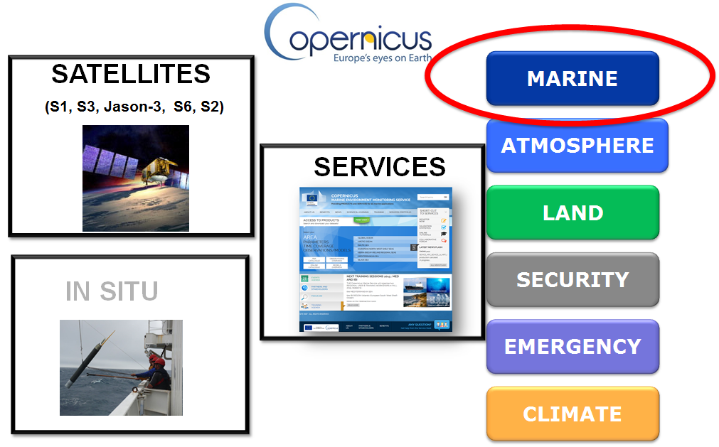
The European Copernicus Programme

Slide 4
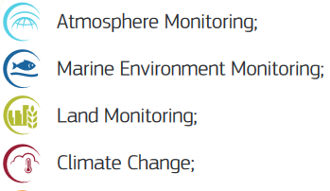

CMEMS organisation
Marine Environment Monitoring
Scientific and Technical Advisory Committee
Entrusted entity:
CROSS-CUTTING COORDINATION
CENTRAL USER SERVICE
System
Service
Outreach
Science
CMEMS OPERATIONS
PRODUCTION AND SERVICE
Service desk and service operations
Central Information System
Monitoring and Forecasting Centres (Models)
Thematic Assembly Centres (Obs)
CMEMS EVOLUTIONS
AND USER UPTAKE
Additional activities complementing CMEMS operations
ARC | BAL | BLACK | IBI | MED | NWS | GLO
Service Evolution
User Uptake
SEA LEVEL | IN SITU | OCEAN COLOR | SST | SEA ICE | WIND | Multi OBS | WAVE

Slide 5
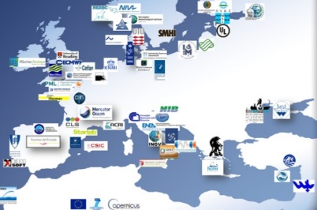
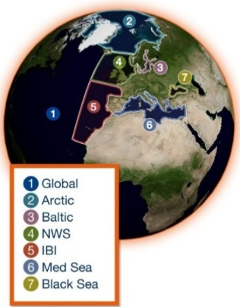
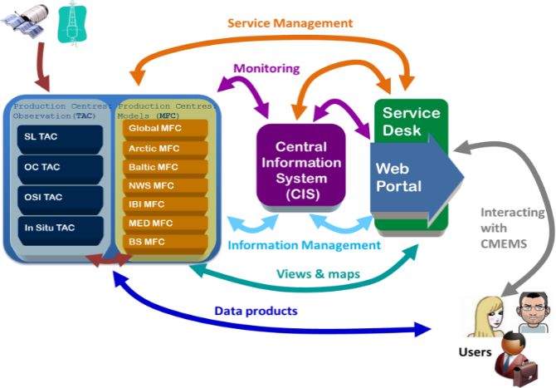
The Copernicus Marine Service - Today
A state of the art and user driven core European service
Operational and scientifically assessed
Observations (satellite, in-situ) and models (analyses/forecasts)
Physics and Biogeochemistry
A network of European producers
A single catalogue: Worldwide and European-wide coverage
A central information system to search, view, download products and monitor the system
A service desk to support users who relies on a network of technical & marine experts
Generic to serve a wide range of downstream applications. More than 12 000 subscribers.

Slide 6
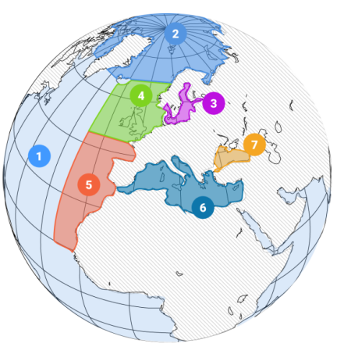
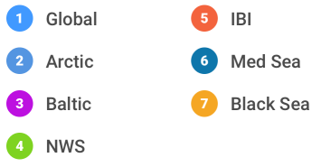
The Copernicus Marine Service
MULTI-YEAR
10 to 45 years
REAL-TIME
Daily, hourly
FORECAST
2 to 10 days
ESSENTIAL MARINE VARIABLES
Physics
Sea-ice
Waves
Biogeochemistry
Observations
In-situ & Satellites
Numerical models & data assimilation
Open and Free access

Slide 7
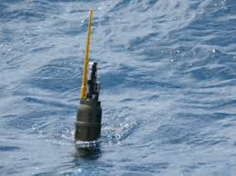
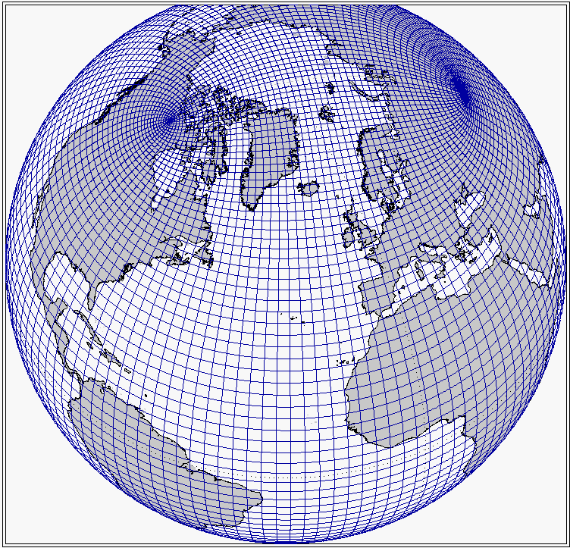

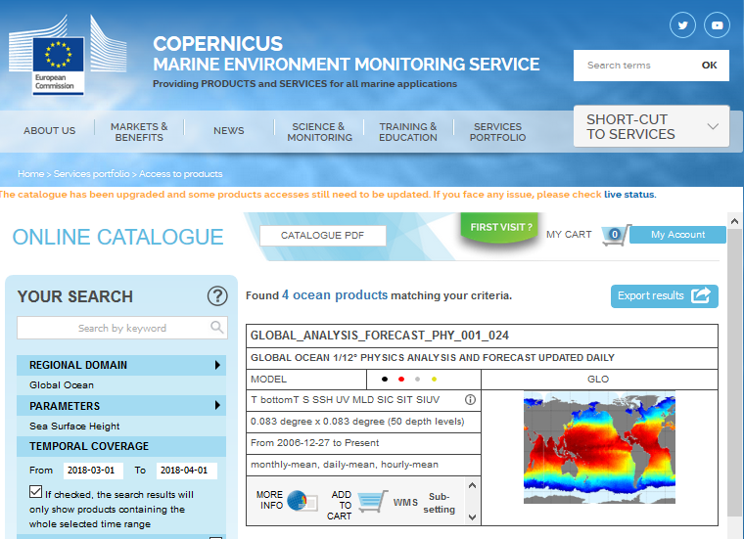
Catalogue of products
Global ocean and European Seas
In-Situ, Satellite Observations, Models
Physical & Biogeochemical variables
  Long time series (> 30 years)
  Real time products
157
products

Slide 8
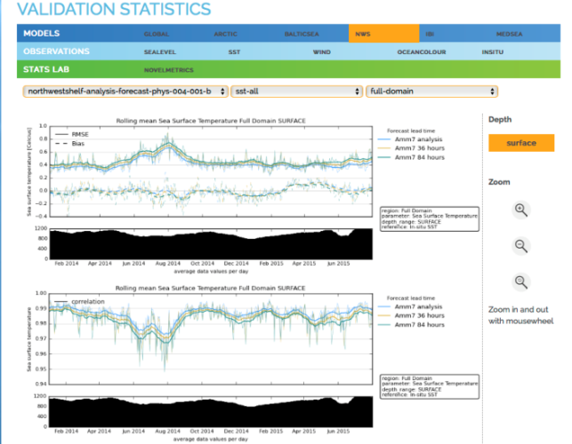
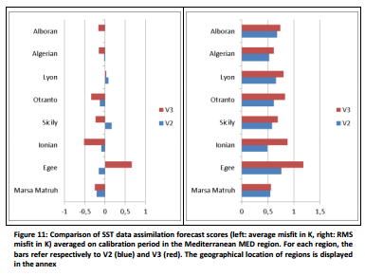
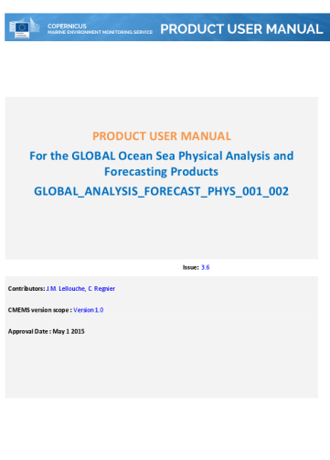
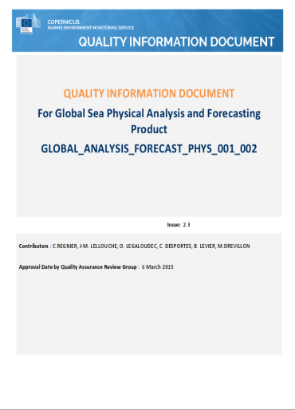
Evaluation of product quality
SCIENTIFIC VALIDATION METHODS / METRICS BASED ON INTERNATIONAL STANDARDS
PRODUCT AND PRODUCT QUALITY DOCUMENTATION FOR ALL PRODUCTS
F. Hernandez et al.

Slide 9
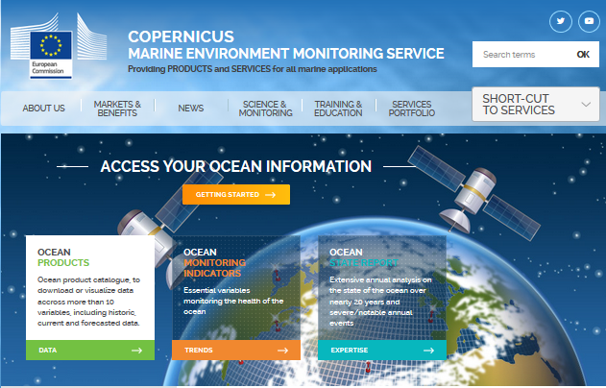
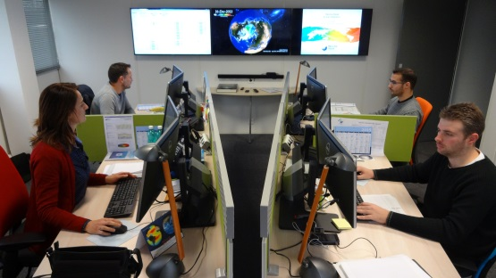
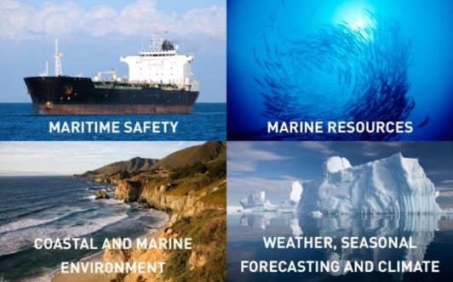
A central service desk / single interface
A Central Service Desk
(assistance, expert support, user monitoring)
marine.copernicus.eu

Slide 10
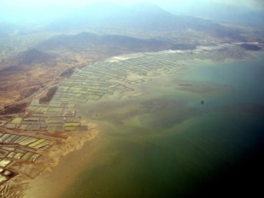
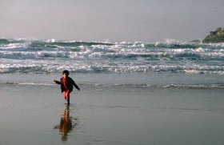

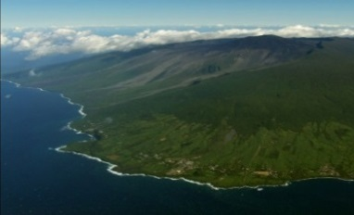
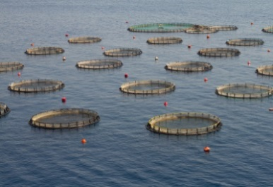
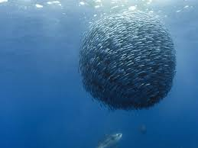
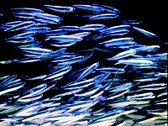

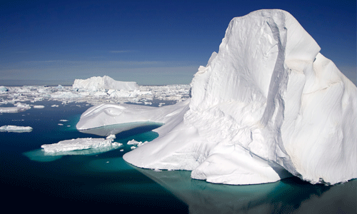

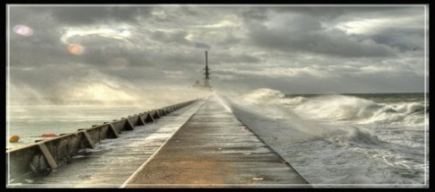
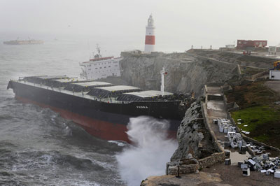
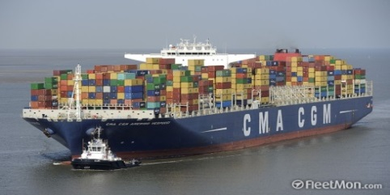
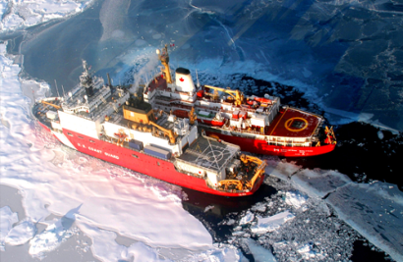
Areas of Benefits
Coastal & marine environment
Marine resources
Weather, seasonal forecasting & climate
Maritime safety

Slide 11

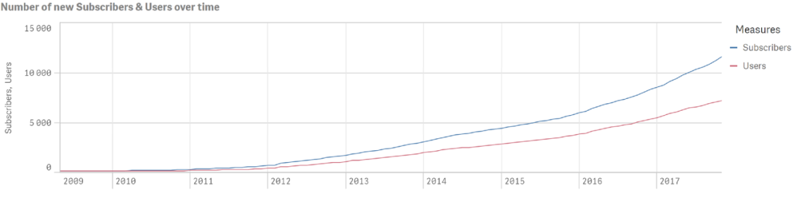
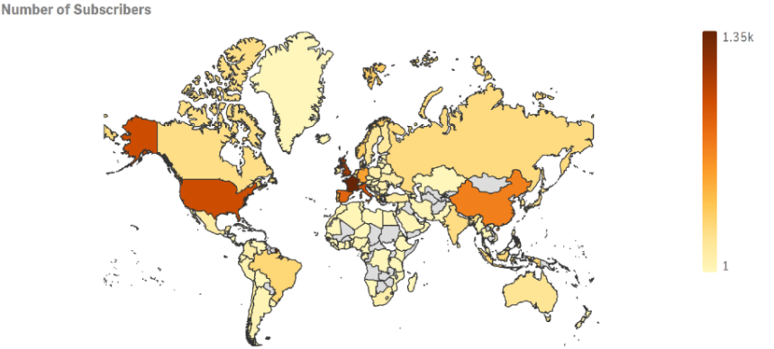
User uptake: a constrant growth of subscribers
More than 12 000 subscribers (~ + 200 new subscribers/month)
12 000 Subscribers (intermediate users)
4000 Different Entities among which 1000 Business Companies
Downloads/month: 35 000
  Download = Pair User/Dataset per Day
Volume/month: 50 Tb
98% products on time
Satisfaction of Users: 4,7/5
Notes:
Let’s start by a quick look of current use statistics.

Slide 12
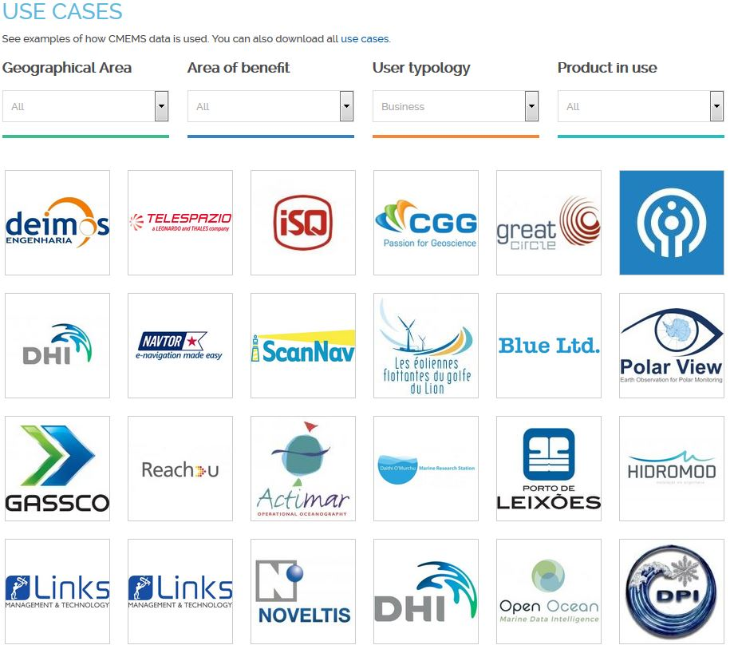
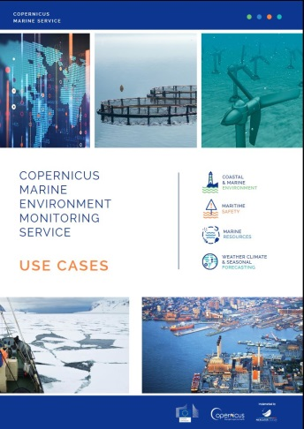
LEARNING FROM OUR USERS
More than 100 use cases available
on line

Slide 13
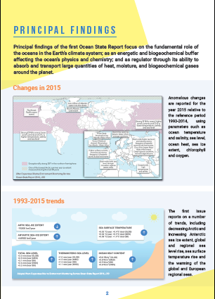
Copernicus Marine: Annual Ocean State Reports
State of the global ocean and the European seas, highlighting changes occurred during the previous year. Value added information based on CMEMS products (reprocessing, reanalysis) and scientific expertise. Published in a peer-reviewed journal (Journal of Operational Oceanography).
ISSUE #2 (in press)
ISSUE #3 (starting)
Summary of outcomes targeted at policy makers
K. von Schuckmann et al.

Slide 14
CMEMS Service Evolution – Principles
Users are explicitly and transparently involved:
  Users needs drive service evolution,
  User feedbacks and needs are regularly monitored and collected,
  Work to translate user requirements into achievable service evolution objectives.
Scientific (satellite and in-situ observations, modelling, data assimilation) and technological (e.g. computing capabilities, information systems & big data) advances relevant for the CMEMS are to be fully taken into account.
Need to maintain a competitive and state of the art service.
Innovation capacity required to attract new users.
Delineation with downstream activities:
  The core service focuses on activities best performed at pan-European scale.

Slide 15
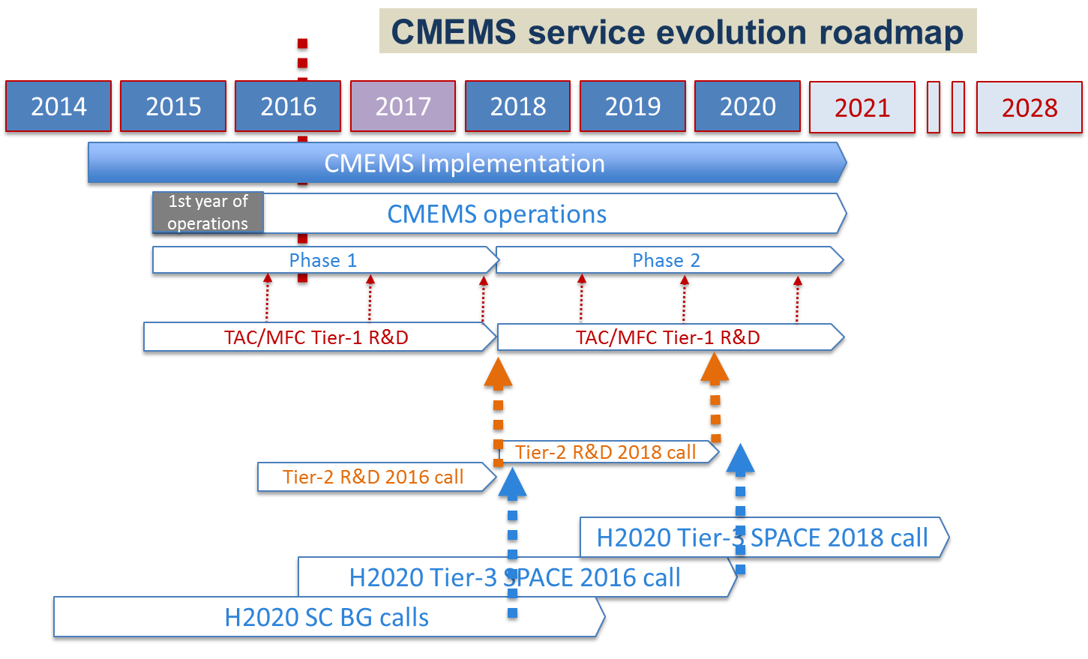
Service Evolution: Roadmap
Operations
R&D
Tier 1
Tier 2
Tier 3

Slide 16
Phase 1 R&D Achievements-Highlights
Important R&D advances have been achieved during CMEMS Phase 1 (April 2015 – April 2018) and significantly improved service is or will be soon proposed to the users:
  wave observations and models,
  improved resolution,
  wave/circulation coupling,
  better use of existing satellite and in-situ observations,
  uptake of Sentinel 1 data (sea ice, wave) and Sentinel 3 (altimetry, sea surface temperature, ocean colour) data,
  longer time series of reprocessed in-situ and satellite data and ocean reanalyses,
  improved and more homogenized product quality assessments,
  ocean monitoring indicators and ocean state report.

Slide 17
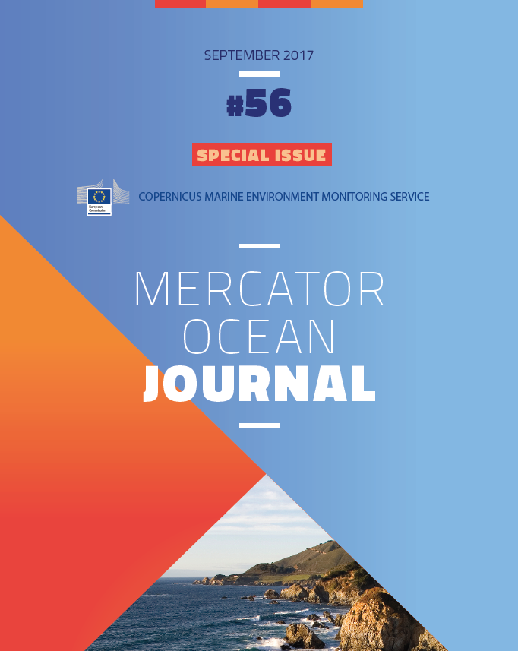
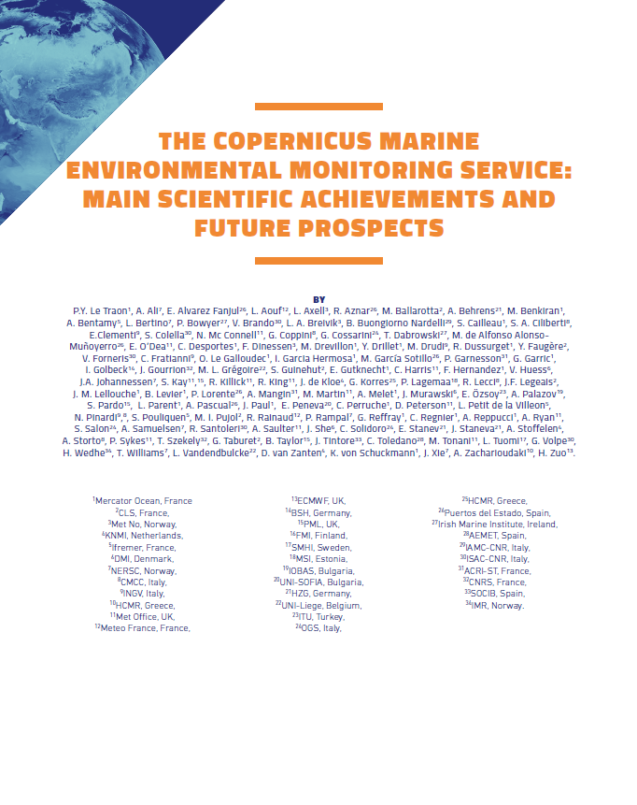
R&D achievements from TACs and MFCs
Tier-1 R&D
https://www.mercator-ocean.fr/en/science-publications/mercator-ocean-journal/mercator-ocean-journal-56-special-issue-cmems/

Slide 18

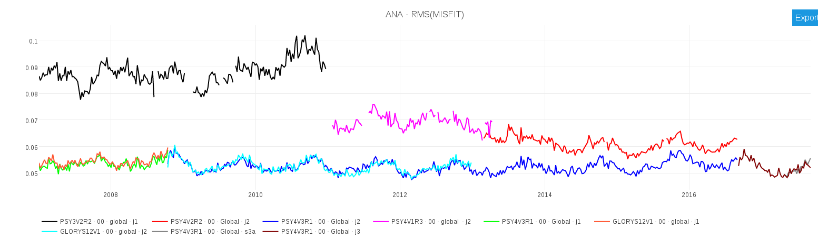
Evolution of sea level analysis errors - global system
Improved model resolution
Improved data assimilation
New observation (S3)
GLOBAL ¼° V2 opr
GLOBAL 1/12° V1 opr
GLOBAL 1/12° V2 opr
GLOBAL 1/12° RAN
GLOBAL 1/12° V3 opr
J1
J2
J2
J3
S3a
GLO MFC team
Notes:
Evolution des performances des systèmes
Le score présenté ici est la RMS du MISFIT en SLA en global pour différent système au ¼° et au 1/12°.
L’erreur était entre 8 et 9 cm dans le système au ¼° opéré pendant MyOcean
Il était entre 6 et 7 cm dans les systèmes au 1/12° pendant MyOcean et au début de CMEMS
Il est maintenant compris entre 5 et 6 cm et est homogène pour les satellites Jason et Sentinel3 en réanalyse et dans le système opérationnel.

Slide 19
The essential role of in-situ and satellite upstream observations

Slide 20
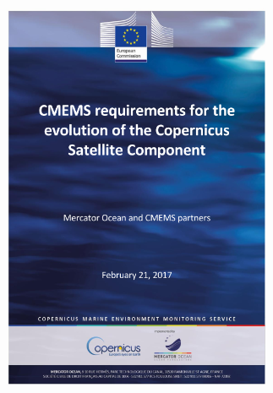
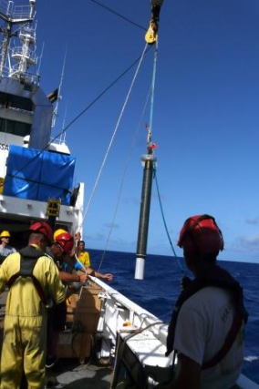
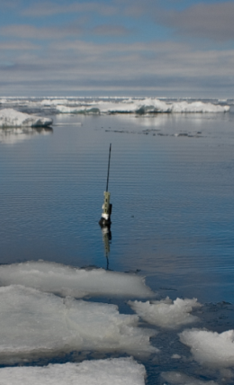
The essential role of observing systems
CMEMS offer is highly dependent on the satellite and in-situ observing capabilities (validation, assimilation).
CMEMS has defined its present/future requirements both for in-situ and satellite observations.
Service and Service evolution require 1/ continuity and 2/ significant improvements of ocean observing capabilities

Slide 21
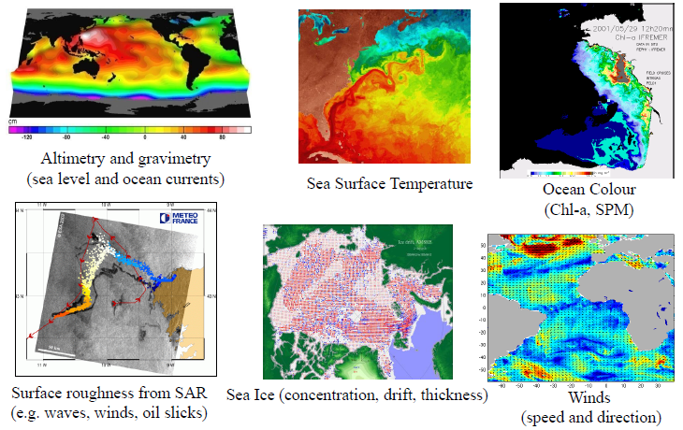
CMEMS Satellite Observations
Sea Level, SST, Sea Ice, Ocean Colour, Wave, Wind Thematic Assembly Centers
Major contribution of Sentinel missions (S1, S3, Jason-3/S6 and S2) + contributing missions (e.g. Metop, MSG, Alti-Ka, SMOS, Cryosat-2, VIIRS, AMSR-2, etc)

Slide 22
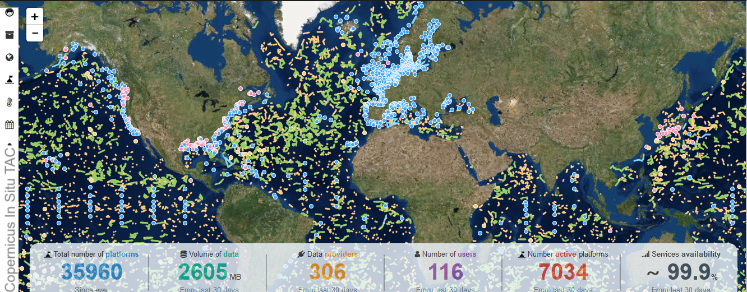
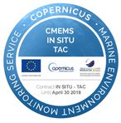
CMEMS In-Situ Observations
CMEMS In-Situ Thematic Assembly Center (last 30 days)

Slide 23
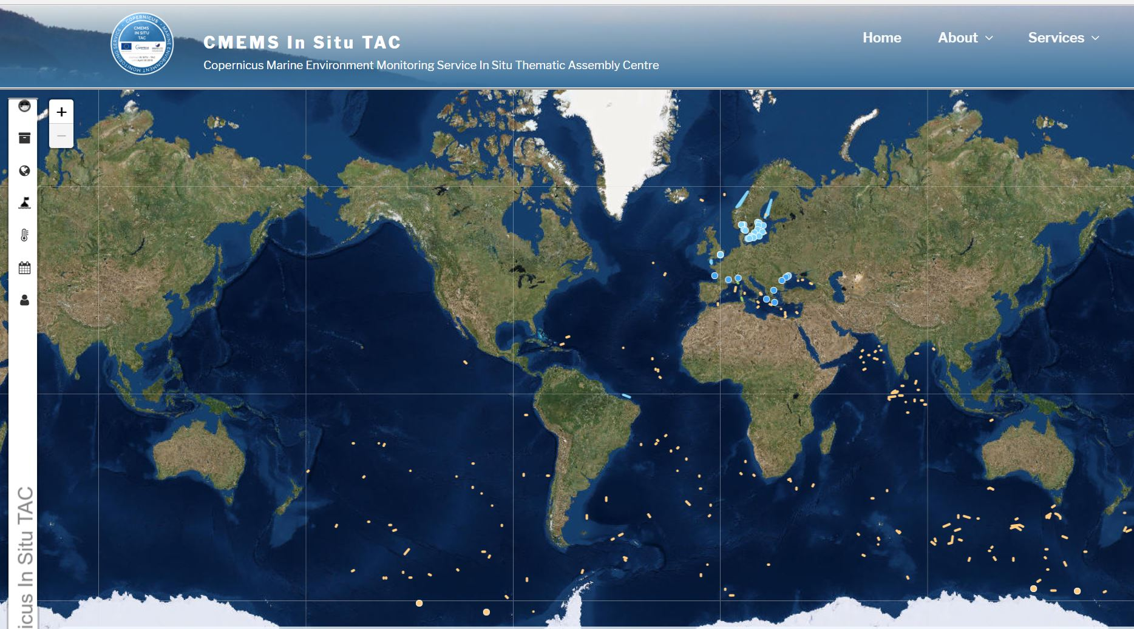
CMEMS in-situ TAC
Biogeochemical data/Chl-a available over one month

Slide 24
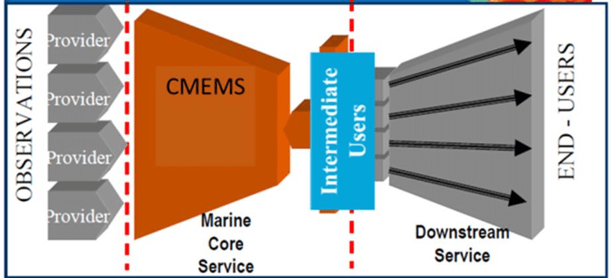
The added value chain: from observations to users
User requirements do not directly translate into observation requirements. Need to take into account the added value chain that goes from observations to information and assessment.

Slide 25
Observation impact studies
Observation impact studies are performed to:
  verify that observation information is « optimally » used in the analysis step and improve the assimilation components
  quantify the impact of the present observation network in ocean analysis and forecasts,
  demonstrate the value of an observation network for operational ocean analysis and forecasts,
  help defining and testing future observing systems from an integrated system perspective involving satellite and in-situ observations and numerical models.
OSEs (Observing System Evaluations) => assessing the impact of existing data sets on a data assimilation system (by withholding observations).
OSSEs (Observing System Simulation Experiments) => help designing new observing systems and to perform preparatory data assimilation work.

Slide 26
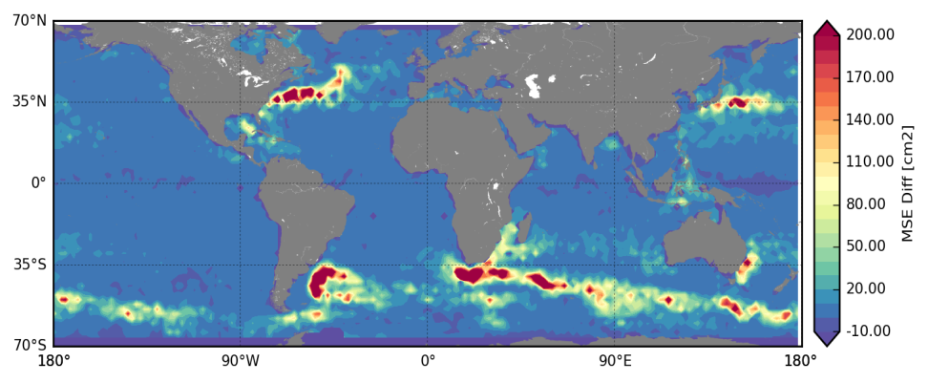
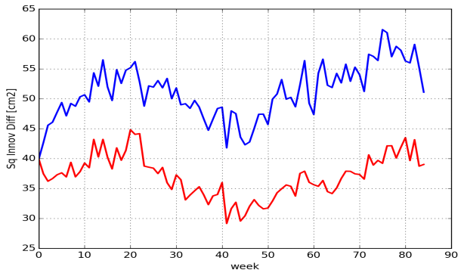
Impact of the altimeter constellation (OSE)
Studies performed to assess the impact of the number of altimeter on the quality of ocean analyses and forecasts.
Forecast error is divided by 2 when moving from 1 to 4 altimeters.
Hamon et al., 2017 (CNES study)
7-day sea level forecast errors : PSY3OSE1 - PSY3OSE4
Variance of 7-day sea level forecast error

Slide 27
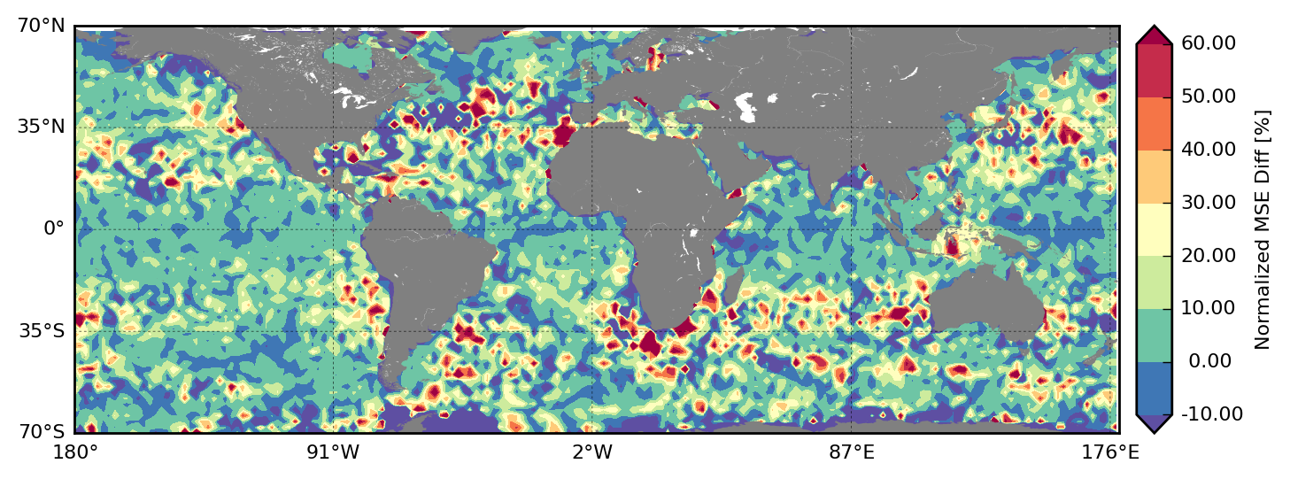
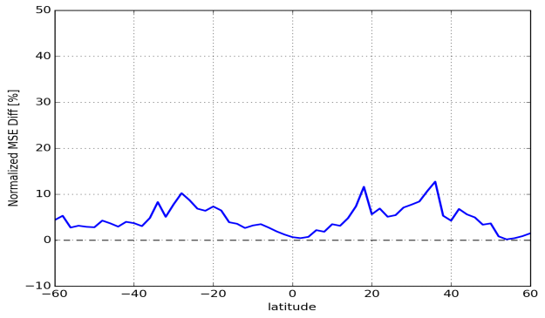
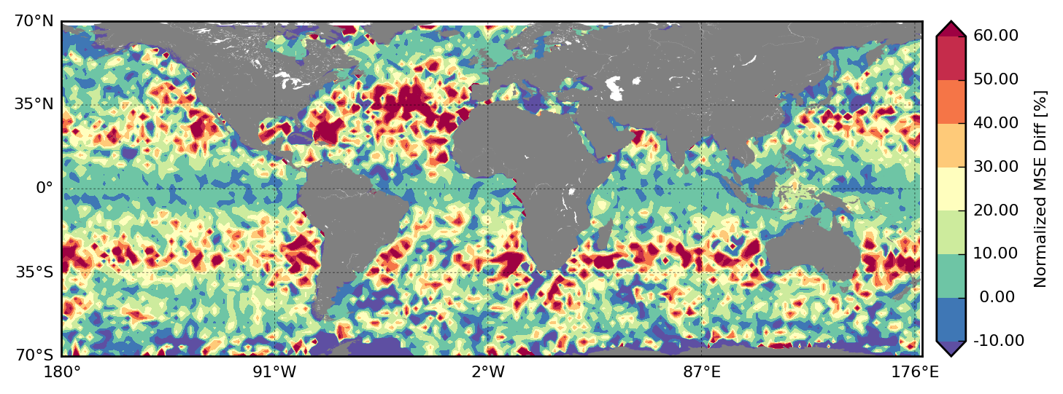

Impact of the altimeter constellation (OSE)
Contribution of a 4th altimeter in a 1/4° model and a 1/12° model (Hamon et al., 2017): Reduction of 7-day forecast errors in % wrt to a 3 satellite configuration.
PSY3
PSY4

Slide 28




Impact of Argo for the Copernicus Marine Service
1-year OSEs with the Mercator Ocean global ocean ¼° analysis and forecasting system (Turpin et al., 2016). Impact of the assimilation of Argo floats and their density.
RMS of 0-300 m temperature differences between Run-Ref and Run-NoArgo
Absolute (left) and normalized (right) RMS of temperature innovations for Run-Ref(blue), Run-Argo/2(yellow), Run-NoArgo (green) and Free Run (red)
Temperature and Salinity forecast errors are reduced by 20% to 60% when Argo float are assimilated. Keeping only half of the Argo floats degrades significantly the analysis.

Slide 29


The extension of Argo into the deep ocean
2010 OHC error in the deep and abyssal oceans for the Backbone, DEEP4000 and DEEP6000 experiments
Gasparin et al., 2018

Slide 30


Future altimeter observations
Today requirements: at least 4 altimeters. Longer term requirements : (much) higher resolution. Model resolution likely to increase by a factor 3 for the post 2021 time period to better represent upper ocean dynamics.
3 Conventional altimeters (colors), Truth (contour)
SWOT (colors), Truth (contour)
A series of Swath altimeters and conventional altimeters ?
Copernicus satellite component LTS
OSSEs in the IBI regional model (North East Atlantic) (SWOT/CNES study)
Nature Run (truth) 1/36°assimilated in a 1/12° model (Benkiran et al., 2017)

Slide 31

CMEMS requirements for the long term evolution of the Copernicus Satellite Component
Based on user requirements and the evolution of the CMEMS for the next decade, the main CMEMS recommendations for the evolution of the Copernicus Satellite Component are as follows:
Ensure a continuity of the present capability of the Sentinel missions (S1, S3, S6) (+ S2)
Develop new capabilities for wide swath altimetry
Fly a geostationary ocean colour mission over Europe to strongly improve the time resolution of ocean colour observations over European seas.
Fly a European microwave mission for high spatial resolution ocean surface temperature and sea ice concentration.
Ensure continuity (with improvements) of the Cryosat-2 mission for sea ice thickness monitoring and sea level monitoring in polar regions.
R&D actions should be developed, in parallel, to advance our capabilities to observe sea surface salinities and ocean currents (e.g. SKIM) from space.

Slide 32
CMEMS requirements – in-situ observations
Critical sustainability gaps, sampling gaps and major gaps for biogeochemical observations (e.g. carbon, oxygen, nutrients, Chl-a).
Sustaining the Argo global array, consolidating its regional components and implementing its major extension (Biogeochemical Argo and Deep Argo) are strong priorities to CMEMS.
Improving EuroGOOS ROOSes (Regional Ocean Observing Systems) and key observing systems such as FerryBoxes, gliders, tide gauges and HF Radars are also strong priorities for regional CMEMS products.
Mercator Ocean is working with the European Environment Agency and EuroGOOS in the framework of a future European Ocean Observing System (EOOS) to address these gaps and consolidate / improve global and regional in-situ observing systems.
A more detailed analysis of CMEMS requirements is now being prepared in collaboration with EuroGOOS. Inputs to EOOS and OceanObs19.

Slide 33


Conclusions
Copernicus Marine Service: a successful initial phase. operational, user uptake, R&D achievements.
A service evolution strategy based on user needs and science/technology advances.
Service and service evolution are strongly linked to the evolution observing systems. CMEMS role: requirements (integrated systems), impact assessment and advocacy.
CMEMS Phase II (2018-2020) = service continuity and evolutions based on R&D advances and evolution of observing systems (Sentinels).
Strategy for the post 2021 evolution under elaboration

