Slide 1
JCOMM, JCOMM OCG, and regional projects TPOS/AtlantOS: managing/coordinating recommended observing system changes and other potential roles for JCOMM and the OCG
David Legler, Susan Wijffels, Brad deYoung

Slide 2
Outline
How are JCOMM, OCG, and observing networks coordinating and managing the recommended changes from regional pilots (e.g. TPOS, AtlantOS, etc)
Nature of recommended ocean observing changes?
Strategy for coordinating the implementation of recommended observing system changes? e.g. changes in observing systems, testing and incorporation of new technologies, communicating of progress towards observing changes?
Progress to date (if any)?
Advice to JCOMM and OCG? (e.g. needs? Actions?)

Slide 3
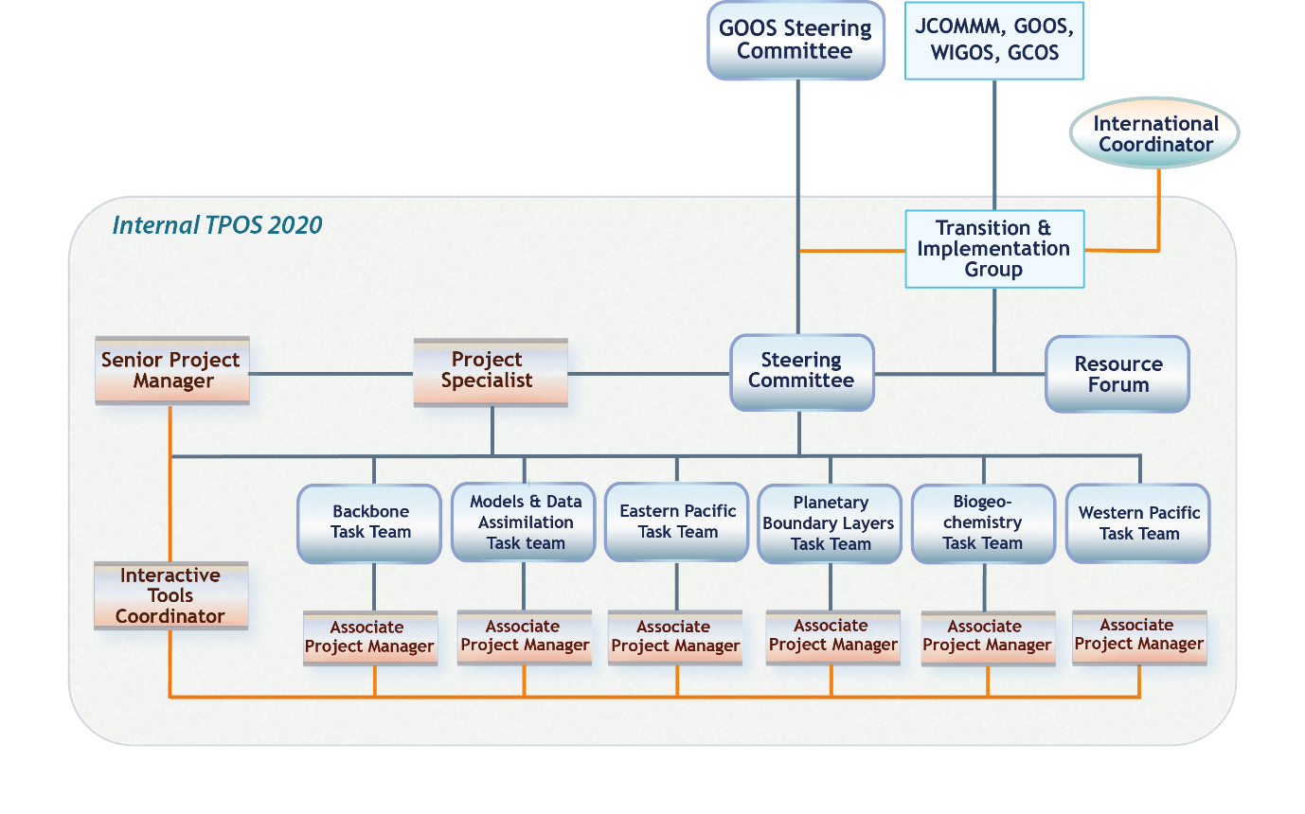
TPOS 2020 Structure
Transition & Implementation
TT
Governance elements:
  (new) Transition and Implementation TT

Slide 4
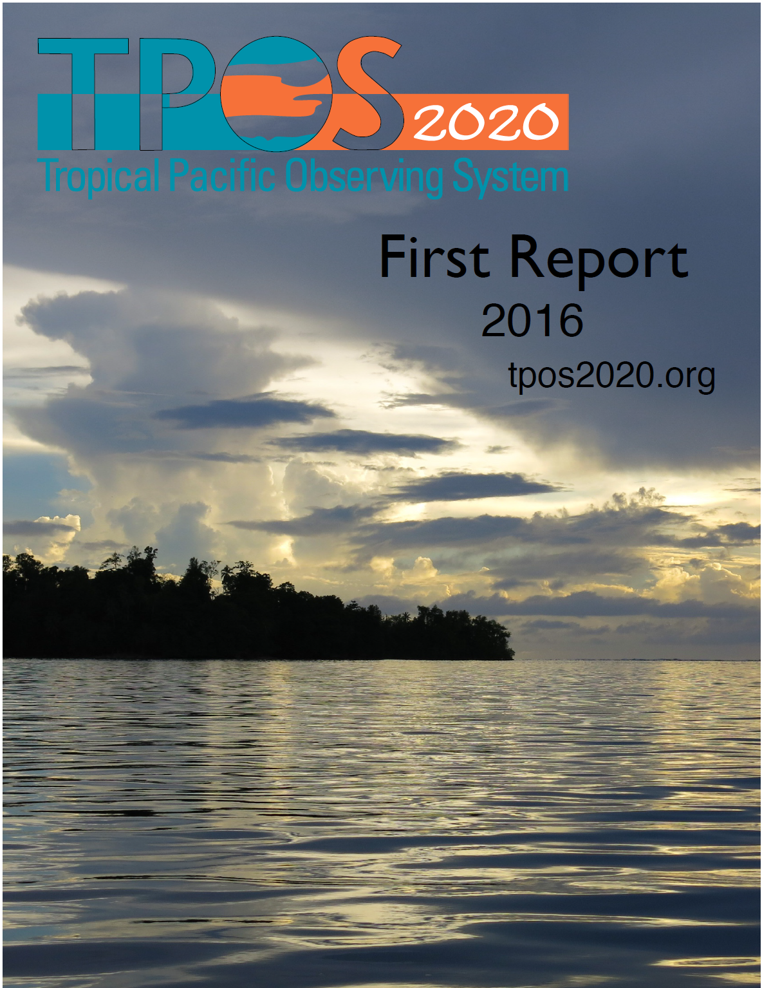
The First Report
Published
  Published 30th December 2016 (GOOS-215)
  Exec summary translated and published (6 languages)
Analysis of requirements
  Comprehensive
  Balmaseda et al (White paper, 2014) and Fujii et al (QJRMS 2015) influential papers
Design Principles
  read with GCOS, WIGOS Principles
22 Recommendations
  Many taking long view, beyond TPOS 2020
  Main link to GOOS/GCOS (and JCOMM)
15 Actions
  TPOS 2020 SC, JCOMM, …
  All actions relevant for GOV but closest ties through 14 (pilots 6.1.6, 6.1.7; Fujii and Kumar)

Slide 5
Recommendations
Maintain space-based broad-scale measurements of the essential ocean surface variables
  vector winds, SSH, SST, SSS, precipitation, and ocean color)
Maintain in situ measurements to improve the calibration, evaluation and validation of the satellite measurements, and inter-calibrate satellite missions and instruments.
Enhance in situ obs of state variables to estimate surface heat and freshwater fluxes, focus on key climate regimes.
  Satellite-based estimates remain problematic
  NWP/Reanalysis biases remain large
    NWP community has recommended work; We must take up offer
  Primary requirement is to improve understanding, models → key climate regimes

Slide 6
Recommendations (2)
Reconfigure the fixed-point moored array:
  more capable moorings, targeting the equatorial circulation, the mixed layer and its interaction with the atmosphere, and key regimes,
Double subsurface temperature and salinity profiling throughout the tropics (10S-10N) through an enhanced Argo presence, and
Initiate pilot and process studies to guide the future design, using the most effective combination of platforms and technologies.

Slide 7
Towards Implementation
Developed Roadmap for future implementation
  Endorsed by sponsors – 15 Agencies
Established Transition and Implementation Task Team with JCOMM
  Now a WIGOS Pre Operational Regional Pilot
  WMO EC-69 TPOS decision
  JCOMM-V Decision 7.1/6
Western Pacific implementation moving quickly
  Good links with YMC

Slide 8
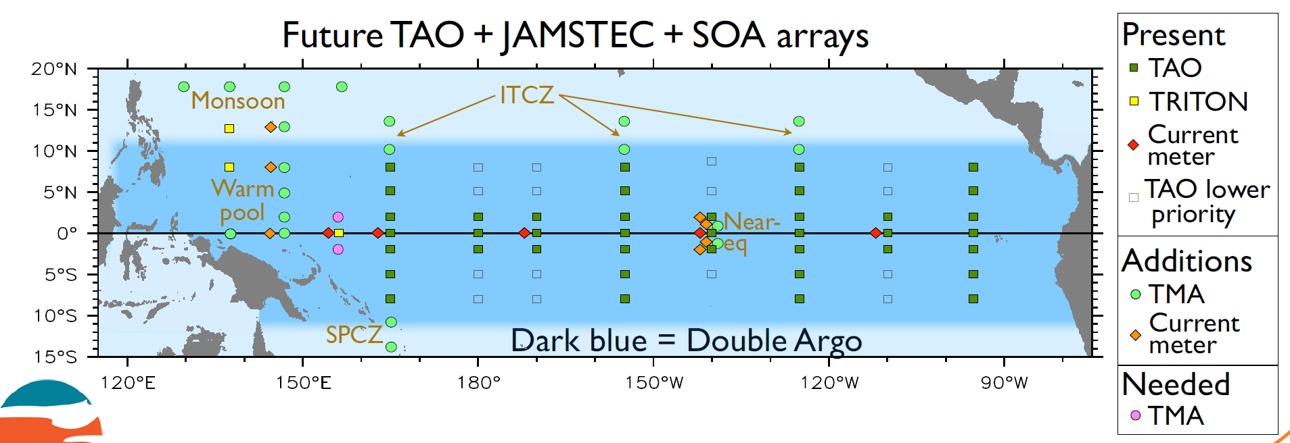
Possible configuration – strong new plans in the west from China

Slide 9
Status on TPOS2020 recommendations:
Tropical Moored Array
strong interest from China and some regional partners for a new and more comprehensive moored array in the western Pacific (where TRITON has been reduced to 3 sites
Cooperative links between implementation partners has been established (SOA/NOAA)
Exact configuration of the TMA is still under discussion
More capable surface flux and upper ocean moored configurations are being tested in funded pilots

Slide 10
Status on TPOS2020 recommendations:
Argo
few national programs have yet secured funding to enhance the 10N-10S coverage. Only modest commitments are secured and these are essentially at the cost of deployments elsewhere (from core funding).
currently the US operates 90% of floats in the TPOS – it would be healthier if other nations increased contributions
implementation could happen quickly: the present 362 float array can be maintained with an additional 80 floats per year
doubling could happen quickly if funded - batches of 20 or more, can be deployed by commercial sailing vessel for $3000 per float anywhere in the TPOS domain
AST and perhaps TPOS 2020 will need to be mre energetic in promoting funding for float deployments in the TPOS domain. Advice will go to the TPOS2020 Transition Team via the TPOS 2020 SC
Argo is juggling calls for many different enhancements – only those that attract funding can be implemented without damaging the core coverage

Slide 11
Status on TPOS2020 recommendations: the challenge of transition and overlap
there is community concern about the climate record - especially for winds and surface fluxes
Ideally we would have observational overlap between systems before a transition is started to demonstrate improved capability
In practice this is very hard to afford, especially in times of limited budgets, and we are often reacting to short term national agency decisions (e.g. decommissioning of most TRITON sites, degradation of regional sea level sites, etc)
TPOS BackBone Task team is wrestling with this issue – to try to find a practical path forward to manage the change, take advantage of learnings from pilots and not take 20 years!
Advice will go to the TPOS2020 Transition Team
Feedback from OCG is most welcome.

Slide 12
TPOS 2020 Transition and Implementation Task Team (T&I TT)
Terms of Reference key elements
  Focal point within TPOS 2020 for matters related to implementation;
  Review/consider Pilots, new technology;
  Advise on governance options for maintenance/implementation, TPOS 2020 and beyond
  Develop implementation plans (with SC);
  To consult and work with other Groups and expert teams of the T&I TT Sponsors, as appropriate; and ***
  To keep informed of the work of other relevant international organizations and programmes. ***

Slide 13
1st Report Actions: SC, TTs
● ● Lead

Slide 14
Atlantic Blueprint
Brad….

Slide 15
Discussion
How are JCOMM, OCG, and observing networks coordinating and managing the recommended changes from regional pilots (e.g. TPOS, AtlantOS, etc)
Needs for increased coordination of the implementation of recommended observing system changes? e.g. changes in observing systems, testing and incorporation of new technologies, communicating of progress towards observing changes?
Actions by JCOMM and/or OCG?

