Slide 1


OCG
OceanSITES
Johannes Karstensen
GEOMAR Helmholtz Centre for Ocean Research Kiel, Kiel, Germany
9th Session of the JCOMM Observations Coordination Group
14 - 17th May 2018, Brest, France

Slide 2
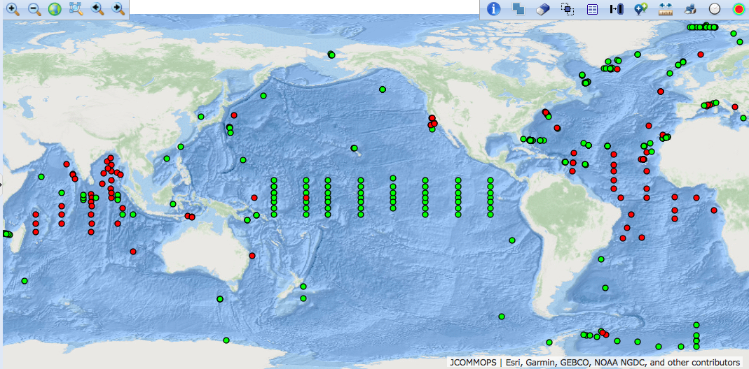
OceanSITES network
Current status
Moored and ship-based time series sites
  366 platforms registered (operational 65% /”inactive” 35%)
  21 countries contributing (33 + registered)
Three “core observing objectives”:
  Transport Moored Arrays
  Air/sea flux reference sites
  GlobalOceanWatch

Slide 3
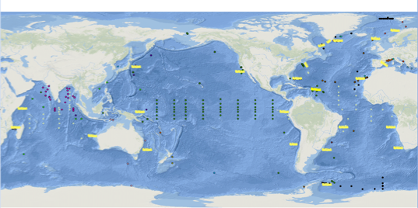
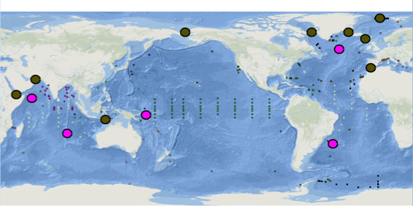
OceanSITES network core observing objectives
Transport Moored Arrays
  Installations that aim to determine volume & property transport
Last year
New transport sites in Atlantic:
– Vema Channel (Brazil); OSNAP Array
– oxygen „upgrade“ at many sites
Multinetwork observations
– BOON regions (Whitepapers; OOPC)
– JCOMMOPS as a tool to highlight observing effort??
Draft Design: BOON
Draft Design: Straits & Passages
Notes:
Observations are desired

Slide 4
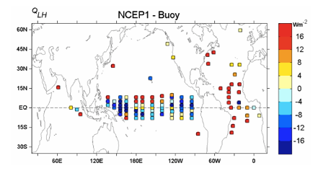
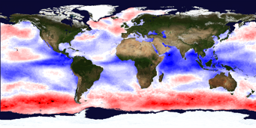
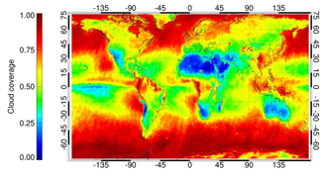
OceanSITES network core observing objectives
Air/Sea flux reference sites
  Cal/val at ocean/atmosphere interface (long time series & boundary layer physics, gas uptake,…)
Last year
– refinement of the important role in improving NWP
– observing gap: high latitude air/sea interaction; decommission of OOI site Southern Ocean
Draft Design
Map: Cloud cover
Draft Design
Map: Wind speed

Slide 5
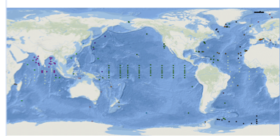
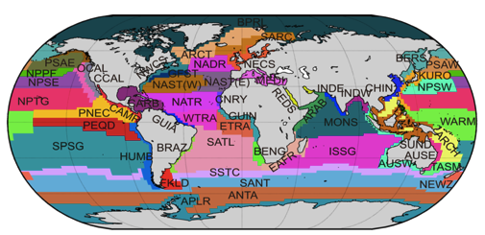
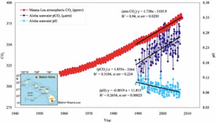
OceanSITES network core observing objectives
Global Ocean Watch
  “Long” time series
  note: for some parameter a seasonal cycle is “long”
  Regions considered “representative” for larger areas (biogeochemical provinces, gyres, etc.)
Draft Design
Reygondeau et al, 2013
Notes:
Integration of Plankton-Observing Sensor Systems to Existing Global Sampling Programs (P-OBS)

Slide 6
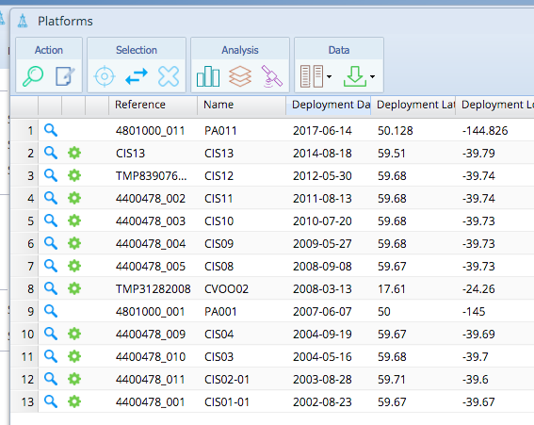
OceanSITES network core observing objectives
1st time that
Sediment trap, nutrient, oxygen, pH
are discoverable at oceansites.jcommops.org
Global Ocean Watch
  “Long” time series
  note: for some parameter a seasonal cycle is “long”
  Regions considered “representative” for larger areas (biogeochemical provinces, gyres, etc.)
Last year
– upgrade with Ocean Tracking network sensors at many sites
– SCOR Working group 154: P-OBS legacy Target strength data
– First non-physics sensors appear at oceansites.jcommops.org
Draft Design
Reygondeau et al, 2013
Notes:
Integration of Plankton-Observing Sensor Systems to Existing Global Sampling Programs (P-OBS)

Slide 7
OceanSITES network
Activties
New Technical coordinator hired in late 2017
  Champika Gallage left 10. Sept 2016 / Long Jiang started 01. Nov. 2017 (Note on JCOMMOPS budget: 13.5 month no salary expenses on TC)
Executive calls (every 4 month) & in-person meeting Feb. 2018
Data management Team – telcon every month
Joint JCOMMOPS/OceanSITES workshop at Ocean Sciences Meeting 2018
US transport sites & Surface mooring review
Deep Ocean Challenge (T/S sensor pool)
SCOR WG 154: Plankton Obs. (P-OBS)
OceanSITES White paper abstract for OceanObs19
Preparation for 12th OceanSITES meeting (2.-6. July 2018, Kiel, Germany)

Slide 8
OceanSITES network
Transition to JCOMMOPS metadata management system
Three phases:
  Preparatory phase (completed):
  metadata needs (OS perspective) introduced;
  populated with data from former OS XLS spread sheet
  Implementation phase (ongoing):
  refinement/adaptation of JCOMMOPS DB for OS needs; use „test sites“ of different complexity;
  expand to all sites & combine with “training!”
  Operational phase (mid 2019 onwards):
  site PI/operators maintain the site management -
  via JCOMMOPS website frontend; netCDF files; XML files; other standard metadata (e.g. European EMSO)
  TC assists only
TC updated all site contacts (key information for implementation phase)

Slide 9
OceanSITES network
Data Management Team
DMT assist data providers to make their data discoverable and accessible
Core “product” is the OceanSITES netCDF format
DMT & JCOMMOPS are in dialogue to ensure Metadata in netCDF file is sufficient to provide input for the JCOMMOPS metadata base (e.g. instruments, site categorise, telemetry system used). Note: Challenge for legacy data!
DMT & SC working on “products” to distribute:
  “Existing products” (e.g. heat, freshwater, properties timeseries)
  Link to Obs4MIPS (WDAC)
ERDAP as a “tool” to concatenate time series BUT not a real integration
Doing more sites/ requires more funding…

Slide 10
OceanSITES network
Forward Look
Continue JCOMMOPS metadata integration
Make “multidisciplinary” dimension “visible” AND obs. Data discoverable
Work towards closing gaps in observing (considering core science missions)
Work towards availability/citeability of OceanSITES time series (e.g. visibility, DOI) – look for examples in the network;
Contribute to development of cross networks observing system performance indicators in the frame of JCOMMOPS
Work on enhancement of DOOS instrumentation on OceanSITES; Continue with “Deep Ocean Challenge”
Synthesize Best practices documentation for OceanSITES:
e.g. HOTS/TAO Manuals; IMOS mooring toolbox, GEOMAR mooring toolbox; FixO3 Handbook;…
Collaboration with DBCP on technological aspects and site management coastal/open ocean sites

Slide 11
Thank you!

