Slide 1





Coordination of Biogeochemistry Observations
Beyond Observing Networks
Maciej Telszewski, IOCCP Director
Biogeochemistry
Panel
Institute of Oceanology of Polish Academy of Sciences, ul. Powstańców Warszawy 55, 81-712 Sopot, Poland
Phone: +48 58 731 16 10 / Fax: +48 58 551 21 30, www.ioccp.org
Biogeochemistry
Panel

Slide 2

IOCCP reporting on observing networks
Ship-based Fixed-Point Observatories
x
x
Moored Fixed-Point Observatories
Profiling Floats
x
x
Ship-based Underway Observations
Gliders
?
x
x
Ship-based Repeat Hydrography
Drifters
Satellite Remote Sensing

Slide 3

1
IOCCP plans to clarify and assemble a set of societal and scientific requirements and develop and implement observing and data management strategies for 3 biogeochemical EOVs.
Oxygen
Most feasible and impactful EOV
Measured on most observing networks
IOCCP Expert appointed and several activities ongoing
Nitrous Oxide
Global interest in information rises
Self-organized community exists around data product
Dissolved Organic Carbon
New territory for IOCCP
Opportunity to attempt readiness level increase from level 1 up
9th Session of the JCOMM Observations Coordination Group
15-17 May 2018, Brest, France
Biogeochemistry
Panel

Slide 4
GOOS Essential Ocean Variables
Physics & Climate
Biogeochemistry
Biology & Ecosystems
Sea State
Oxygen
Phytoplankton
Biomass & Diversity
Ocean Surface Stress
Nutrients
Zooplankton
Biomass & Diversity
Sea Ice
Inorganic Carbon
Fish
Abundance & Distribution
Sea Surface Height
Transient Tracers
Marine Turtles, Birds, Mammals Abundance & Distribution
Sea Surface Temperature
Particulate Matter
Hard Coral Cover & Composition
Subsurface Temperature
Nitrous Oxide
Seagrass Cover
Surface Currents
Stable Carbon Isotopes
Macroalgal Canopy
Subsurface Currents
Dissolved Organic Carbon
Mangrove Cover
Sea Surface Salinity
Ocean Colour
Microbe Biomass & Diversity
Emerging EOVs
Subsurface Salinity
Benthic Invertebrate Abundance & Distribution
Ocean Surface Heat Flux
EOV Specification Sheets: www.goosocean.org/eov
www.ioccp.org/foo
Notes:
After the publication of the February 2016 version of the Biogeochemistry EOV Specification Sheets, the process of preparing the next updated version started almost immediately. The main goals included: (i) harmonizing the EOV related definitions and Specification Sheet structures across the three disciplinary expert panels of GOOS, (ii) improving internal consistency of the content of the Biogeochemistry EOV Specification Sheets. During GOOS-SC-5, GOOS BGC Panel was also charged with the task of developing an Ocean Colour EOV in consultation with the ocean colour community; and with initiating a dialogue with the United Nations Environment Programme (UNEP) in relation to the potential development of a Marine Pollutants/Contamination EOV.
Here you see the current list of all GOOS EOVs.

Slide 5
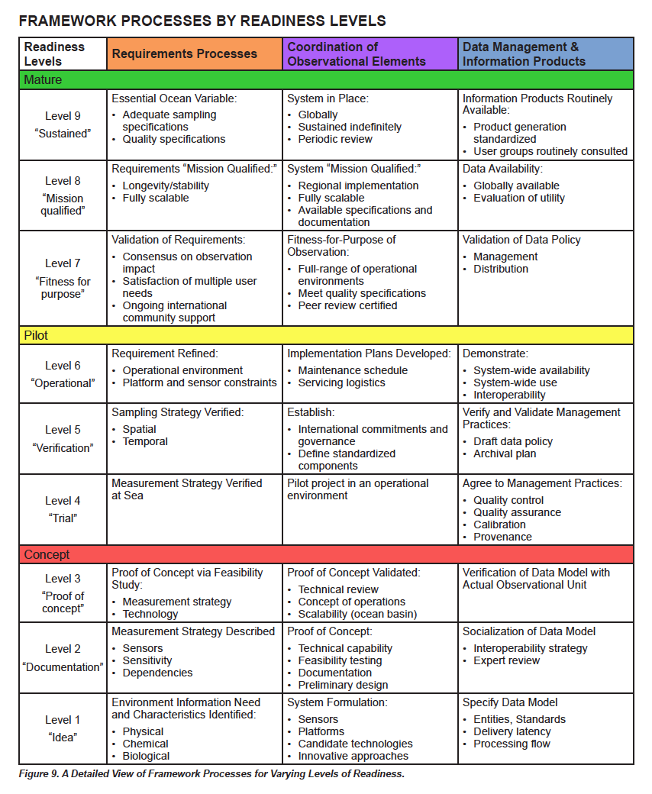
Towards sustained system: requirements, observations, data management Readiness
Mature
Pilot
Attributes:
Products of the global
ocean observing system are
well understood, documented,
consistently available, and
of societal benefit.
Concept
Increasing Readiness Levels
Attributes:
Planning, negotiating, testing, and approval within appropriate local, regional, global arenas.
Attributes:
Peer review of ideas and
studies at science, engineering, and data management
community level.
Notes:
The readiness levels are in fact an idea that has been with us on the physical side for a couple of decades, the precursor of OOPC (OODSP) spent a lot of time examining the feasibility and impact of different observing systems, to see if they were ready for global sustained observations. We believe that many biogeochemical and biological variables also need global sustained observations, but perhaps the technologies and techniques are not yet ready for instant application globally. We need to increase the readiness of these observing networks so they drive towards being capable of global sustained observations delivering an important data product that has impact on science or society.
If there is an ambition to run a regional pilot to build a future global system – this type of pull helps engage the research community, and they want to be engaged.
For Argo, new sensors should be and are being trialed in pilot projects, to improve their readiness for deployment on more of the array.

Slide 6
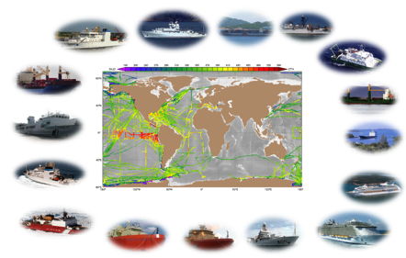
2
Coordinate the Surface Ocean CO2 Observing NETwork (SOCONET) .
9th Session of the JCOMM Observations Coordination Group
15-17 May 2018, Brest, France
Biogeochemistry
Panel

Slide 7
3
IOCCP plans to help develop a strategy for ship-based measurements of atmospheric CO₂ allowing to meet the rigorous accuracy requirements set by the atmospheric community required to constrain the global carbon cycle estimates in Earth system models.
Ocean regions remain severely under-sampled
Needed to better constrain of the global carbon cycle in Earth System models
to constrain atmosphere-land CO₂ fluxes
Ocean community CO₂ systems do not typically meet the rigorous accuracy standards of the atmospheric community
IOCCP, WMO’s Global Atmosphere Watch (GAW) and WMO/IAEA’a Greenhouse Gases and Measurement Techniques (GGMT) group, observational community centred around the SOCONET network will develop dedicated instrument and gas handling protocols allowing to achieve sufficiently accurate data using existing measurement systems
9th Session of the JCOMM Observations Coordination Group
15-17 May 2018, Brest, France
Biogeochemistry
Panel

Slide 8
4
IOCCP will continue to develop and promote the use of standards, reference materials, manuals, best practices, etc. among the marine biogeochemistry observationalist community
User Manuals
come from developer/manufacturer
Good to assemble and for deployment
Specs often recorded in unrealistic environment
Standard Operating Procedures
Very comprehensive one parameter, one platform description
Describe method and not nuances of specific design
Best Practices (guides / manuals)
Practical knowledge plus elements of two above categories
Often developed for specific environment, phenomenon or platform
(Certified) Reference Materials and Standards
Provide trusted reference for calibration and quality control

Slide 9
Observing Approach ☞ |  |  |  | Ship-based Repeat Hydrography | Ship-based Underway Observations | Profiling Floats | Moored Fixed-point Observatories | Gliders | Ship-based Fixed-point Observatories | Satellite Remote Sensing | ...
EOV | Sub-variable | Procedure
INORGANIC CARBON |  | Measurement technique ☞
 | pCO₂ | Deployment & sampling
 |  | Data retrieval & formatting
 |  | Calibration / validation
 |  | Reference materials & standards
 |  | Primary quality control | (Near) real-time
 |  |  | Delayed-mode
 |  | Secondary quality control
 | DIC
 | Total Alkalinity
 | pH
OXYGEN
NUTRIENTS
TRANSIENT TRACERS
PARTICULATE MATTER
NITROUS OXIDE
STABLE CARBON ISOTOPES
DISSOLVED ORGANIC MATTER
OCEAN COLOUR
Standard Operating Procedures & Guides for Best Practices

Slide 10




Observing Approach ☞ |  |  |  | Ship-based Repeat Hydrography |  | Ship-based Underway Observations |  | Profiling Floats |  | Moored Fixed-point Observatories |  | Gliders |  | Ship-based Fixed-point Observatories
Leading Observing Network ☞
 |  |  |  | The Global Ocean Ship-Based Hydrographic Investigations Program (GO-SHIP) |  | Ship of Opportunity Programme (SOOP) |  | Biogeochemical Argo |  | OceanSITES |  | OceanGliders / Everyone's Glider Observatory (EGO)
EOV | Sub-variable | Procedure
INROGANIC CARBON |  | Measurement technique ☞ |  | Discrete samples NDIR |  | Non-dispersive infrared | Cavity ring down spectroscopy | Spectrophotometric |  | Non-dispersive infrared | Optode | Spectrophotometric | Optode | Non-dispersive infrared | Cavity ring down spectroscopy
 | pCO₂ | Deployment & sampling |  | Dickson et al. (2007, SOP4) |  | Dickson et al. (2007, SOP5) |  | e.g. Lorenzoni et al. (2017) |  | Dickson et al. (2007, SOP5) | FixO3 handbook (2016) | e.g. PRO-OCEANUS user manual |  | Dickson et al. (2007, SOP5)
 |  | Reference materials & standards |  | NOAA gas standards |  | NOAA gas standards |  |  |  | NOAA gas standards |  |  |  | NOAA gas standards
 |  | Calibration / Validation |  | Dickson et al. (2007, SOP4) |  | Dickson et al. (2007, SOP5) |  |  |  | Dickson et al. (2007, SOP5) | FixO3 handbook (2016) |  |  | Dickson et al. (2007, SOP5)
 |  | Data retrieval & formatting |  | Dickson et al. (2007, SOP4) |  | Dickson et al. (2007, SOP5) |  |  |  | Dickson et al. (2007, SOP5) | FixO3 handbook (2016) | e.g. PRO-OCEANUS user manual |  | Dickson et al. (2007, SOP5)
 |  | Primary Quality Control | (Near) real-time |  |  |  |  |  |  |  | FixO3 handbook (2016)
 |  |  | Delayed-mode | Dickson et al. (2007, SOP4) |  | Dickson et al. (2007, SOP5) |  |  |  | Dickson et al. (2007, SOP5) | FixO3 handbook (2016) |  |  | Dickson et al. (2007, SOP5)
 |  | Secondary Quality Control |  | Bakker et al. (2016) |  | Bakker et al. (2016) |  | Bakker et al. (2016) |  | Bakker et al. (2016) |  | Bakker et al. (2016) |  | Bakker et al. (2016)
*Satellite observations not included.
Notes:
Should individual user manuals be considered in here? Or as a separate category of documents?
IOCCP Tsukuba report + SOCAT docs

Slide 11
5
IOCCP plans to continue the development of the Global Data Assembly Centre for Marine Biogeochemistry and Automation and FAIR implementation across platforms and biogeochemical EOVs.
Data Management team at JCOMM OCG heavily involved (agenda item 9 at OCG9)
Integration with data flows for other parameters whenever possible
Following Argo – Biogeochemical Argo model
New data flow streams developed fully integrated with existing FAIR requirements
Oxygen and Nitrous Oxide will be a test
9th Session of the JCOMM Observations Coordination Group
15-17 May 2018, Brest, France
Biogeochemistry
Panel

Slide 12
























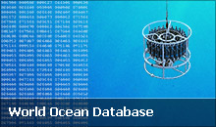

Biogeochemistry EOV Data Management
9th Session of the JCOMM Observations Coordination Group
15-17 May 2018, Brest, France
Biogeochemistry
Panel

Slide 13


Biogeochemistry EOV Data Management
Other Data products eg.TS
Repeat
Hydrography
U/D
VOS/SOOP
U/D
GDAC for Ocean
Biogeochemistry
Fixed Ocean
Times Series
U/D
Drifting
Platforms U/D
‘New’ platforms
Alternative sensors
U/D
Other
Cruises U/D
U = underway
D = discrete
9th Session of the JCOMM Observations Coordination Group
15-17 May 2018, Brest, France
Biogeochemistry
Panel

Slide 14
6
IOCCP will continue to support the existing data synthesis products: SOCAT and GLODAP and lead the development on new data synthesis products based on community needs in particular ocean acidification and time series communities.
SOCAT
Most feasible and impactful EOV
Measured on most observing networks
GLODAP
Global interest in information rises
Self-organized community exists around data product
Development of Time Series data product
New territory for IOCCP
Opportunity to attempt readiness level increase from level 1 up
9th Session of the JCOMM Observations Coordination Group
15-17 May 2018, Brest, France
Biogeochemistry
Panel

Slide 15

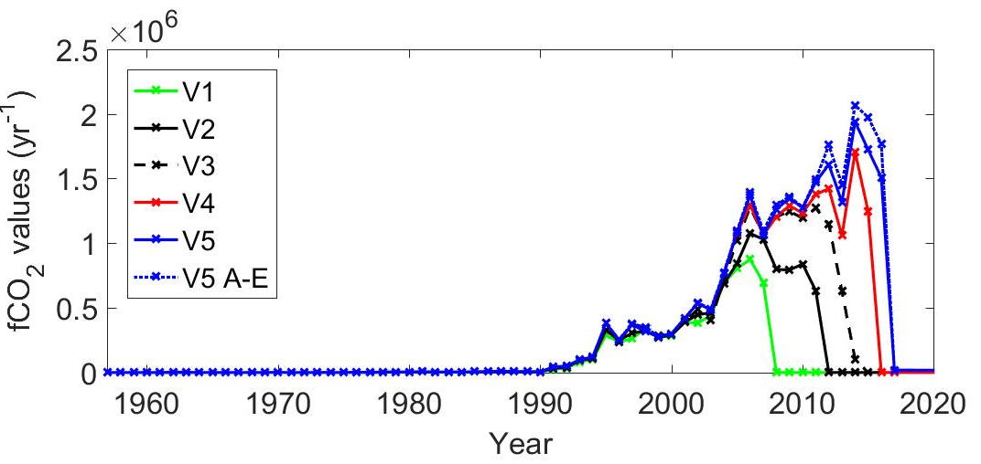
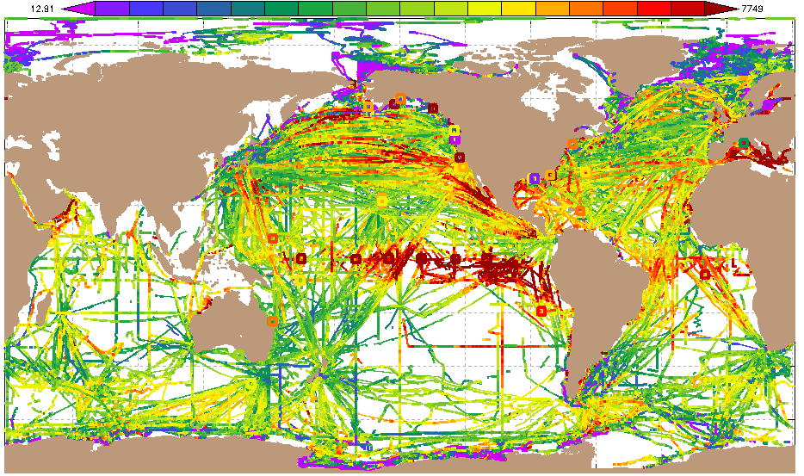
Surface Ocean CO₂ Atlas at 10!
www.socat.info
260 290 320 350 380 410 440
(µatm)
1957-2017
A-E, V5
Global synthesis and gridded products of surface ocean fCO₂
in uniform format with quality control;
V5: 21.5 million fCO₂ values from 1957-2017, accuracy < 5 μatm (flags A-D);
Plus calibrated sensor data (< 10 μatm, flag of E);
Interactive online viewers;
Online viewers, downloadable (text, NetCDF, ODV, Matlab);
Documented in ESSD articles;
Community activity with >100 contributors worldwide.

Slide 16
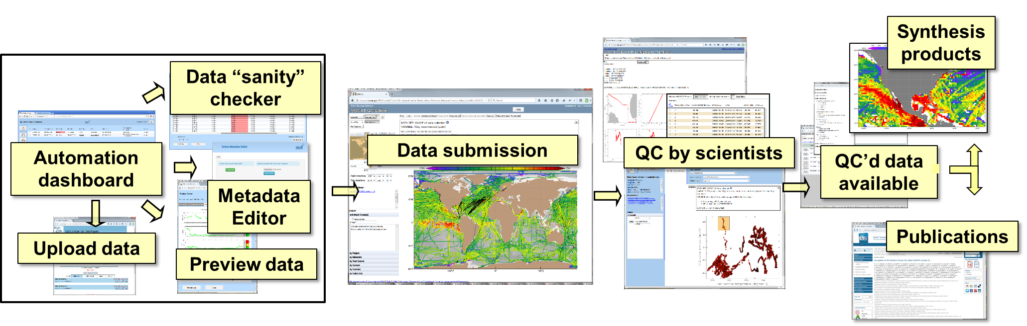
Release of SOCAT version 5 –
Annual release upon
automated data upload
www.socat.info
NEW data
Automation of data upload, initial data checks speeds up data submission and enables annual, public releases of SOCAT.
Online viewers.
SOCAT data is discoverable, accessible and citable.
Future: Automation of metadata upload.
(O’Brien et al., in prep.)

Slide 17
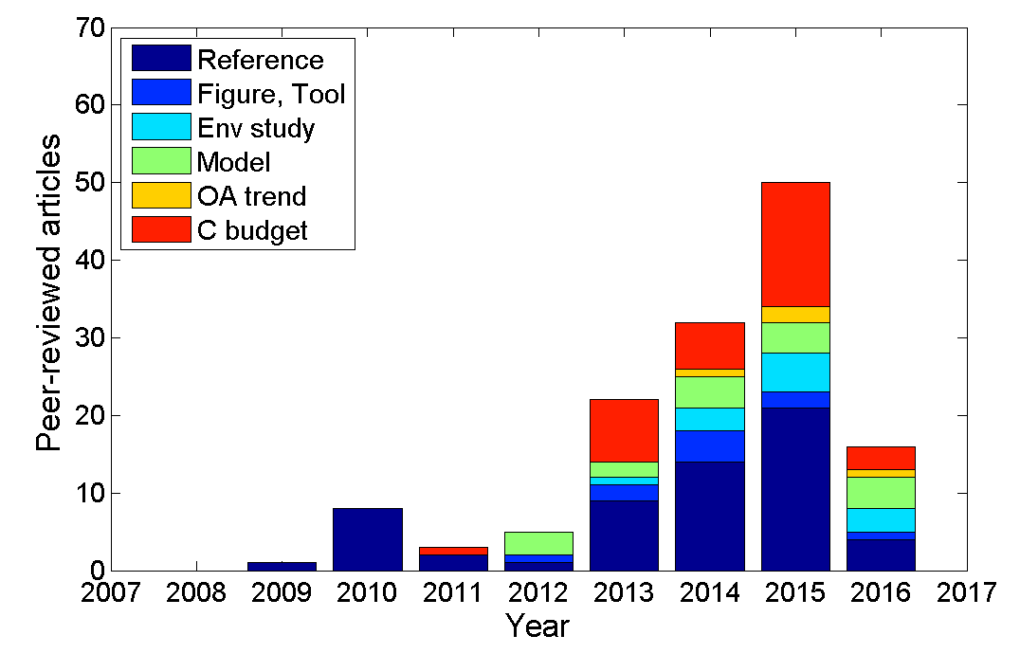
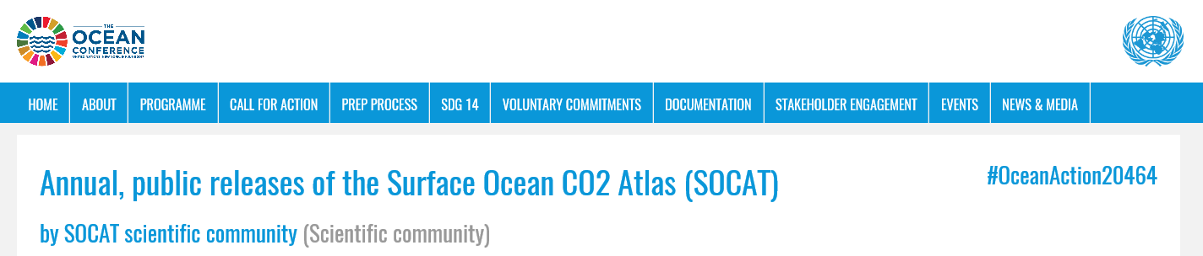
Applications
www.socat.info
SOCAT is named or cited in
194 peer-reviewed articles
Ocean carbon sink,
Ocean acidification and aragonite saturation clim,
Model evaluation,
Environmental studies,
Figures or tools,
Reference to SOCAT
(Bakker et al., 2016)
Voluntary Commitment to the 2017 UN Ocean Conference

Slide 18
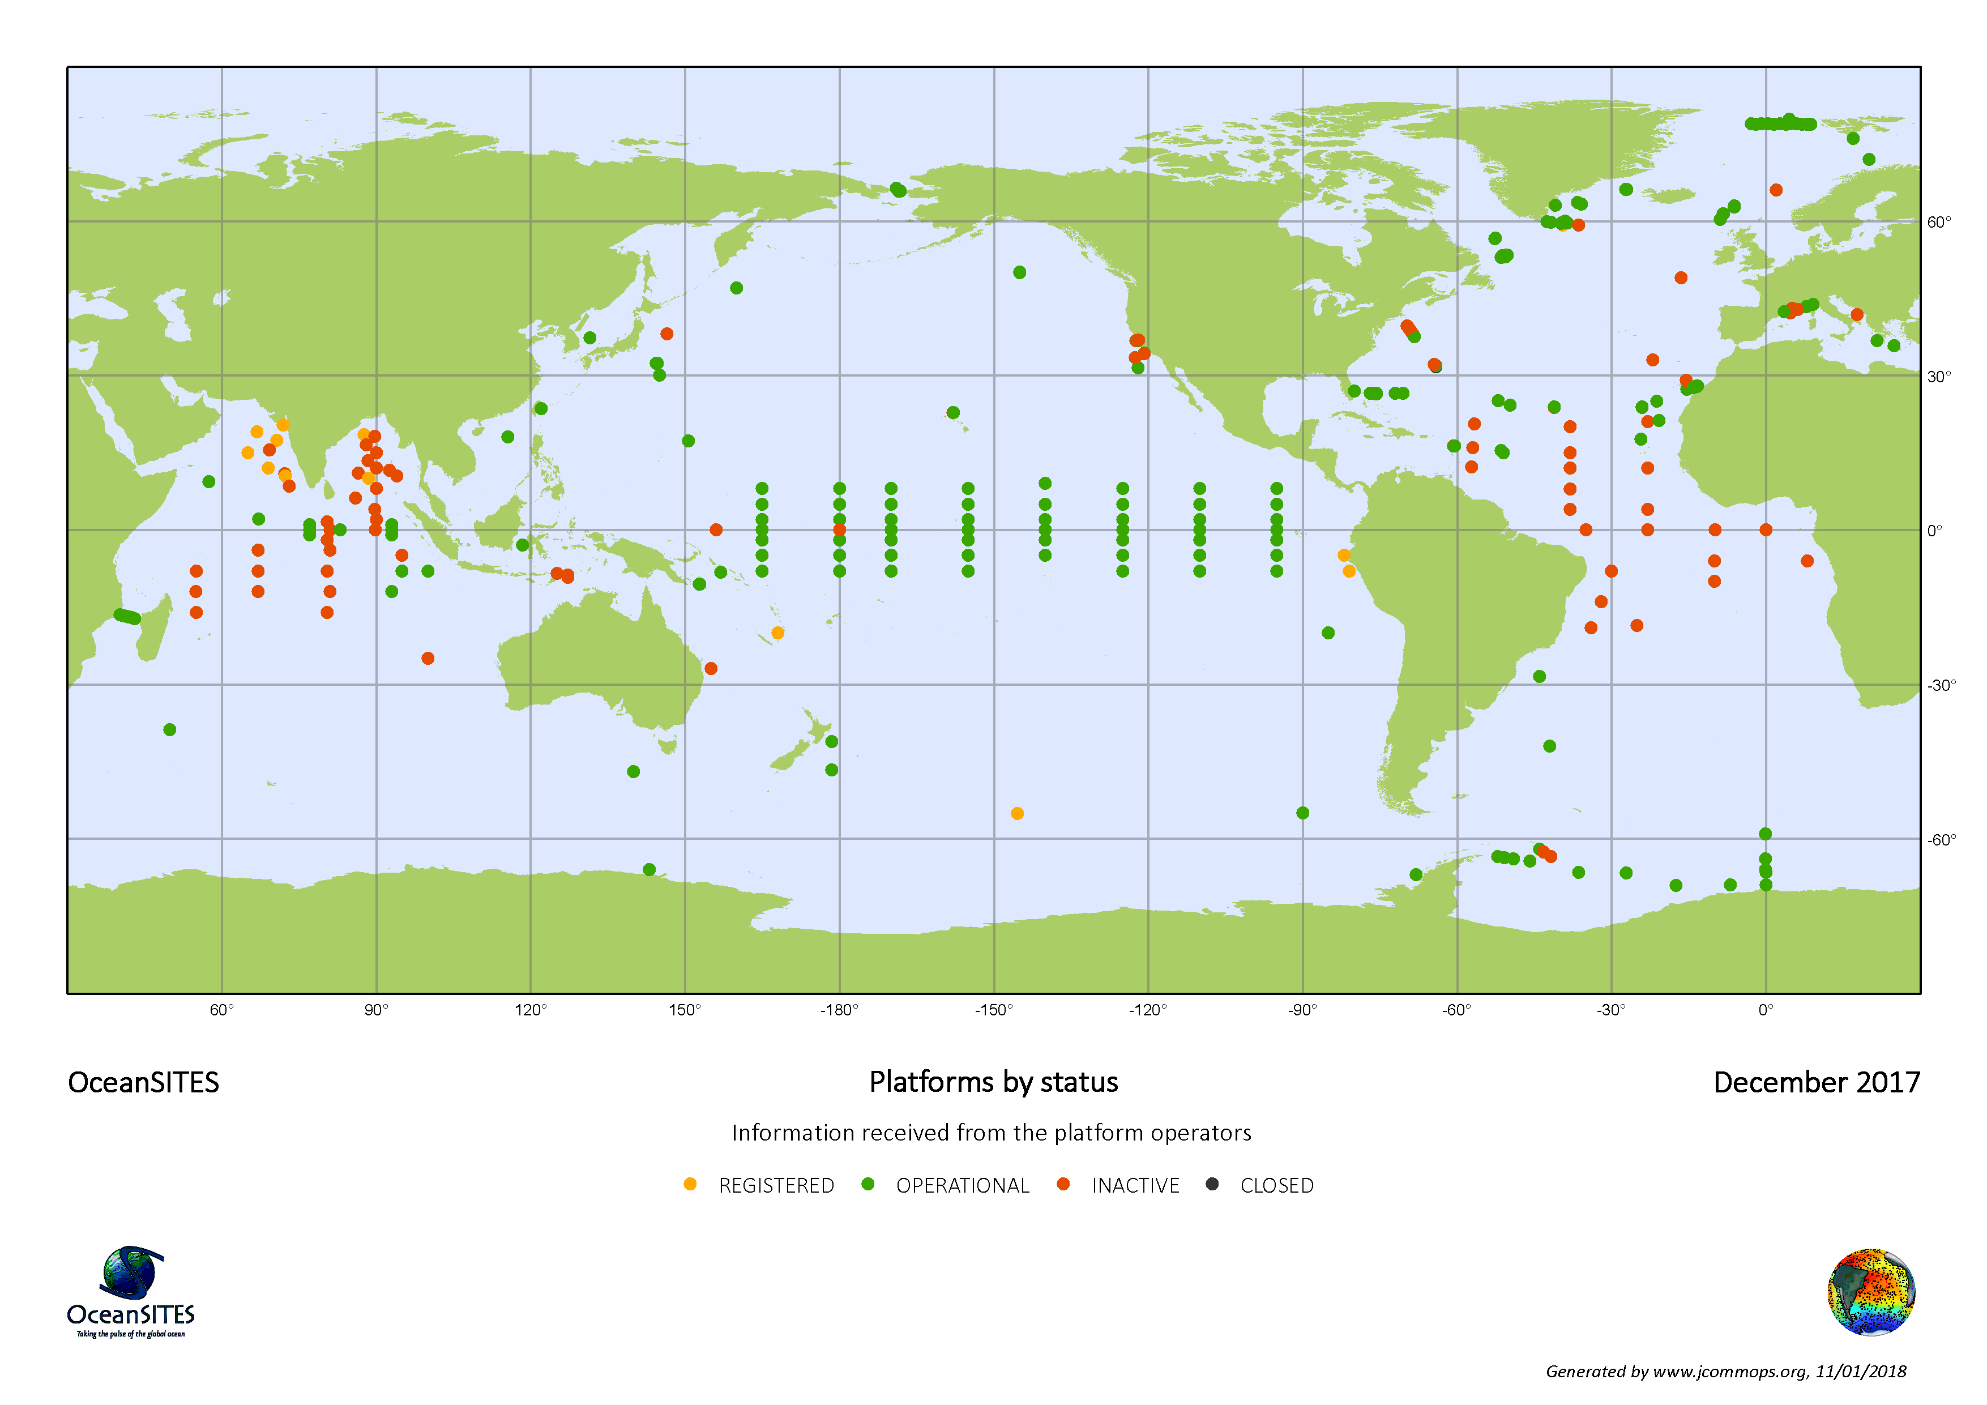
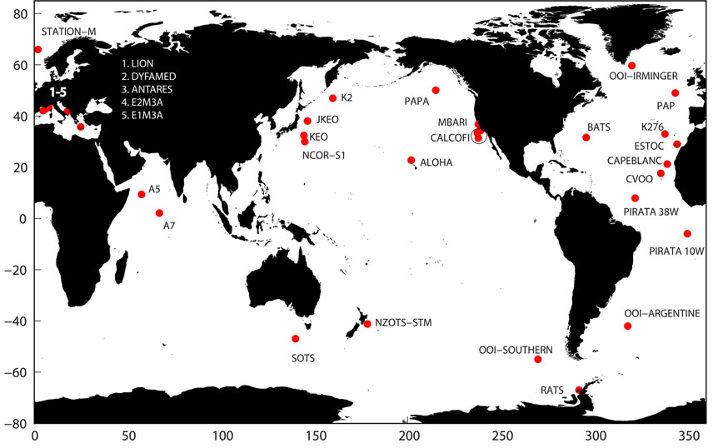
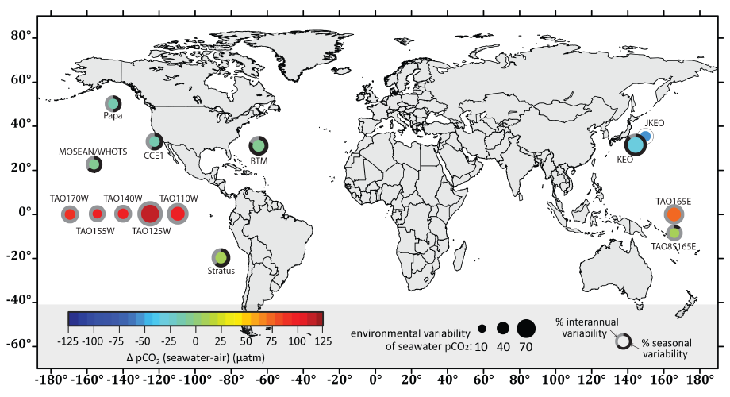
Biogeochemical Time Series
All OceanSITES – Dec 2017
BGC OceanSITES (Henson et al. (2016))
MapCO₂ sites (Sutton et al. 2014)

Slide 19
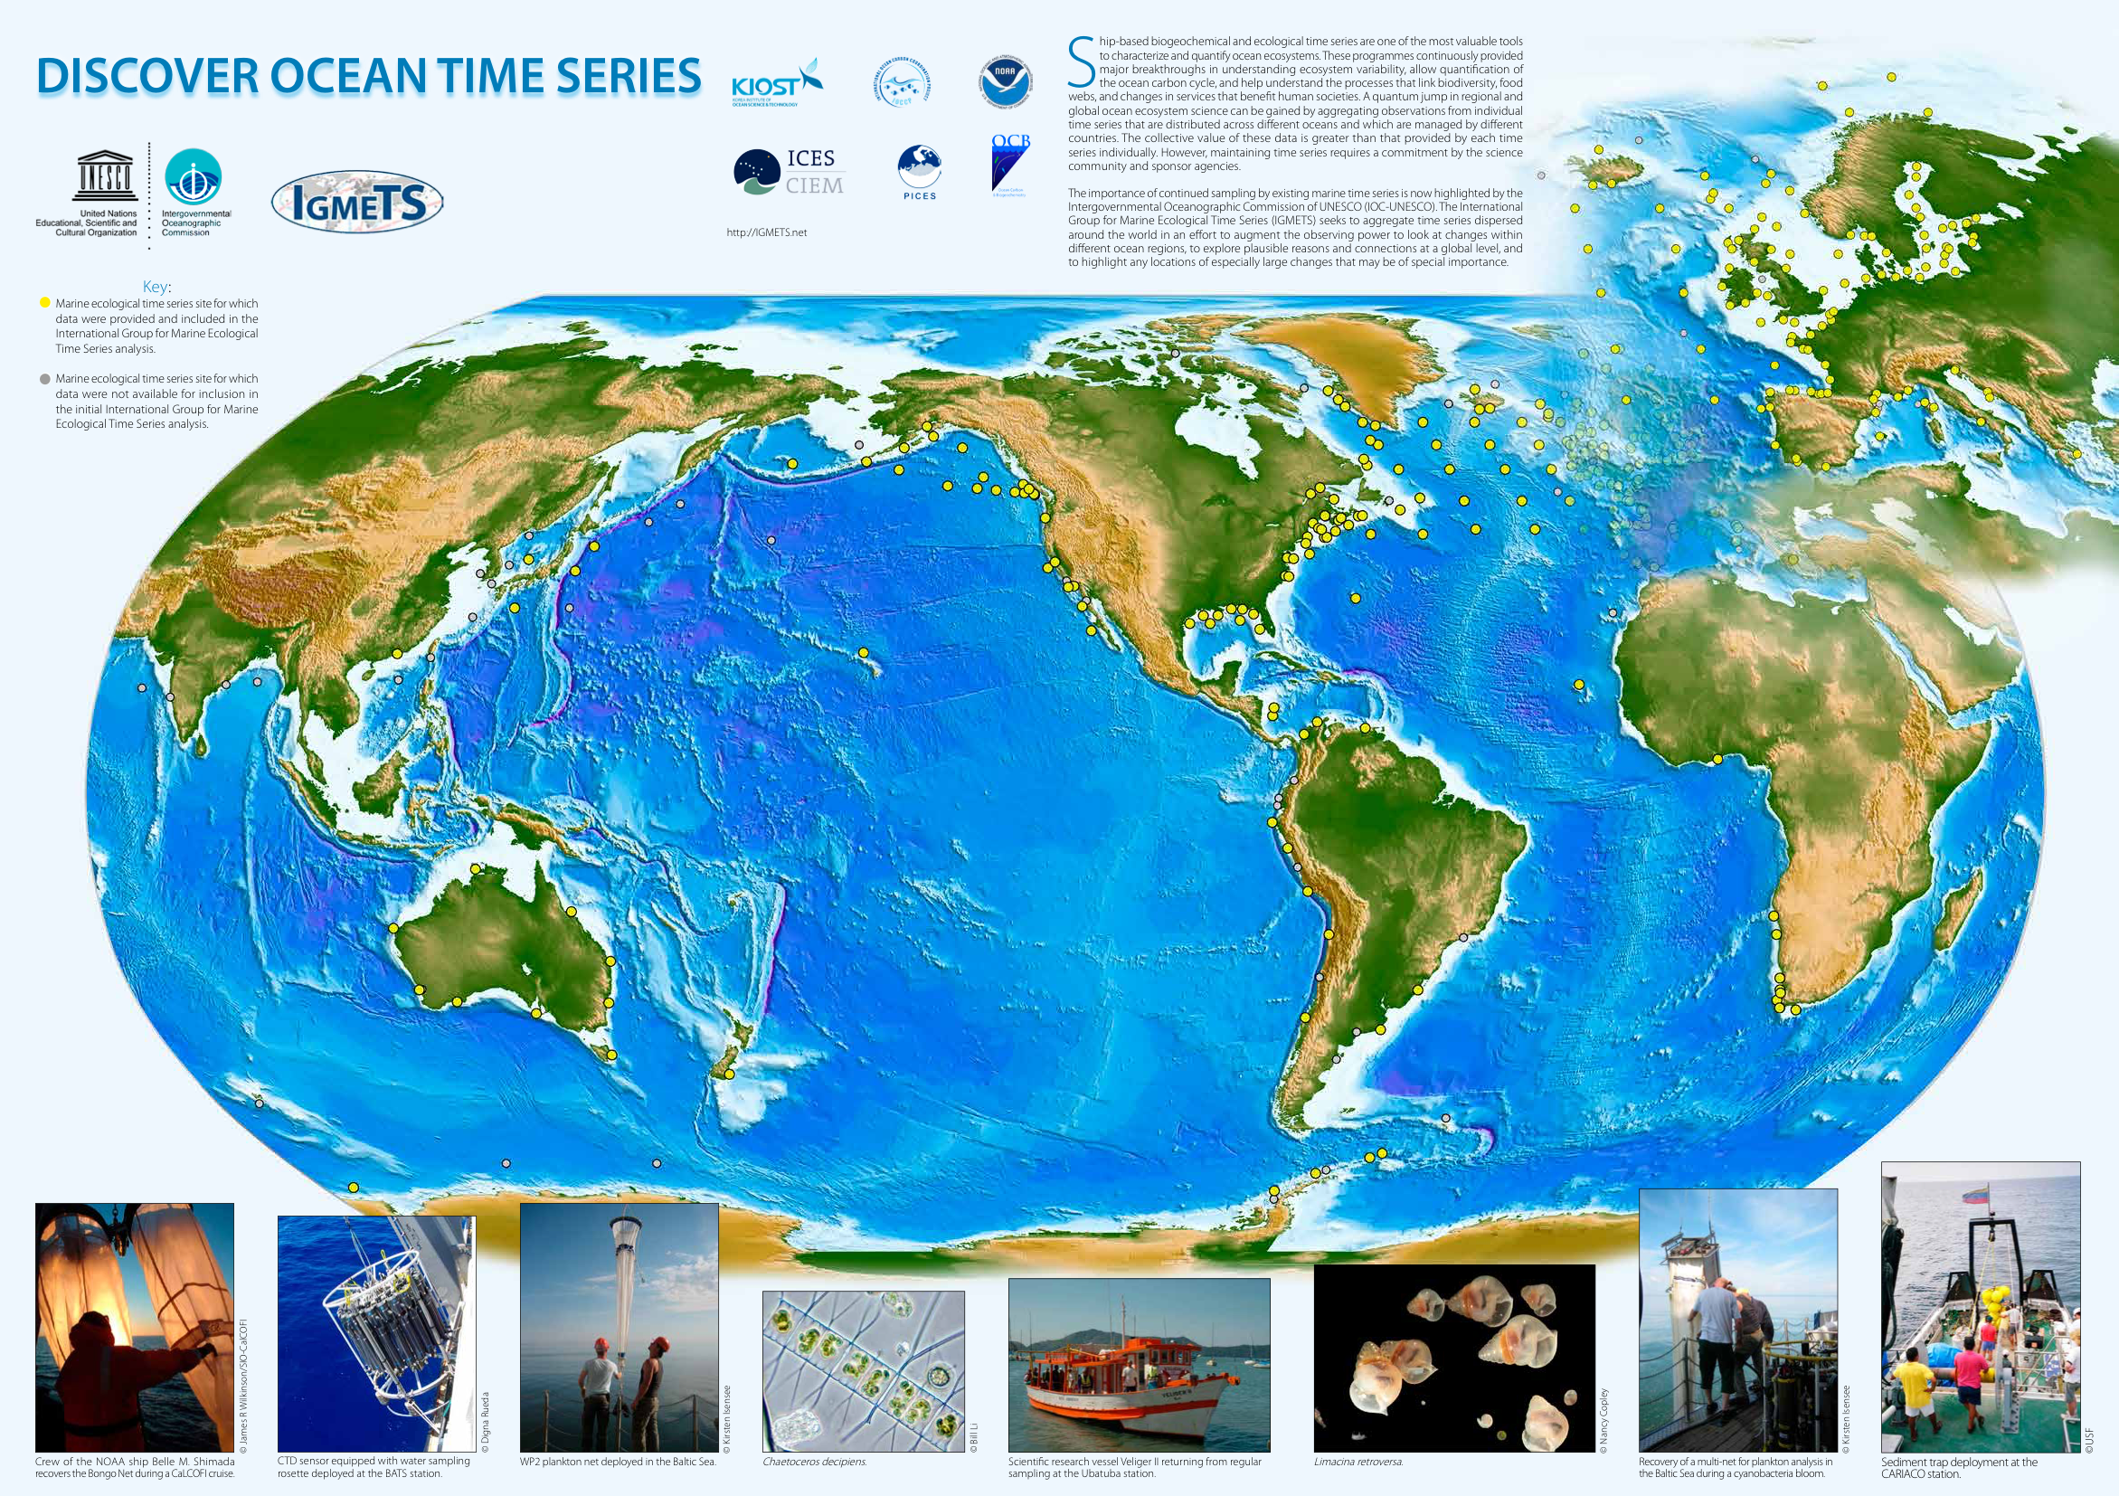
IGMETS

Slide 20
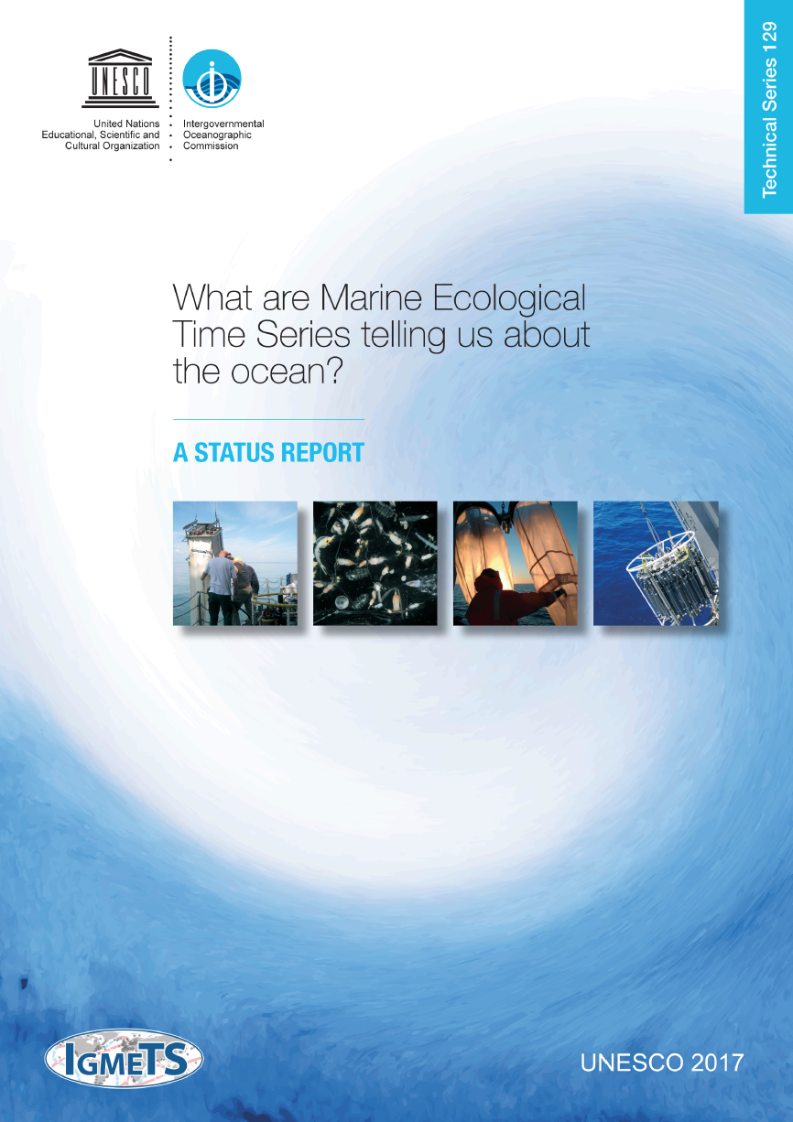
Development of a new, global, time-series based data synthesis product will be one of IOCCP’s foci over the coming years
This activity promises to attract interest from most time series sites and therefore has a large potential to serve as an axis for coordination
During discussions with several time-series operators and funders, ocean acidification emerged as one critical phenomenon lacking data-based global synthesis product

Slide 21
A communication and coordination service for marine biogeochemistry
Institute of Oceanology of Polish Academy of Sciences, ul. Powstańców Warszawy 55, 81-712 Sopot, Poland
Phone: +48 58 731 16 10 / Fax: +48 58 551 21 30, www.ioccp.org
Biogeochemistry
Panel

Slide 22


For questions and input please contact us at:
Maciej: m.telszewski@ioccp.org
Visit our website: www.ioccp.org
Institute of Oceanology of Polish Academy of Sciences, ul. Powstańców Warszawy 55, 81-712 Sopot, Poland
Phone: +48 58 731 16 10 / Fax: +48 58 551 21 30, www.ioccp.org
Biogeochemistry
Panel

