Slide 1

OCG
Ship Observations Team
Darin J. Figurskey
NOAA’s National Weather Service
Ocean Prediction Center
Henry Kleta
Marine Network Manager
Deutscher Wetterdienst
9th Session of the JCOMM Observations Coordination Group
14 - 17th May 2018, Brest, France

Slide 2
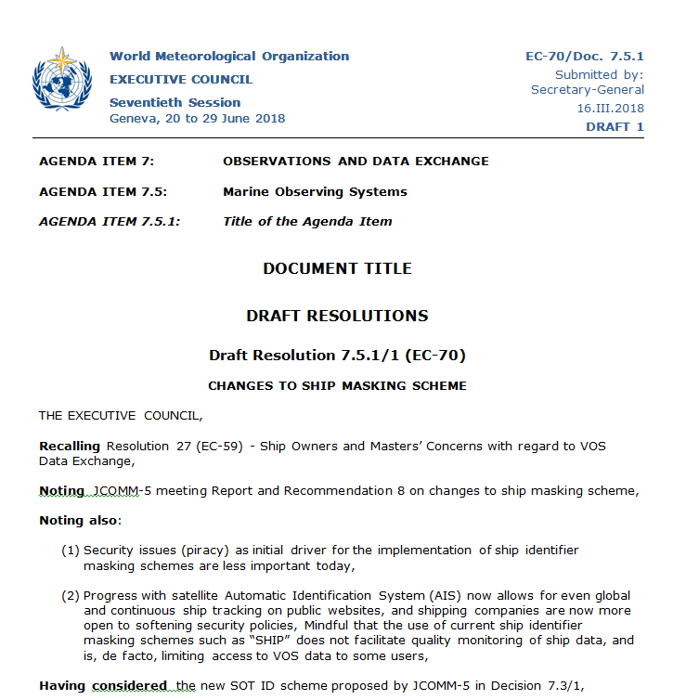
Implementation of SOT-ID Scheme
SOT has prepared draft resolution 7.5.1/1 (EC-70)
EC-70 requests members discontinue using ship masking and to use SOT identifier scheme.
Requests JCOMM to prepare transition plan with instructions on timing and procedures.
Recognizes that some nations have yet to negotiate the transition with national authorities.
Already being implemented for E-ASAP.
  The migration to SOT identifiers to be completed by summer, 2018.
Notes:
All stations in the E-ASAP fleet transmit BUFR messages only. There are no longer any TEMP messages.

Slide 3
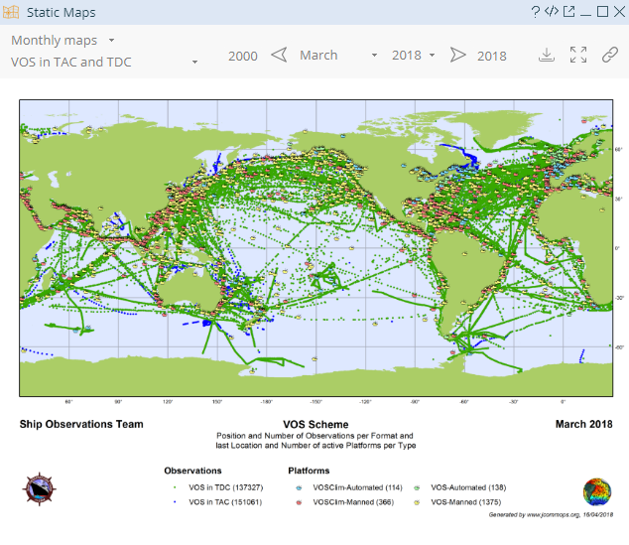
VOS Metadata
Work ongoing to migrate metadata from E-SURFMAR to JCOMMOPS.
A lot of progress toward implementing the JCOMMOPS database for station / platform metadata.
Contractor working on metadata content (including SOOP & ASAP).
Rehired contractor to fix technical issues with the VOS database in its existing format, and to update the database with new VOS metadata.
Contractor will also train the SOT TC in database maintenance.

Slide 4
VOS Metadata (continued)
Long-term goal is to ensure JCOMMOPS database has the most current, complete metadata available.
Primary challenges:
  Harmonizing the technology across the networks.
  Sufficient support at JCOMMOPS for maintaining the database and its contents.
E-SURFMAR database must continue to be used and updated until the JCOMMOPS database is stable and validated.
Cross-network issue?
Notes:
May need a cross-cutting metadata meeting as this issue is getting large.

Slide 5
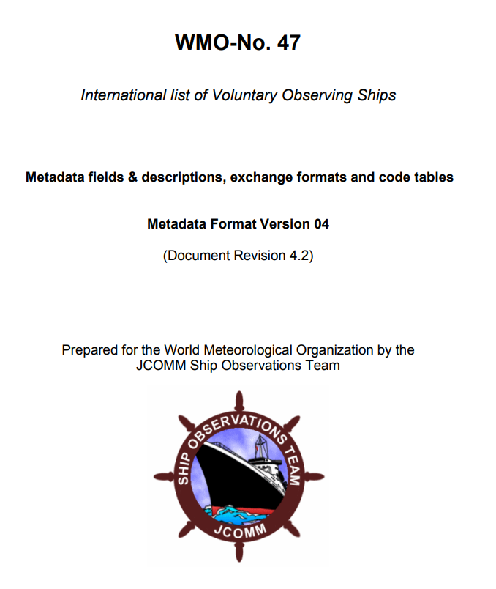
Pub47
SOT recommends the revision of JCOMM decision 7.3/3 so as not to “discontinue” Pub47 until migration into WIGOS metadata.
Present and old versions need to be retained, and archived.
The transition will also need to manage SOOP metadata, and proper nomenclature.
SOT agrees with replacing Pub47 with a more robust and operational database, but there is concern about continuity of resources for JCOMMOPS to manage the new database and retain the archive.
Notes:
Mention that the wording of the SOT recommendation was changed at JCOMM5, but the new wording raises concerns that Pub47 may be lost to future users. SOT wishes to ensure that version 4.2 is maintained until the JCOMMOPS database transition is complete and that all older versions are archived and accessible to users. Maintaining an official separate publication forever will have a cost -- plus ongoing work to fold the VOS metadata into WIGOS metadata is well underway already.

Slide 6
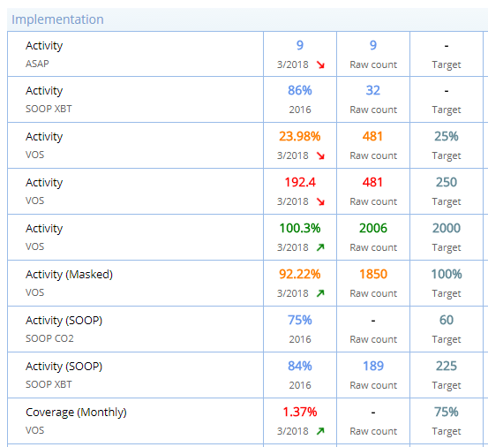
Key Performance Indicators
SOT TT has developed an initial conceptual draft of KPIs.
The draft includes VOS, ASAP, SOOP, and GO-SHIP parameters.
SOT recommends a workshop on KPIs.
  OceanObs19
  Another community workshop
Such a workshop is a cross-network suggestion to alleviate subjectivity and ad-hoc nature of KPIs in and across networks.
  Good KPIs require input from both operational and user (science) communities
Notes:
The draft is still being iterated -- plus the ship TC will need to confirm that JCOMMOPS can compute all the indicators proposed, otherwise these have to be adjusted

Slide 7
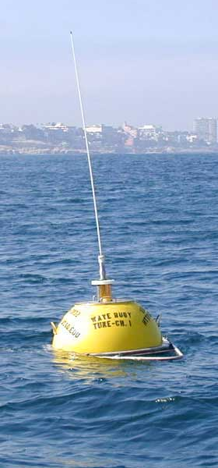
Information Technology Security
Maersk has required some of its fleet to cease taking VOS observations due to the need for more software controls.
  SOT working with Maersk over its concerns with TurboWin.
Scripps buoy was affected by ransomware.
Came to SOT as a VOS problem.
Certainly a cross-network problem.
Subject for WMO and OceanObs19?
Notes:
Both a land and sea concern.

Slide 8
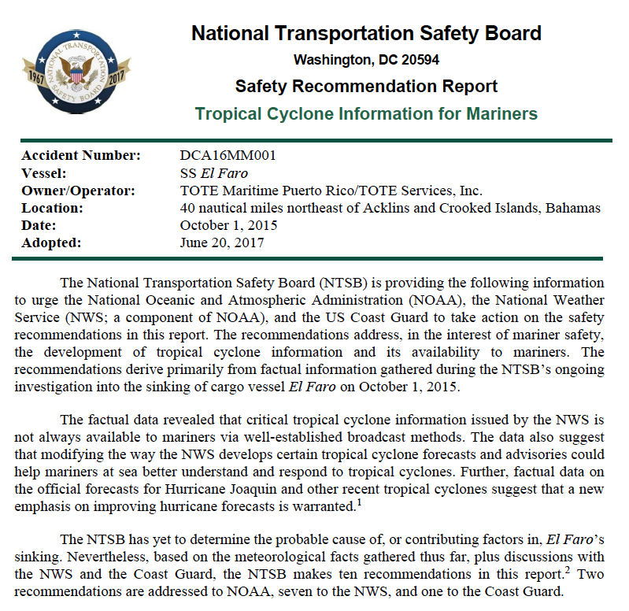
Opportunity for VOS
AIS data transfer for VOS.
NTSB report from El Faro recommends NOAA perform a proof of concept project.
SOT may be able to help harmonize efforts internationally.
  Ship Forum

Slide 9

Risks
Budgetary concerns over metadata transition and long-term maintenance of JCOMMOPS database.
Increase in costs
  CLS
Ensuring sufficient financial awareness to allow for informed decisions.

Slide 10
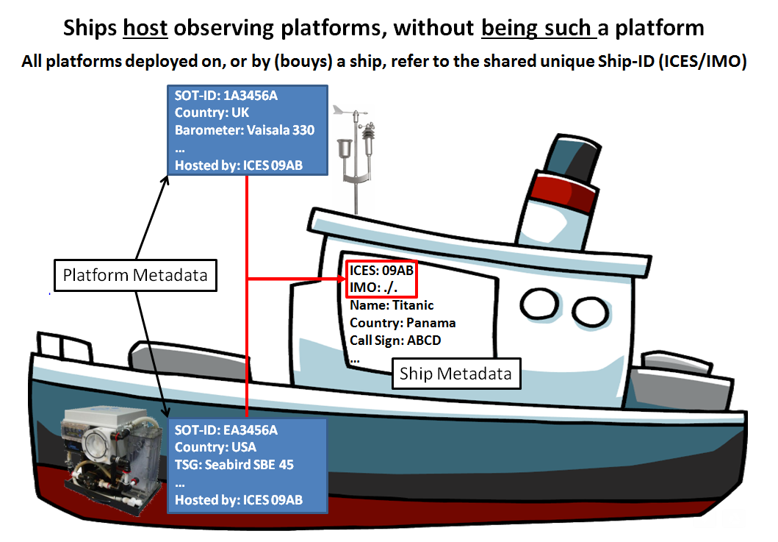
Nomenclature
A cross-network issue.
Decision 7.3/1 at JCOMM-5 included terminology for “platforms”, “stations”, etc.
“Host” vs. “platform”
“Station” vs. “platform”
Will need to work with the DBCP and others (WIGOS, CIMO, etc) to develop consistent nomenclature.

Slide 11
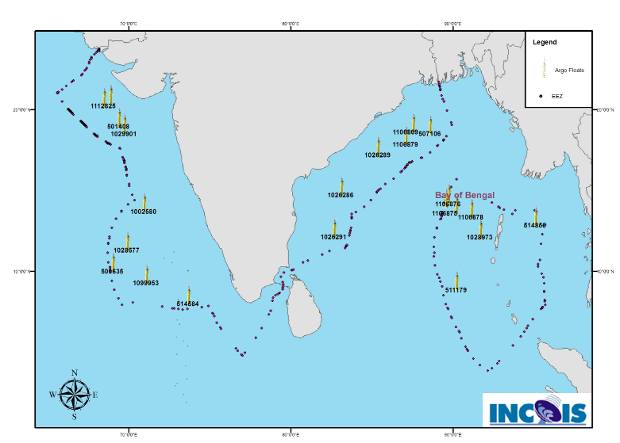
Data Acquisition in EEZs
IOC circular encourages IOC member states to facilitate the deployment of Argo floats.
There are EEZ questions for ships.
  Including for SOOP
Recommend that OCG play a role to monitor and approach EEZ concerns.
OCG work through the IOC on how the issue might be brought to, and resolved through, member states.
Reaction to Argo initiative could inform this process.
Notes:
Possible VOS measurements are illegal in EEZs? The other issue for us is the EEZ deployments for XBT. From my point of view, it is really an understanding I need. How does it work, is there documentation available? I get asked the question a lot about deployments of XBTs and Argo and I really don’t know where to go to find the information....

Slide 12
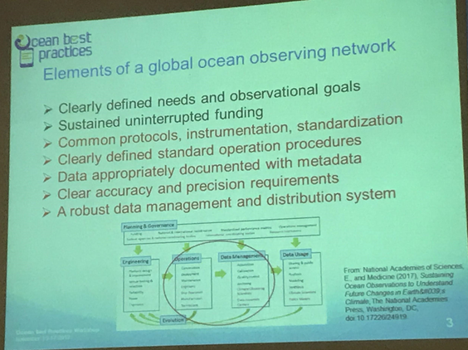
OCG Network
SOT working toward:
  Metadata transition
  KPIs
  Nomenclature
Funding is a concern
Need the opportunity to provide feedback in a timely manner.
  “Opportunity to provide feedback into GOOS/GCOS…”

Slide 13
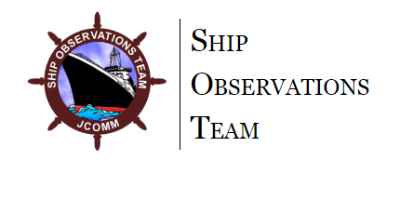
SOT Terms of Reference
SOT has established an Executive Board:
  Chair
  Vice Chair
  VOS & SOOP Panels Chairs & Vice Chairs
  Secretariat
Need to develop SOT governance
  Operating principles document
  May incorporate aspects of DBCP EB structure
Need clear documentation of the approvals process through JCOMM

Slide 14
Summary of Requests
Database support
Ensuring transfer of existing/operational metadata (e.g., Pub47)
Resources for KPIs
Greater working knowledge of finances
Support for VOS opportunities
EEZ issue monitoring
Opportunities to provide feedback in a timely manner
Nomenclature coordination as needed
Clear documentation of the approvals process throughout JCOMM
  Timeline for OCG to document its role within OPA and how approvals of items from SOT, DBCP, and other networks flow through OCG and to JCOMM.
Notes:
Be clear that you are concerned here about "present" Pub47 metadata (version 4.2). Old metadata in the marine climate world can mean ship metadata going back to the 1600s!
Note that SOT TT role in ensuring this is done completely and correctly, but funding side of this at JCOMMOPS is an OCG issue.

