Slide 1
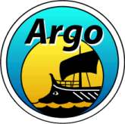
Argo Program Status Report
Breck Owens
Argo Director

Slide 2
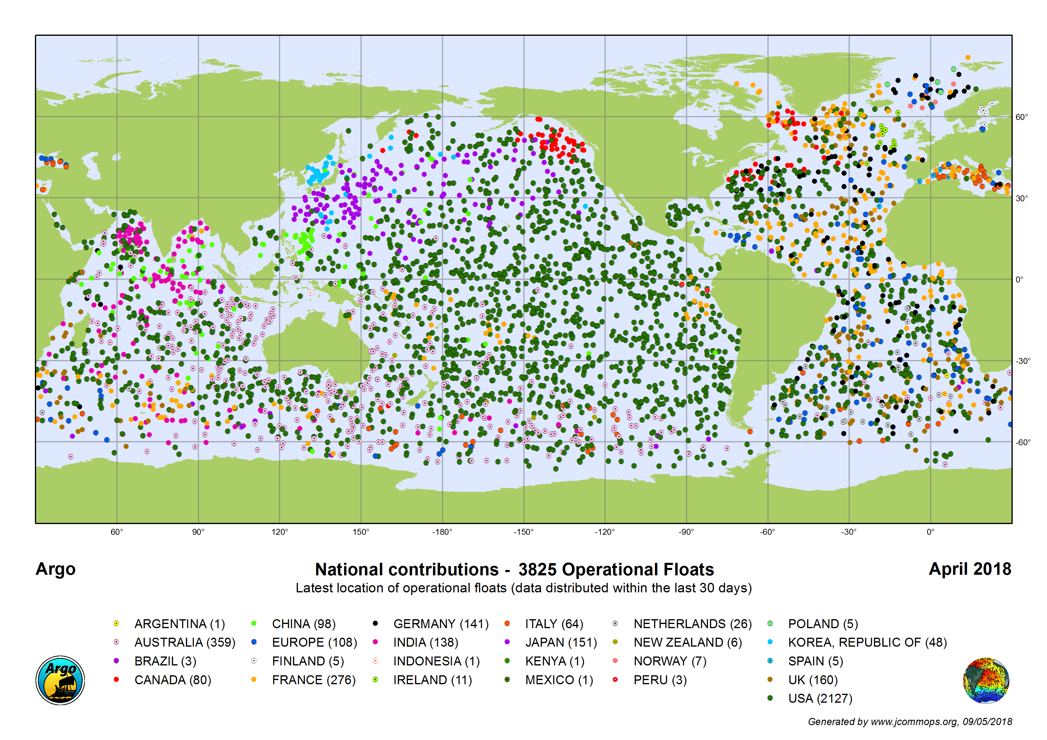
Present Coverage 3825 active floats
Expanded Coverage into Marginal Seas
Continued expansion into Polar Regions
BGC Argo
Deep Argo
2 millionth profile expected in late November to early December, 2018
AIC / JCOMMOPS is critical for monitoring and notifying pf floats in Argo Array
Data transmitted to GTS (BUFR format only September, 2018) and submitted to GDACS 90% within 24 hours

Slide 3




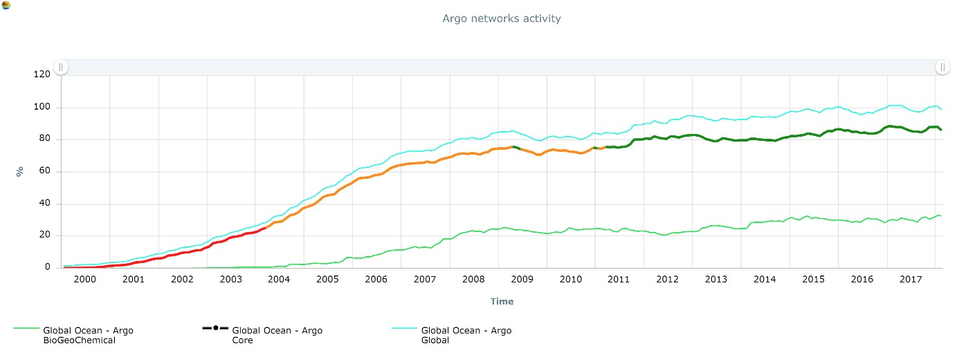
Core Argo short by 15%
Extras contributions are essential to meet the global target
Plateau reached for parts of Argo
Argo oscillates between 3800/3900 operational floats

Slide 4

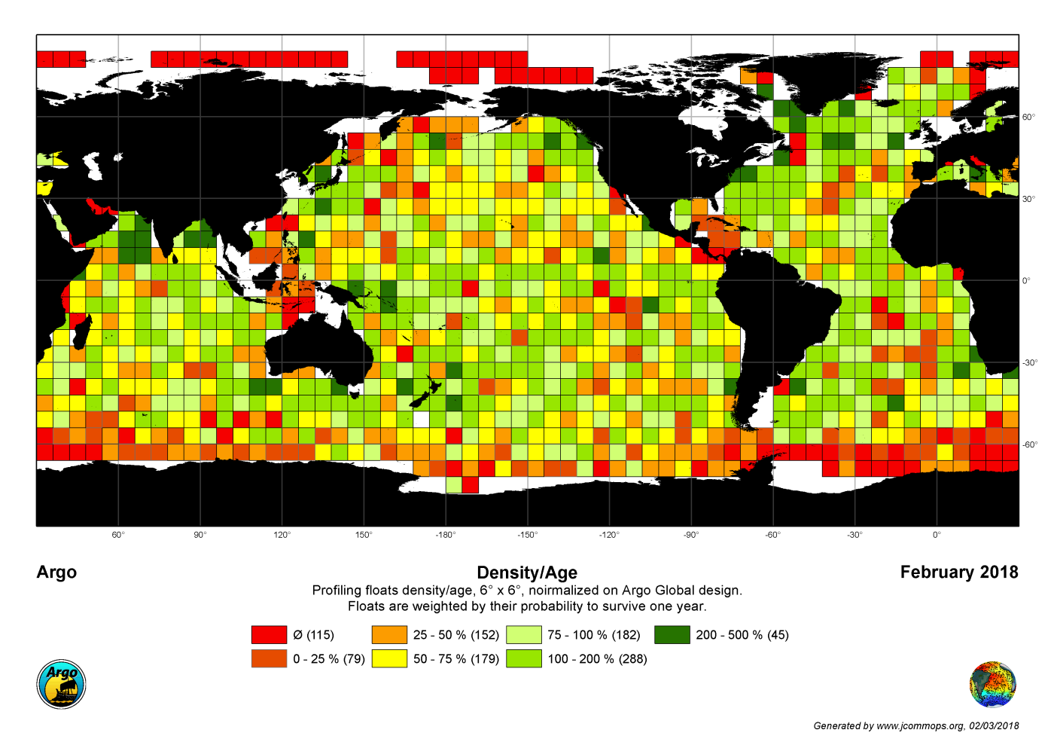

Slide 5
Biogeochemical Argo
Proposal to IOC EC to accept these six parameters as additional Argo Parameters
Parameter | Method
Oxygen | Fluorescence Quenching
pH | Ion Sensitive Transistor
Nitrate | UV Light Absorption
Chlorophyll | Chlorophyll Fluorescence
Backscatter | Optical backscatter
Irradiance | Wavelength selective light sensor
Define process for approval of future parameters

Slide 6
Deep Argo
Regional Pilot Programs
Floats operate to either 4000 or 6000 meters
For Deep Solo
Allen Family Foundation support for commercial version to be deployed in South Atlantic

Slide 7
Technical Workshop, September 2017
Shared technical information from “super user” groups to Argo community
Goal to expand lifetime of floats to be able to maintain array
Identified “passivation” of batteries as a potential for expanding array
Solo-2 floats only get 50% of stored energy from batteries. Going to Tadiran hybrid battery pack can increase performance to 80%. Smaller improvements for other float types. Goal is to have floats make an average of 400 profiles.

Slide 8
Quality Control
Workshops being held for delayed-mode operators to have common practices:
EuroArgo Workshop, April, 2018, Brest
BGC-Argo Workshop, September, 2018, Seattle
Workshop, December, 2018, La Jolla
Developing GitHub site for shared code
- Improved salinity drift code will be prototype
Real-time quality control tests were set up at start of program. Only identify gross errors. Development of improved tests using 1.5 M delayed mode quality controlled Argo data and recent high quality ship-based data to provide verification data. Methods using “machine-learning” concepts being developed.

Slide 9
CTD Issues
Some recently deployed (in past 2 years) SBE CTDs have large salinity drifts. Likely cause has been identified by Seabird.
Seabird has identified that temperature compensation for pressure measurements needs to be changed, present errors are O(10 dbar). Will implement new algorithm in CTDs. Argo working out how to correctly compensate older measurements to eliminate potential bias for climate drift estimates.
Argo AST has recommended a global pilot program for RBR CTDs. These CTDs use an inductive conductivity cell and can make measurements to the sea surface also use much less power than SBE CTDs

Slide 10
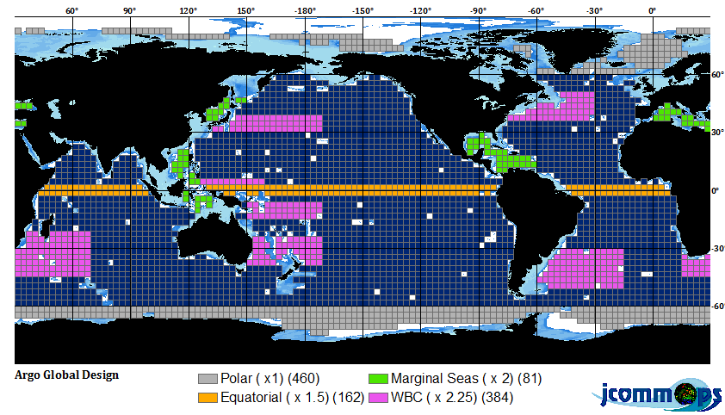
Argo extensions
These extensions of Argo have community acceptance, but essentially no funding

Slide 11
Summary
Array has been maintained, but this has been done primarily through innovation and improved instrumentation (loaves and fishes).
Technical expertise expanded to broad community, developing tools to display and access data for outreach.
Ability to monitor and assess array vastly improved. North Atlantic is over-sampled compared to Argo desired density, proposing to move resources elsewhere.
Potential for the average Argo float to last for 10 years.
Enhancements of Argo Program more than triple the original design:
– BGC Argo
– Deep Argo
– Marginal Seas
– Regional increased coverage
– Polar Seas
Funding for these enhancements is presently only for pilot programs.
.

