Slide 1
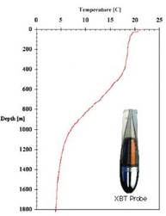

The Path of an XBT through the Global Oceanographic Data System
XB T graphic from http://imos.org.au/facilities/shipsofopportunity/expendablebathythermograph/xbt-instrumentation/
Black box graphic from https://pixabay.com/en/black-box-container-cardboard-box-310220/

Slide 2
1, What is the historic (and present) importance of the XBT for ocean observation/science?
2. Why is the historic XBT database in the state it is in and what is/can be done about it?

Slide 3
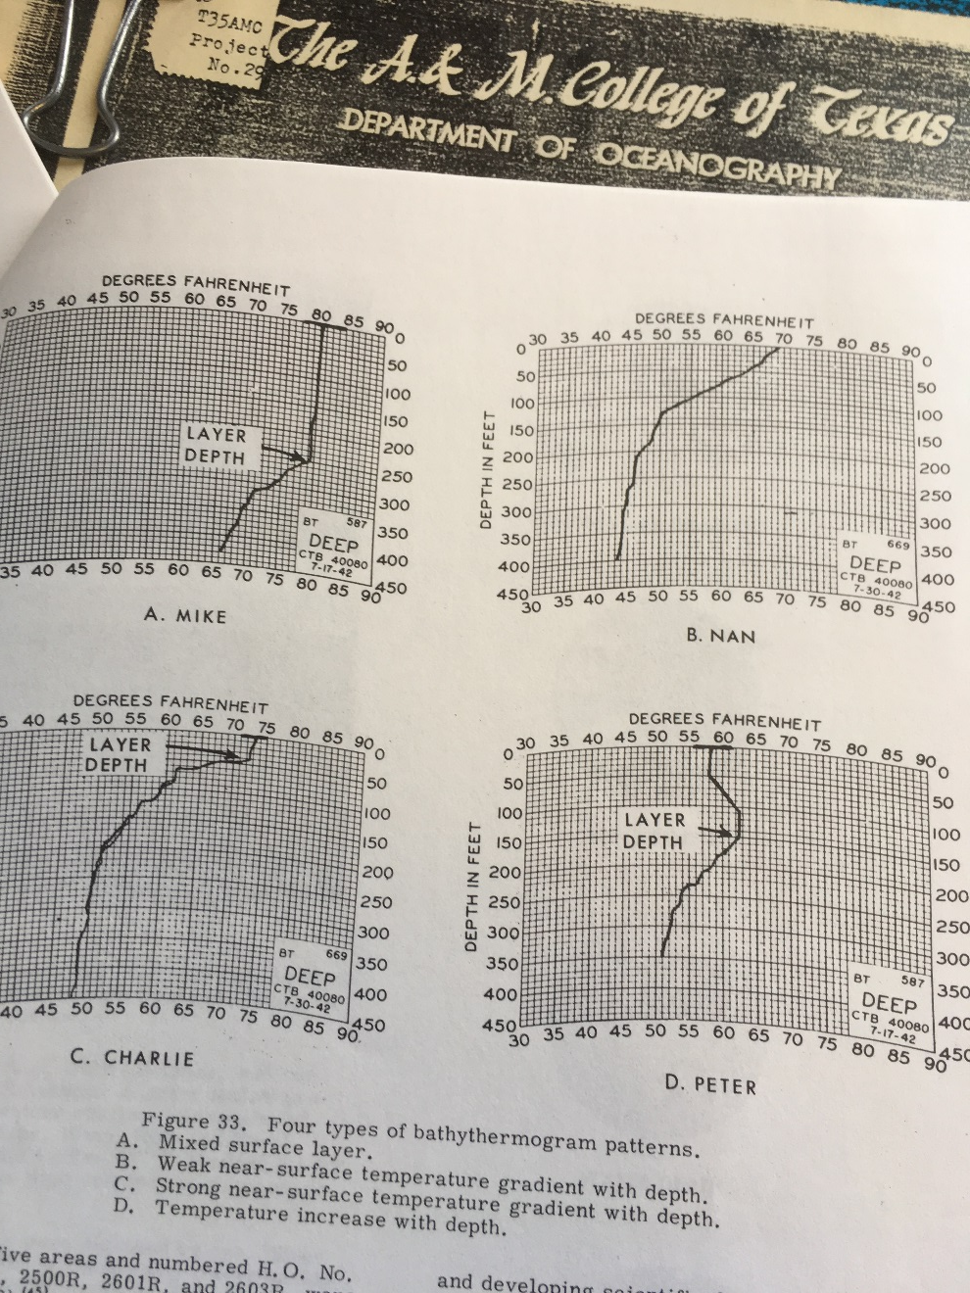
Pre-XBT and early XBT
Strip Chart Pre-screening and digitization at the U.S. NODC in conjuction with U. S. Navy Fleet Numeric
Visual Quality Control
Analog to Digital line fitting to within 0.015 inches on page
Archive in NODC UBT format at flex points or standard levels
Graphic from Couper B. K. and E. C. La Fond (1970): Mechanical Bathythermograph an Historical Review, Advances in Instrumentation, Paper 7353-70

Slide 4
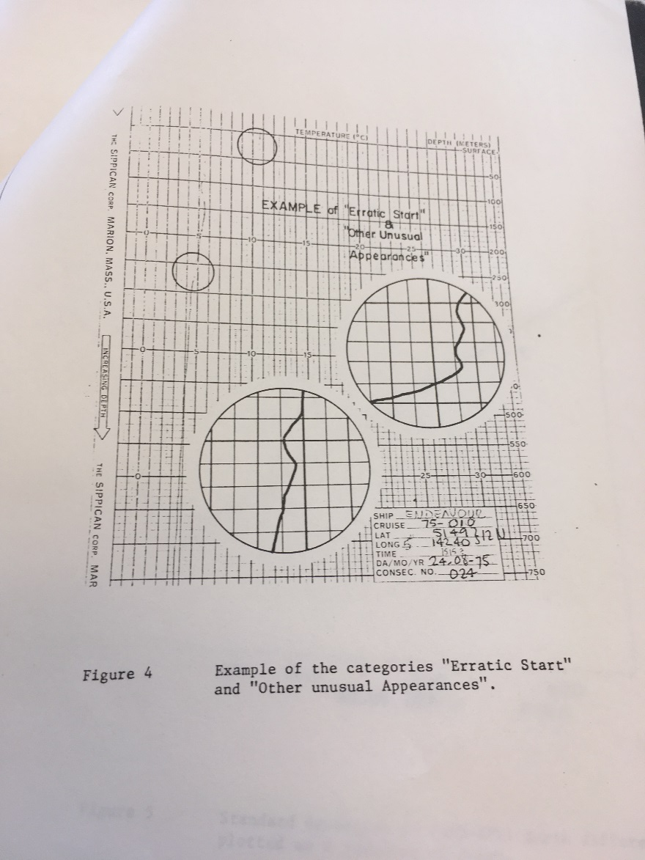
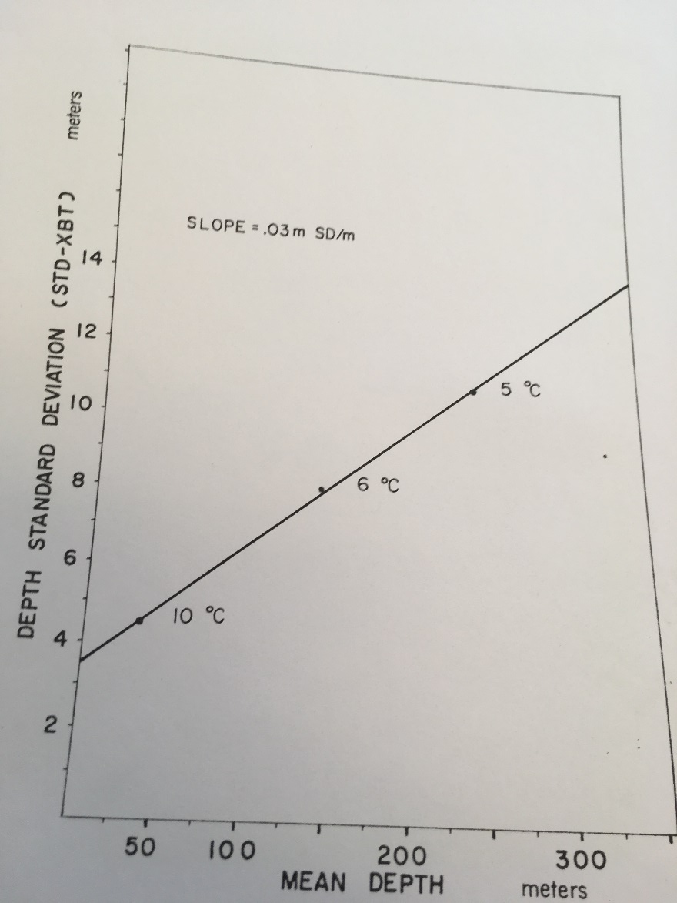
Many Priceless Data did not make it into the public domain
64 XBT-STD pairs side by side tests
Have not as yet been located
Wood, W. (1976) Practical Accuracy of Sippican T-7 XBT, unpublished report
Institute of Ocean Science , Patricia Bay Victoria B.C. Canada

Slide 5
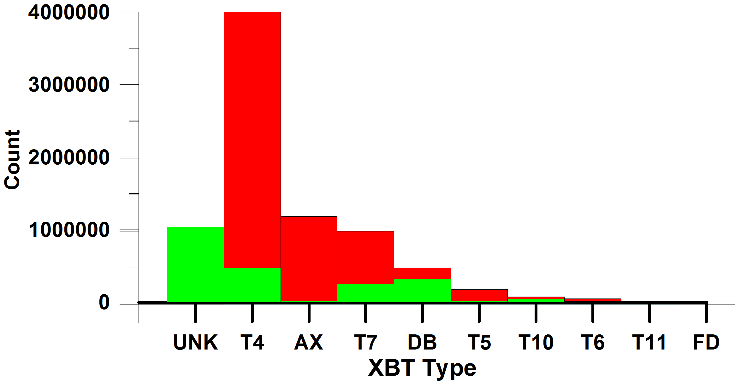
Where are all the XBTs?
From Jim Hannon, Sippican Inc. email Aug. 7, 2002
‘To date, nearly 7 million [XBTs] have been produced’
‘On 10 December 1972, Sippican produced its 1,000,000 XBT’
In WOD: 1.99 million XBTs dated Aug. 7, 2003 or prior
0.28 million XBTs dated Dec. 10, 1973 or prior
Drops to Aug. 7, 2003
Red Sippican Estimate
Green in WOD

Slide 6
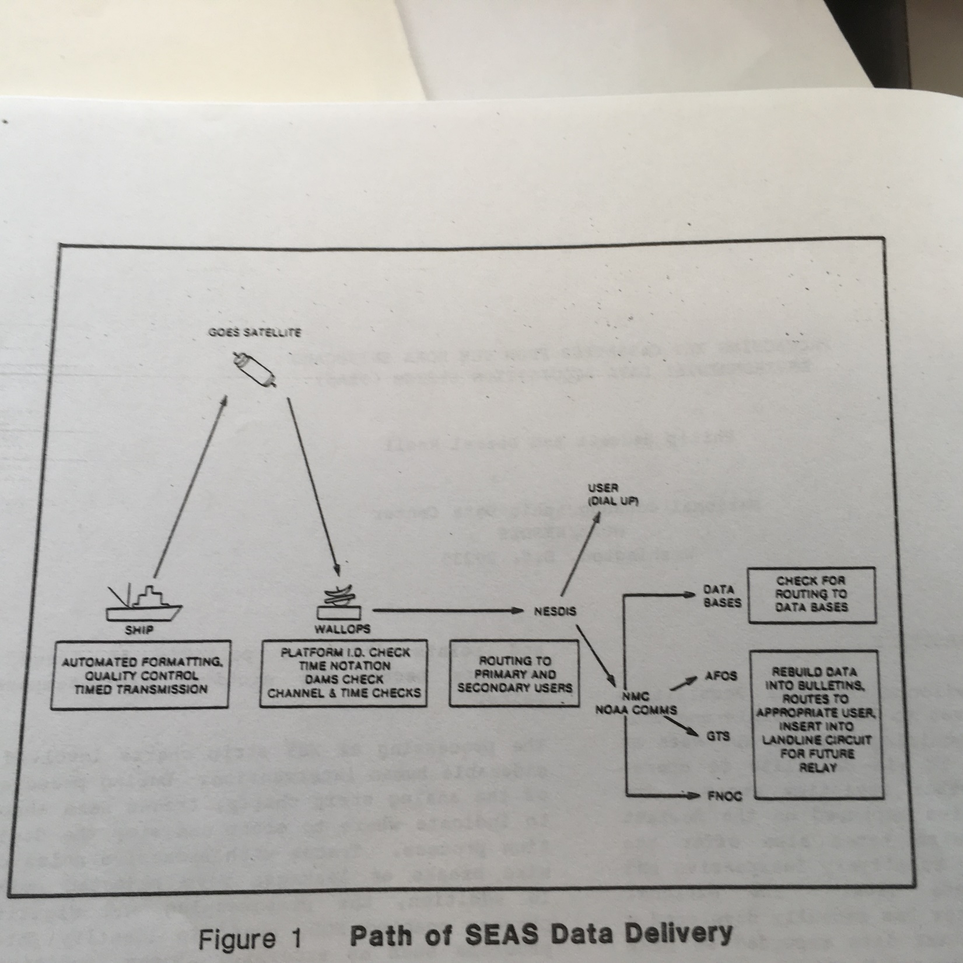
Mid-1980s: Data delivery to NODC archive as electrical information on cassette tape
Hadsell, P. and D. Knoll (1986) Processing XBT Cassettes from the NOAA Shipboard Environmental Data Acquisition System (SEAS), Proceedings Oceans 86 18, 453-457

Slide 7
GTSPP: 1990 to present
Global Temperature and Salinity Profile Project (now Program)
International agreement to gather and preserve near-real time temperature and salinity data from the Global Telecommunications System (GTS), archive and curate.
Replace with high quality full resolution data from each country
Canada provides data from GTS three times per week to US NODC (now NCEI)
US maintains Continuously Managed Database (CMD)
Australia, Canada, Japan, France, Germany, United States (AOML, Scripps), ?
Probe type metadata on a more routine basis (still 1.03 of 2.30 M unknown)

Slide 8
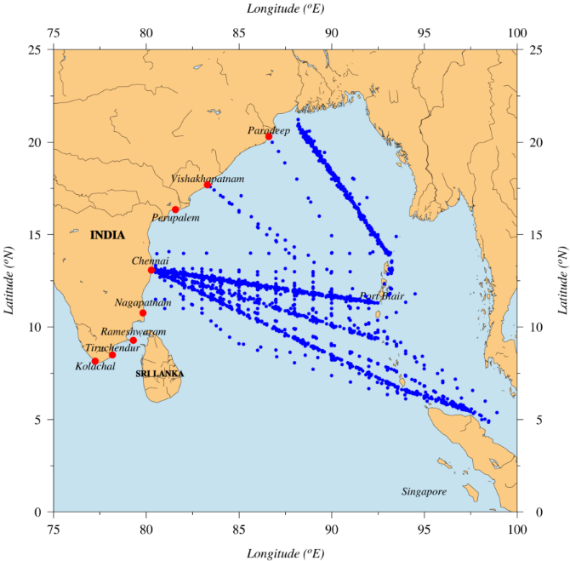
Most, but not all XBT data are part of the GTSPP data stream
Above – Indian Bay of Bengal XBT time series

Slide 9
GTSPP now
Since 1990 – 757,00 near-real time data from GTSPP in WOD
Since 1990 – 1.09 million total XBT drops in WOD
For 2016, 17,430 XBT drops in WOD, 5,219 still GTSPP near-real time versions
Yearly (or more frequent) delayed-mode submissions from Australia (CSIRO, BOM, RAN), AOML, Scripps.
No yearly data from France since 2014 (2010 usable files)
Yearly data submissions from Canada, Japan, not through GTSPP, few or no XBTs

Slide 10
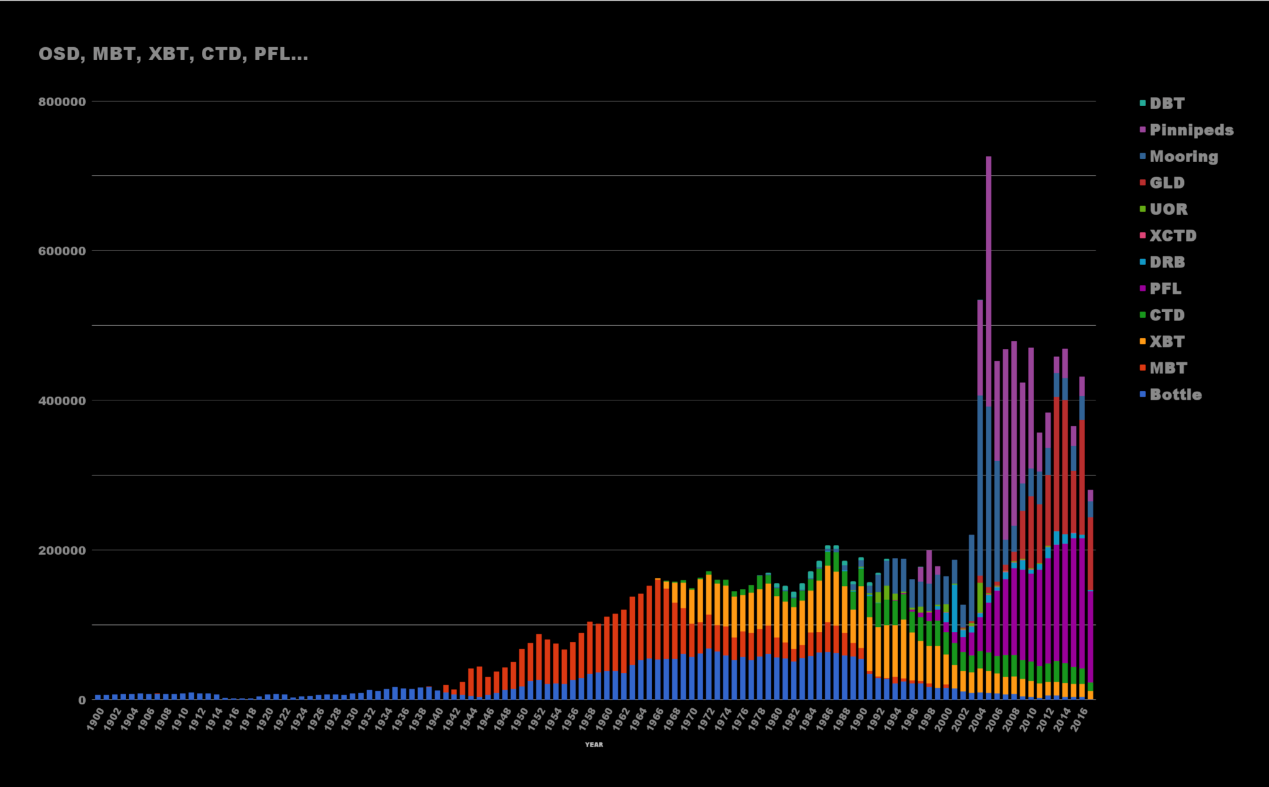
WOD by Instrument Type
2.3 million XBT
2.4 million MBT
1.0 million CTD
1.9 million profiling floats

Slide 11
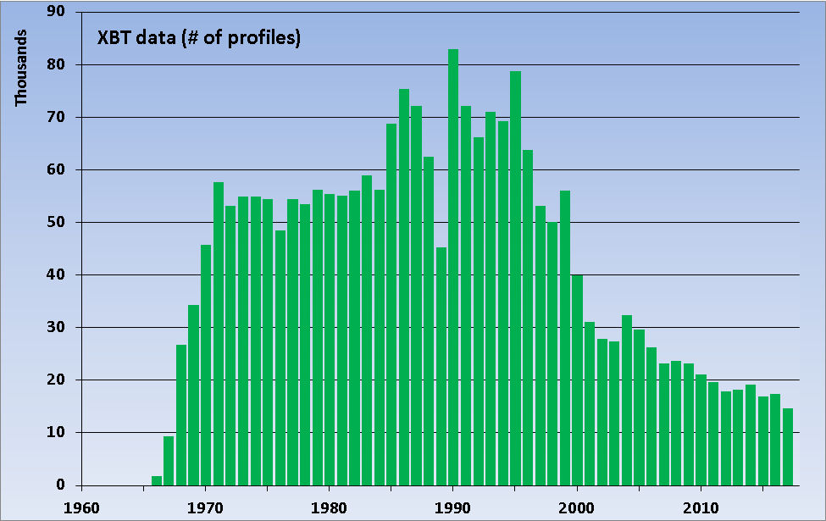

Slide 12
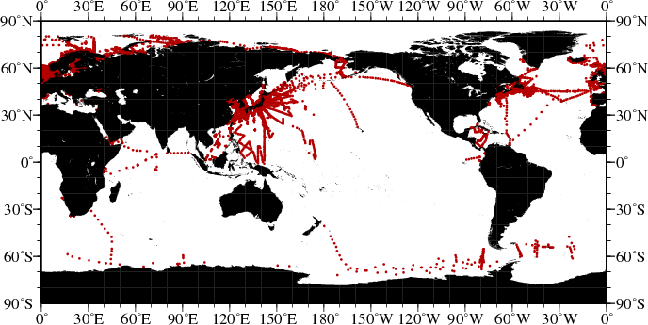
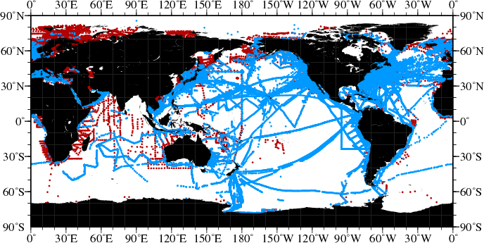
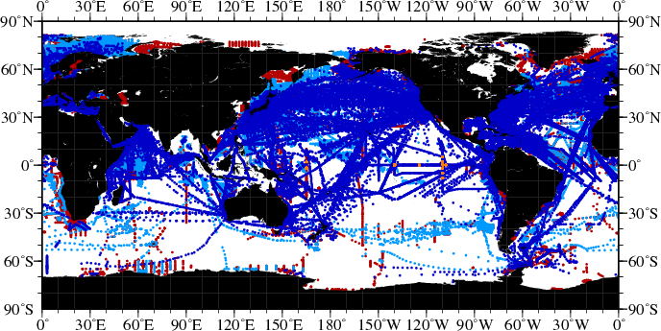
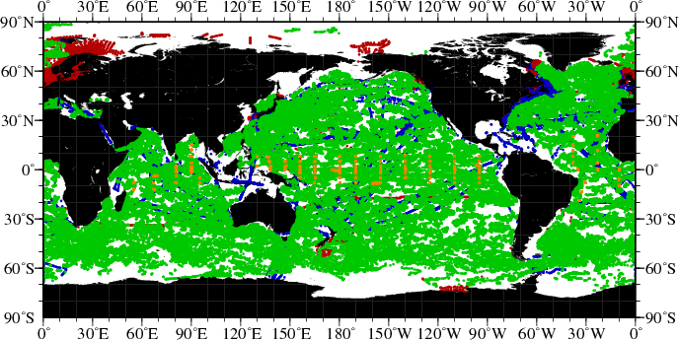
Temperature Data During Peak of Different
Observing Systems
1934 : Nansen Cast
1960 : MBT
1985 : XBT
Red=Nansen Cast /CTD[1890s/1964]
Light Blue=MBT [1939]
Dark Blue=XBT [1967]
Green=Argo float [2001]
Orange=Tropical buoy [1984]
2009 :
Argo
Abraham et al., 2013

Slide 13
WOD XBT database under continuous repair/update
Expert reports on problems in XBT data set
Franco Reseghetti XBT super sleuth: ‘P’ used instead of ‘D’ in GTSPP; Texas A&M data probe type converted incorrectly by WOD
Toru Suzuki leads Japan review of XBT data
Shoichi Kizu supplies T5/CTD pairs from his papers
Mathieu Ouellet – investigating Sparton start/end dates
Delayed-mode data originators answer questions about data formats, quality, metadata
Conversion of edf files: Sippican software supplied, also working on batch conversion

Slide 14
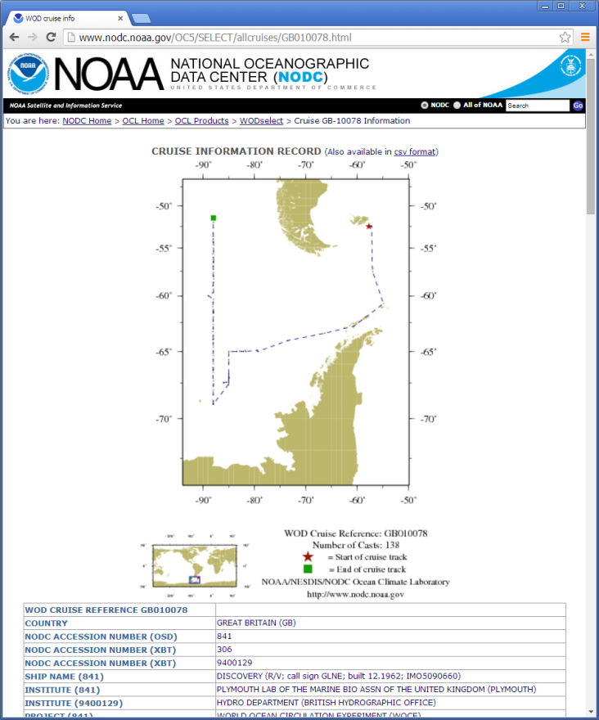
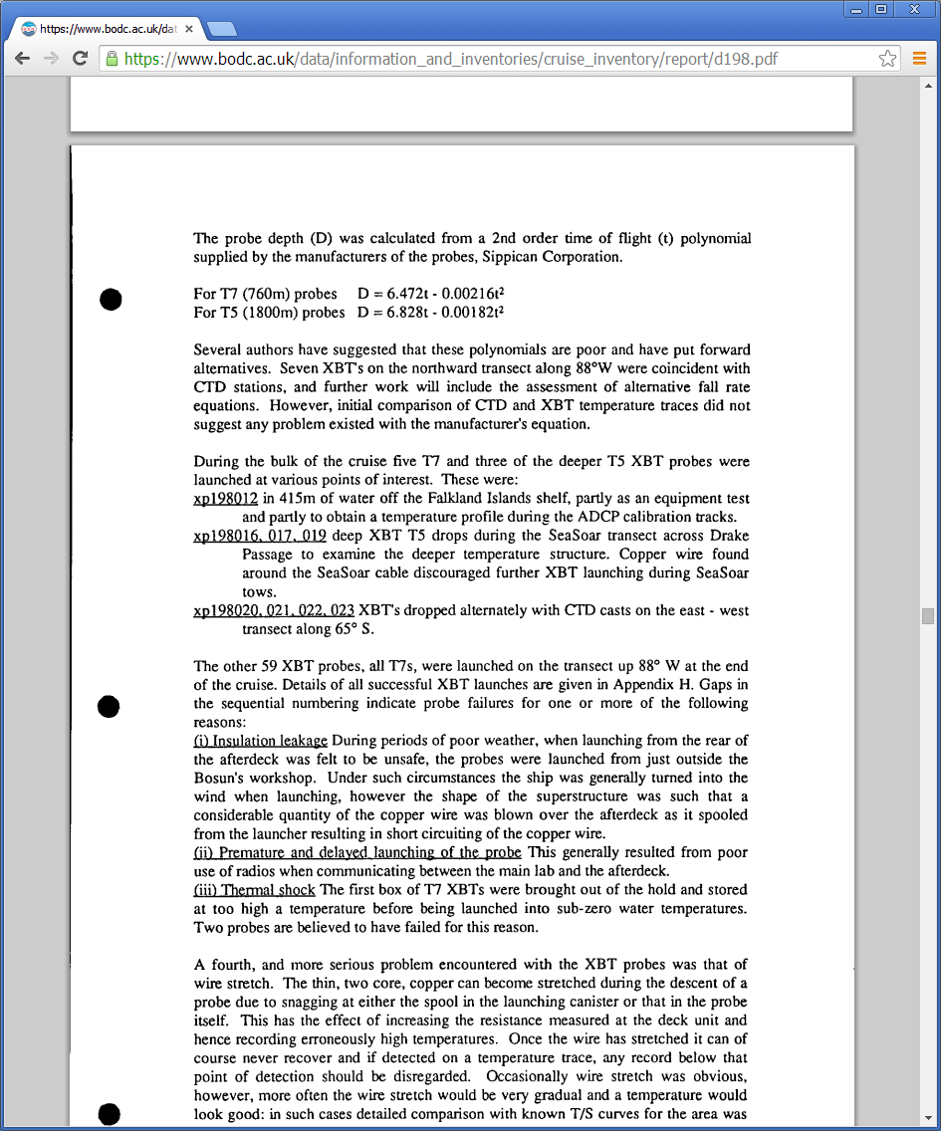
RRS Discovery Cruise Nov. 1992
66 XBTs – not all XBT types identified in WOD
Cruise Report online (BODC)
Same cruise – details XBT type for each drop. Also includes CTD calibration information

Slide 15
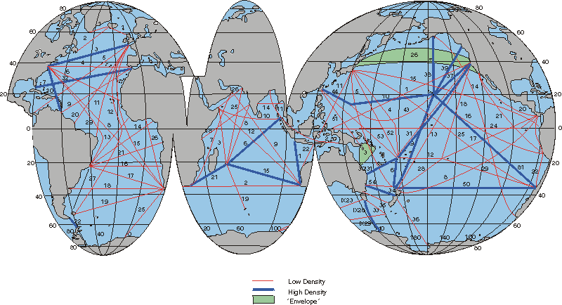
WOCE Global XBT lines
Other Improvements Needed: Identify XBT data by line in WOD

Slide 16
XBT biases - metadata
Known since at least 1972
International effort – Hanawa et al. 1995
International agreement – store XBT data with Sippican drop rate
Choice of drop rate in TSK/Sippican software 1996
Inclusion of drop rate metadata not common until 1998
In 1996, 29,000 of 64,000 drops , in 1998 9,000 of 50,000 , in 2017 8 of 17,000
Other information: drop height, year of manufacture not often included

Slide 17
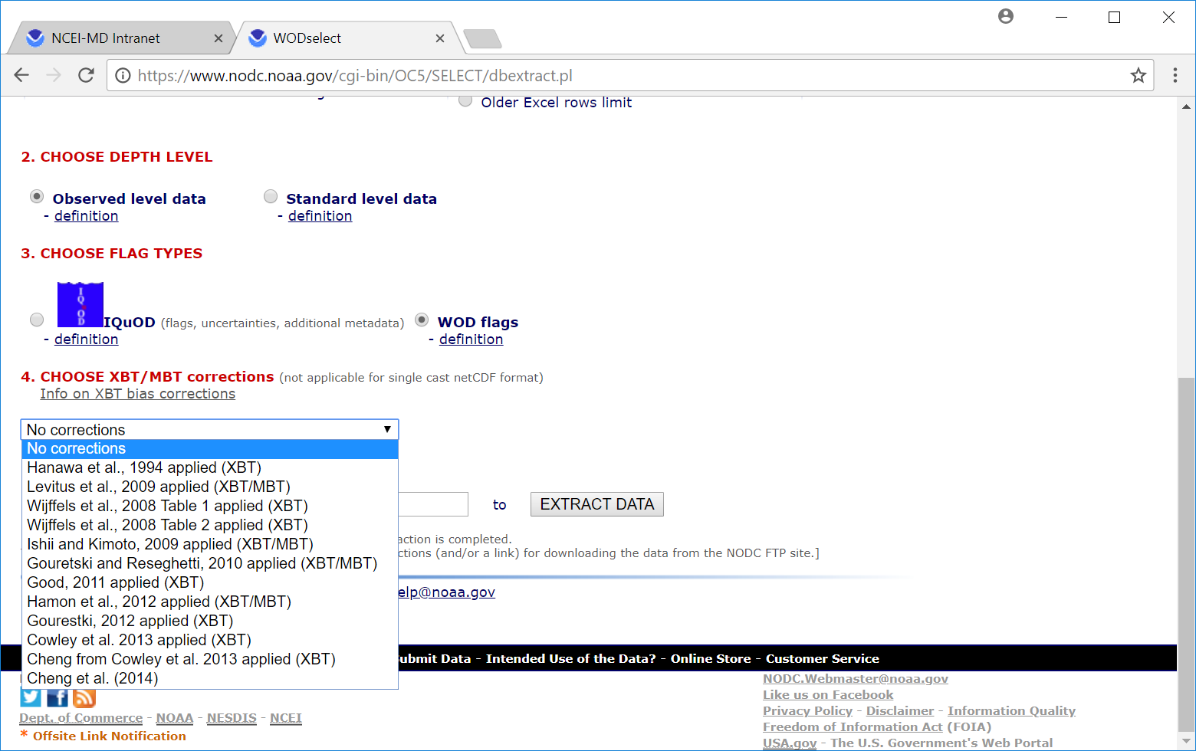
XBT bias corrections (from WODselect)

Slide 18
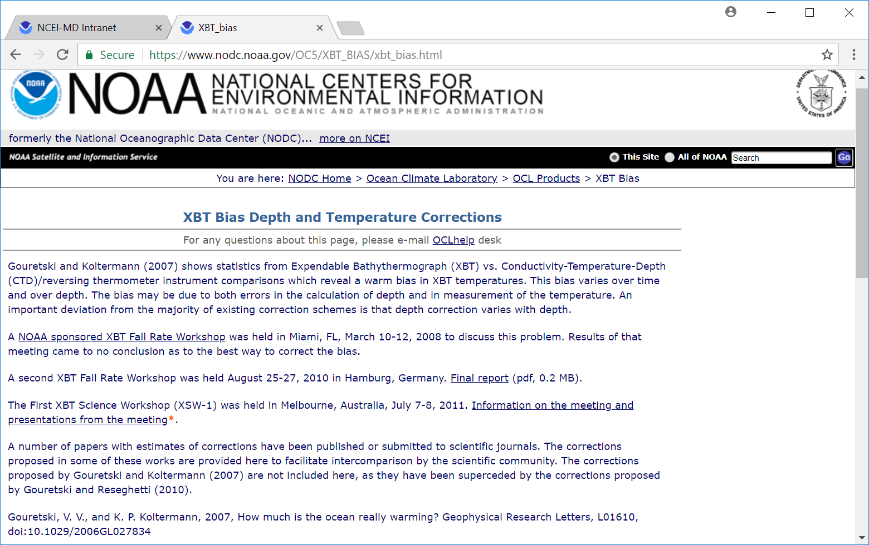
Apply correction yourself https://www.nodc.noaa.gov/OC5/XBT_BIAS/xbt_bias.html

Slide 19
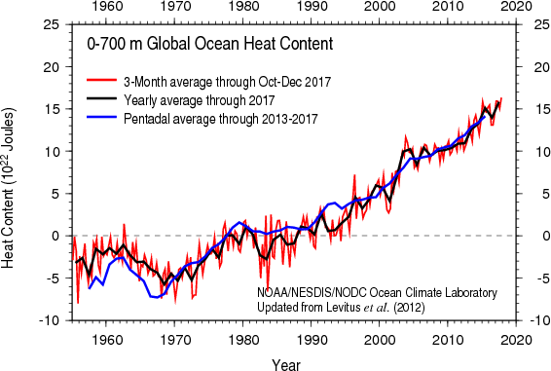
Scientific Use: World Ocean Atlas climatological mean temperature fields
Scientific Use: NCEI Global Ocean Heat Content
Working now on possible switch from Levitus et al., 2009 XBT correction to Cheng et al., 2014

