Slide 1


EuroGOOS activities and successes 2015-2017
Glenn Nolan,
Erik Buch
Vicente Fernandez,
Patrick Gorringe,
and
Dina Eparkhina
GRA Forum, Singapore, September 5th to 7th 2017

Slide 2
General information
Type: International Non-Profit Association under Belgian Law
Funding characterization: Membership and projects
GRA leadership
Secretariat:
Glenn Nolan, Secretary General
Email: glenn.nolan@eurogoos.eu
Website: [http://eurogoos.eu/]
Membership: 41 members in 19 countries [http://eurogoos.eu/about-eurogoos/list-of-eurogoos-member-agencies-and-contact-persons/]
Terms of Reference: http://eurogoos.eu/documents/reference-documents/
Meetings: The EuroGOOS Annual General Assembly takes place in Brussels every year in May.
Name | Country | 1st mandate | 2nd mandate
Erik buch, chair | Denmark | 2013-2016 | 2016-2018
George Petihakis, vice-chair | Greece | 2015-2018
Bernd Brugge | Germany | 2013-2016 | 2016-2019
Patrick farcy | France | 2016-2019
urmas lips | Estonia | 2013-2016 | 2016-2019
Rosalia santoleri | Italy | 2015-2018
antonio santos martinho | Portugal | 2015-2018
Henning Wehde | Norway | 2016-2019

Slide 3
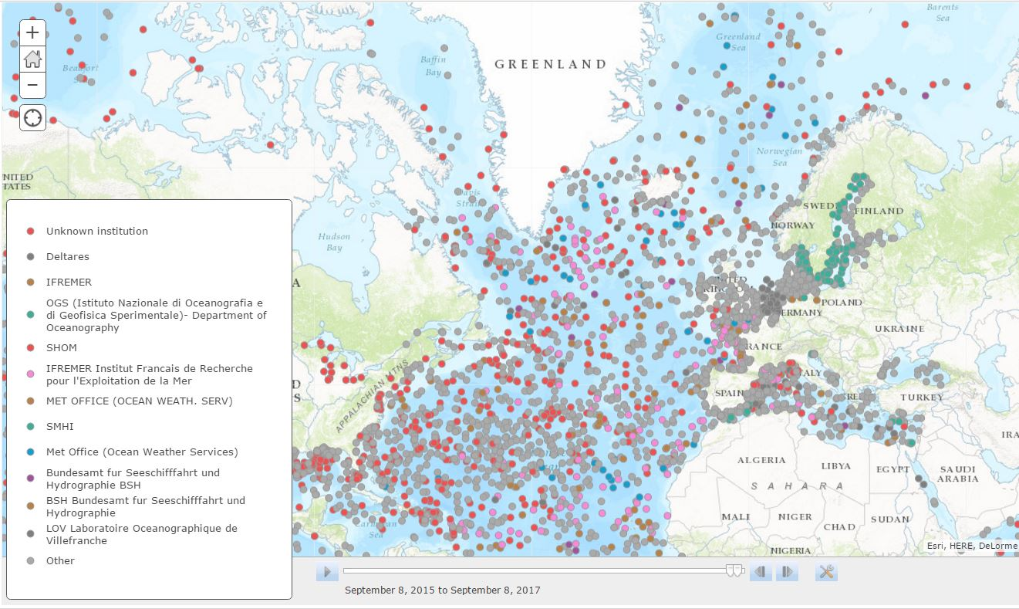
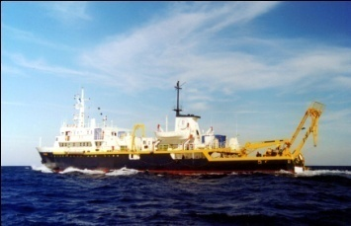
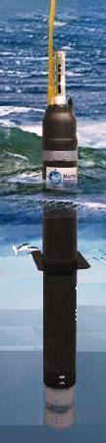
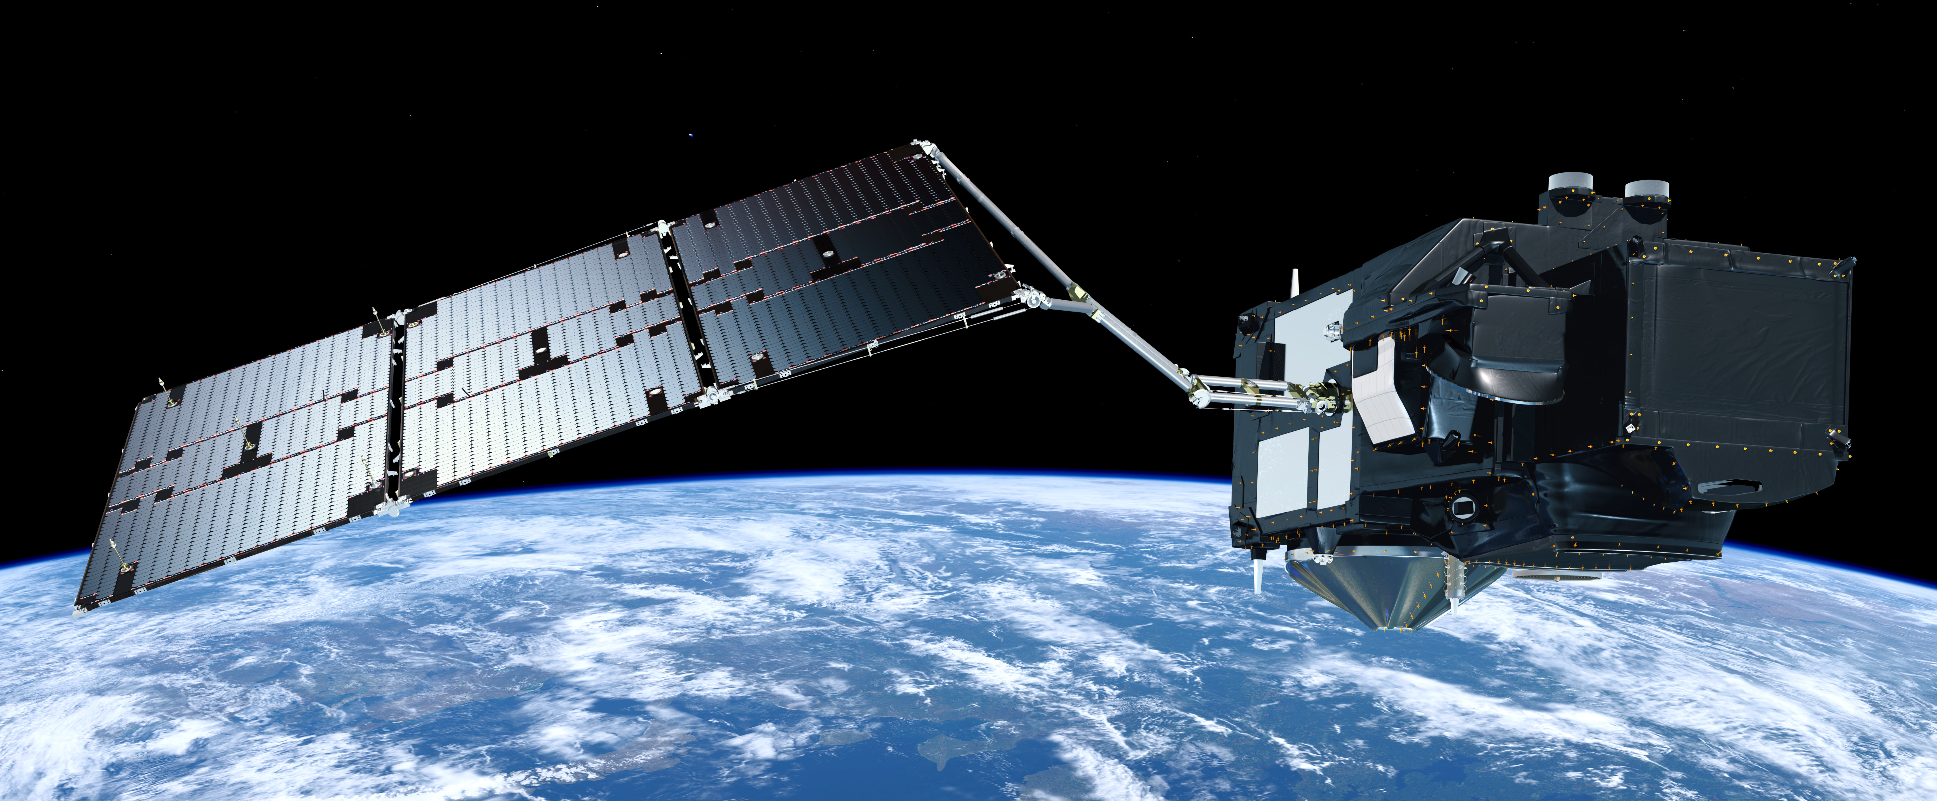
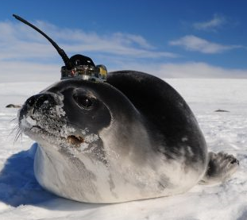
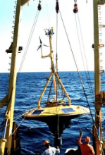
Ocean Observations
INTAROS
JERICO NEXT
EOOS
AtlantOS
ODYSSEA

Slide 4

Outputs from OO initiatives
AtlantOS:
Requirements
Gaps
Networks
Blueprint
INTAROS:
Requirements: whole system
Gaps
New technologies
Partnerships
JERICO NEXT:
Coastal strategy
Biological components
Standards
Data policy
New technologies
ODYSSEA:
Requirements
Obs system design
New technologies
SME role
EOOS:
Alignment
Gaps
Multiple Use
Integration at global scale
eurogoos.eu | twitter.com/EuroGOOS

Slide 5
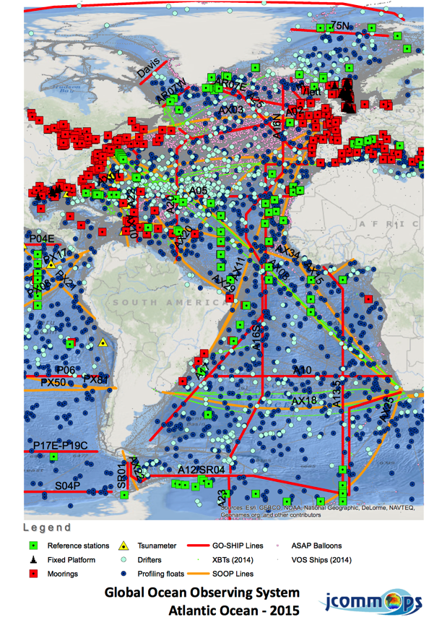
Developing a Blueprint for an Atlantic Ocean Observing System
Strong need to develop a strategy for integrated ocean observing in the Atlantic
Seek to facilitated a more sustainable, well coordinated, comprehensive system
Need to better serve societal needs
System should be sustainable, efficient and fit-for-purpose
Ambitious, multi-national, multi sectoral, fit-for-purpose
Should include capacity development and enhance partnerships between science, service, private sector and civil society
Early 2018 public release of first draft
The Blueprint will serve as inspiration for the other regional projects who most likely will formulate similar documents

Slide 6
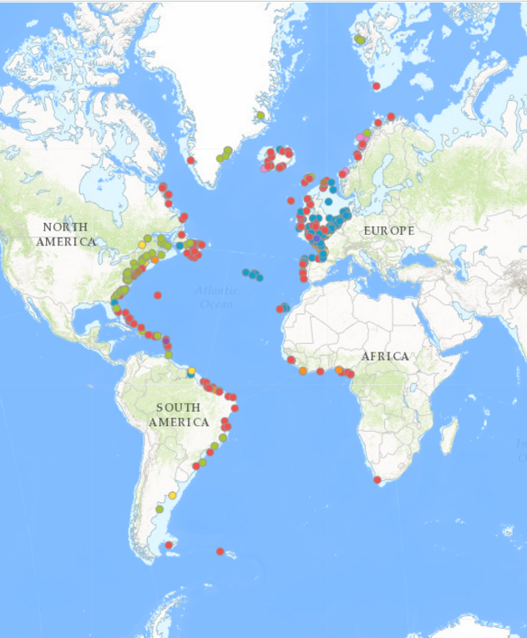
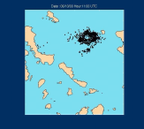
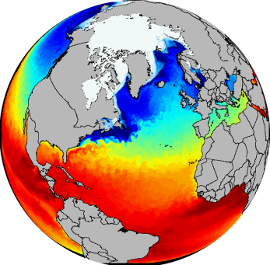
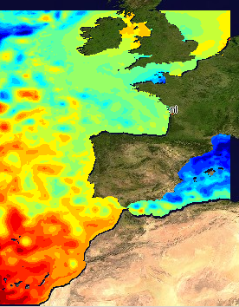
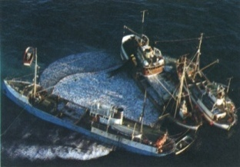
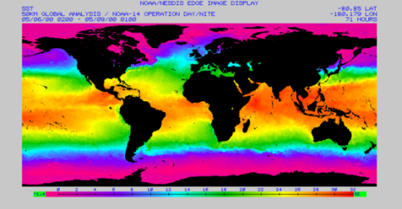
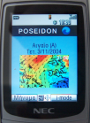
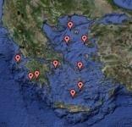
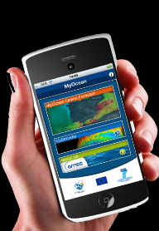
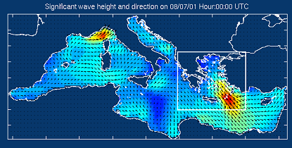
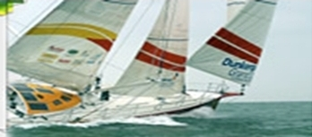
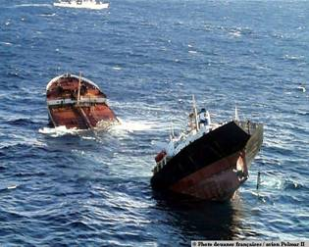
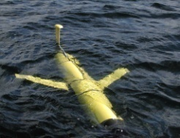
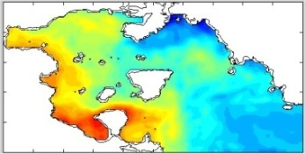
Value chain from observations to societal applications
Observations
Processing & Modeling
Services
EOOS
GOOS
G7
Downstream Services
CMEMS
+ Other
Local/national Forecasts and analysis
End Users

Slide 7
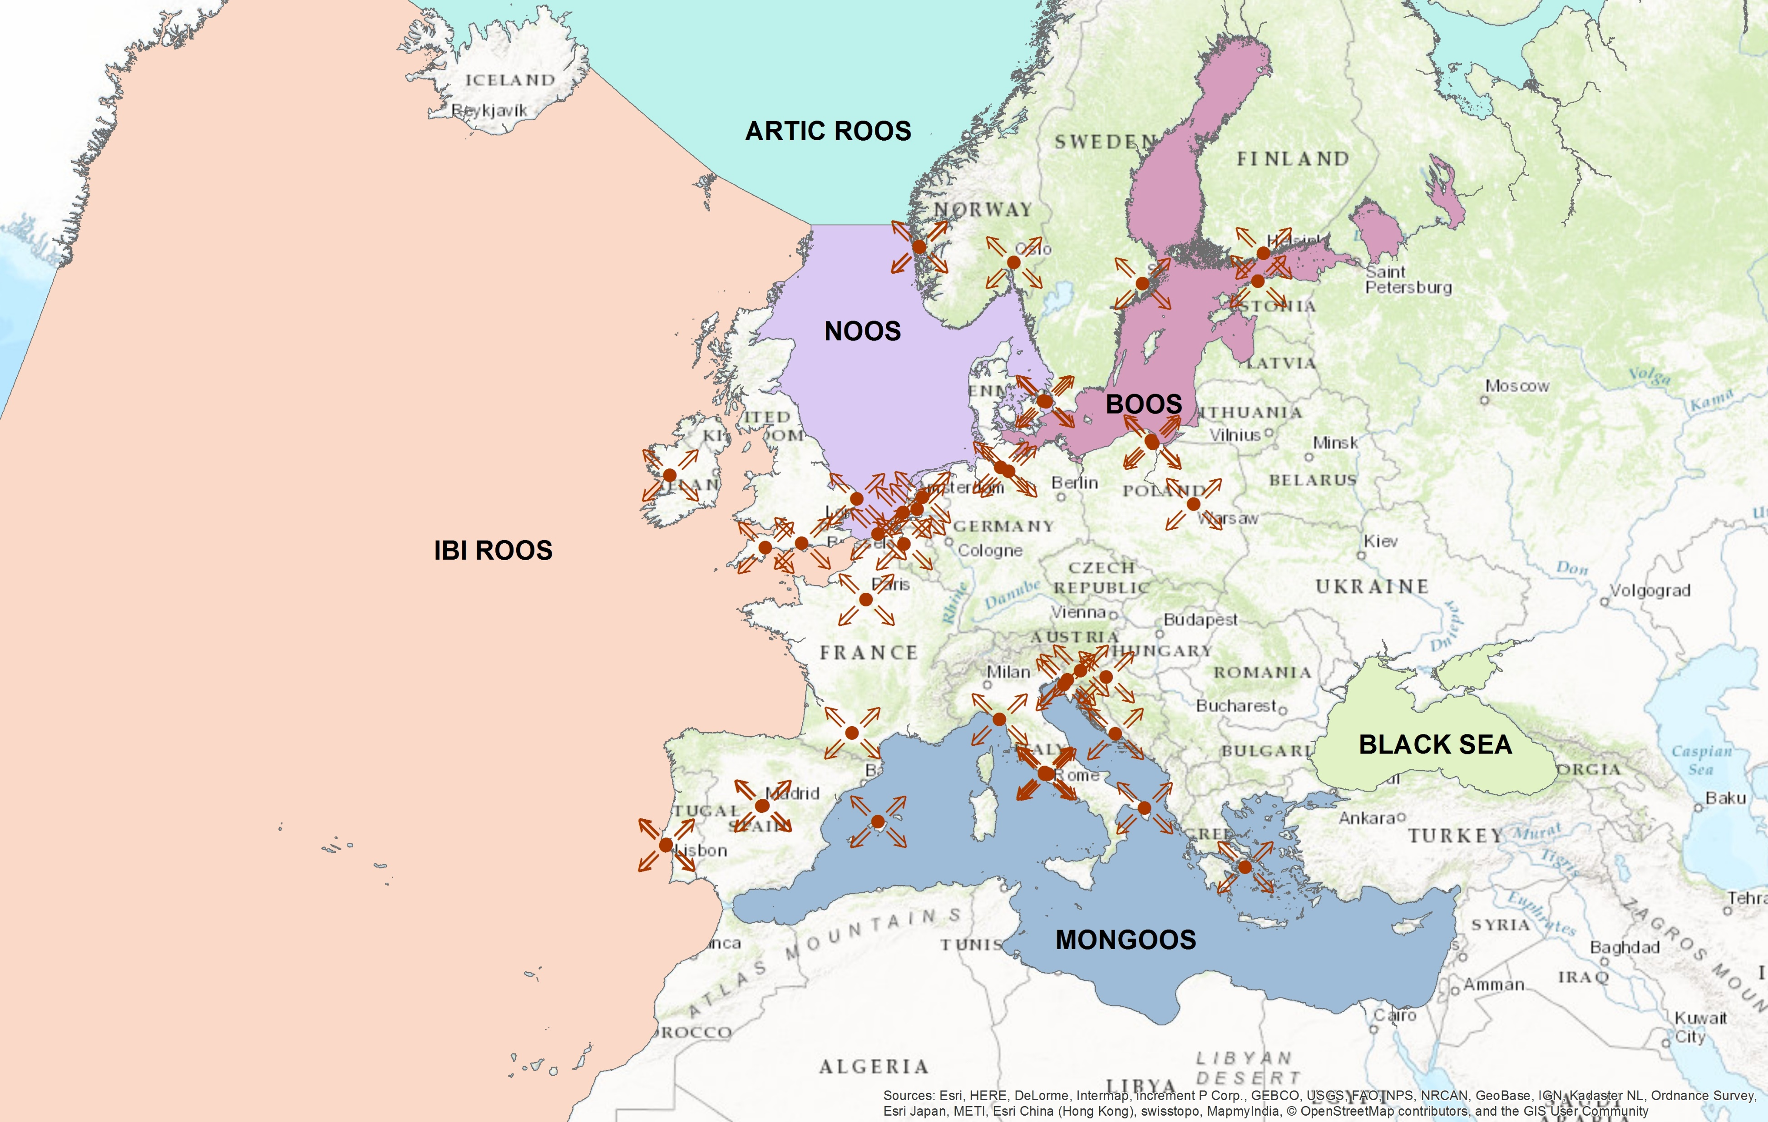
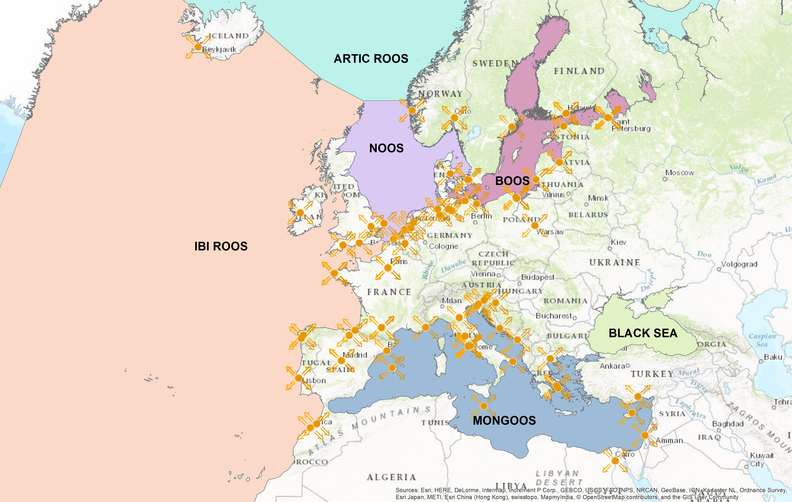
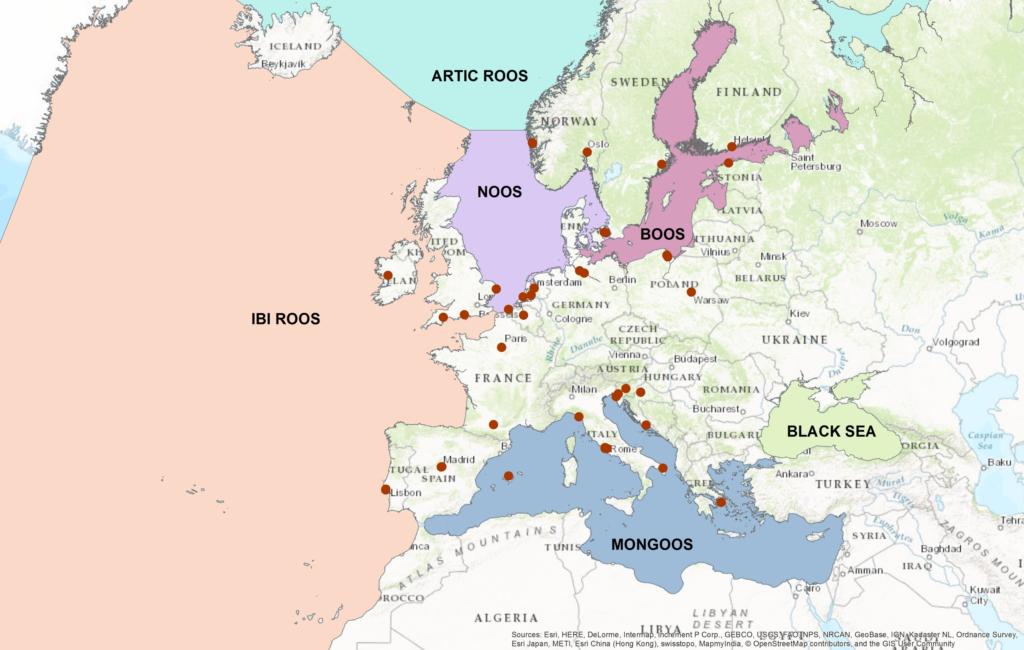
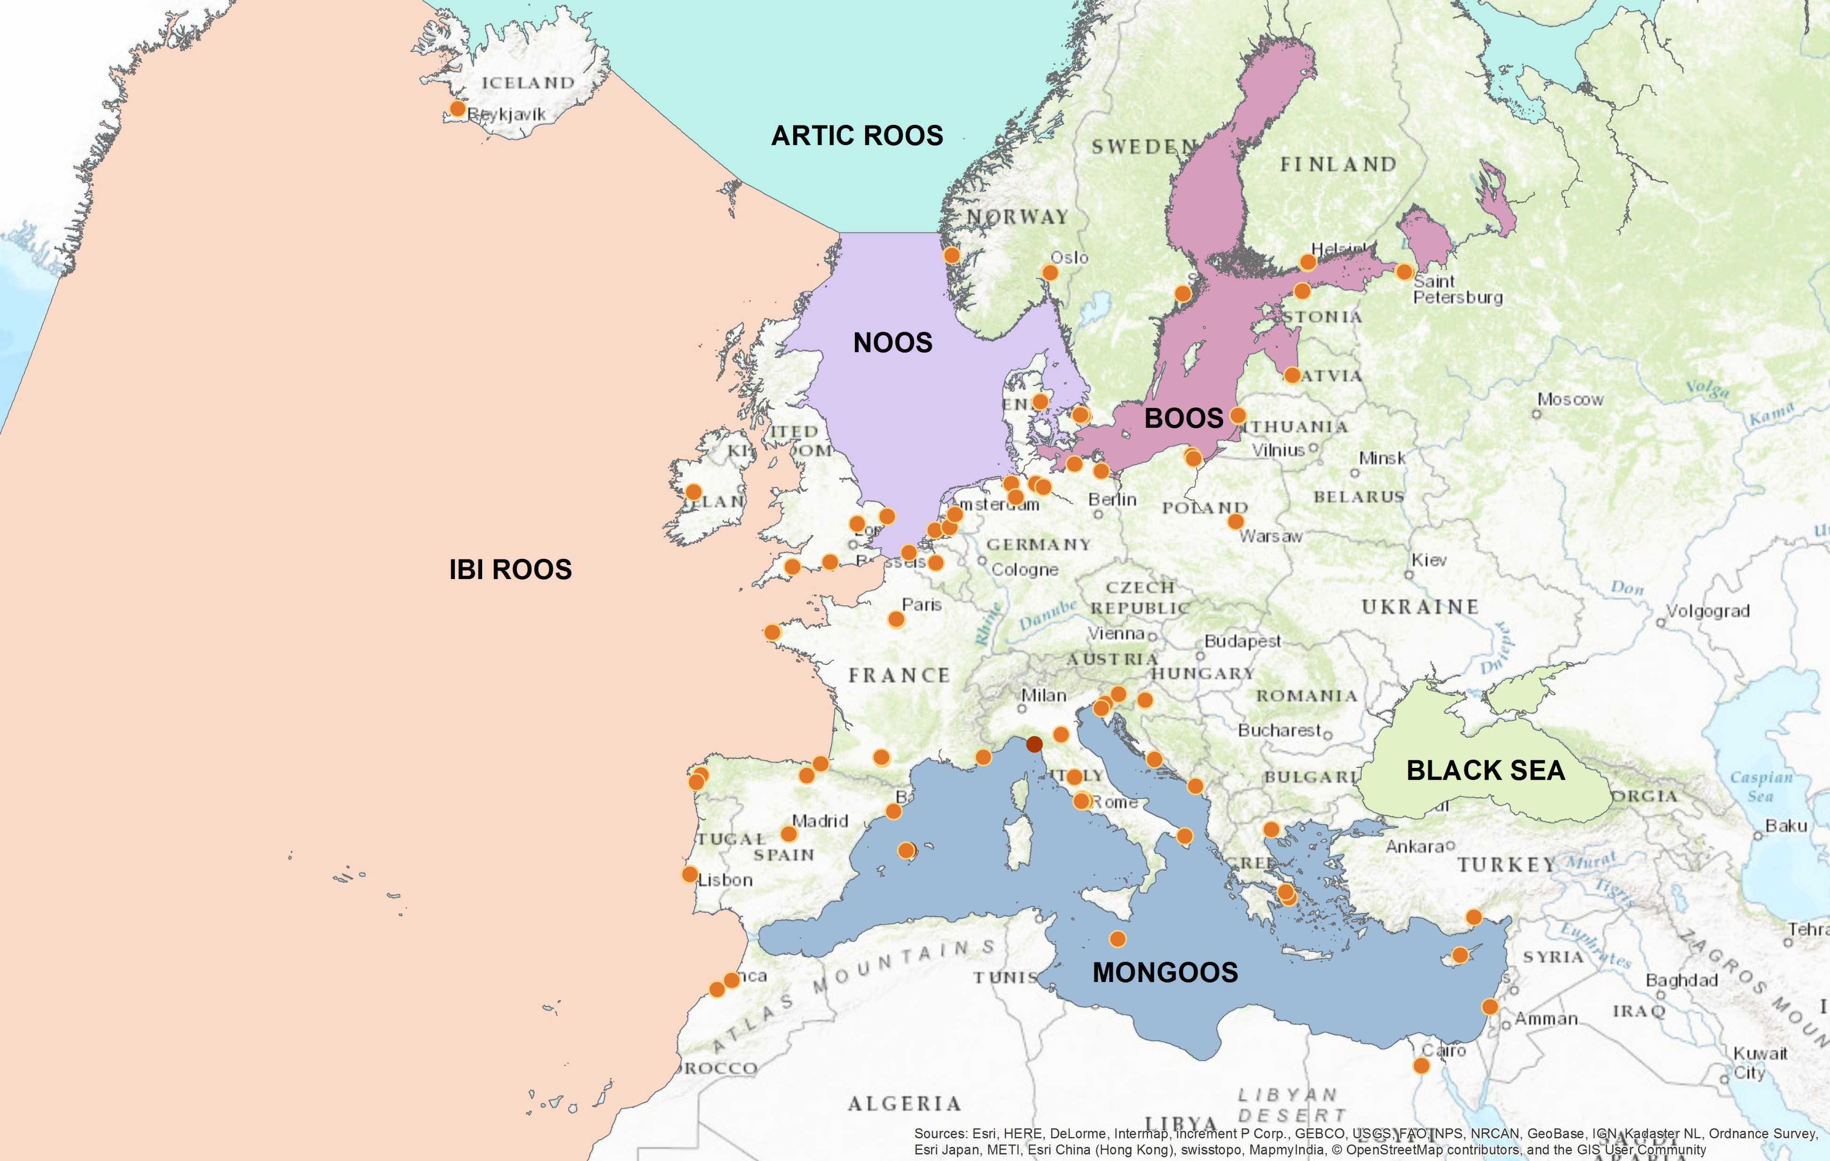
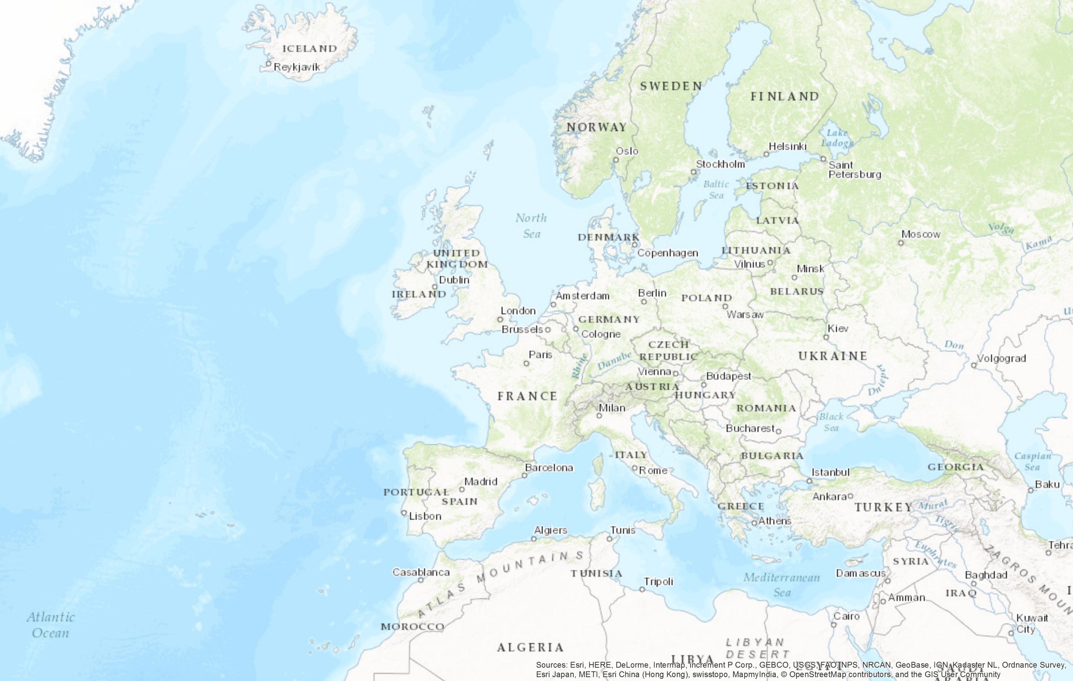
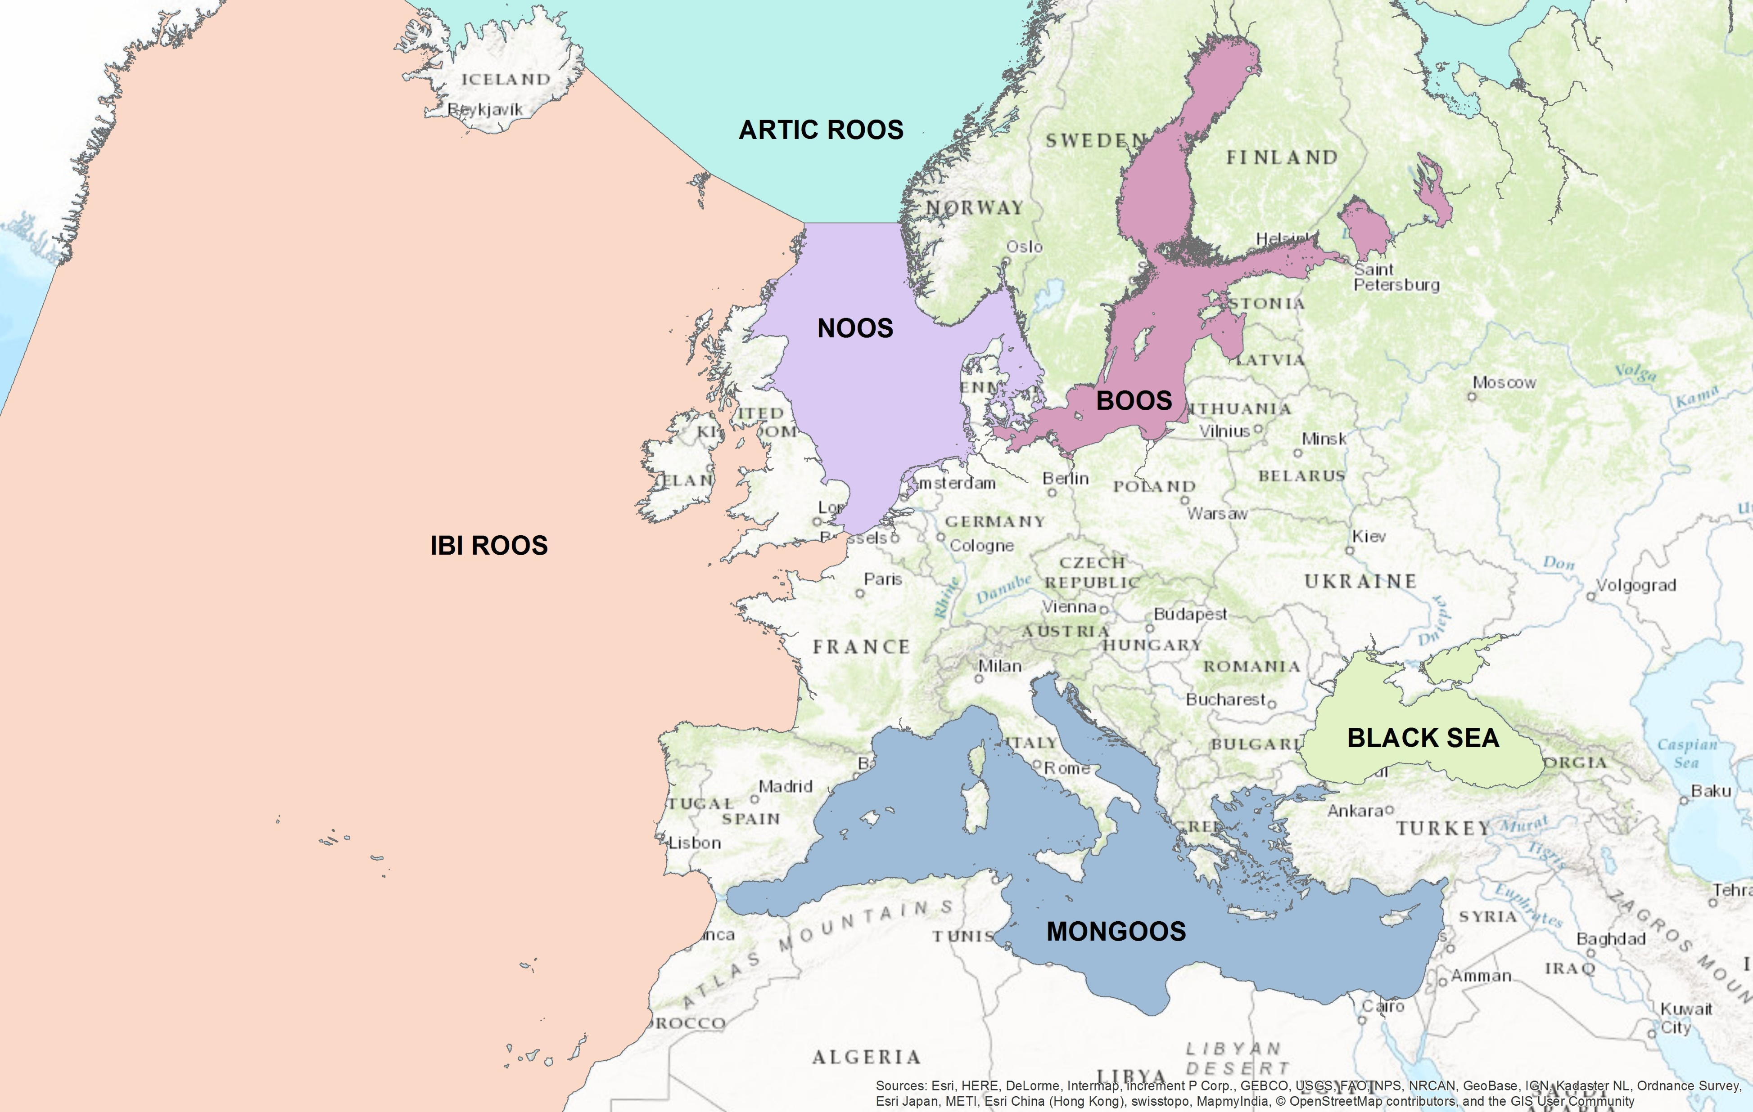
41 EuroGOOS members
48 additional ROOS members

Slide 8

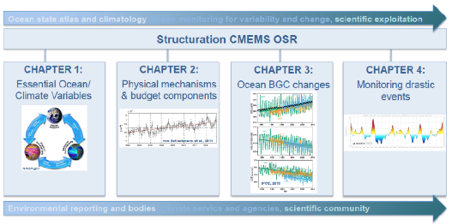
CMEMS Annual Ocean State Report
State of the global ocean and the European seas, highlighting changes occurred during the previous year.
Value added information based on CMEMS products (reprocessing, reanalysis) and scientific expertise
Published in a peer-reviewed journal (Journal of Operational Oceanography).

Slide 9
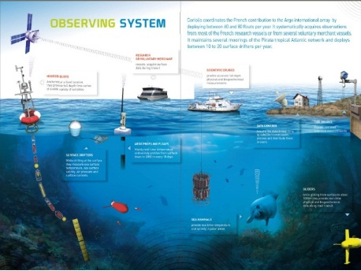

Virtual Data exchange backbone
The long term goal
Data management for network
INS TAC Copernicus
Data management for network
SeaDataNet
EMODnet
Euro-BIS
ICES
Data management for network
GEOSS
Data management for network
Data mgt for network
Services
TOOLS
TOOLS
Users
Standardization between networks from acquisition to service to users
EuroGOOS involved in strengthening cooperation between the 3 major data initiatives

Slide 10

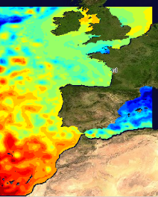

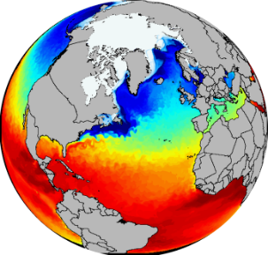

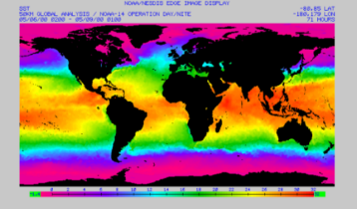


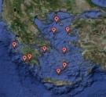
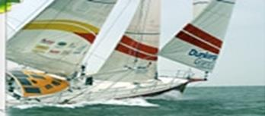

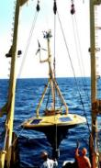
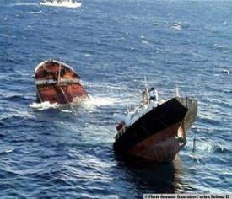
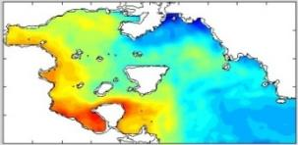
EOOS Stakeholders
Institution
EC
Legal entity
IOC
Mare
Res
Services
Programme
Observations
Processing & Modeling
Project
GOOS
ICES
JCOMM
IODE
EC
CIESM
EuroGOOS
WMO
IOC
EuroGOOS
Euro-ARGO
EMSO
ERIC
Mare
Res
GO-SHIP
Ocean
Sites
EC
GLOSS
End Users
Grow
GODAE-OV
EMODNet
IOCCP
Copernicus
Copernicus
EMODNet
ODP/OBIS
IRSO/ERVO
EuroGOOS
DBCP
Sea Basin
Checkpoints
EuroGeoSurveys
JERICO
Other
AtlantOS
SeadataNet

Slide 11
EuroGOOS Coastal Working Group
Sustained observations:
Funding
Gaps
Data:
Unlock access
Convey requirements
INSPIRE:
Recommendations
Inventory
Modelling:
Future priorities
Assimilation
Hydrology
Products:
Requirements;
sci and other
Inventory
Fitness for purpose
eurogoos.eu | twitter.com/EuroGOOS

Slide 12


glenn.nolan@eurogoos.eu
Website
www.eurogoos.eu
Twitter
twitter.com/EuroGOOS
E-mail
eurogoos@eurogoos.eu

